Slide 1


Slide 2

Unit
5
1
Unit
FAMILY LIFE
INVENTIONS
LESSON 3
READING
Artificial intelligence

Slide 3

Unit
1
1
FAMILY LIFE
Family Life
Unit
OBJECTIVES
Develop reading skills for main ideas and specific information about artificial intelligence.

Slide 4
LESSON 3
READING
WARM-UP
Video watching
Task 1: Discuss the questions.
Vocabulary
PRE-READING
Task 2: Choose the best title.
Task 3: Match the pictures with the uses of AI.
Task 4: True or false.
WHILE-READING
POST-READING
Task 5: Discussion.
CONSOLIDATION
Wrap-up
Homework

Slide 5
LESSON 3
READING
WARM-UP
Video watching

Slide 6

VIDEO WATCHING
READING
Unit
Work individually.
Watch a video about artificial intelligence (AI) and take notes.
Answer the questions using the notes.
Notes:
https://www.youtube.com/watch?v=UdE-W30oOXo

Slide 7
ANSWER THE QUESTIONS
1. What is artificial intelligence?
2. What are some real-life cases in which we have probably dealt with AI?
3. What benefits do robots/ AI bring to us?
4. Can AI replace human?

Slide 8
LESSON 3
READING
WARM-UP
Video watching
Task 1: Discuss the questions.
Vocabulary
PRE-READING

Slide 9
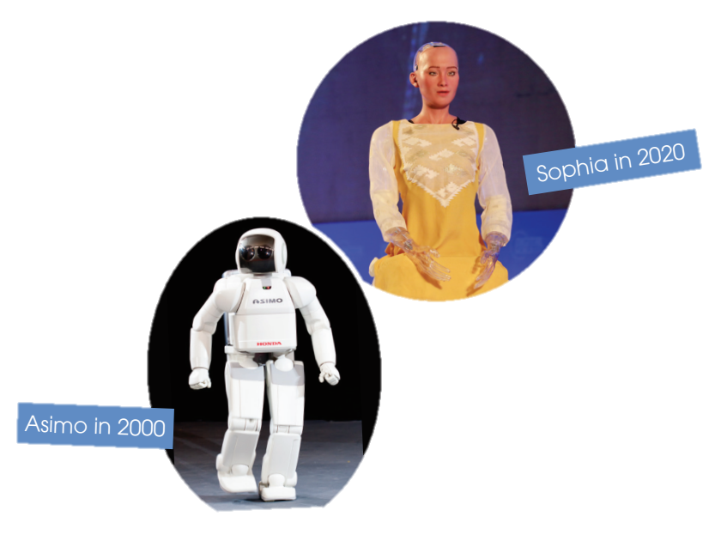
PRE-READING
1
Look at the pictures of Asimo and Sophia and discuss the questions below in pairs.
1. What are they?
They are robots.
2. What do you think they can do?
They can walk, talk, show emotions, and do household chores.

Slide 10
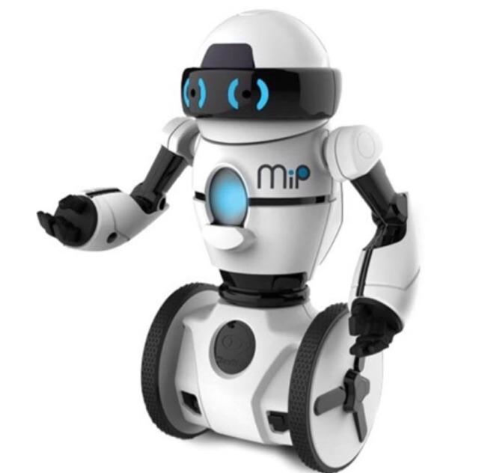

VOCABULARY
robot (n)
/ˈrəʊbɒt/
a machine that can perform a complicated series of tasks by itself

Slide 11

VOCABULARY
communicate (v)
/kəˈmjuːnɪkeɪt/
to share or exchange information, news, ideas, feelings, etc

Slide 12

VOCABULARY
emotion (n)
/ɪˈməʊʃn/
a strong feeling such as love, fear or anger; the part of a person’s character that consists of feelings

Slide 13

VOCABULARY
artificial intelligence (AI)
(n)
/ɑːtɪfɪʃl ɪnˈtelɪdʒəns/
the study and development of computer systems that can copy intelligent human behaviour

Slide 14
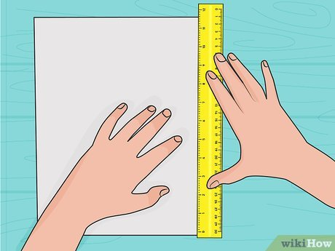
VOCABULARY
measure (v)
/ˈmeʒə(r)/
to find the size, quantity, etc. of something in standard units

Slide 15
VOCABULARY
New words | Pronunciation | Meaning
1. robot (n) | /ˈrəʊbɒt/ | a machine that can perform a complicated series of tasks by itself
2. communicate (v) | /kəˈmjuːnɪkeɪt/ | to share or exchange information, news, ideas, feelings, etc.
3. emotion (n) | /ɪˈməʊʃn/ | a strong feeling such as love, fear or anger; the part of a person’s character that consists of feelings
4. artificial intelligence (AI) (n) | /ˌɑːtɪfɪʃl ɪnˈtelɪdʒəns/ | the study and development of computer systems that can copy intelligent human behaviour
5. measure (v) | /ˈmeʒə(r)/ | to find the size, quantity, etc. of something in standard units

Slide 16
LESSON 3
READING
WARM-UP
Video watching
Task 1: Discuss the questions.
Vocabulary
PRE-READING
Task 2: Choose the best title.
Task 3: Match the pictures with the uses of AI.
Task 4: True or false.
WHILE-READING

Slide 17
WHILE-READING
2
Read the text and choose the main idea.
In 2000, Asimo, a robot created by Honda, amazed everyone by just walking down the stairs.
Twenty years later, a robot named Sophia can even communicate with people by using human
language and expressing emotions.
However, robots are just one example of Artificial Intelligence (AI) – the study and development of
machines that can copy human intelligence. Nowadays, AI has been applied to various areas of life.
At home, devices such as vacuum cleaners can now use AI to measure the room size and recognise
any furniture. They can then decide on the most effective way to clean the house.
In transport, AI can be used on many smartphones to collect information about traffic. This can then
help drivers find the most suitable route. Travelling has become much more convenient thanks to AI.
At work, the uses of AI are even more useful and exciting. Computer programs, such as AI software or chatbots, can help customers plan their holidays, book flights and hotels, and answer questions.
AI is one of the most important inventions of the 21st century. It has completely changed our daily
work and life.

Slide 18
WHILE-READING
2
Read the text and choose the best title for it.
A. AI development over time
B. Robots: The best AI inventions
C. AI in use today
D. AI in education

Slide 19
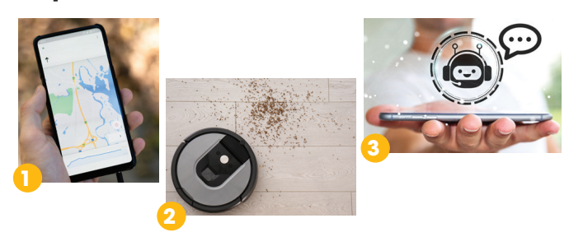
WHILE-READING
3
Match the pictures with the uses of AI.
a. Uses of AI at home
b. Uses of AI at work
c. Uses of AI in transport

Slide 20
WHILE-READING
PRACTICE
4
True or false
 | T | F
1. Sophia can show emotions when talking to humans.
2. AI helps to make machines that think and act like humans.
3. AI is one of the most important inventions of the 20th century.
✔
✔
✔

Slide 21
LESSON 3
READING
WARM-UP
Video watching
Task 1: Discuss the questions.
Vocabulary
PRE-READING
Task 2: Choose the best title.
Task 3: Match the pictures with the uses of AI.
Task 4: True or false.
WHILE-READING
POST-READING
Task 5: Discussion.

Slide 22
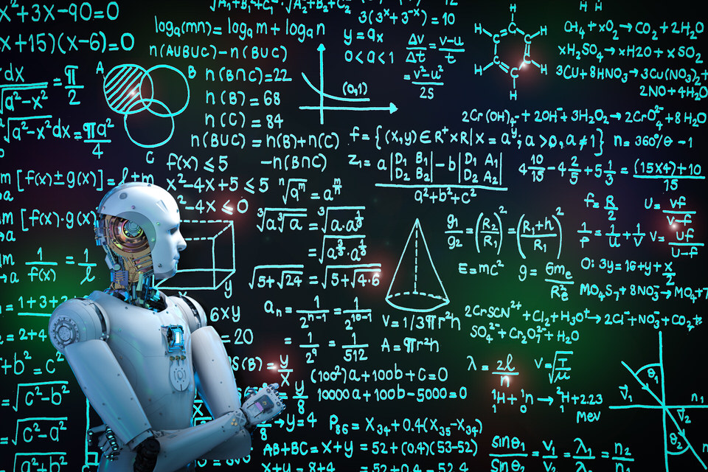
POST-READING
5
Discussion
Work in groups and brainstorm possible uses of AI in schools.

Slide 23
LESSON 3
READING
WARM-UP
Video watching
Task 1: Discuss the questions.
Vocabulary
PRE-READING
Task 2: Choose the best title.
Task 3: Match the pictures with the uses of AI.
Task 4: True or false.
WHILE-READING
POST-READING
Task 5: Discussion.
CONSOLIDATION
Wrap-up
Homework

Slide 24
CONSOLIDATION
1
Wrap-up
Reading for general and specific information about artificial intelligence.

Slide 25
CONSOLIDATION
2
Homework
Prepare for the next lesson: Unit 5 – Speaking
2. Do exercises in the workbook

Slide 26

Website: hoclieu.vn
Fanpage: facebook.com/www.tienganhglobalsuccess.vn

