Slide 1
Welcome to our class today!
Liên hệ: 034.989.5579

Slide 2
Unit
3
COMMUNITY SERVICE
LESSON 1: GETTING STARTED
Sounds like great work!
Unit
HOBBIES

Slide 3
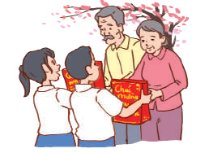
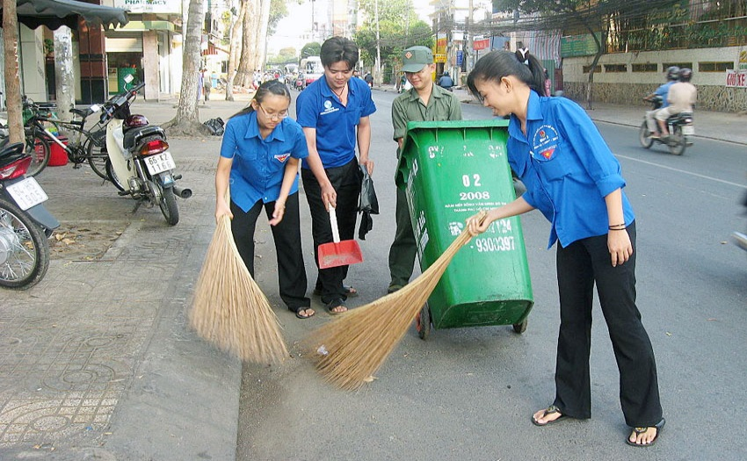
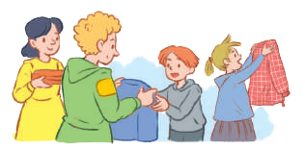
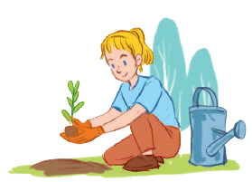
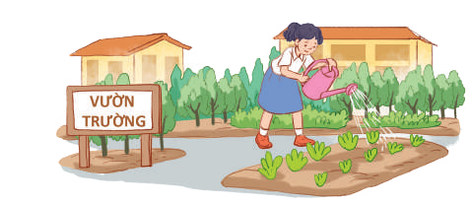
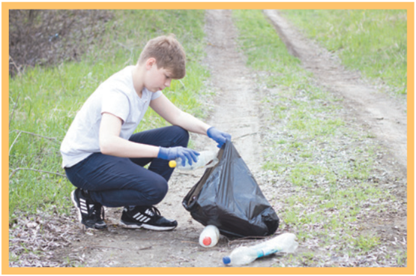
WARM-UP
Describe the picture.
➢Community service

Slide 4
* Community service
- donate clothes, book, money,….
- clean the street,..
- Planting trees, vegetables
- pick up litter
- help homeless people

Slide 5
Community service
The work that people do to help others without paying

Slide 6
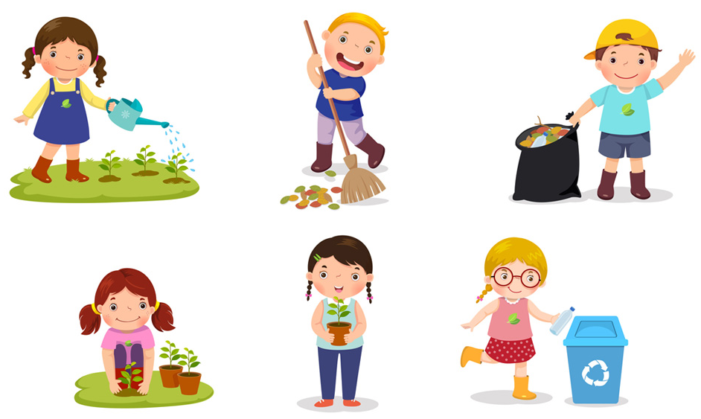
* Vocabulary
- community activity (n.phr.):
hoạt động cộng đồng
/kəˈmjuːnɪti ækˈtɪvɪti/

Slide 7
- donate (v):
quyên góp, ủng hộ
/dəʊˈneɪt/

Slide 8
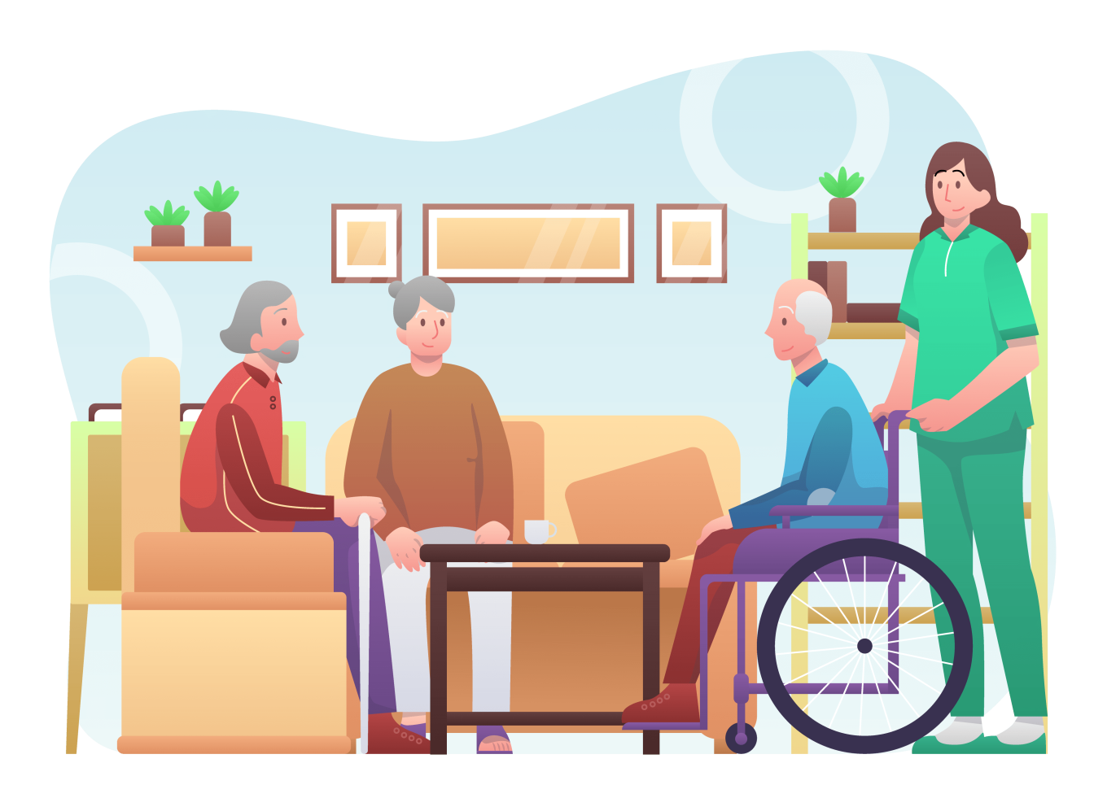
nursing home (n.phr.):
viện dưỡng lão
/ˈnɜːsɪŋ həʊm/

Slide 9
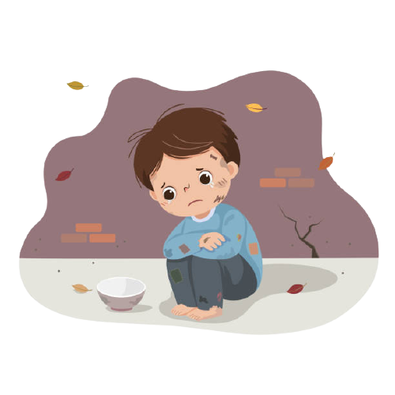
- homeless (adj):
vô gia cư
/ˈhəʊmləs/

Slide 10
* Vocabulary
New words | Pronunciation | Meaning
community activity | /kəˈmjuːnɪti ækˈtɪvɪti/ | hoạt động cộng đồng
donate | /dəʊˈneɪt/ | quyên góp, ủng hộ
nursing home | /ˈnɜːsɪŋ həʊm/ | viện dưỡng lão
homeless | /ˈhəʊmləs/ | vô gia cư

Slide 11
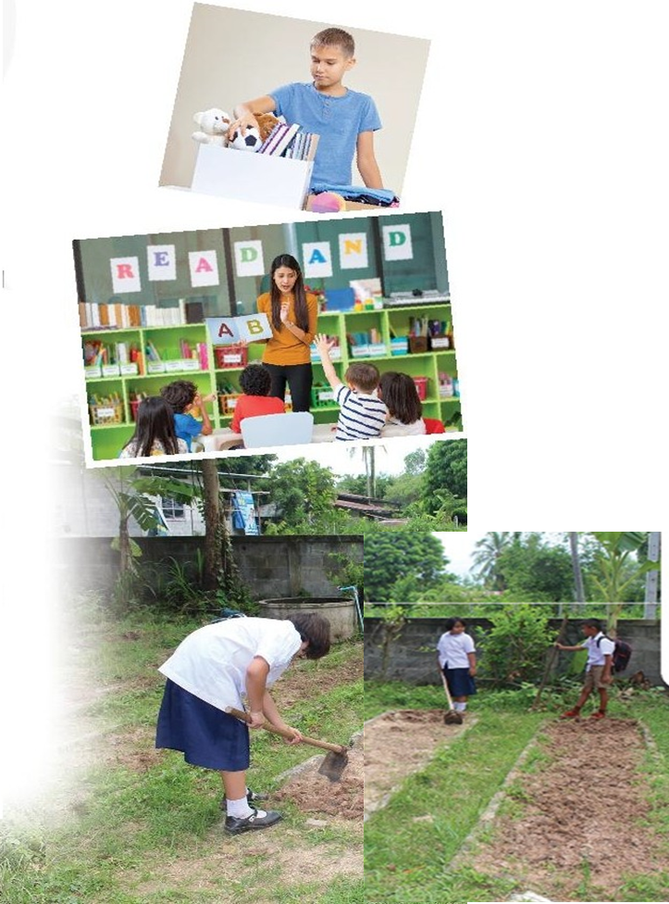
* Answer some questions
- What can you see in the pictures?
Where do you think the boys and the girls are?
What do you think they are doing?
➢ In picture 1: I can see a boy with a box. He is arranging books and toys (and may be clothes).
➢I n picture 2: I can see a girl and some small children. They are in a classroom. The girl is teaching the small children.
➢ In picture 3: I can see two girls and a boy. They are in the garden.They are gardening.

Slide 12
* PRACTICE
1
Listen and read.
Minh: Hi, Tom. Are you back in Ha Noi? Tom: Yes. I came back yesterday. Can we meet up this Sunday morning? I bought you a board game. Minh: Sure, I can’t wait! But our Green School Club will have some community activities on that morning. Tom: What activities does your club do? Minh: Well, we pick up litter around our school and plant vegetables in our school garden. Tom: School gardening? That’s fantastic! Minh: Yes. We donate the vegetables to a nursing home. Does your school have any activities like these? Tom: Yes. We donate books to homeless children. We also have English classes. Last summer, we taught English to 30 kids in the area. Minh: Sounds like great work! Tom: Thanks. Minh: ... So, let’s meet in the afternoon then.

Slide 13
2
Read the conversation again and tick the appropriate box.
Community activity | Minh’s club | Tom’s club
1. picking up litter
2. planting vegetables
3. donating books
4. donating vegetables
5. teaching English
✓
✓
✓
✓
✓

Slide 14
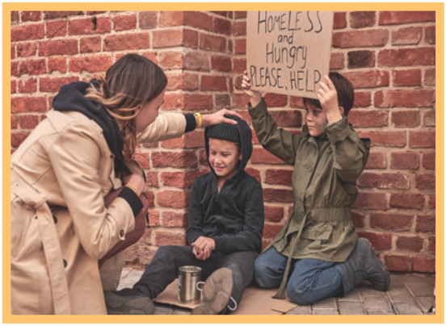
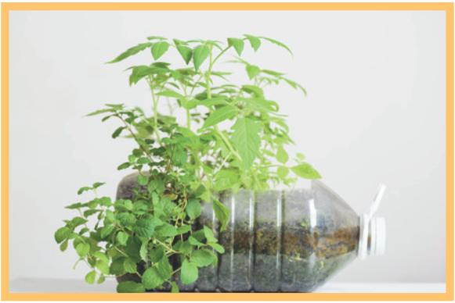
3
Complete the phrases under the pictures with the verbs below.
pick up clean donate recycle help
pick up
recycle
1. ________ litter
help
2. ______ homeless children
3. _______ plastic bottles

Slide 15
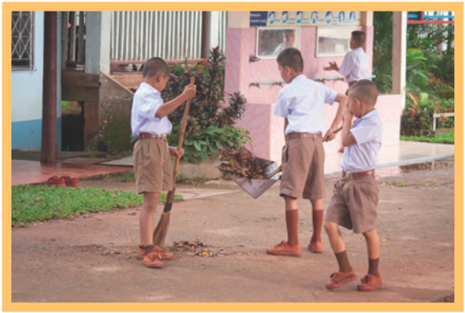
3
Complete the phrases under the pictures with the verbs below.
pick up clean donate recycle help
donate
clean
4. _________ clothes
5. ________ the playground

Slide 16
4
Complete the sentences with the correct words or phrases below.
old people homeless children planted litter taught
1. We collected clothes and gave them to _________________. 2. Those students picked up all the __________ on the street. 3. We helped ____________ in the nursing home last Sunday. 4. The club members ________ maths to primary students during school holidays. 5. We __________ a lot of trees in the park last summer.

Slide 17
Who’s faster?
4
5
3
6
7
2
1

Slide 18
4
Complete the sentences with the correct words or phrases below.
old people homeless children planted litter taught
1. We collected clothes and gave them to _________________.
homeless children

Slide 19
4
Complete the sentences with the correct words or phrases below.
old people homeless children planted litter taught
2. Those students picked up all the __________ on the street.
litter

Slide 20
4
Complete the sentences with the correct words or phrases below.
old people homeless children planted litter taught
3. We helped ____________in the nursing home last Sunday.
old people

Slide 21
4
Complete the sentences with the correct words or phrases below.
old people homeless children planted litter taught
4. The club members ________ maths to primary students during school holidays.
taught

Slide 22
4
Complete the sentences with the correct words or phrases below.
old people homeless children planted litter taught
5. We __________ a lot of trees in the park last summer.
planted

Slide 23
LUCKY apple!
you get 1 plus point

Slide 24
4
Complete the sentences with the correct words or phrases below.
old people homeless children planted litter taught
1. We collected clothes and gave them to _________________. 2. Those students picked up all the __________ on the street. 3. We helped ____________ in the nursing home last Sunday. 4. The club members ________ maths to primary students during school holidays. 5. We __________ a lot of trees in the park last summer.
homeless children
litter
old people
taught
planted

Slide 25
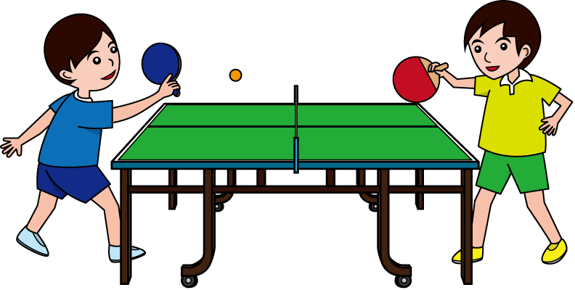
* PRODUCTION
5
Game: Vocabulary Ping-pong
Work in two teams.
Team A provides a cue word.
Team B makes up a sentence with it.
Then switch roles.
Example: Team A: Litter Team B: We often pick up litter in the park. Trees Team A: We plant trees in our school every year. Book
Team A: …

Slide 26
CONSOLIDATION
1
WRAP-UP
What have we learnt in this lesson?
identify the topic of the unit
use lexical items related to community activities
identify the language features that are covered in the unit

Slide 27
2
HOMEWORK
Think about community activities that students can do (at least 3 activities)
Prepare for the Project lesson

Slide 28
Goodbye!
See you again!

