Slide 2



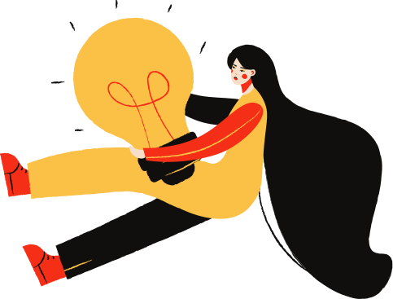

Unit 9
CAREER PATHS
PREPARATION FOR EMPLOYMENT
LESSON 5 – LISTENING

Slide 3

LESSON 5
LISTENING
WARM-UP
Quiz
Task 1: Choose the correct answer
PRE- LISTENING
Task 2: Listen to a conversation
Task 3: Listen to a conversation
WHILE- LISTENING
Task 4: Discuss the questions.
POST- LISTENING
CONSOLIDATION
Wrap-up
Homework

Slide 4
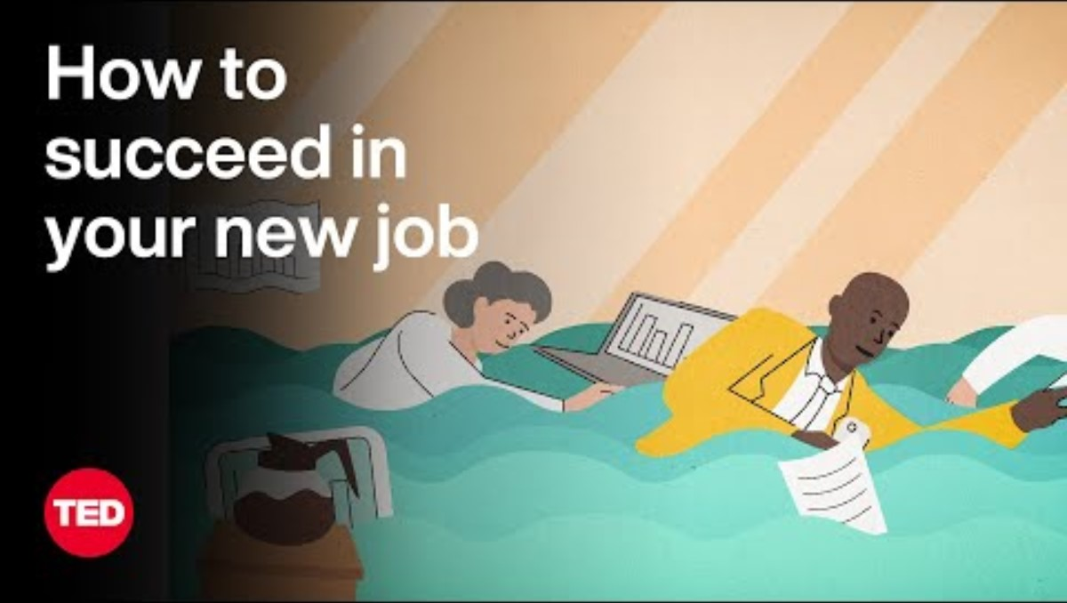
WARM-UP
https://www.youtube.com/watch?v=WgR6mUSsEig

Slide 5

1. Which situation DOESN’T happen when you start a new job in the video?
Meeting new people
Getting bullied
Unfamiliar situations
Wondering “What does everyone think of me?”

Slide 6
2. Which “C” is not mentioned in “the 3 Cs”?
Casualties
Commitment
Compatibility
Competence

Slide 7
3. In the “competence” section, what should you do when you are given a task?
Think and do the task step- by- step. Learn from others’ advice when you can’t try anymore.
Ask for help from colleagues right away or try to solve everything in silence.

Slide 8
4. In the “commitment” section, which question is not mentioned?
What are my top priorities?
How would you like to communicate?
What have your highest performers done that you would suggest I doo, too?
What does everyone think of me?

Slide 9
5. In the “compatibility” section, what should you do?
Do your job well
Have a good relationship with other people
Consider whether this is a good place or not
All the above

Slide 10


PRE-LISTENING
Reliable (a)
/rɪˈlaɪəbl/
Someone or something that is reliable can be trusted or believed because he, she, or it works or behaves well in the way you expect
E.g: Gideon is very reliable - if he says he'll do something, he'll do it.

Slide 11

PRE-LISTENING
rapidly (adv)
/ˈræpɪdli/
very quickly; at a great rate
E.g: Things are changing very rapidly.

Slide 12

PRE-LISTENING
go up (phr. V)
/ɡəʊ/ /ʌp/
to move higher, rise, or increase

Slide 13

PRE-LISTENING
medical facilities (n.phr)
/ˈmɛdɪkəl/ /fəˈsɪlətiz/
a places or establishments where medical care, treatment, and health-related services are provided.

Slide 14
PRE- LISTENING
1
Choose the correct meanings of the underlined words.
1. I like science because it is a fascinating subject.
A. extremely interesting
B. completely boring
2. Lots of university students work as tutors to help school children learn better.
A. teaching assistants
B. private teachers

Slide 15
PRE- LISTENING
1
3. People with a strong character are honest, responsible, and confident.
A. a set of personal qualities that makes someone different from others
B. a main actor or actress in a film that you admire a lot
4. You need to send in your CV and an application letter in order to apply for this job.
A. a letter showing your academic achievements
B. a written record of your education and the jobs you have done

Slide 16
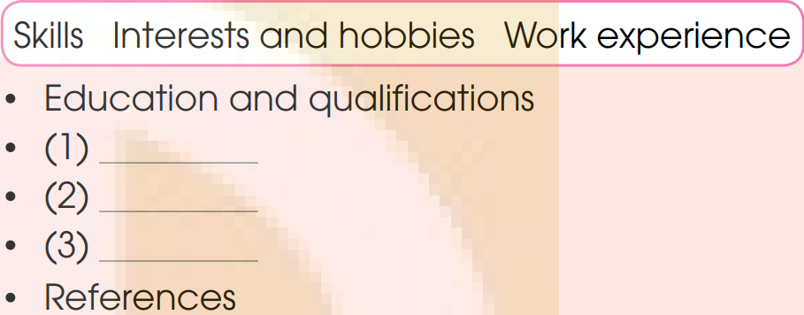
WHILE- LISTENING
2
Listen to a conversation between Mai Chi and her teacher, Ms Hoa.
Put the information in the order you hear it.
Work experience
Skills
Interests and hobbies

Slide 17
WHILE- LISTENING
3
Listen to the conversation again and choose the correct answer a, B, or C.
1. What is the conversation about?
A. How to qualify to teach in a school.
B. How to get a job as a home tutor.
C. How to become a good teacher.
2. What do you need to do before starting a teacher training course?
A. Get some teaching experience in the classroom.
B. Get a degree in a related subject.
C. Earn a teaching certificate.

Slide 18
WHILE- LISTENING
3
Listen to the conversation again and choose the correct answer a, B, or C.
3. Which of the skills are NOT mentioned by Ms Hoa?
a. Good communication and teamwork skills.
B. Understanding people’s feelings.
C. Tutoring skills.
4. Why does Ms Hoa think reading is an important habit for teachers?
A. It helps them learn new things.
B. It improves their communication skills.
C. It exercises the brain.

Slide 19
WHILE- LISTENING
3
Listen to the conversation again and choose the correct answer a, B, or C.
5. According to Ms Hoa, what does ‛a reference’ mean?
A. An application letter that gives additional information about someone’s abilities.
B. A person who agrees to provide information about a job applicant.
C. A record of the things someone has learnt and done.

Slide 20
POST- LISTENING
Work in groups. Discuss the following questions.
4
Would you like to become a teacher?
Why/Why not?
*Suggested answer:
I would like to become a teacher, because I like working with children and helping them learn new things.

Slide 21
CONSOLIDATION
1
Wrap-up
What have you learnt today?
Some lexical items about careers
Reading for specific information

Slide 22

CONSOLIDATION
2
Homework
Do exercises in the workbook.
Prepare Lesson 6 – Unit 9.

Slide 23
Website: hoclieu.vn
Fanpage: facebook.com/www.tienganhglobalsuccess.vn

