Slide 1

Unit 5: Science and technology
Lesson 2.3 – Pronun. & Speaking
Pages 50 & 51

Slide 2
Lesson Outline
Warm-up
Pronunciation
Speaking
Consolidation
Wrap-up

Slide 3

By the end of this lesson, students will be able to…
- practice stress the first syllable for most 3-syllable words ending in "-ly".
- compare robots, using comparative adverbs, and functional English - Showing agreement.

Slide 4

WARM UP

Slide 5
Odd One Out
Choose the word whose underlined part is pronounced differently form that of the others.
A. save B. game C. care D. waste
/seɪv/ /geɪm/ /ker/ /weist/
2. A. flood B. moon C. zoo D. spoon
/flʌd/ /muːn/ /zuː/ /spuːn/
3. A. bread B. heat C. dream D. steam
/bred/ /hiːt/ /driːm/ /stiːm/

Slide 6
Odd One Out
Choose the words whose main stress is placed differently from the others.
A. quietly B. carefully C. silently D. completely
/ˈkwaɪətli/ /ˈkɛrfəli/ /ˈsaɪləntli/ /kəmˈpliːtli/
2. A. storage B. tablet C. robot D. return
/ˈstɔːrɪdʒ/ /ˈtæblɪt/ /ˈrʊbɑːt/ /rɪˈtɜːrn/
3. A. complete B. provide C. protect D. listen
/kəmˈpliːt/ /prəˈvaɪd/ /prəˈtekt/ /ˈlɪsən/

Slide 7
Decide whether the following sentences are correct or incorrect.
CORRECT
INCORRECT
1.
Kitbot's battery lasts longer than Frogfoot's.
2.
Wall-D can jump higher than Twitchy.
3.
Wall-D moves more slow than Tsunami.
4.
Ziggy completed the rescue task worse than Sparky.
Reveal Answer
Notes:
Free template from PPTVBA.com
https://youtu.be/Csh4rwXhPKM

Slide 8

Presentation

Slide 9
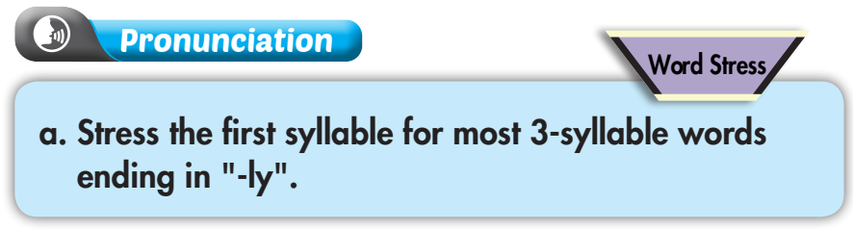

/ -ly /

beautifully
attractively

angrily

fatherly


Slide 10
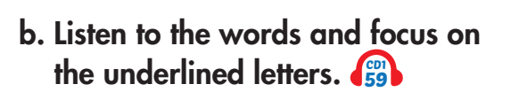


Slide 11


Slide 12
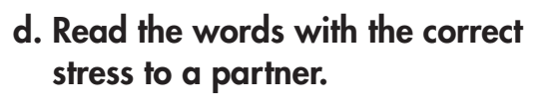


Slide 13

Practice

Slide 14
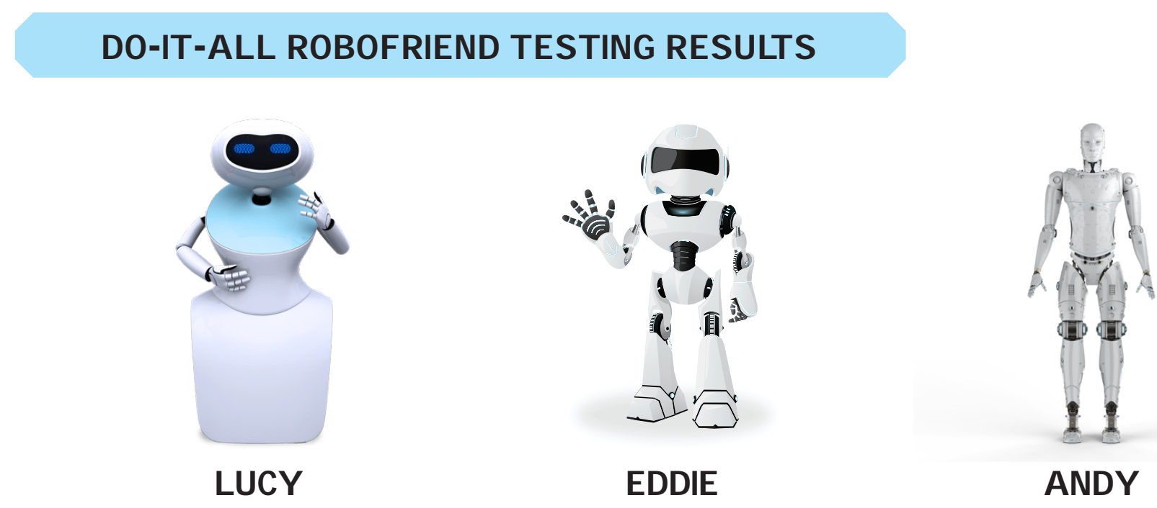

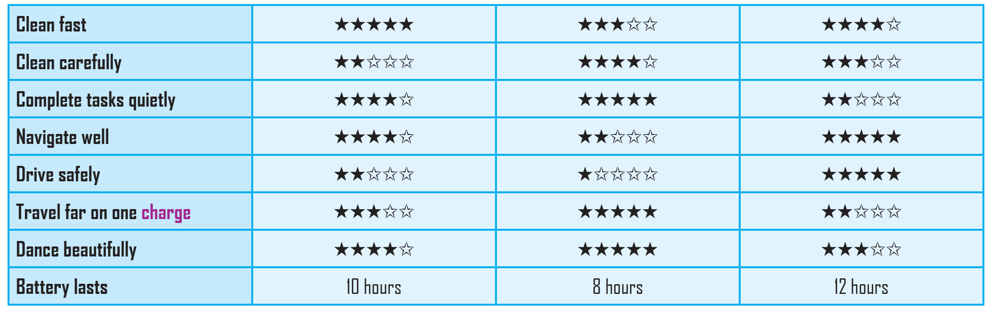

Slide 15
____ cleans more carefully than ___
____ completes tasks more quietly than ___
____ navigates better than___
____ drives more safely than___
____ travels farther on one charge than___
____ dances beautifully than___
____’s battery lasts longer than___

Slide 16
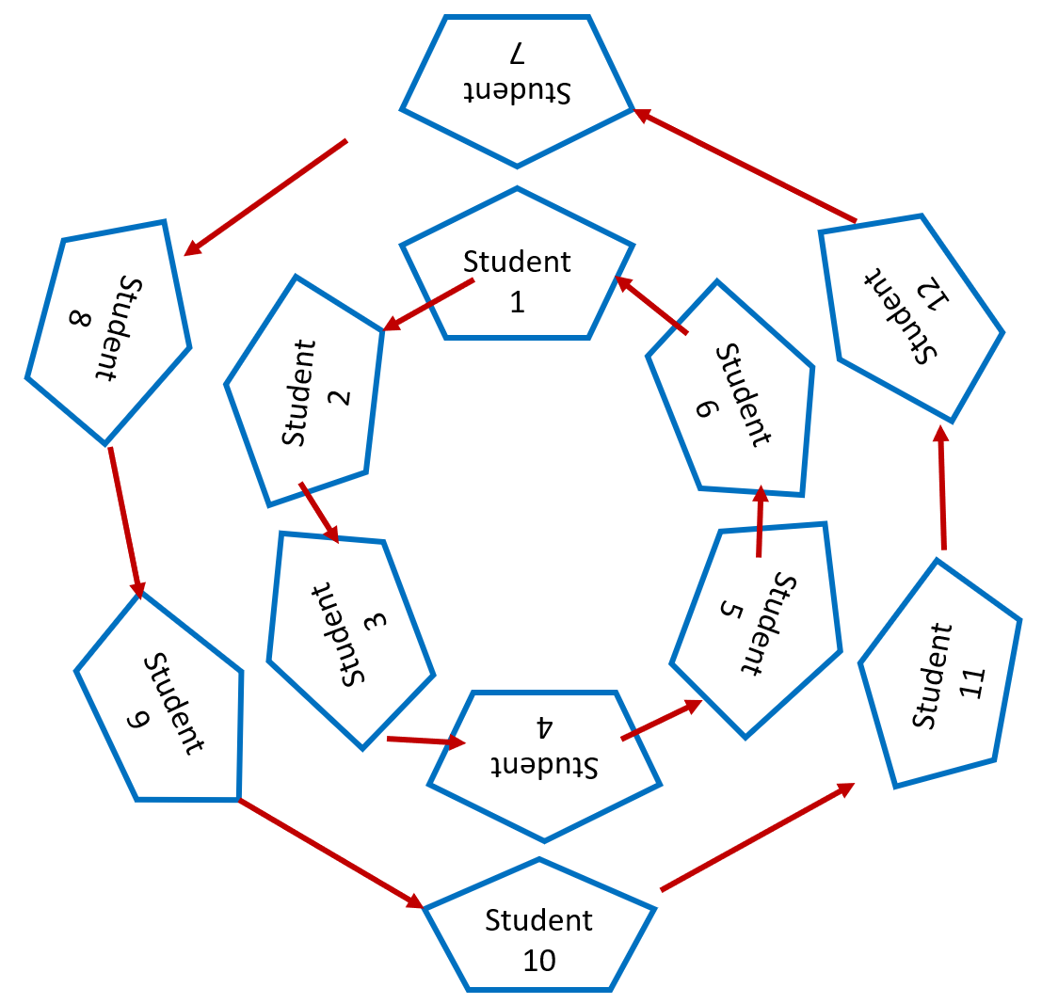
SPEED CONVERSATION
- Bring your books, stand up and make two circles to have face-to-face conversations.
Talk to another S standing across from you and talk for two to three minutes as much as you can about comparisons of different robots according to their abilities.
- One on one side moves one space to the left hand when the time is up. Then, continue your talk with your new partners.
- Repeat as many as necessary or until you find your original partner.

Slide 17
Production

Slide 18
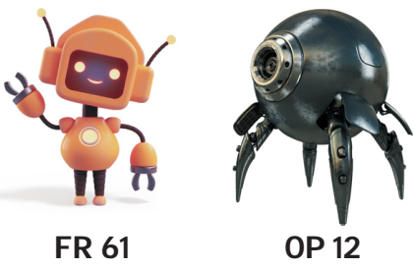

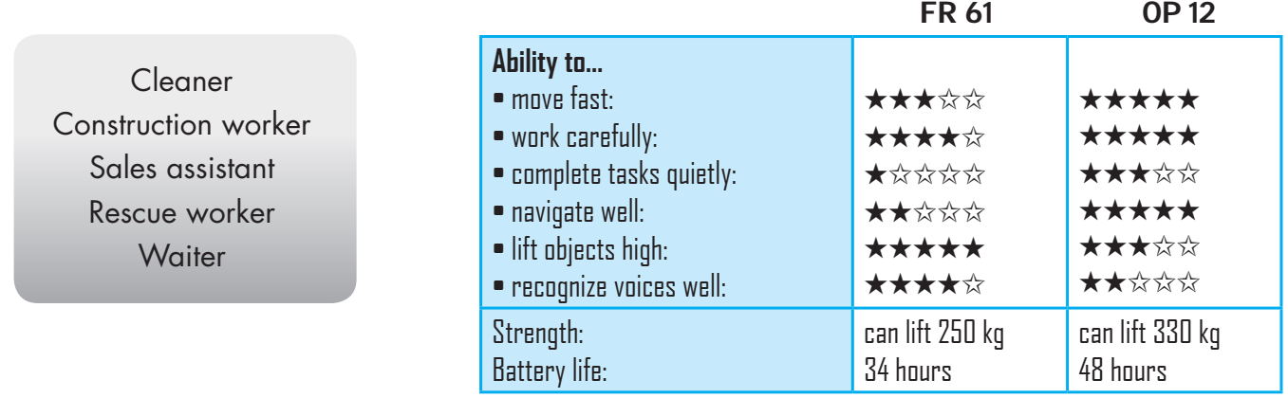
You’re right./ I agree.

Slide 19

Work in pairs
Do you think robots can do any of the jobs better than humans? Why (not)?

Slide 20

CONSOLIDATION

Slide 21
Do you think robots can do any of the jobs better than humans? Why (not)?

Slide 22

WRAP-UP

Slide 23
Today’s lesson
Focusing on stress the first syllable for most 3-syllable words ending in "-ly".
Talking about robots’ abilities.

Slide 24
Homework
- Make 2 sentences including 3-syllable comparative adverbs and practice reading them, paying attention to stress the first syllable for most 3-syllable words ending in "-ly".
- Do the exercises in WB: Writing (page 29).
- Prepare: Lesson 3.1 – Reading & Writing (pages 52 & 53).
- Play the consolidation games in Tiếng Anh 8 i-Learn Smart World DHA App on www.eduhome.com.vn

Slide 25

Lesson 3
Stay positive and have a nice day!

