Slide 1
Unit 3:
Protecting the Environment
Lesson 1.2: Grammar
-- Pages 25 & 26 --

Slide 2
Lesson Outline
Warm-up
Grammar
Consolidation
Wrap-up

Slide 3
By the end of this lesson, students will be able to…
- practice and use the First Conditional with if or unless correctly.

Slide 4
WARM UP

Slide 5
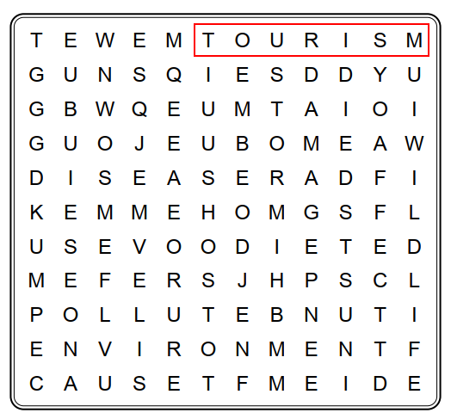
Wordsearch
How many words can you see?

Slide 6
Wordsearch
Can you find ten words?

Slide 7
Presentation

Slide 8
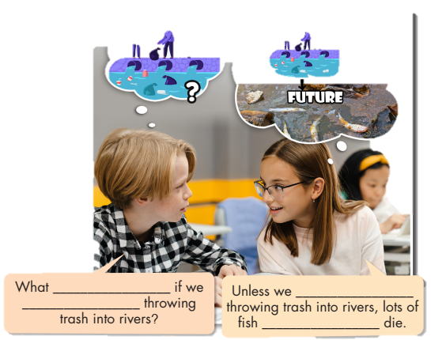
Look at the picture and fill in the blanks.
What are they talking about?
will happen
keep
keep
will die

Slide 9
Listen again and repeat
will happen
keep
keep
will die

Slide 10
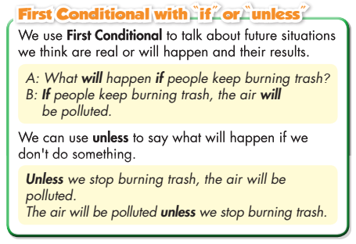
Read the box and answer the question below.
What do we use First Conditional for?

Slide 11
- Read the sentences and underline the bold words.
- Focus on the usage of unless and if.

Slide 12
First Conditional
We use the First Conditional to talk about future situations we think are real or will happen and their result.
If clause | Main clause
Present simple (+) S + Vs/es + O. (-) S + don’t/doesn’t + V + O. (?) Do/does + S + V + O? * Note: do not = don’t does not = doesn’t | Future simple (+) S + will + V + O. (-) S + won’t + V + O. (?) Will + S + V + O? * Note: will not = won’t
We can make negative conditionals using unless instead of if.
Can you give more examples using First Conditional?

Slide 13
Practice

Slide 14
Task a
will happen
don’t do
won’t affect
keep
will be
don’t stop
is
will want
won’t able to
keep

Slide 15
Task b
Look at a student’s notes and write First Conditional sentences using “if” or “unless” clauses.
Animals will lose home unless people protect forests.
If we keep leaving plastic bags and bottles on beaches, it’ll badly affect tourism
If we breathe polluted air, we’ll get sick.
If more people use public transportation, there will be less air pollution.
There will be more diseases if people keep polluting the environment.

Slide 16
Production:
Speaking

Slide 17
Work in pairs
Make First Conditional sentences using the prompts and “if” or “unless”.

Slide 18
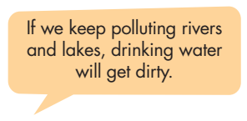

Slide 19
CONSOLIDATION

Slide 20
keep
won’t
if
what
affect
trees
increases

Slide 21
WRAP-UP

Slide 22
Today’s lesson
Grammar:
We use First Conditional to talk about future situations we think are real or will happen and their result.
Speaking:
Make First Conditional sentences with the given prompts.

Slide 23
Homework
Make five sentences using First Conditional.
Do the exercises in WB: Grammar (page 15).
Play the consolidation games in Tiếng Anh 8 i-Learn Smart World DHA App on www.eduhome.com.vn
Do the exercises in Tiếng Anh 8 i-Learn Smart World Notebook, page 22.
- Prepare: Lesson 1 – Pronunciation and Speaking (pages 26 & 27 – SB).

Slide 24
Lesson 3
Stay positive and have a nice day!

