Slide 1

Unit 4: Community Services
Lesson 3.1: Listening & Reading
Page 34

Slide 2



LESSSON OUTLINE
Consolidation

Slide 3

By the end of this lesson, students will be able to…
practice listening and reading for main ideas and specific information.
be well-prepared for the writing activity in the next lesson.

Slide 4

WARM UP

Slide 5

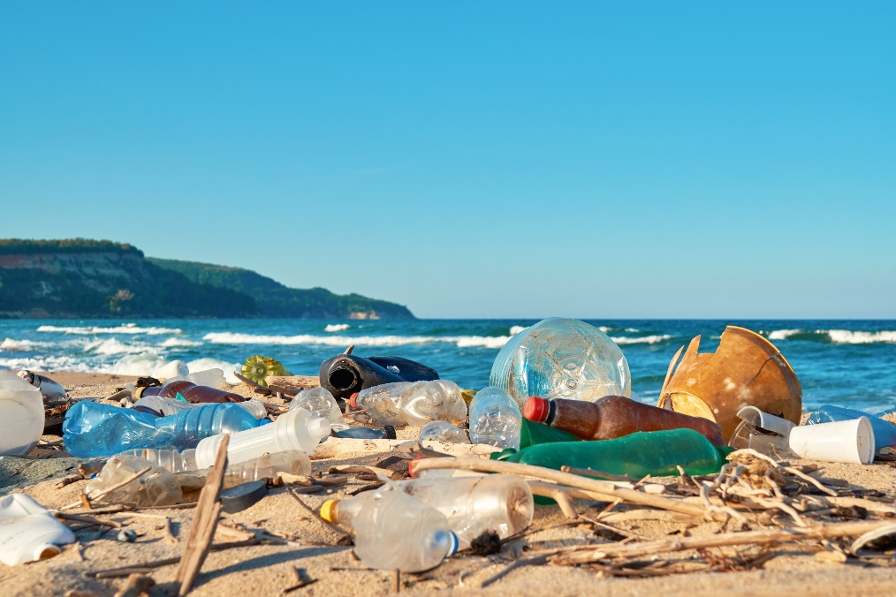
Work in pairs.
Look at the picture and discuss.
1. Do you know any beaches that look like this?
2. How does it make you feel?
3. What can we do to stop this from happening?
Suggested answers:
1. Vung Tau, Long Hai, …
2. It makes me feel terrible.
3. We can put some trash bins along beaches.

Slide 6


It’s listening time….

Slide 7
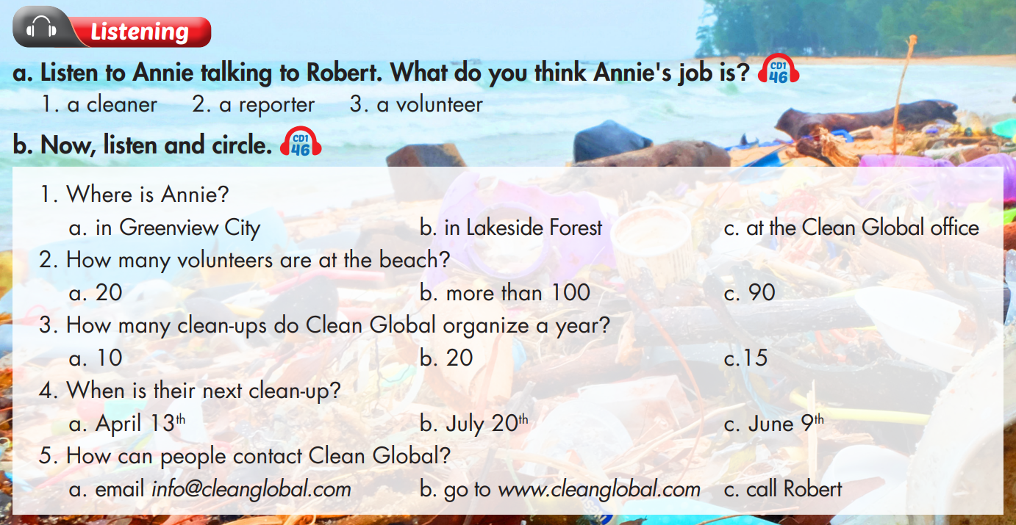

Slide 8
Pre – listening
Before listening
a. Underline the key words and guess what Annie’s job is.
a person who cleans houses, offices, public places, etc.
a person who collects and reports news for newspapers, radio or television.
a person who does a job without being paid for it.

Slide 9

While - listening
Listen the first time to recognize what Annie’s job is.
Hello. I'm Annie Jones and I'm here at Shell Beach in Greenview City. Today, Clean Global is here with over one hundred volunteers to clean up the beach. Here I have Robert Owen, the organizer of today's event. Hi Robert! Tell us about your organization.
Annie is a reporter.

Slide 10
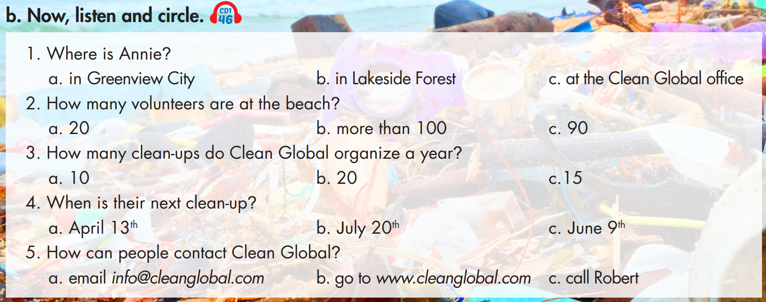
b. Underline the key words in each question and predict the answer.

Slide 11
b. Now, listen and circle.
3. How many clean-ups do Clean Global organize a year?
10
20
15
4. When is their next clean-up?
April 13th
July 20th
June 9th
5. How can people contact Clean Global?
email info@cleanglobal.com
go to www.cleanglobal.com
call Robert
We're Clean Global. We organize fifteen clean-ups every year all over the country.
1. Where is Annie?
in Greenview City
in Lakeside Forest
at the Clean Global office
2. How many volunteers are at the beach?
20
more than 100
c. 90
Hello. I'm Annie Jones and I'm here at Shell Beach
in Greenview City.
If you want to contact us, get more information, or join in, please visit us at www.cleanglobal.com.
Today, Clean Global is here with over one hundred volunteers to clean up the beach.
On Saturday, July twentieth, we are meeting at Lakeside Forest.

Slide 12
3. How many clean-ups do Clean Global organize a year?
10
20
15
4. When is their next clean-up?
April 13th
July 20th
June 9th
We're Clean Global. We organize fifteen clean-ups every year all over the country.
On Saturday, July twentieth, we are meeting at Lakeside Forest.

Slide 13
5. How can people contact Clean Global?
email info@cleanglobal.com
go to www.cleanglobal.com
call Robert
If you want to contact us, get more information, or join in, please visit us at www.cleanglobal.com.

Slide 14

Post - listening
Work in pairs
Do you think their activity is good for the community? Why (not)?

Slide 15
Audio Scripts
Practice the conversation with a partner.
W: Hello. I'm Annie Jones and I'm here at Shell Beach in Greenview City. Today, Clean Global is here with over one hundred volunteers to clean up the beach.
Here I have Robert Owen, the organizer of today's event. Hi Robert!
M: Hello.
W: Tell us about your organization.
M: We're Clean Global. We organize fifteen clean-ups every year all over the country. We help keep beaches, parks, and forests clean.
W: That's great.
M: Thanks. But we need more volunteers. On Saturday, July twentieth, we are meeting at Lakeside Forest. If you want to contact us, get more information, or
join in, please visit us at www.cleanglobal.com. For every clean-up we provide trash bags, gloves, and a small lunch for all volunteers. Just remember to bring water and sunscreen!

Slide 16
Pre - reading
Underline the key words and guess whether Jane would like to take part in future clean-ups.

Slide 17
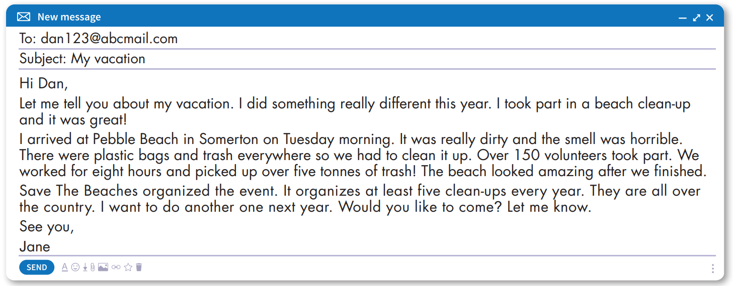
While - reading
Skim the email and underline the key words.
Answer: a. Yes

Slide 18
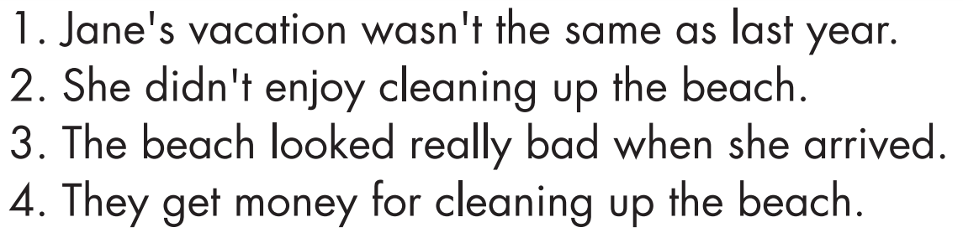
Pre - reading
Read the sentences and underline the key words.

Slide 19
While - reading
Scan the email and underline the key words.
1. Jane's vacation wasn't the same as last year.
True

Slide 20
While - reading
Scan the email and underline the key words.
False
2. She didn't enjoy cleaning up the beach.

Slide 21
While - reading
Scan the email and underline the key words.
3. The beach looked really bad when she arrived.
True

Slide 22
While - reading
Scan the email and underline the key words.
4. They get money for cleaning up the beach.
False

Slide 23
Post - reading
Work in pairs
Would you like to take part in a beach clean-up? Why (not)?

Slide 24
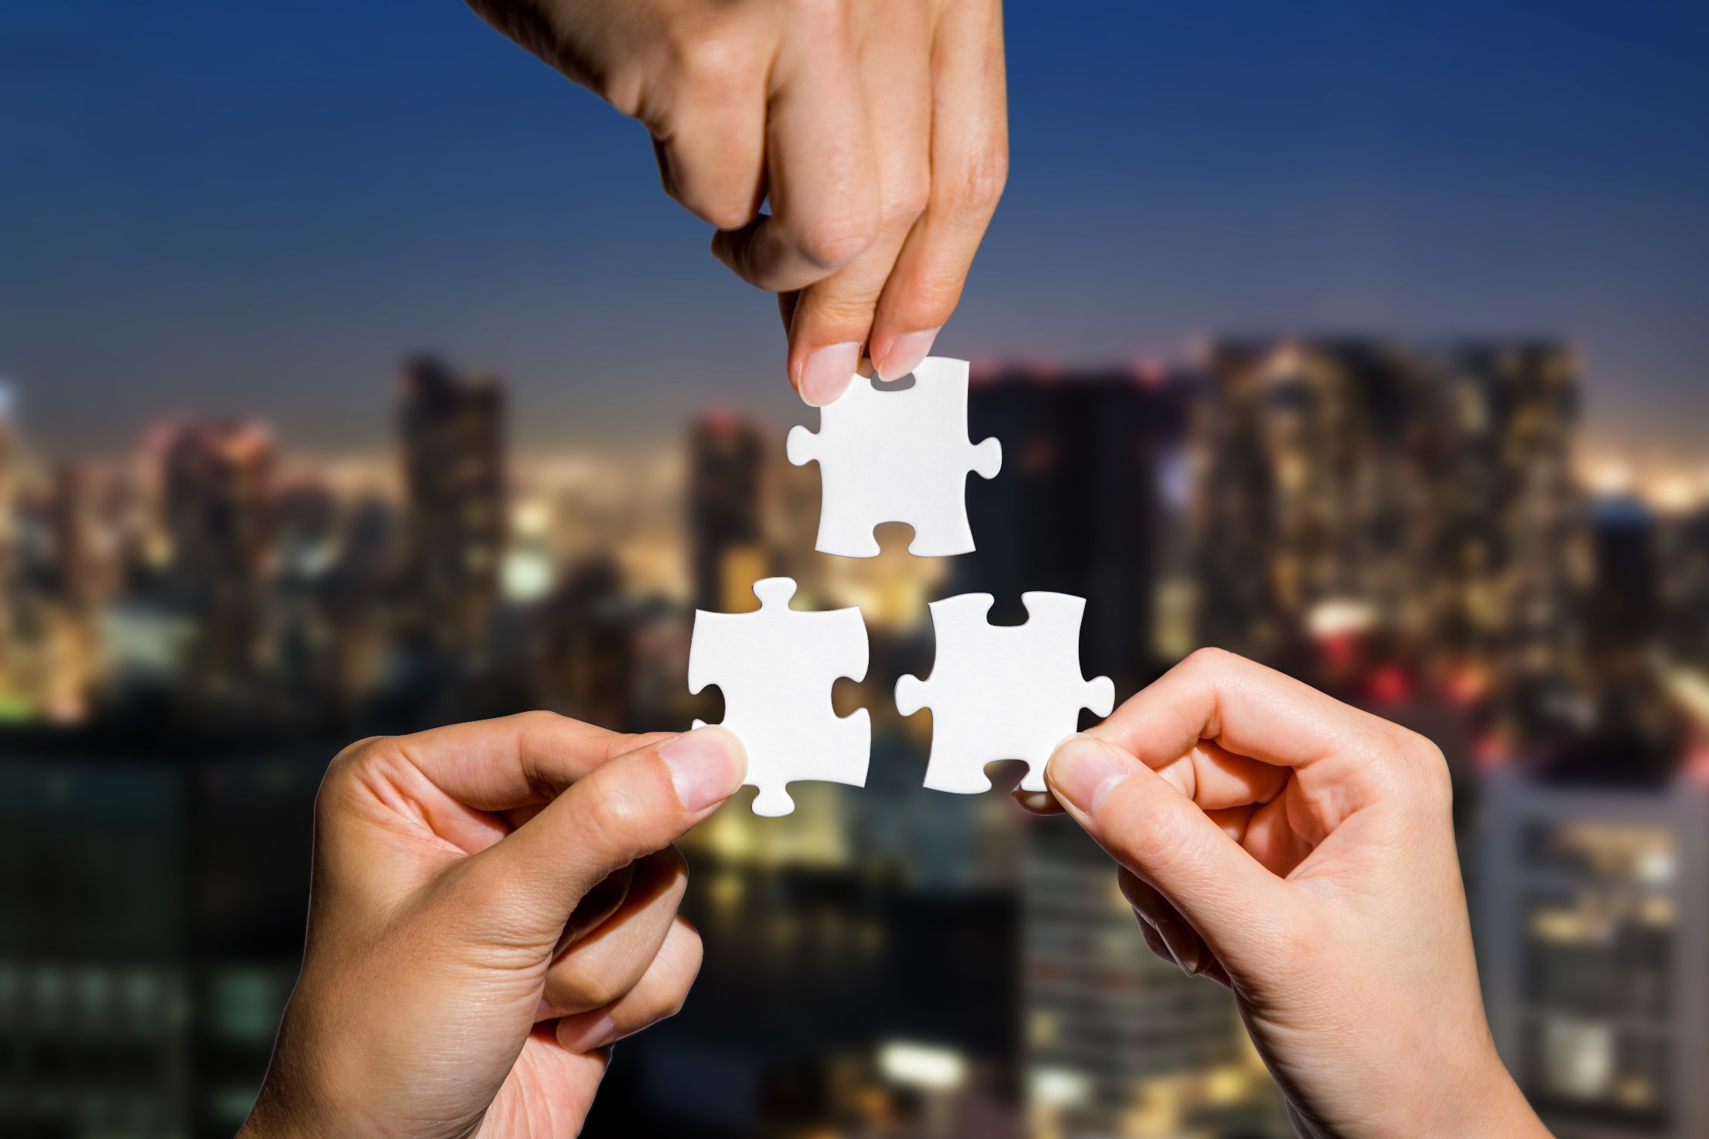
CONSOLIDATION

Slide 25
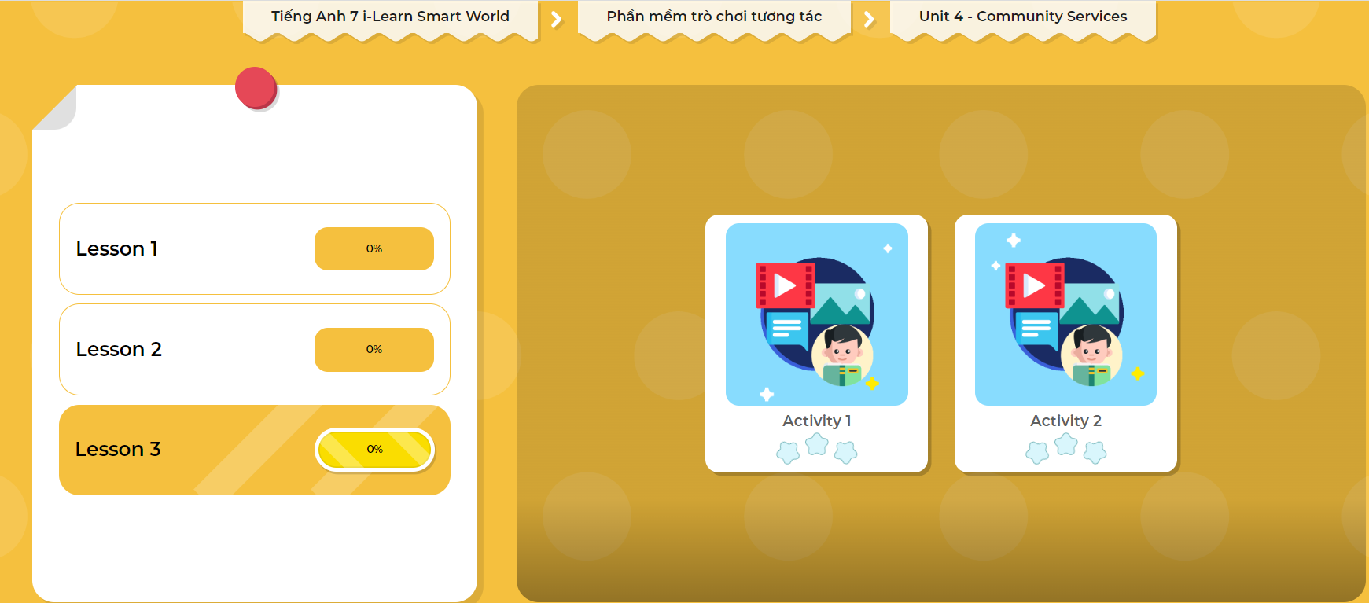
LET’S PLAY!
Click here to play the games

Slide 26

WRAP-UP

Slide 27
Today’s lesson
Listening:
- Listen for gist and choose the correct information.
Reading:
- Skim and scan for general and specific information.

Slide 28
Homework
Do the Listening and Reading exercises on page 24 WB.
Do the exercises in Tiếng Anh 7 i-Learn Smart World Notebook on page 26.
Prepare the next lesson (page 34 SB).
Play the consolidation games in Tiếng Anh 7 i-Learn Smart World DHA App on www.eduhome.com.vn

Slide 29

Lesson 3
Stay positive and have a nice day!

