Slide 1

Unit 5: Travel & Transportation
Lesson 5d: Everyday English
Page 85

Slide 2
Lesson Outline
Warm-up
Reading
Speaking
Pronunciation
Wrap-up

Slide 3
Objectives
By the end of this lesson, students will be able to…
- act out a dialogue about buying tickets for transport.
- practise pronunciation of consonant clusters.

Slide 4

WARM-UP

Slide 5

Work in pairs.
Choose the word whose underlined part is
pronounced differently from that of the other words.
1. A. customer B. duration C. umbrella D. punishment
2. A. rhythm B. toothache C. thunder D. birthday
3. A. agent B. station C. cable D. adult
/ˈkʌstəmər/
/duˈreɪʃn/
/ʌmˈbrelə/
/ˈpʌnɪʃmənt/
/ˈrɪðəm/
/ˈtuːθeɪk/
/ˈθʌndər/
/ˈbɜːθdeɪ/
/ˈeɪdʒənt/
/ˈsteɪʃn/
/ˈkeɪbl/
/əˈdʌlt/

Slide 6
Work in pairs.
Please find at least 5 kinds of transport you have to buy tickets to use:
e.g. bus, airplane, ship, train, cable car

Slide 7

It’s time to learn …

Slide 8
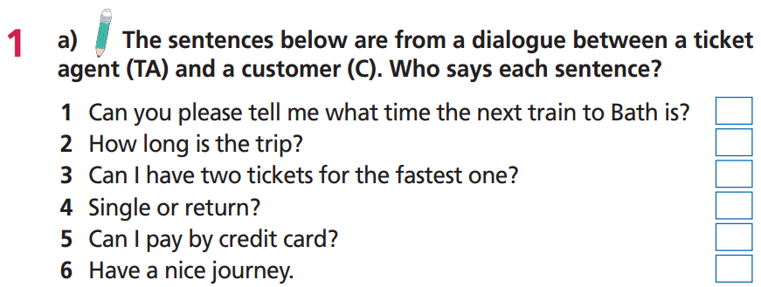


C
C
C
TA
C
TA

Slide 9
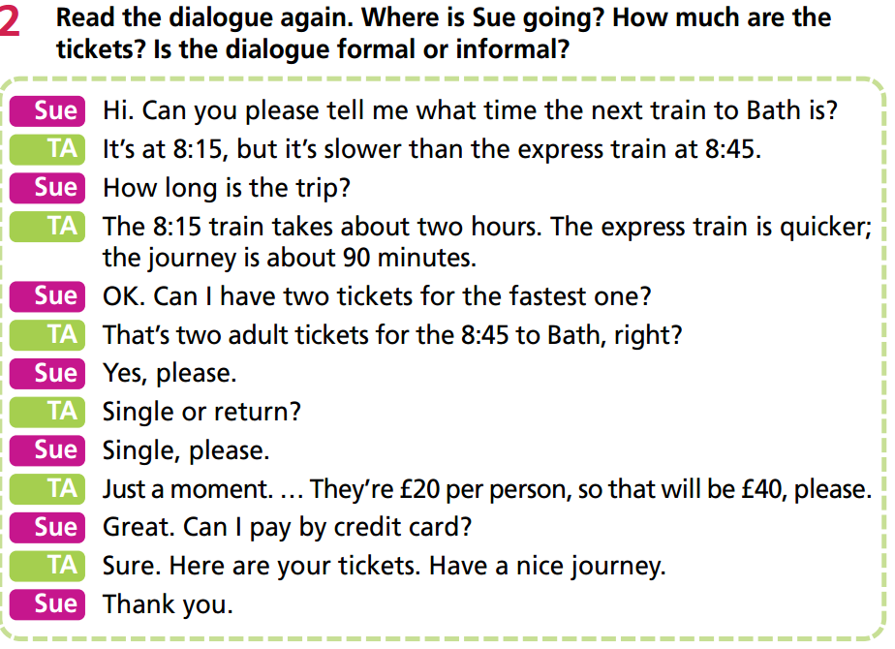

Slide 10
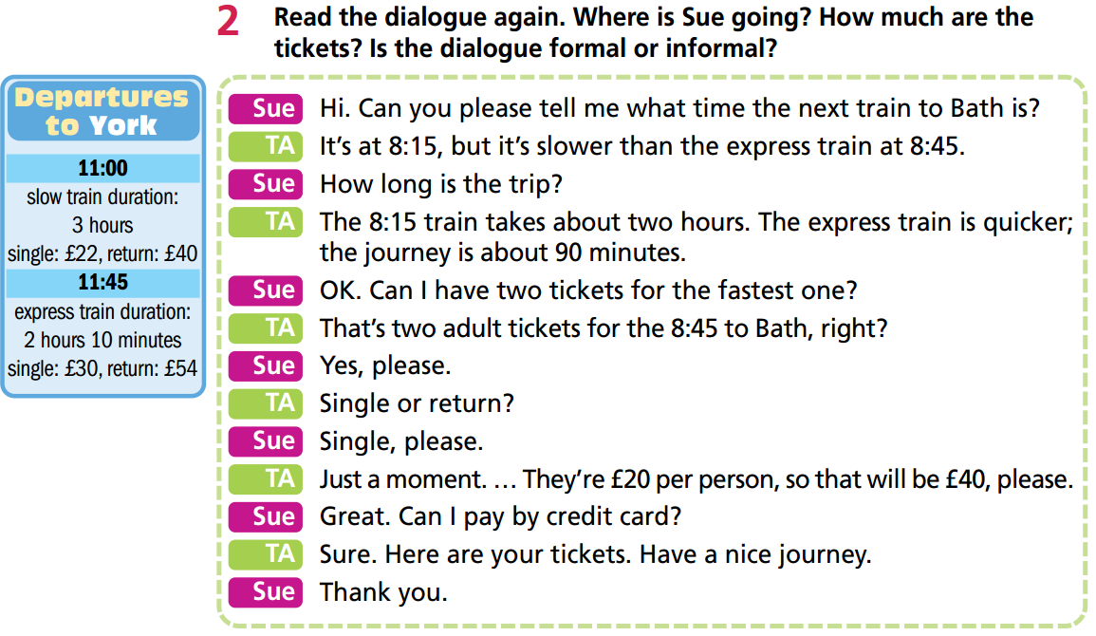
Sue is going to Bath.
Two tickets cost £40.
The dialogue is informal.

Slide 11
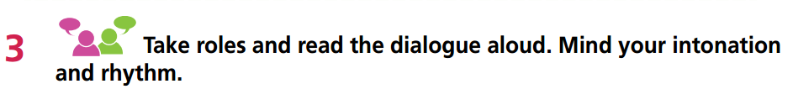

Slide 12
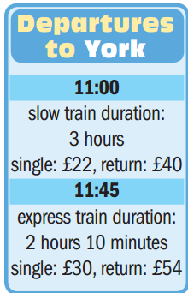
Choose suitable sentences to fill in the dialogue.
The 11:00 train takes about three hours. The express train is quicker; the journey is about 2 hours and 10 minutes.
Great. Can I pay by credit card?
Return please.
It’s at 11:00, but it’s slower than the express train at 11:45.
A: Hi. Can you please tell me what time the next train to York is?
B: __________________________________________________
A: How long is the trip?
B: ___________________________________________________
A: OK. Can I have two tickets for the 11:45, please?
B: Single or return?
A:___________________________________________________
B: Just a moment. … They’re £54 per person so that will be £108.
A:___________________________________________________
B: Sure. Here are your tickets. Have a nice journey.
A: Thank you.
It’s at 11:00, but it’s slower than the express train at 11:45.
The 11:00 train takes about three hours. The express train is quicker; the journey is about 2 hours and 10 minutes.
Return please.
Great. Can I pay by credit card?

Slide 13
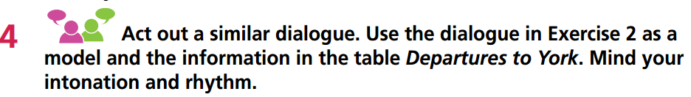
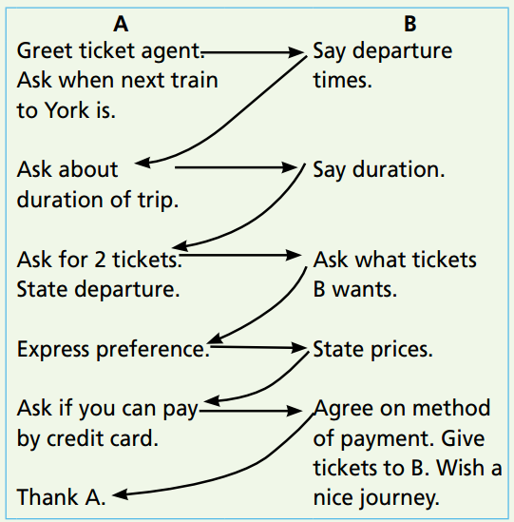
Remember to follow these steps:
E.g.
A: Hi. Can you please tell me what time the next train to York is?
B: It’s at 11:00, but it’s slower than the express train at 11:45.
A: How long is the trip?
B: The 11:00 train takes about three hours. The express train is quicker; the journey is about 2 hours and 10 minutes.
A: OK. Can I have two tickets for the 11:45, please?
B: Single or return?
A: Return please.
B: Just a moment. … They’re £54 per person so that will be £108.
A: Great. Can I pay by credit card?
B: Sure. Here are your tickets. Have a nice journey.
A: Thank you.

Slide 14
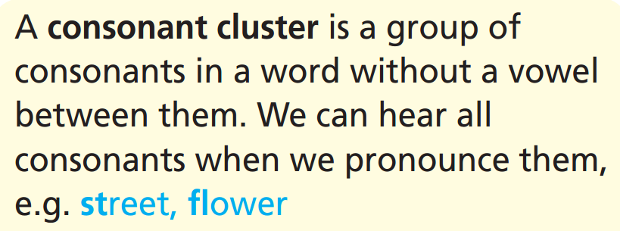
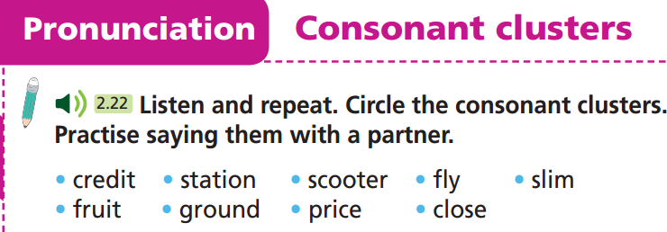

Slide 15

CONSOLIDATION

Slide 16
Write a paragraph (60-80 words) about your last journey by bus / train / plane by answering these questions.
When was your last journey by bus/train/plane?
What was the departure and the destination of the journey?
What was the departure time for your journey?
How long was the journey?
Who went with you on your journey?
Which kind of ticket did you buy for the journey: single or return?
How much was the ticket?
How did you feel about the journey?

Slide 17
Write a paragraph (60-80 words) about your last journey by bus / train / plane by answering these questions.
e.g.
My last journey by plane was about 3 years ago. I had a flight from Ho Chi Minh City to Đà Nẵng City. The departure time was 7:00 a.m. It took me 1 hour for this flight. I travelled there with my sister. I bought a single ticket. The ticket price was 1,000,000 VND per person. I felt very happy with the journey.

Slide 18

WRAP-UP

Slide 19
Today’s lesson
Speaking
Act out a dialogue buying tickets for transport.
Pronunciation
Practise pronunciation of consonant clusters.

Slide 20
Homework
Practise the vocabularies and make sentences using them.
Do the exercises in TA 7 Right on WB (page 45)
Prepare the next lesson (page 86 SB)
Do the exercise in TA 7 Right on Notebook (page 39)

Slide 21

Enjoy your day!

