Slide 1


Slide 2

Unit
5
1
Unit
FAMILY LIFE
INVENTIONS
LESSON 8
LOOKING BACK AND PROJECT

Slide 3

Unit
1
1
FAMILY LIFE
Family Life
Unit
OBJECTIVES
Review the vocabulary and grammar of Unit 5;
Apply what students have learnt (vocabulary and grammar) into practice through a project.

Slide 4
LESSON 8
LOOKING BACK AND PROJECT
Unit
WARM-UP
Brainstorming
Pronunciation and vocabulary
Solve the crossword. use the three syllable nouns in this unit. Read out the correct answers in pairs when you finish.
Grammar
Circle the correct answers.
LOOKING BACK
PROJECT
Inventions for the classroom
Wrap-up
Homework
CONSOLIDATION

Slide 5

LESSON 8
LOOKING BACK AND PROJECT
Unit
WARM-UP
Brainstorming
Brainstorm three-syllable nouns about topic Inventions

Slide 6

LESSON 8
LOOKING BACK AND PROJECT
Unit
WARM-UP
Brainstorming
Inventor
Invention
Computer
Telephone
Beverage
Camera
Submarine
Telegraph
Telescope
Typewriter
…

Slide 7
LESSON 8
LOOKING BACK AND PROJECT
Unit
WARM-UP
Brainstorming
Pronunciation and vocabulary
Solve the crossword. use the three syllable nouns in this unit. Read out the correct answers in pairs when you finish.
Grammar
Circle the correct answers.
LOOKING BACK

Slide 8
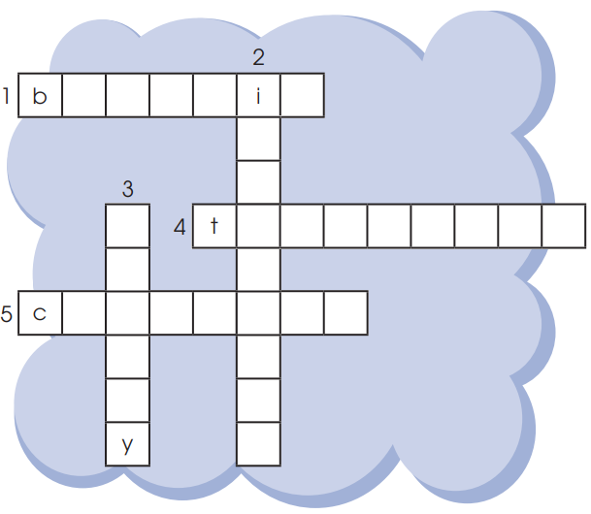
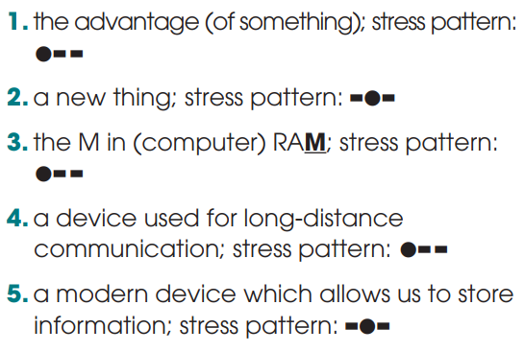
PRONUNCIATION & VOCABULARY
Solve the crossword. use the three syllable nouns in this unit. Read out the correct answers in pairs when you finish. (p. 60).
benefit
invention
memory
telephone
computer

Slide 9
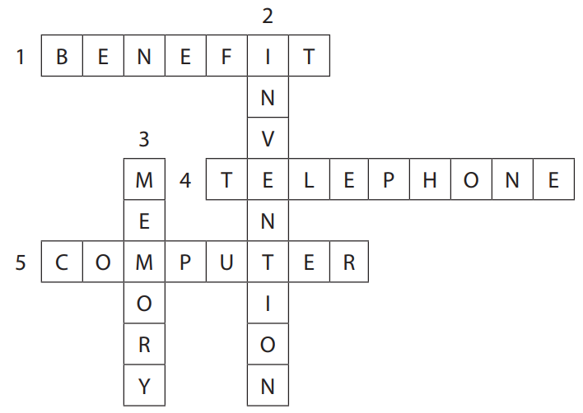
PRONUNCIATION & VOCABULARY
Solve the crossword. use the three syllable nouns in this unit. Read out the correct answers in pairs when you finish. (p. 60).

Slide 10
GRAMMAR
Circle the correct answers. (p. 60).
1. They just installed / have just installed some interesting software on the school computers. The programs are working very well and everyone enjoys to use / using them.
2. Smartphones allow people sending / to send information over long distances. Learn / To learn with a smartphone is fun as well.
3. Since television was invented / has been invented, TV designs changed / have changed a lot.

Slide 11
LESSON 8
LOOKING BACK AND PROJECT
Unit
WARM-UP
Brainstorming
Pronunciation and vocabulary
Solve the crossword. use the three syllable nouns in this unit. Read out the correct answers in pairs when you finish.
Grammar
Circle the correct answers.
LOOKING BACK
PROJECT
Inventions for the classroom

Slide 12

PROJECT
Inventions for the classroom
Work in groups. Your class is organising a Technology Fair. The theme is “Inventions for the classroom”. Each group is presenting a useful invention for the classroom. This can be an existing or new invention.
Use these questions to help you.
• What is the invention? (If it's a new invention, give it an interesting name.)
• What does it look like?
• How can it be used in the classroom?
• Why do you think it will be a useful invention?

Slide 13
LESSON 8
LOOKING BACK AND PROJECT
Unit
WARM-UP
Brainstorming
Pronunciation and vocabulary
Solve the crossword. use the three syllable nouns in this unit. Read out the correct answers in pairs when you finish.
Grammar
Circle the correct answers.
LOOKING BACK
PROJECT
Inventions for the classroom
Wrap-up
Homework
CONSOLIDATION

Slide 14
CONSOLIDATION
1
Wrap-up
Review the vocabulary and grammar of Unit 5;
Apply what students have learnt (vocabulary and grammar) into practice through a project.

Slide 15
CONSOLIDATION
2
Homework
Prepare for the next lesson: Unit 6_Getting started
Do exercises in the workbook

Slide 16


