Slide 1



Unit 2: Adventure
Lesson 2E: Word skills

Slide 2


www.phuongnam.edu.vn

Slide 3


Ex1. Read the text. Find the name of the person in the photo.
www.phuongnam.edu.vn

Slide 4


Profile
Name | Hector Turner | Geordie Stewart | Mike Perham
Age | 16 | 20 | 17
Activity | ultra-marathon | mountain climbing | circumnavigate by boat
Location | Sahara Desert | Everest | around the world
www.phuongnam.edu.vn

Slide 5

“Kids dream more than adults.”
Do you agree…
…or disagree?
www.phuongnam.edu.vn

Slide 6



UNIT 2:
ADVENTURE
www.phuongnam.edu.vn

Slide 7
Ex2. Complete the table with words from the text in exercise 1.
noun | verb
attempt | attempt
completion | complete
achievement | achieve
need | need
exploration | explore
experience | experience
dream | dream
www.phuongnam.edu.vn

Slide 8

Introduction on How to Use
LONGMAN Dictionary
www.phuongnam.edu.vn

Slide 9
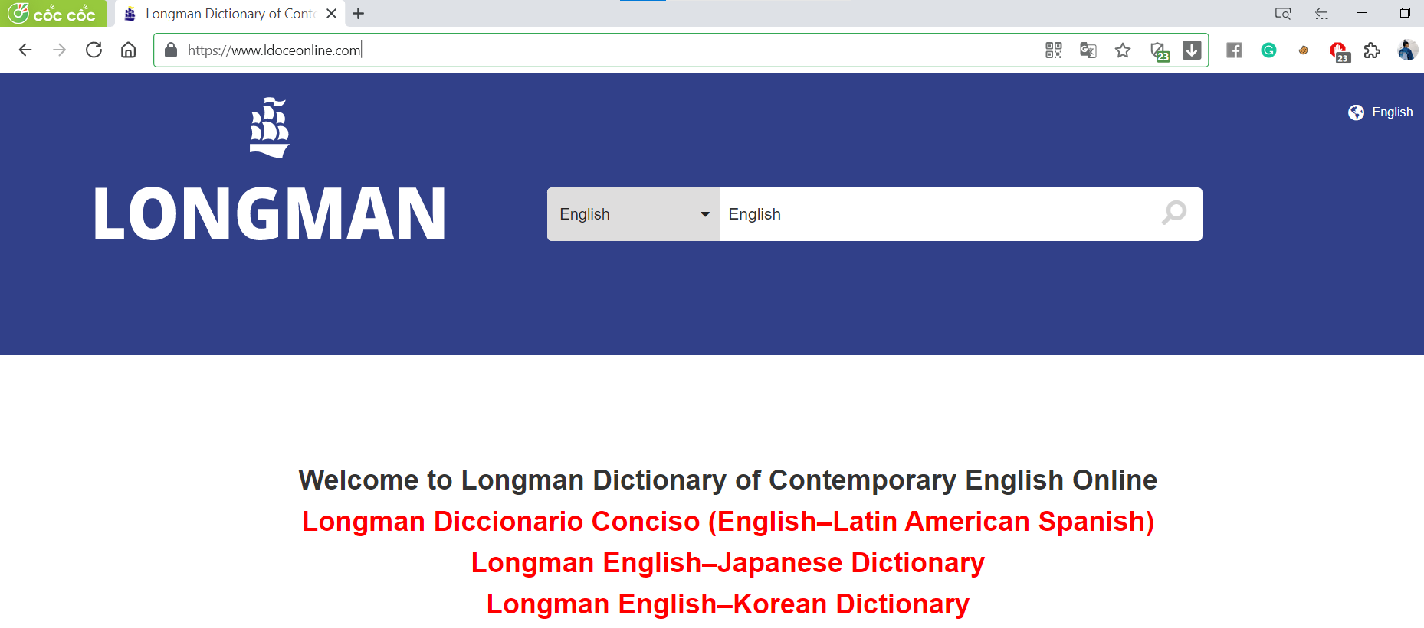
Link: https://www.ldoceonline.com/
www.phuongnam.edu.vn

Slide 10
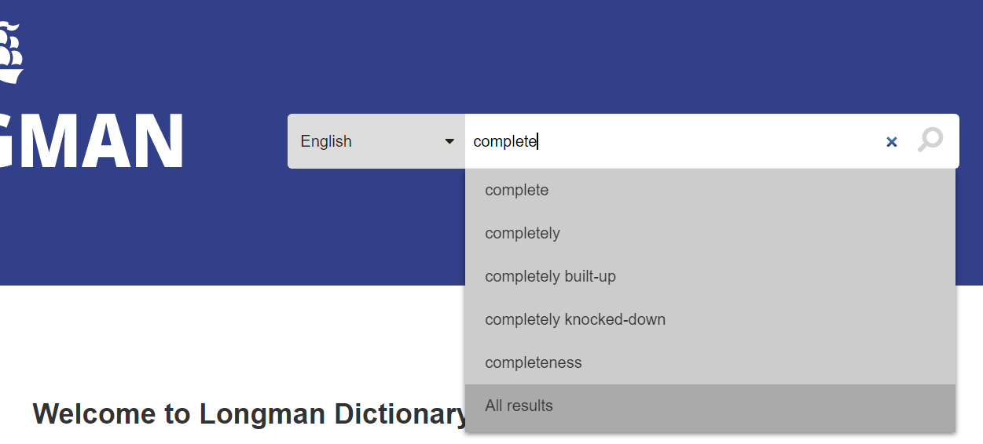
Link: https://www.ldoceonline.com/
www.phuongnam.edu.vn

Slide 11
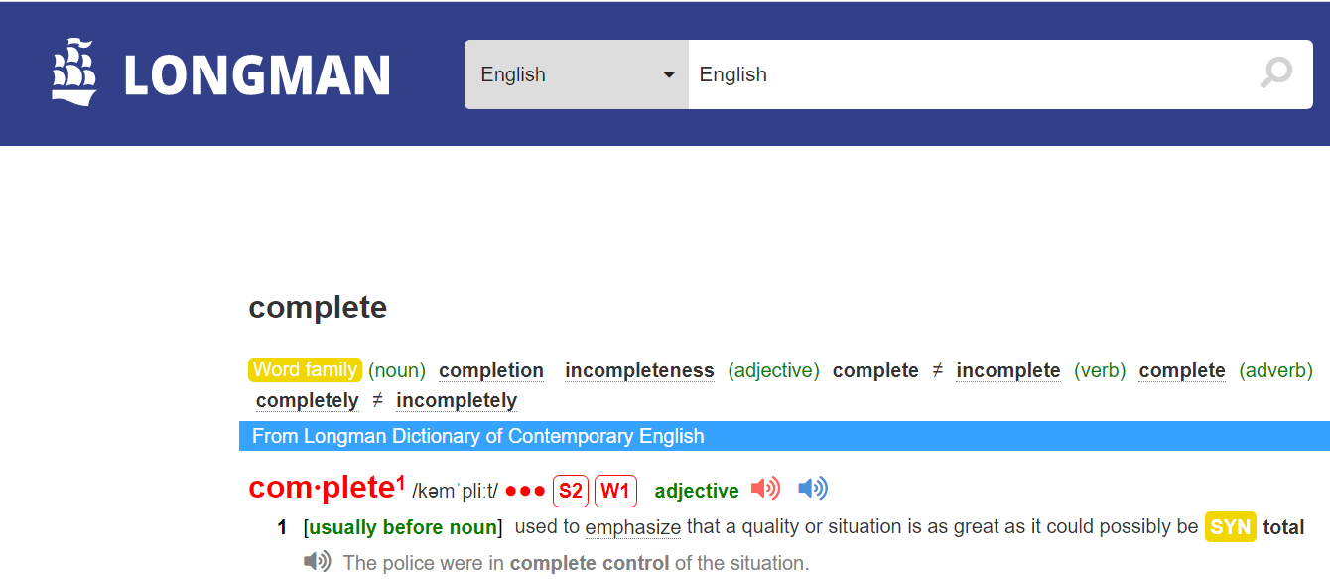
Link: https://www.ldoceonline.com/
www.phuongnam.edu.vn

Slide 12
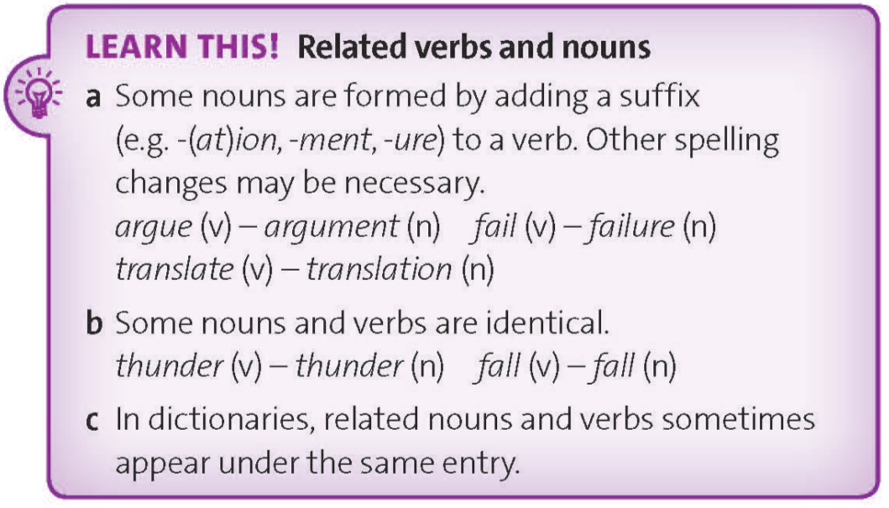
www.phuongnam.edu.vn

Slide 13
Ex3. Which different noun suffixes can you find in the text in exercise 1? Which nouns do not have a suffix?
no suffix: attempt
-tion: exploration
-ure: adventure
www.phuongnam.edu.vn

Slide 14
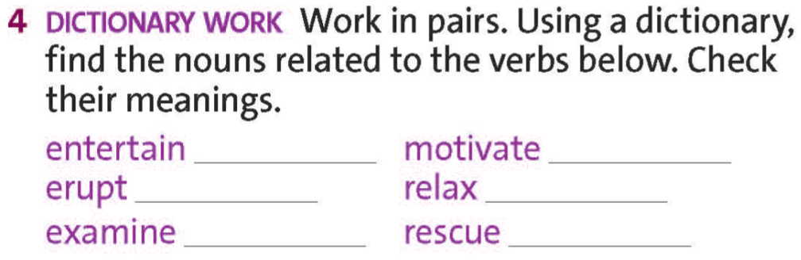
Link: https://www.ldoceonline.com/
entertainment
motivation
eruption
relaxation
examination
rescue
www.phuongnam.edu.vn

Slide 15

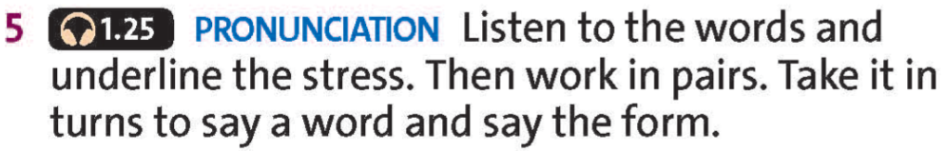
Link: https://www.ldoceonline.com/
entertainment
motivation
/entəˈteɪn/
/entəˈteɪnmənt/
/ˈməʊtɪveɪt /
/məʊtəˈveɪʃən/
eruption
relaxation
/ɪˈrʌpt/
/ɪˈrʌpʃən/
/rɪˈlæks/
/riːlækˈseɪʃən/
examination
rescue
/ɪɡˈzæmɪn/
/ɪɡˌzæməˈneɪʃən/
/ˈreskjuː/
/ˈreskjuː/
www.phuongnam.edu.vn

Slide 16
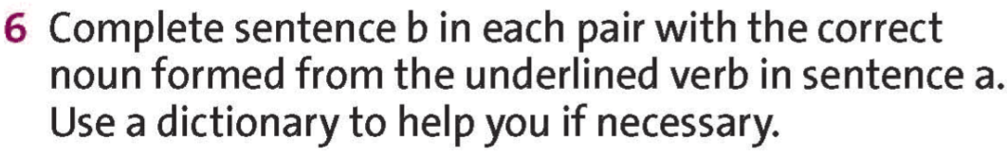
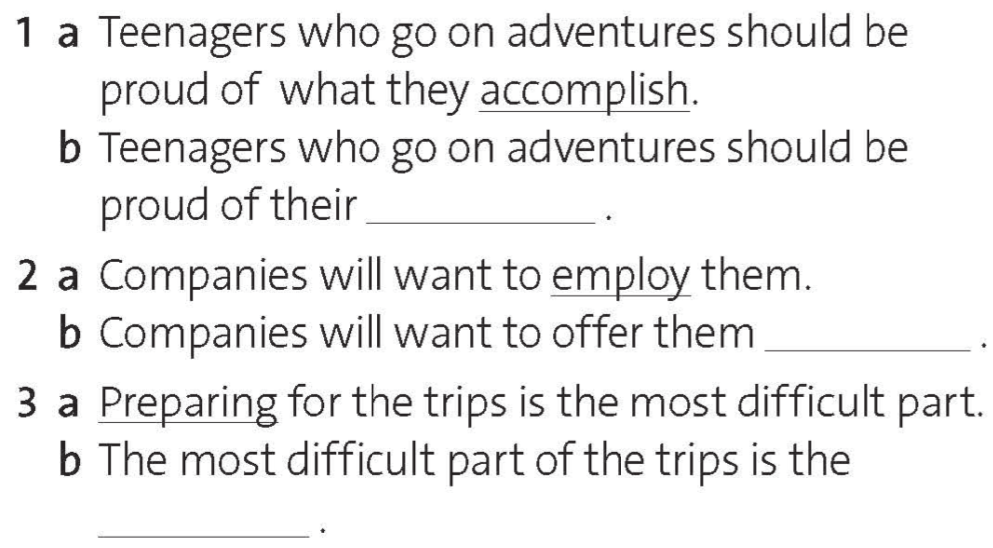
accomplishments
employment
preparation
www.phuongnam.edu.vn

Slide 17
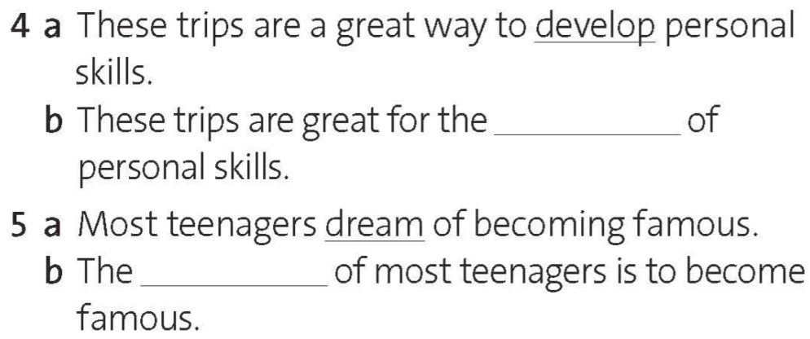
development
dream
www.phuongnam.edu.vn

Slide 18

Pair-work
www.phuongnam.edu.vn

Slide 19
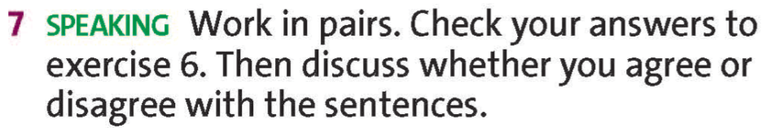
accomplishments
Do you agree…
…or disagree?
www.phuongnam.edu.vn

Slide 20
employment
Do you agree…
…or disagree?
www.phuongnam.edu.vn

Slide 21
preparation
Do you agree…
…or disagree?
www.phuongnam.edu.vn

Slide 22
development
Do you agree…
…or disagree?
www.phuongnam.edu.vn

Slide 23
dream
Do you agree…
…or disagree?
www.phuongnam.edu.vn

Slide 24

Homework
- Review on how to use Longman Dictionary.
- Prepare for next lesson – Reading
www.phuongnam.edu.vn

Slide 25

www.phuongnam.edu.vn

Slide 26



Thank you!
CTCP ĐẦU TƯ VÀ PHÁT TRIỂN GIÁO DỤC PHƯƠNG NAM

