Slide 2
Unit
1
A long and healthy life
Unit
FAMILY LIFE
LESSON 4
SPEAKING
Giving instructions for an exercise routine

Slide 3
LESSON 4
SPEAKING
WARM-UP
Watch a video
PRE-SPEAKING
Task 1. Match the two parts of each sentence to complete the instruction
Task 2. Fill in the blanks with one word.
Task 3. Practice giving instructions
Task 4. Take turns demonstarting the exercise routine and giving instructions
WHILE-SPEAKING
POST-SPEAKING
Further practice
Wrap-up
Homework
CONSOLIDATION

Slide 4
WARM-UP
WATCH A VIDEO

Slide 5
WARM-UP
Can you remember any instructions in the video???
turn around
clap your hands
stretch it out
jump
shake
stomp your feet

Slide 6
PRE-SPEAKING
slightly (adv)
/ˈslaɪtli/
a little
E.g. Are you worried?’ ‘Only slightly.’

Slide 7
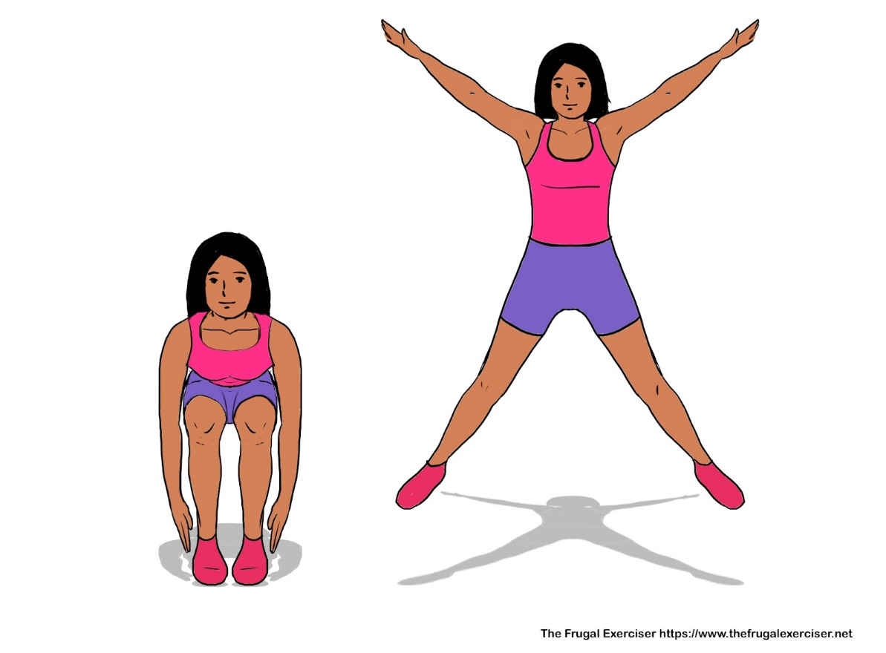
PRE-SPEAKING
star jump (n)
/stɑː(r) dʒʌmp/
an exercise in which you stand with your legs together and your arms at your sides and jump to a position with your legs apart and your arms spread out

Slide 8
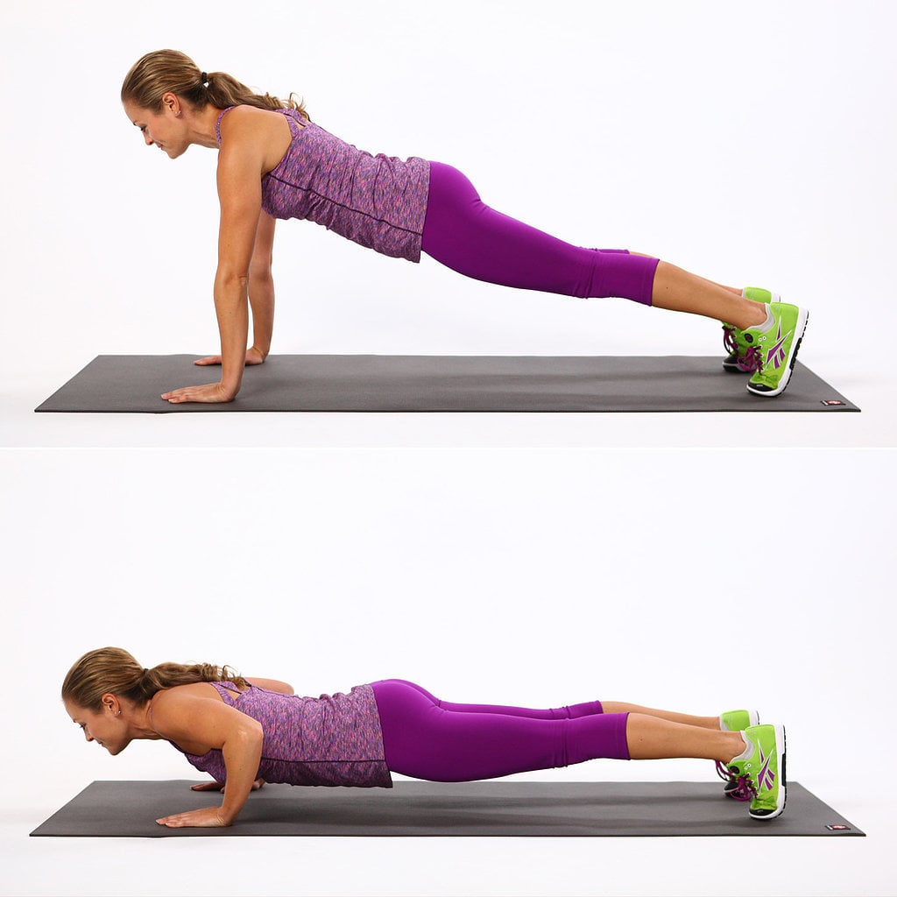
PRE-SPEAKING
press-up
/ˈpres ʌp/
an exercise in which you lie on your stomach and raise your body off the ground by pressing down on your hands until your arms are straight

Slide 9
PRE-SPEAKING
(to) squat
/skwɒt/
to sit on your heels with your knees bent up close to your body

Slide 10
PRE-SPEAKING
Form | Pronunciation | Meaning
1. slightly (adv) | /ˈslaɪtli/ | a little
2. star jump (n) | /stɑː(r) dʒʌmp/ | an exercise in which you stand with your legs together and your arms at your sides and jump to a position with your legs apart and your arms spread out
3. press-up (n) | /ˈpres ʌp/ | an exercise in which you lie on your stomach and raise your body off the ground by pressing down on your hands until your arms are straight
4. (to) squat | /skwɒt/ | to sit on your heels with your knees bent up close to your body

Slide 11
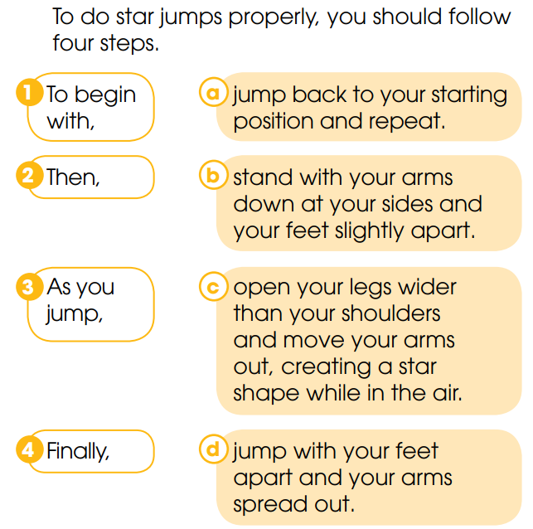
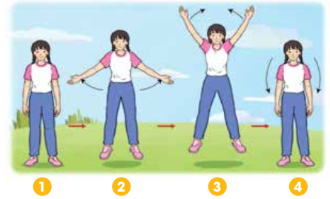
PRE-SPEAKING
1
Look at the diagram. Match the two parts of each sentence to complete the instruction.

Slide 12
PRE-SPEAKING
Tips to give instructions:
Fill in the blanks with a suitable word:
1. Start by _______________ the process.
2. Sequencing the steps, using ___________ words or phrases (i.g: first, second, next, finally …)
3. Give ___________ direction at a time.
introducing
linking
one

Slide 13
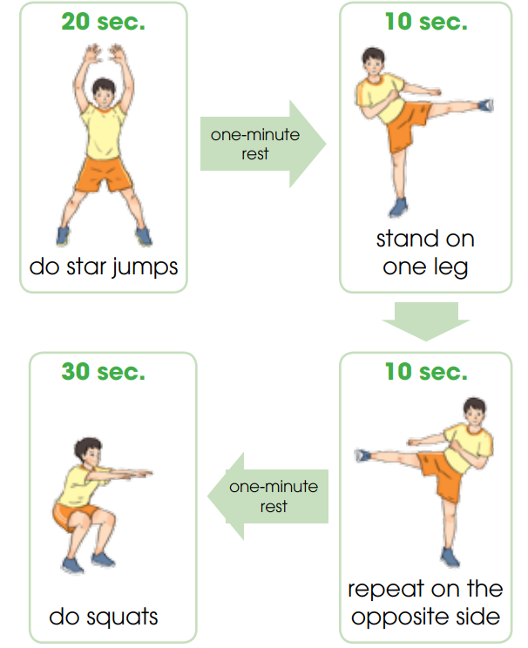
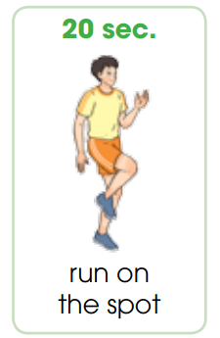
WHILE-SPEAKING
2
Look at the How to burn fat exercise. Fill in the blanks with one word to complete the first part of the instructions
First
Second
Next/Then

Slide 14
WHILE-SPEAKING
3
Work in pairs. Practice giving instructions for the rest of the exerice routine

Slide 15
WHILE-SPEAKING
4
Take turns demonstarting the exercise routine and giving instructions to the rest of your group so that they can do the exercise with you.

Slide 16
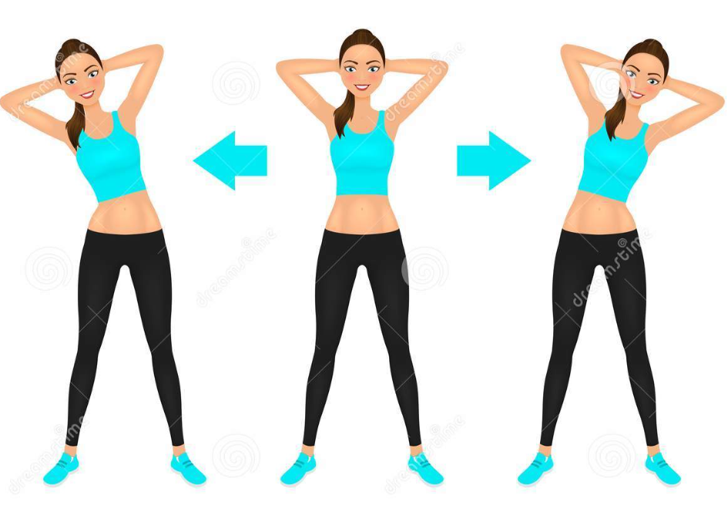
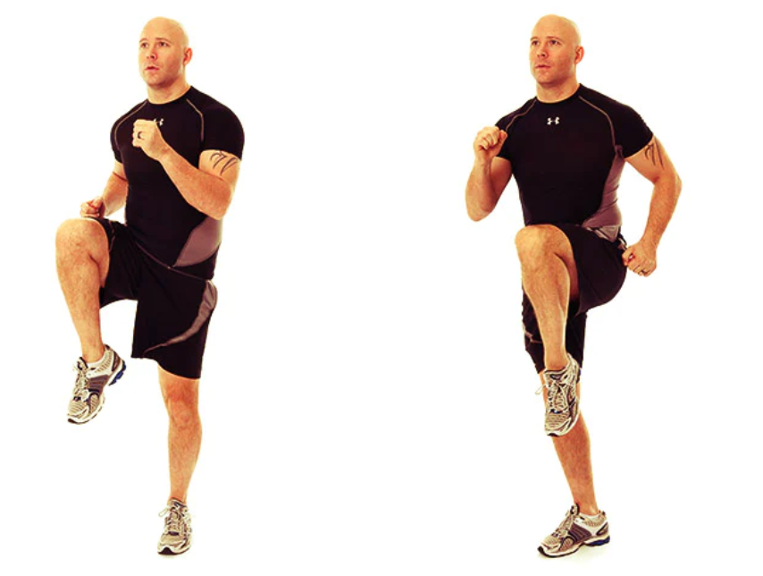
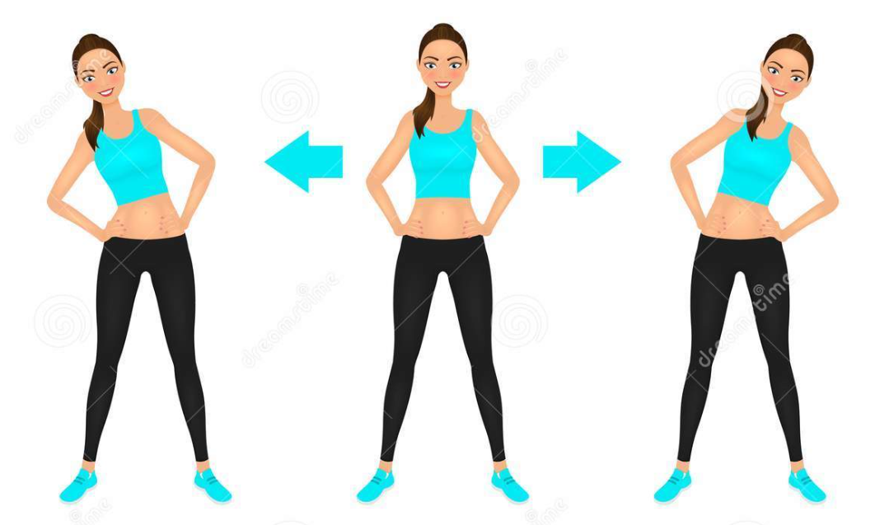
POST-SPEAKING
FURTHER PRACTICE
- Work in pairs and come up with instructions for another exercise routine. (e.g: Warm-up exercise in the P.E lesson)
- Demonstrate your routine in front of the class and give instructions.

Slide 17
CONSOLIDATION
1
Wrap-up
What have you learnt today?
How to give instructions for an exercise routine
Vocabulary to talk about an exercise routine

Slide 18
CONSOLIDATION
2
Homework
Do exercises in the workbook.
Prepare for Lesson 5 - Unit 1.

Slide 19
Website: hoclieu.vn
Fanpage: facebook.com/www.tienganhglobalsuccess.vn

