Slide 1

Unit 6: Clothes
Lesson 1.1
Page 82

Slide 2
Lesson Outline
Warm-up
Vocabulary
Structure
Consolidation
Wrap-up

Slide 3
Objectives
By the end of this lesson, students will be able to talk about what clothes they want.
Vocabulary: dress, shirt, shorts, socks, pants
Structure: What do you want? I want a dress/I want some socks.

Slide 4

WARM UP

Slide 5






WORDSNAKE
Look and find 5 words about sports.
socvolleyballten
soccerbal
dfbasketball
badmintonvoll
hgtennisfr
Click on the number to check the answers.
◆
❖
⬥


Click on the animal to show the answers.
Notes:
Click vào dấu mũi tên sau khi thực hiện xong trò chơi

Slide 6



Click on the picture to hear the sound.
basketball
Click here to return to the game.

Slide 7
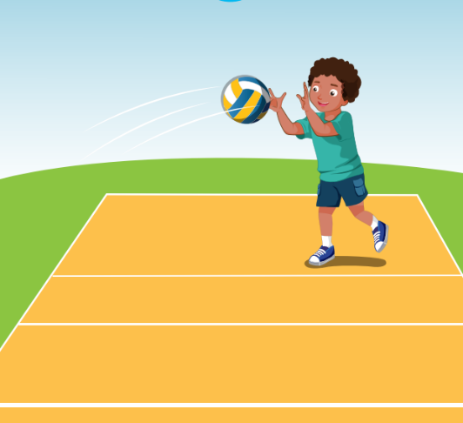
Click on the picture to hear the sound.
volleyball
Click here to return to the game.

Slide 8
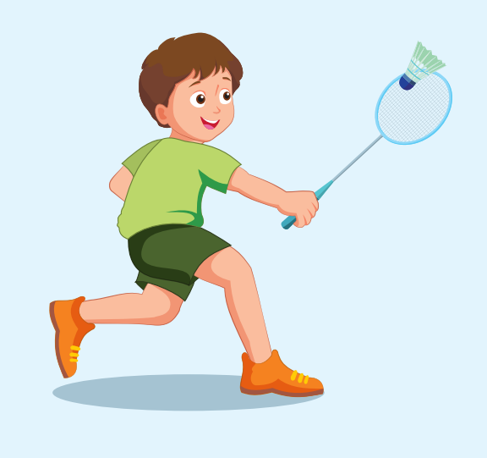
Click on the picture to hear the sound.
badminton
Click here to return to the game.

Slide 9
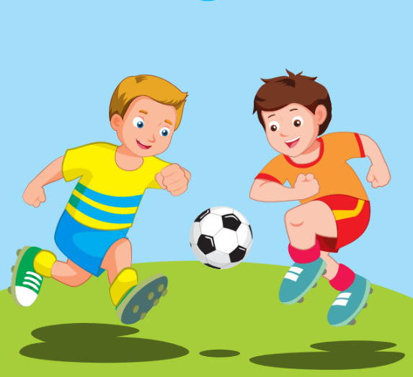
Click on the picture to hear the sound.
soccer
Click here to return to the game.

Slide 10
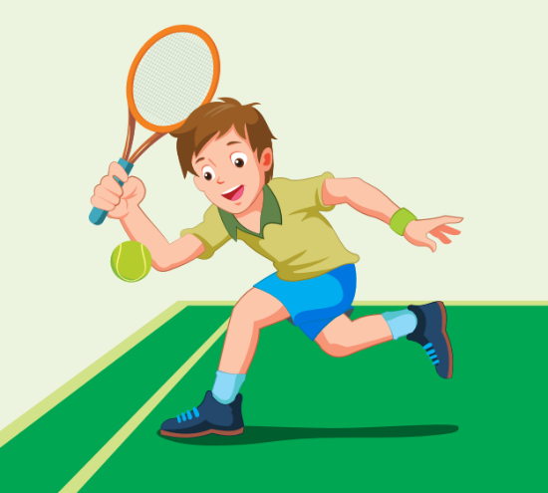
Click on the picture to hear the sound.
tennis
Click here to return to the game.

Slide 11

It’s time to learn …

Slide 12
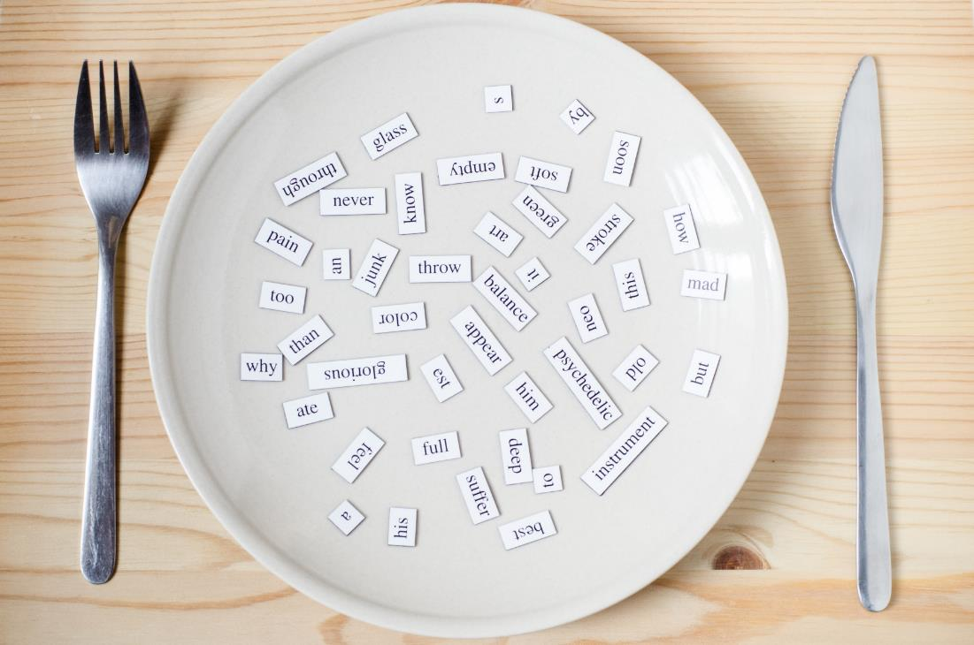
New words
dress
shirt
shorts
socks
pants

Slide 13

Presentation

Slide 14

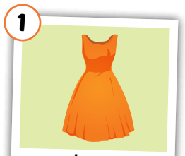
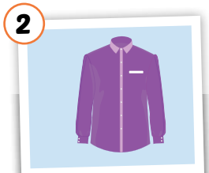
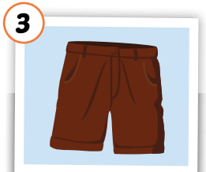
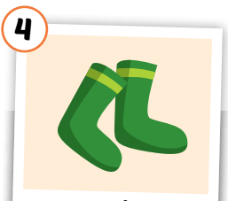
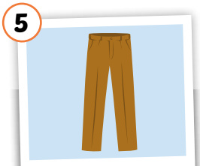
Click each English word to hear the sound.
dress
shirt
shorts
socks
pants
/dres/
đầm, áo đầm
/ʃɜːrt/
áo sơ mi
/ʃɔːrts/
quần soóc,
quần cộc
/sɑːks/
đôi tất
/pænts/
quần tây, quần dài
Notes:
GV giới thiệu từ vựng, CCQ

Slide 15
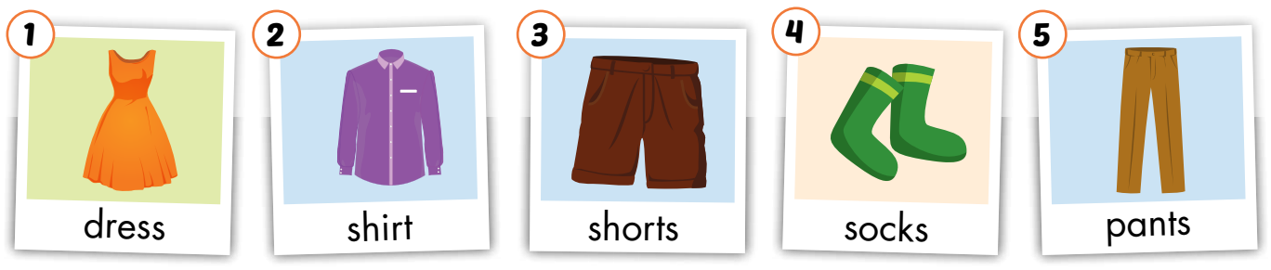
Look and read. Then listen and point to the right picture .
a
b
c
d
e
f
g
h
i
j
Click on the letters to play audios.

Slide 16
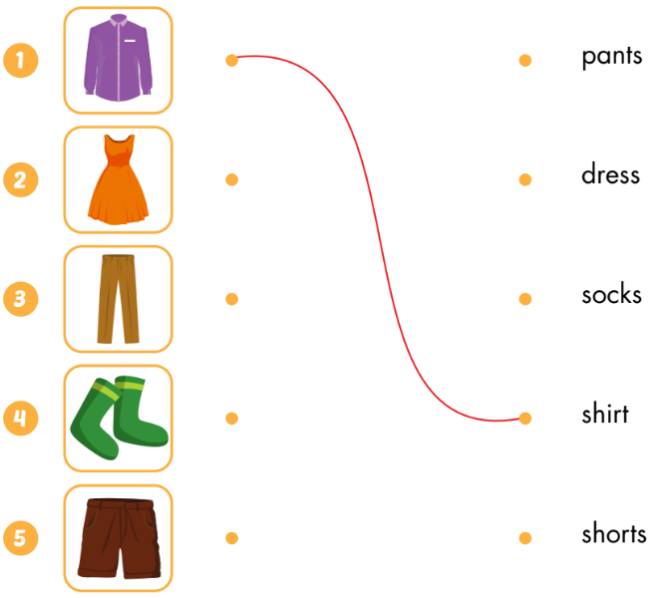
Draw lines

Slide 17


Look at the word and say the right number
shirt

Slide 18
Look at the word and say the right number
socks

Slide 19
Look at the word and say the right number
dress

Slide 20
Look at the word and say the right number
pants

Slide 21
Look at the word and say the right number
shorts

Slide 22
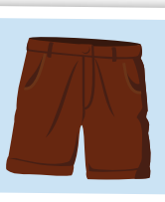

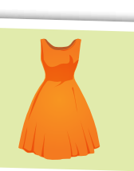
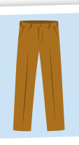
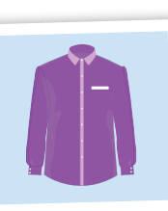
Put the pictures in the right group
◆
❖
a
some

Slide 23
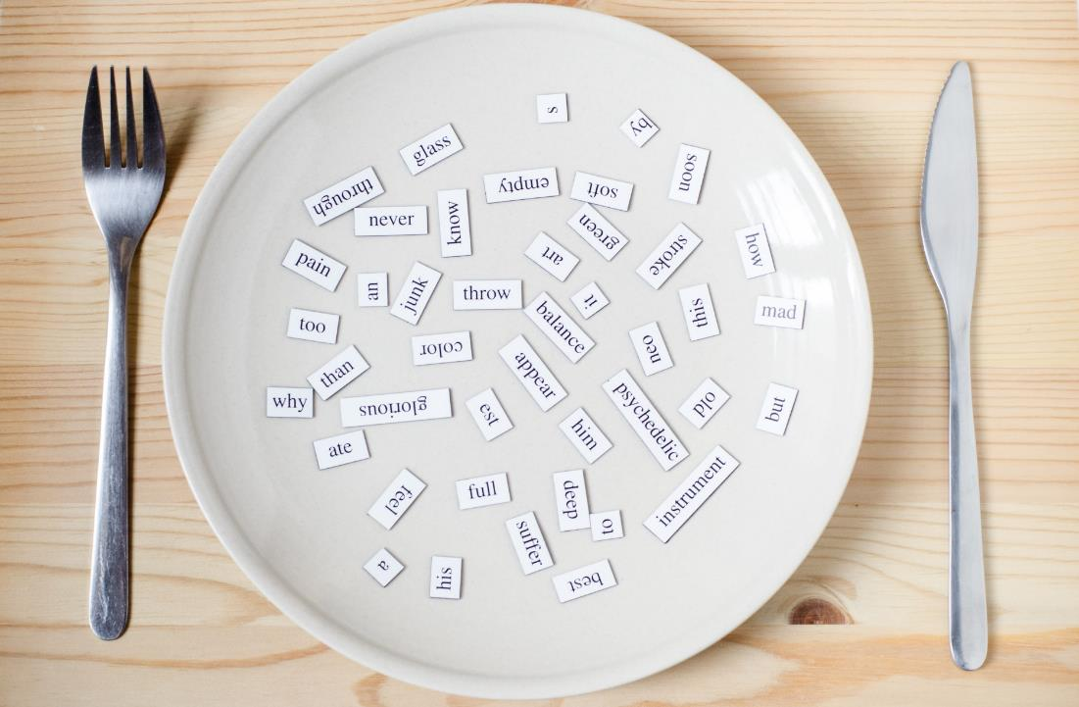
Structures
What do you want?
I want a dress.
What do you want?
I want some socks.

Slide 24

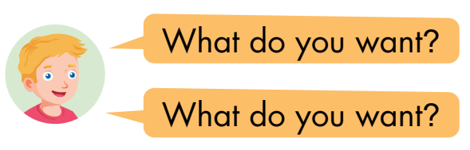
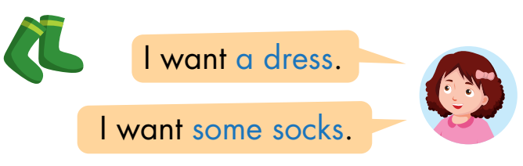

◆
❖
⬥


Slide 25

Practice

Slide 26


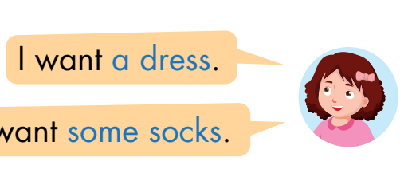
some shorts
__________

Slide 27
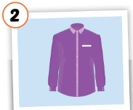
some socks
__________

Slide 28

some pants
__________

Slide 29

a dress
__________

Slide 30
a shirt
__________

Slide 31

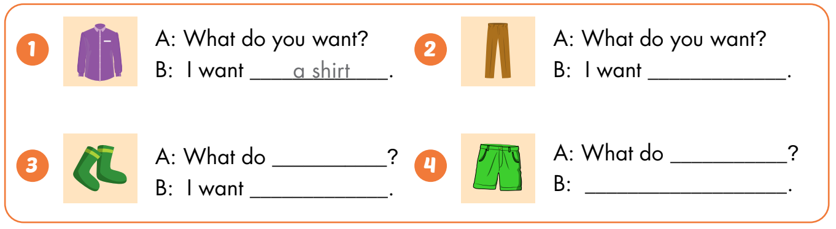
some pants
you want
you want
some socks
I want some shorts

Slide 32

CONSOLIDATION

Slide 33



Draw clothes you want. Ask and answer with 3 friends.

Slide 34

WRAP-UP

Slide 35
Today’s lesson
Vocabularies
dress
shirt
shorts
socks
pants
Structures/ Sentence patterns
What do you want?
I want a dress.
What do you want?
I want some shorts.

Slide 36
Homework
Practice the vocabularies and structure; and make sentences using them.
Do the exercises in Tiếng Anh 3 i-Learn Smart Start Workbook (page 58)
Prepare the next lesson (page 83 SB)
Play the consolidation games in Tiếng Anh 3 i-Learn Smart Start DHA App on www.eduhome.com.vn
Do the exercise in Tiếng Anh 3 i-Learn Smart Start Notebook (page 40)

Slide 37

Enjoy your day!

