Slide 1

Unit 3: Music and Arts
Lesson 3.2: Writing
Page 27

Slide 2


LESSON OUTLINE
Consolidation

Slide 3

By the end of this lesson, students will be able to…
understand steps to write a description of a movie.
practice writing a description of a movie.
talk about a movie you like.

Slide 4

WARM-UP

Slide 5

Work in pairs.
What kind of movies do you often watch? Why do you like it?

Slide 6


It’s writing time….

Slide 7
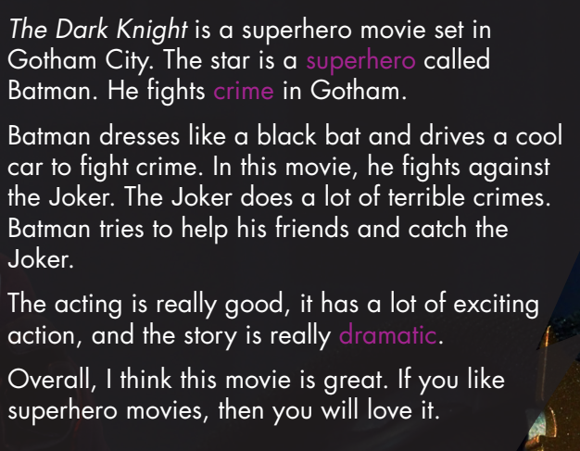
Pre - writing
Read the description of The Dark Knight and tell how many parts are there in the description. Try to discuss what should be included in each part.
Work in pairs
4 PARTS
INTRODUCTION
PLOT SUMMARY
OTHER DETAILS
CONCLUSION

Slide 8
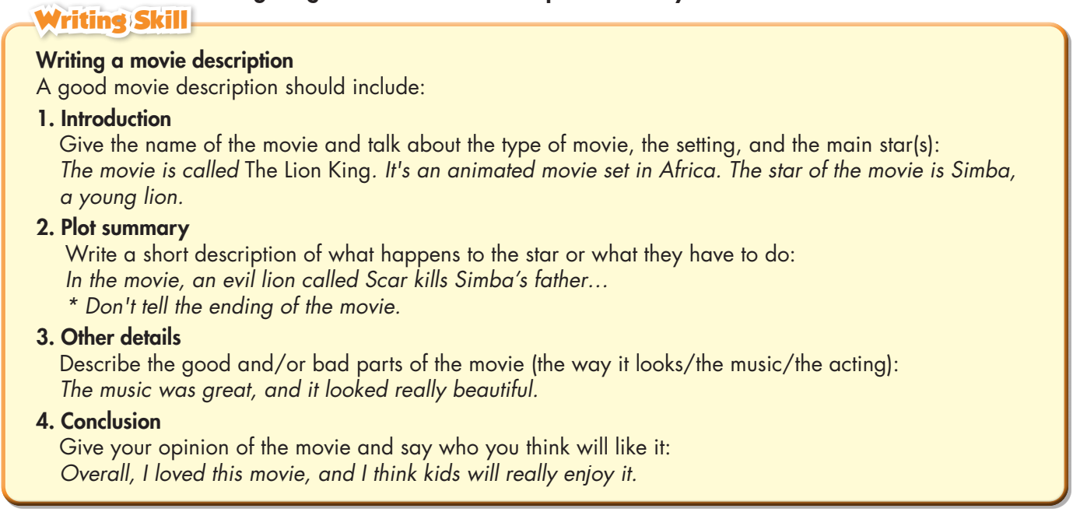
Pre - writing
Read the instructions about writing a movie description carefully.

Slide 9
Read the description of The Dark Knight again and circle the plot summary.

Slide 10
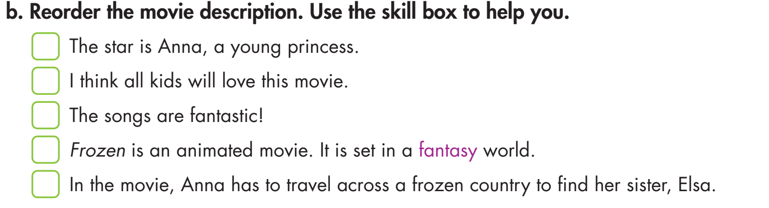
Pre - writing
2
5
4
1
3

Slide 11

Work in pairs
a. You're talking about your favorite movies. Ask your partner the following questions.
• What's your favorite movie?
• What kind of movie is it?
• Where and when is it set?
• Who's the star?
• What happens in the movie?
• What's the best part of the movie?
• Who'll like this movie
Harry Potter and the Philosopher's Stone
the life of a wizard
science fiction movie
Someone wants to bargain the stone from Harry, but Harry refuses. Someone tries to kill Harry.
in United States and in 2001
Daniel Radcliffe
Those who like science fiction

Slide 12
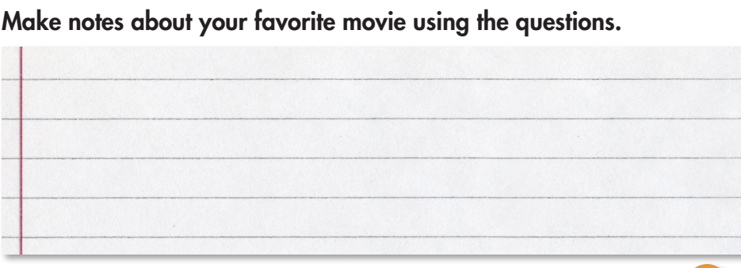
While - writing

Slide 13
Now, write a short description of a movie you like.
Write 60 to 80 words.
An example
The movie is called The Lion King.
It's an animated movie set in Africa.
The star of the movie is Simba, a young lion.
In the movie, an evil lion called Scar kills Simba's father. Simba has to fight him to become the king of the lions.
The music in this movie was great, and it looked really beautiful.
I love this movie, and I think kids will really enjoy it.

Slide 14
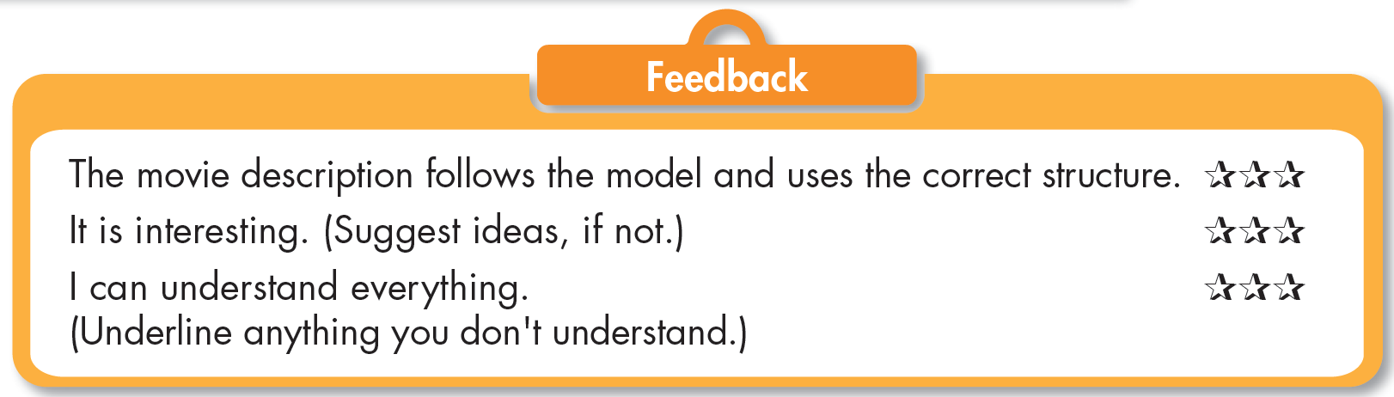
Exchange your work with a partner. Double check to see if you can help your friend write better!

Slide 15

CONSOLIDATION

Slide 16
Writing an introduction
Writing a plot summary
Writing a description of a movie.
Adding other details
Writing a conclusion

Slide 17

WRAP-UP

Slide 18
Today’s lesson
Writing:
Understand steps to write a description of a movie.
Practice writing a description of a movie.
Speaking:
- Talk about a movie you like.

Slide 19
Homework
Do the exercises on page 19 WB.
Complete the writing notes in Tiếng Anh 7 i-Learn Smart World Notebook on page 19.
Prepare Review Unit 3 (pages 88 & 89 SB).
Play the consolidation games in Tiếng Anh 7 i-Learn Smart World DHA App on www.eduhome.com.vn

Slide 20

Lesson 3
Stay positive and have a nice day!

