Slide 1


Slide 2
The UN Climate Change Conference
Unit
5
GLOBAL WARMING
Unit
FAMILY LIFE
LESSON 3 - READING

Slide 3
LESSON 3
READING
WARM-UP
Describing game
Task 1: Discuss the problems.
PRE-READING
Task 2: Choose the best title.
Task 3. Match the highlighted words with their meanings.
Task 4. Choose the correct answers.
WHILE-READING
POST-READING
Task 5: Discussion
Wrap-up
Homework
CONSOLIDATION

Slide 4
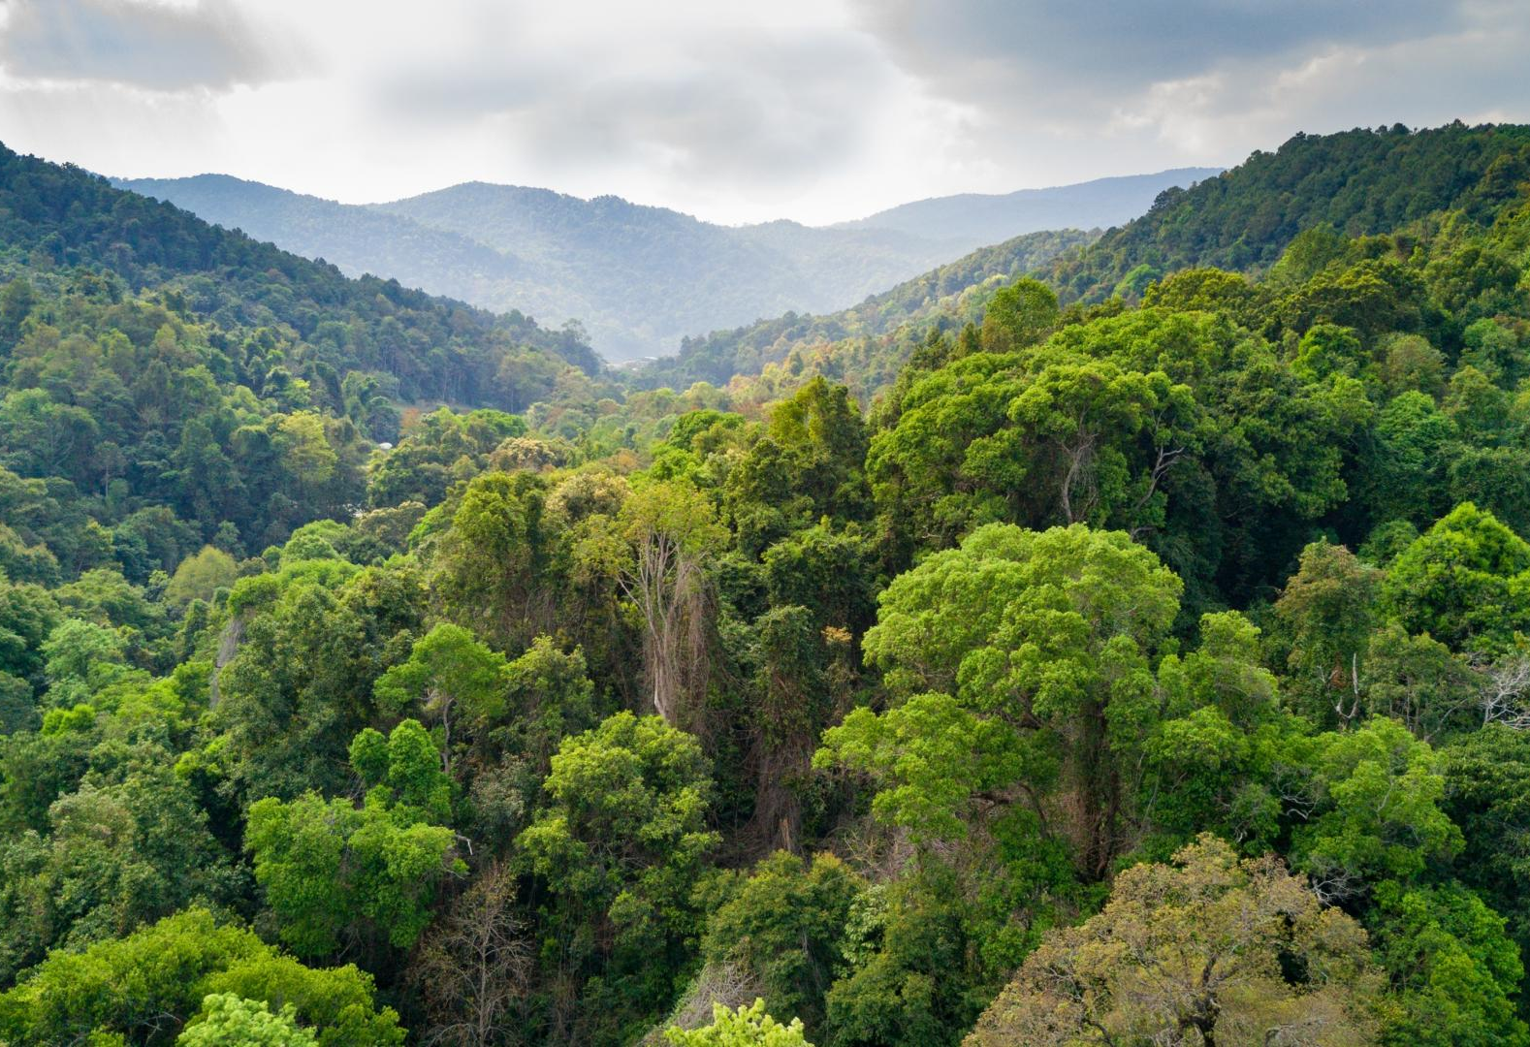
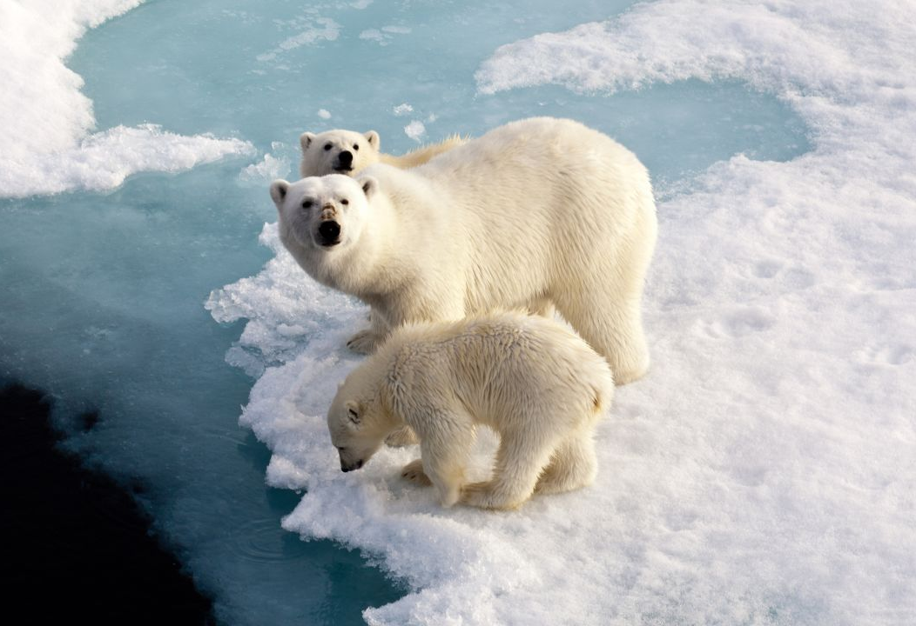
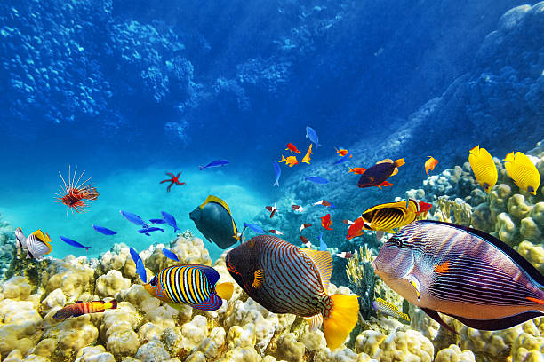
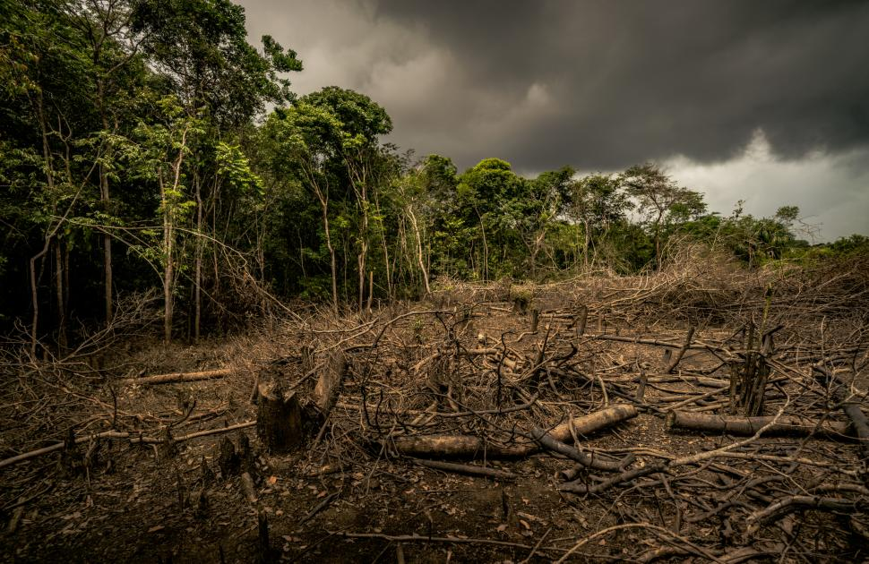
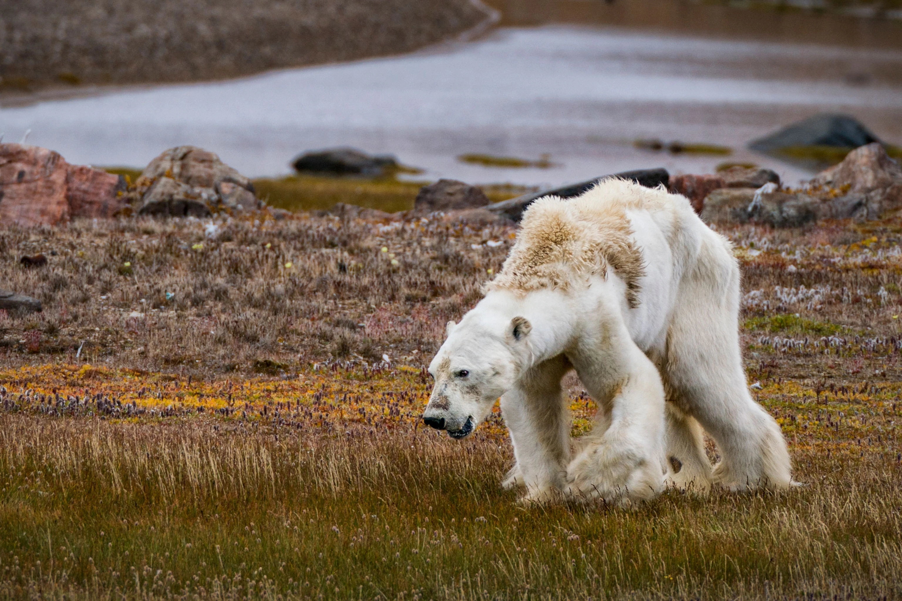
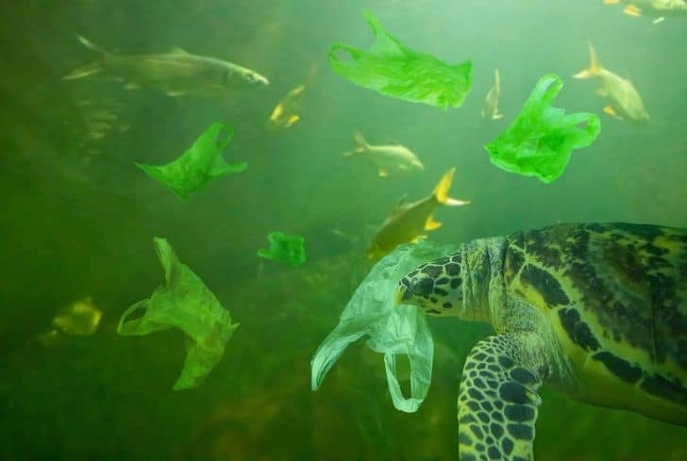
WARM-UP
Work in groups. Look at the pictures and describe the situations before and after.

Slide 5
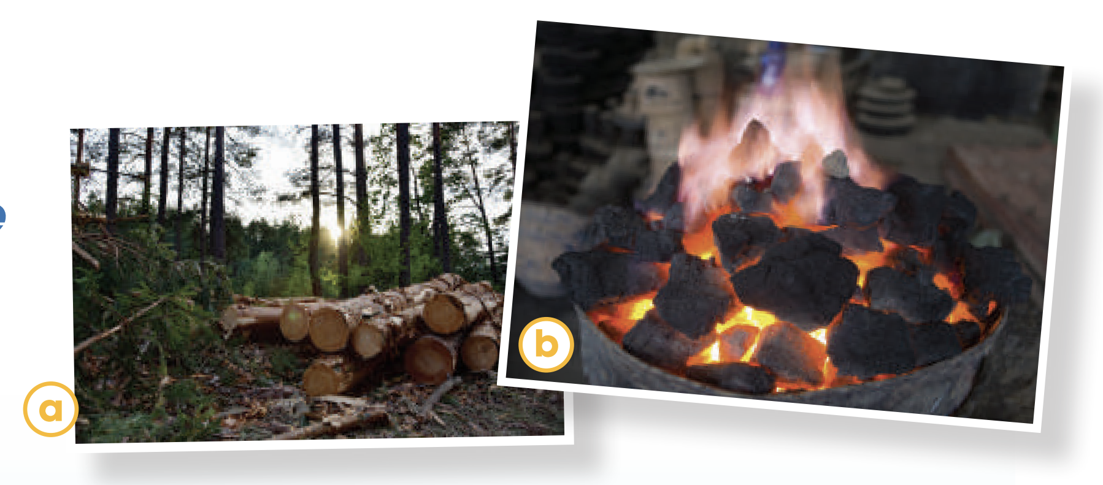
PRE-READING
1
Work in pairs. Look at the pictures and discuss the environmental problems you see.

Slide 6
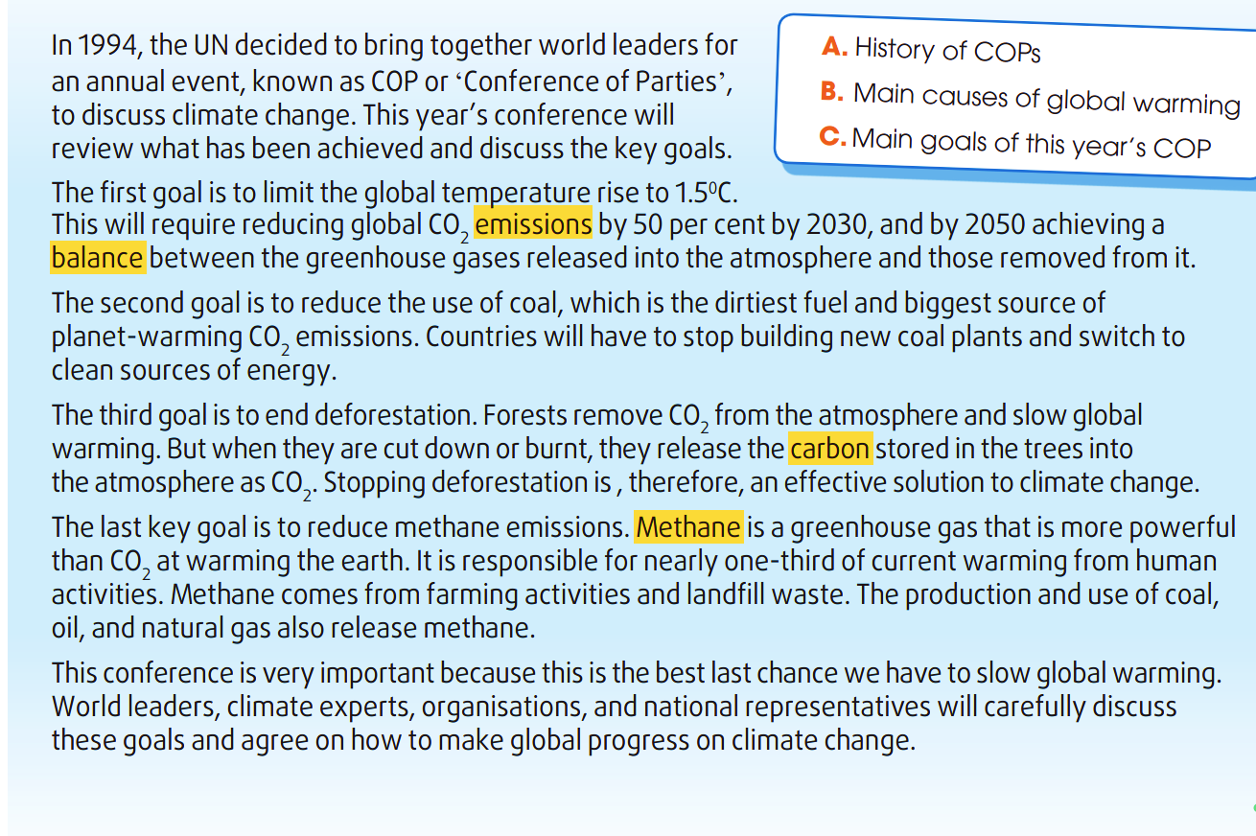
WHILE-READING
2
Read the article and choose the best title for it.
C

Slide 7
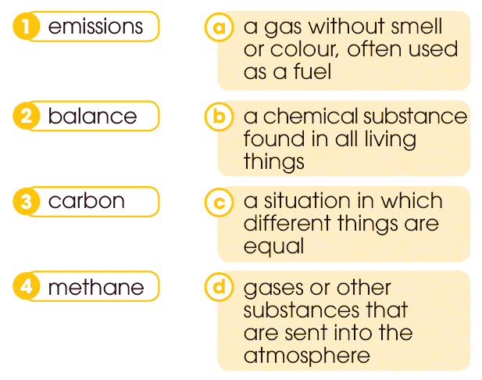
WHILE-READING
3
Match the highlighted words with their meanings.

Slide 8

WHILE-READING
4
Read the article again and choose the correct answers A, B, or C.
Which of the following is not a COP’s key goal?
A. Stop cutting down forests.
B. Replace coal with cleaner sources of energy.
C. End methane emissions.

Slide 9
WHILE-READING
4
Read the article again and choose the correct answers A, B, or C.
What will happen if there is a balance between the greenhouse gases released and those removed from the atmosphere?
A. Global warming will be limited to 1.5∘C.
B. Global CO2 emissions will increase.
C. Countries will switch to clean energy.

Slide 10
WHILE-READING
4
Read the article again and choose the correct answers A, B, or C.
Why is it important to reduce the use of coal?
A. Because it is easy to build coal plants.
B. Because coal is not as clean as gas.
C. Because it is responsible for a large part of the CO2 emissions.

Slide 11
WHILE-READING
4
Read the article again and choose the correct answers A, B, or C.
How does deforestation contribute to global warming?
A. Trees remove carbon dioxide from the atmosphere.
B. Trees release carbon into the atmosphere when they are cut down or burnt.
C. Forests trap heat and increase temperatures.

Slide 12
WHILE-READING
4
Read the article again and choose the correct answers A, B, or C.
Why is reducing methane emissions a key goal?
A. Because its emissions result from farming activities and landfill waste.
B. Because methane's warming power is stronger than that of CO2.
C. Because it is produced through human activities.

Slide 13
POST-READING
5
Work in groups. Discuss the following question.
“What should we do to reduce
global warming?”

Slide 14
WHAT HAVE YOU LEARNT TODAY?
- Vocabulary about global warming
- Read for main ideas and specific information in an article about the climate change conference
CONSOLIDATION
1
Wrap-up

Slide 15
CONSOLIDATION
2
Homework
Do exercises in the workbook.
Prepare for Lesson 4 - Unit 5.

Slide 16

Website: hoclieu.vn
Fanpage: facebook.com/tienganhglobalsuccess.vn/

