Slide 1
Gender Equality
Unit 6
Lesson 2: Language

Slide 2
Table of contents
01
02
03
Warm-up
Pronunciation
Vocabulary
04
05
Grammar
Consolidation

Slide 3
01
Warm-up
Game: Tag team

Slide 4
OBJECTIVES
Use lexical items related to the topic Gender Equality
Pronounce three-syllable adjectives and verbs with
correct stress
Use the passive voice with modals

Slide 5
WARM-UP
Tag team – Rules:
Play in two teams & stand in two lines.
In 2 minutes, write on the board as many three-syllable words related to a topic as possible!
After writing a word, give the chalk to the teammate behind you and go to the back of the line.
The team with most words wins!

Slide 6
2 minutes
ROUND 1:
THREE-SYLLABLE ADJECTIVES
End

Slide 7
2 minutes
ROUND 2:
THREE-SYLLABLE VERBS
End

Slide 8
02
Pronunciation

Slide 9
PRONUNCIATION
1
Listen and repeat. Pay attention to the stressed syllable in each word.
Three-syllable adjectives | Three-syllable verbs
ex'pensive | 'organise
fan'tastic | 'benefit
'medical | de'velop
'opposite | en'courage

Slide 10
PRONUNCIATION
2
Listen and mark the stressed syllables in the words in bold.
We'll celebrate her success with a party.
They hope to discover new ways to promote gender equality.
The job requires both physical and mental strength.
Equal opportunities in education bring important changes in society.
We'll ‘celebrate her success with a party.
They hope to dis’cover new ways to promote gender equality.
The job requires both ‘physical and mental strength.
Equal opportunities in education bring im’portant changes in society.

Slide 11
03
Vocabulary

Slide 12
VOCABULARY
1
Match the words with their meanings.
WORDS
1. equal (adj)
2. kindergarten (n)
3. treat (v)
4. surgeon (n)
5. gender (n)
MEANINGS
a. school for children aged three to five
b. to deal with or behave towards somebody in a certain way
c. a doctor who does operations in a hospital
d. the fact of being male or female
e. having the same rights, opportunities, etc. as other people

Slide 13
VOCABULARY
2
Complete the following sentences with the words in Task 1.
1. Nowadays male teachers can be seen working at _____________.
2. The __________ performed an eight-hour operation on my grandpa yesterday.
3. Some parents may _______ boys differently from girls.
4. Traditional __________ roles influenced how men and women should behave.
5. They should promote ________ income opportunities for men and women.
kindergarten
surgeon
treat
gender
equal

Slide 14
04
Grammar

Slide 15
GRAMMAR
Remember!
can | could | may | might | must | ought to | should
 | Active voice | Passive voice
Rule | Modal + verb | Modal + be + PII
Example: | Engineers may build a new bridge. | A new bridge may be built (by engineers).

Slide 17
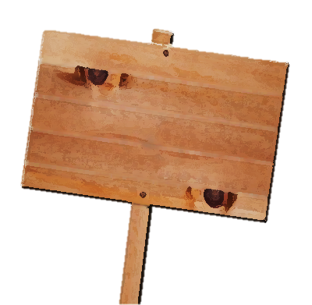
Choose the best answer
shouldn't be allowed
Some people still think married women shouldn't allow / shouldn't be allowed to work.
TIME’S UP

Slide 18
Choose the best answer
can work
Both men and women can work / can be worked as surgeons.
TIME’S UP

Slide 19
Choose the best answer
may be offered
Cooking classes may offer / may be offered to all students.
TIME’S UP

Slide 20
Choose the best answer
could join
My sister could join / could be joined the air force. She wants to be a fighter pilot.
TIME’S UP

Slide 21
Choose the best answer
must be prepared
All the food must prepare / must be prepared before the guests arrive.
TIME’S UP

Slide 22
PRACTICE
2
Rewrite the following sentences using the passive voice.
1. They may complete the report on gender equality by April.
The report _________________________________________________
2. Businesses can create more jobs for girls and women.
More jobs ____________________________________________________
3. They must provide all girls with access to education.
All girls ______________________________________________
4. Governments should improve education in rural areas.
Education _____________________________________________________
5. They ought to give men and women equal rights.
Men and women _______________________________________
on gender equality may be completed by April.
for girls and women can be created (by businesses).
must be provided with access to education.
in rural areas should be improved (by governments).
ought to be given equal rights.

Slide 23
05
Consolidation

Slide 24
CONSOLIDATION
1
Wrap-up
Lexical items related to the topic Gender Equality
Three-syllable adjectives and verbs with correct stress
The passive voice with modals

Slide 25
CONSOLIDATION
2
Homework
Do exercises in the workbook.
Prepare for the Project.

Slide 26
SEE YOU NEXT TIME !!

