Slide 1


Slide 2
Unit
8
BECOMING INDEPENDENT
Unit
FAMILY LIFE
LESSON 5
LISTENING
Becoming independent learners

Slide 3
LESSON 5
LISTENING
WARM-UP
Reorder
PRE-LISTENING
Task 1. Tick the column
Task 2. Choose the correct answer
Task 3. Answer the questions.
WHILE-LISTENING
POST-LISTENING
Develop a characteristic of independent learners.
Wrap-up
Homework
CONSOLIDATION

Slide 4
WARM-UP
REORDER
1. Reward yourself at important milestones.
2. Learn through practical experience.
3. Teach yourself using many sources.
4. Compare your work with an expert's.
3-2-4-1

Slide 5
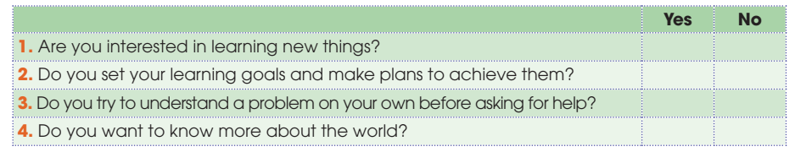
PRE-LISTENING
1
Tick the columns to complete the following table about you. Compare your answers in pairs.

Slide 6
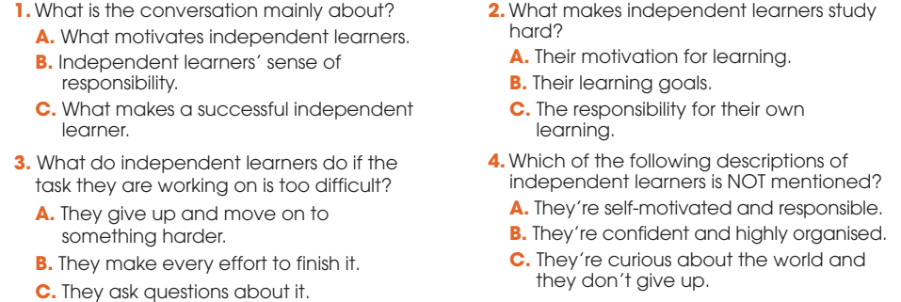
WHILE-LISTENING
2
Listen to a conversation between Mai and Mike, and choose the correct answers A, B, or C.

Slide 7
WHILE-LISTENING
3
Listen to the conversation again and answer each of the following questions using no more than THREE words or numbers.
Four / 4
Their own learning
(Detailed) study plans
Asking difficult questions

Slide 8
POST-LISTENING
5
Work in groups. Discuss the following questions.
Which of the characteristics of independent learners do you think you have?
Which one do you want to develop in the future?

Slide 9
CONSOLIDATION
1
Wrap-up
What have you learnt today?
Characteristics of independent learners
Listening for main ideas and specific information

Slide 10
CONSOLIDATION
2
Homework
Do exercises in the workbook.
Prepare for Lesson 6 - Unit 8.

Slide 11

Website: hoclieu.vn
Fanpage: facebook.com/sachmem.vn/

