Slide 1

Unit 4: Holidays!
Progress Check
Page 84

Slide 2
Lesson Outline
Warm-up
Vocabulary
Grammar
Consolidation
Wrap-up

Slide 3
Objectives
By the end of this lesson, students will be able to…
review vocabulary and grammar in Unit 4.

Slide 4

WARM-UP

Slide 5

Work in pairs.
Choose the word whose main stress is placed
differently from the others.
1. A. museum B. example C. holiday D. performance
2. A. lion B. party C. message D. idea
3. A. follow B. discuss C. repeat D. explain
/mjuˈziːəm/
/ɪɡˈzɑːmpl/
/ˈhɒlədeɪ/
/pəˈfɔːməns/
/ˈlaɪən/
/ˈpɑːti/
/ˈmesɪdʒ/
/aɪˈdɪə/
/ˈfɒləʊ/
/dɪˈskʌs/
/rɪˈpiːt/
/ɪkˈspleɪn/

Slide 6

Miming
Work in groups
Students work in groups. The teacher invites 1 student from each group to use gestures to perform the activities on holiday they have learnt in this unit (e.g. make a snowman, have a barbecue, go sightseeing, etc.) without making any sound. Other students close the books and guess the activities. One correct guess will give both the guessing group and the miming student’s group 1 point.
In the end, the group that gets more points is the winner.

Slide 7

It’s time to learn …

Slide 8
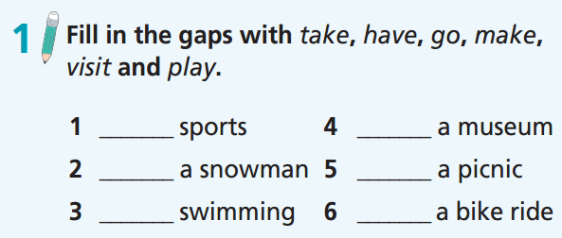
play
visit
make
have
go
take

Slide 9
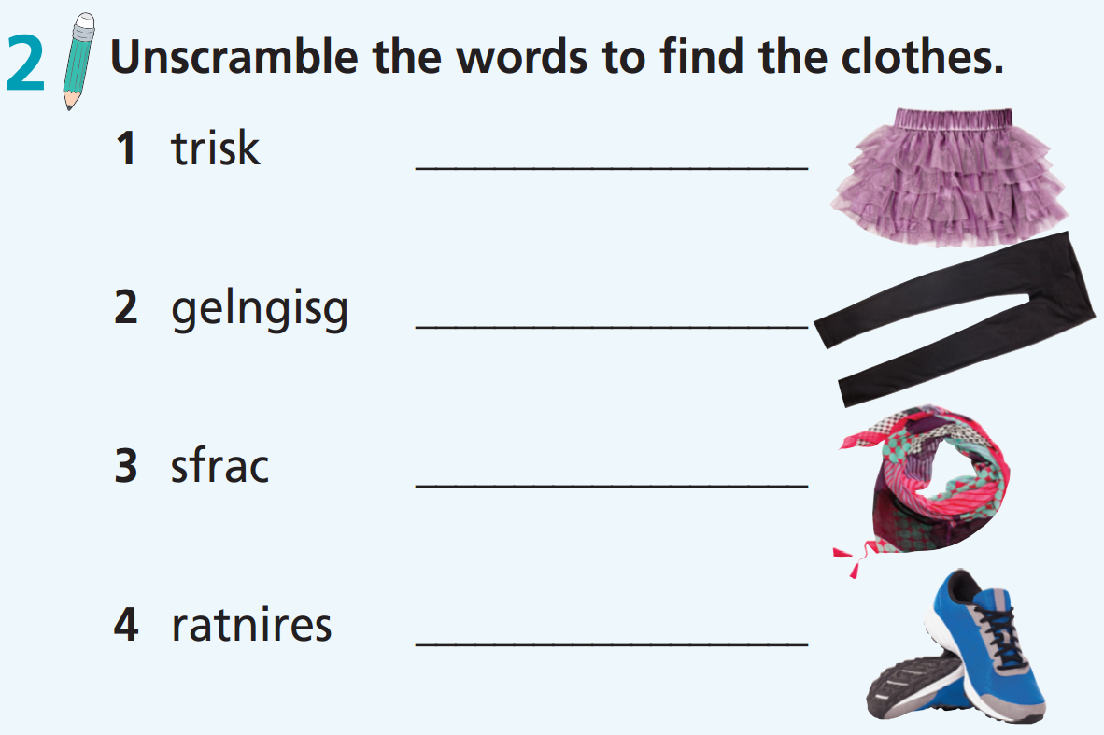
skirt
leggings
scarf
trainers

Slide 10
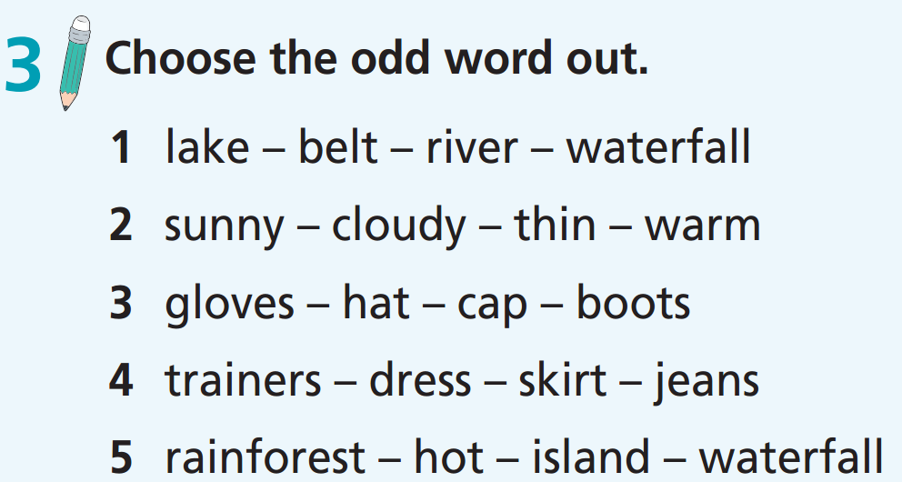

Slide 11
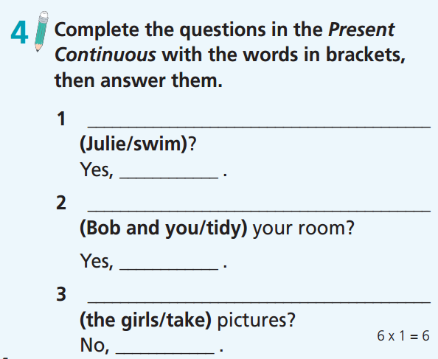
Is Julie swimming
she is
Are Bob and you tidying
we are
Are the girls taking
they aren’t

Slide 12
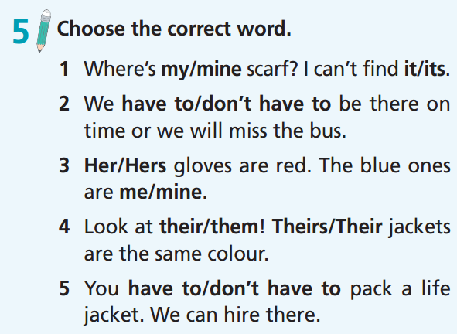

Slide 13
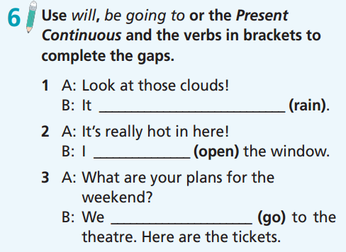
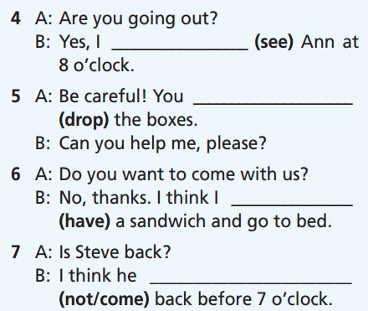
am seeing
are going to drop
is going to rain
will open
will have
are going
won’t come

Slide 14
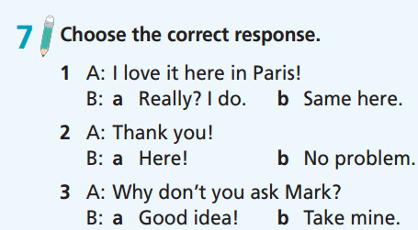

Slide 15
Work in pairs.
Imagine you are on a holiday. Take turns to say what you are doing now. Try to think about all the activities you can do on holiday.
I am playing with sand on the beach.
I am building a camp.

Slide 16

CONSOLIDATION

Slide 17
Write a paragraph of 50-60 words about what you prepare for your next holiday trip. Try to answer the following questions:
Where are you going on holiday? Why?
Who are you going on holiday with?
What activities can you do there?
What are the things you have to / don’t have to prepare for your holiday?

Slide 18
Write a paragraph of 50-60 words about what you prepare for your next holiday trip.
e.g.
I’m going to Da Lat for my holiday with my family. I can go sightseeing in many beautiful places in Da Lat. I can take a bike ride around Xuan Huong Lake. I have to prepare warm clothes like jeans, jackets, scarves, etc., and my toothbrush. I don’t have to prepare food and drinks because my parents are going to do it.

Slide 19

WRAP-UP

Slide 20
Today’s lesson
Review vocabulary and grammar in Unit 4.

Slide 21
Homework
Practise the vocabulary and make sentences using them.
Do Unit 4 Test 2 in Bài Tập Bổ Trợ TA 6 Right on (pp. 38-39).
Prepare for the next lesson (p. 85 SB).

Slide 22
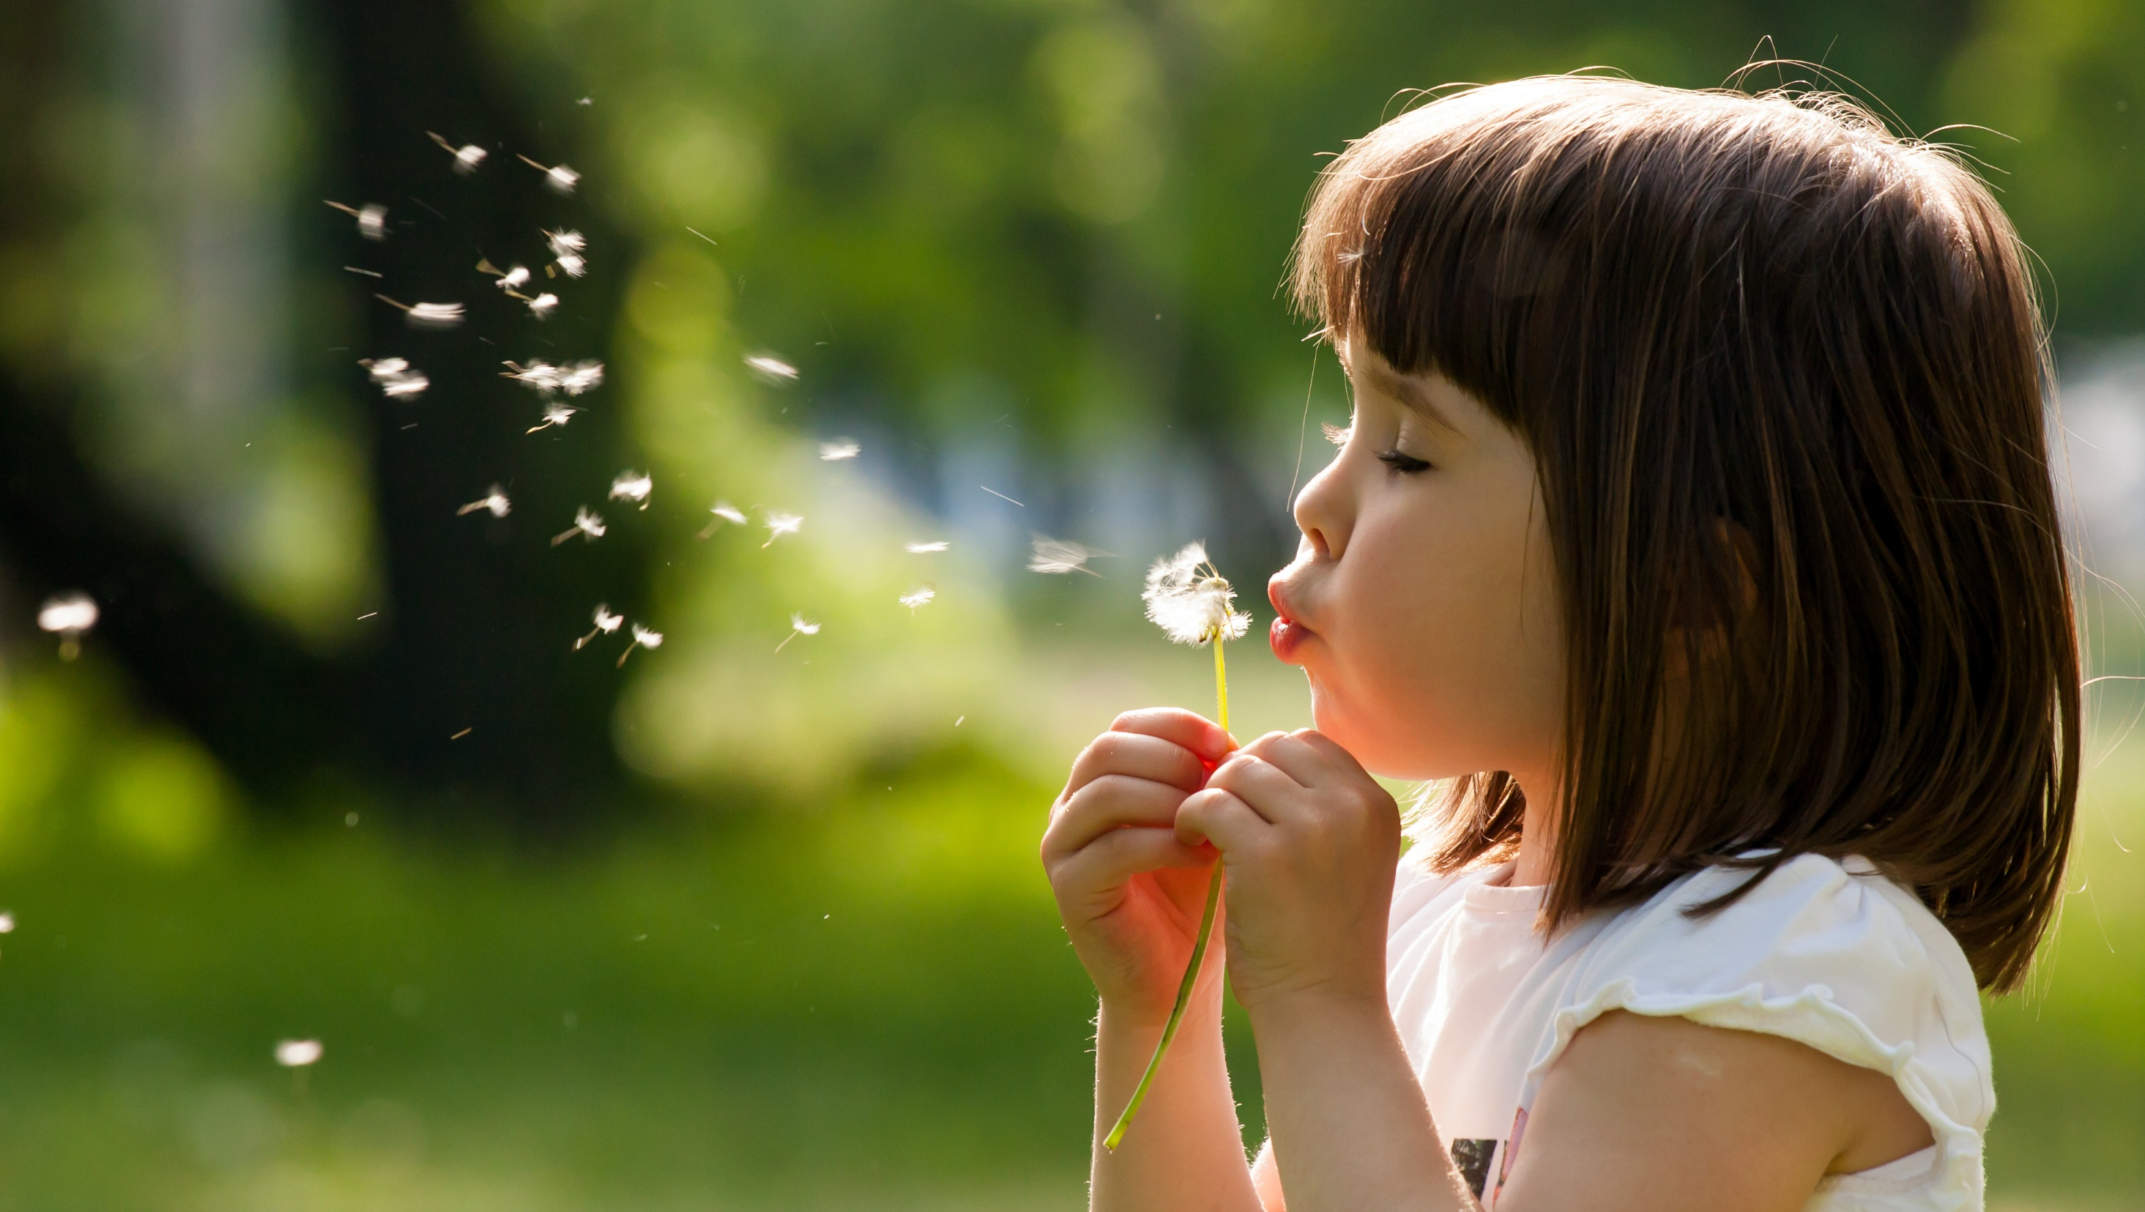
Enjoy your day!

