Slide 1


Slide 2

Unit
5
1
Unit
FAMILY LIFE
INVENTIONS
LESSON 2
LANGUAGE

Slide 3

Unit
1
1
FAMILY LIFE
Family Life
Unit
OBJECTIVES
Use the lexical items related to the topic Inventions;
Pronounce correctly stress in three-syllable nouns;
Understand the present perfect, gerunds and to-infinitives.

Slide 4
LESSON 2
LANGUAGE
Unit
Guessing the years of inventions.
WARM-UP
Pronunciation
Activity 1: Listen and repeat. Pay attention to the stressed syllable in each word.
Activity 2: Connect all the words with the stress pattern -.- to cross the river. Then listen and check your answers. Practise saying these words in pairs.
PRESENTATION
Vocabulary: Community development
Unscramble the underlined letters in these words. Use the pictures below and the glossary (page 127) to help you.
PRACTICE
Grammar:
Present perfect: Circle the correct answers.
Gerunds and to-infinitives: Complete the sentences using the gerund or the to-infinitive of the verbs in brackets. Sometimes both forms are possible.
PRODUCTION
CONSOLIDATION
Wrap-up
Homework

Slide 5

LESSON 2
LANGUAGE
Unit
GETTING STARTED
WARM-UP
Guessing the years of inventions.
+ The Internet (1969)
+ Light bulb (1906)
+ Telephone (1876)
+ Refrigerator (1850)
+ Paper (100)

Slide 6
LESSON 2
LANGUAGE
Unit
GETTING STARTED
WARM-UP
Guessing the years of inventions.
PRESENTATION
Pronunciation
Activity 1: Listen and repeat. Pay attention to the stressed syllable in each word.
Activity 2: Connect all the words with the stress pattern -.- to cross the river. Then listen and check your answers. Practise saying these words in pairs.

Slide 7
PRESENTATION
Tips:
Most three syllable nouns are stressed on the first syllable.
Examples: ’Century
’Holiday
’Energy
Nouns ending in “-tion”, “-sion” or “-al” among other suffixes, generally have the stress on the syllable before these terminations.
Examples: Con’sumption
De’nial
in’vention

Slide 8
LESSON 2
LANGUAGE
Unit
GETTING STARTED
Guessing the years of inventions.
WARM-UP
PRESENTATION
Pronunciation
Activity 1: Listen and repeat. Pay attention to the stressed syllable in each word.
Activity 2: Connect all the words with the stress pattern -.- to cross the river. Then listen and check your answers. Practise saying these words in pairs.
PRACTICE

Slide 9

PRACTICE
1
Listen and repeat. Pay attention to the stressed syllable in each word.
Invention computer holiday century

Slide 10
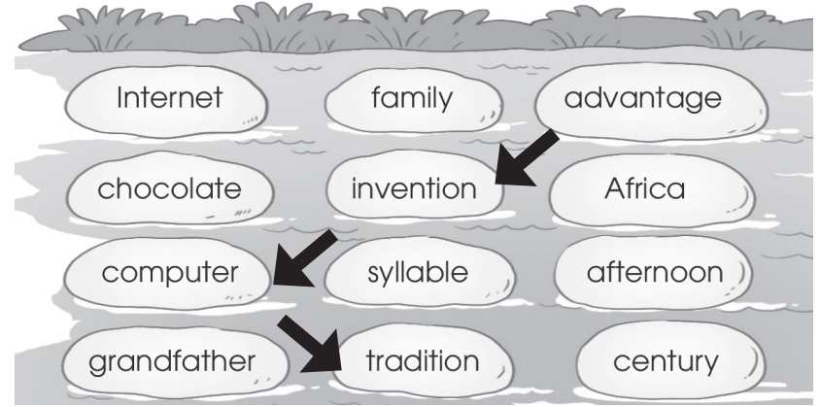
PRACTICE
2
Connect all the words with the stress pattern -.- to cross the river (p.53). Then listen and check your answers. Practise saying these words in pairs.

Slide 11
LESSON 2
LANGUAGE
Unit
Guessing the years of inventions.
WARM-UP
Pronunciation
Activity 1: Listen and repeat. Pay attention to the stressed syllable in each word.
Activity 2: Connect all the words with the stress pattern -.- to cross the river. Then listen and check your answers. Practise saying these words in pairs.
PRESENTATION
Vocabulary: Community development
Unscramble the underlined letters in these words. Use the pictures below and the glossary (page 127) to help you.

Slide 12
PRESENTATION
Match the words with their meanings.
1. Device (n)
a. the machines and electronic parts in a computer or other electronic system
2. Laboratory (n)
b. a scientific test that is done in order to study what happens and to gain new knowledge
3. Experiment (n)
c. ​the programs used by a computer for doing particular jobs
4. Equipment (n)
d a room or building used for scientific research, experiments, testing, etc.
5. Software (n)
e. the things that are needed for a particular purpose or activity
6. Hardware (n)
f. a piece of computer equipment, especially a small one such as a smartphone

Slide 13
LESSON 2
LANGUAGE
Unit
Guessing the years of inventions.
WARM-UP
Pronunciation
Activity 1: Listen and repeat. Pay attention to the stressed syllable in each word.
Activity 2: Connect all the words with the stress pattern -.- to cross the river. Then listen and check your answers. Practise saying these words in pairs.
PRESENTATION
PRACTICE
Vocabulary: Community development
Unscramble the underlined letters in these words. Use the pictures below and the glossary (page 127) to help you.

Slide 14
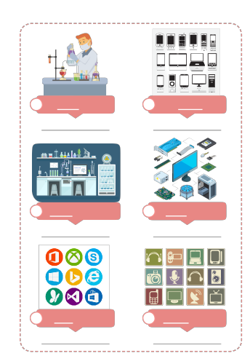
PRACTICE
Unscramble the underlined letters in these words. Use the pictures below and the glossary (page 127) to help you (p.54).
Experiment
2. Devices
3. Laboratory
4. hardware
5. Software
6. equipment
1. EXIREPMENT
1. EXIREPMENT
2. DECEVIS
3. LOBARATORY
4. HDRAWARE
5. STOFWARE
6. EPIQUMENT

Slide 15
LESSON 2
LANGUAGE
Unit
Guessing the years of inventions.
WARM-UP
Pronunciation
Activity 1: Listen and repeat. Pay attention to the stressed syllable in each word.
Activity 2: Connect all the words with the stress pattern -.- to cross the river. Then listen and check your answers. Practise saying these words in pairs.
PRESENTATION
Vocabulary: Community development
Unscramble the underlined letters in these words. Use the pictures below and the glossary (page 127) to help you.
Grammar:
Present perfect: Circle the correct answers.
Gerunds and to-infinitives: Complete the sentences using the gerund or the to-infinitive of the verbs in brackets. Sometimes both forms are possible.

Slide 16
PRESENTATION
Tips: The present perfect
Form
S + have/ has + VPII + …
S + haven’t/ hasn’t + VPII + … .
Have/ has + S + VPII+ … ?
Use:
We use the present perfect to talk about:
- Something that happened in the past, but is still true or important now.
Example: I have lost my key. Now I can’t open the door.
- Something the started in the past, and is still happening now (often use with since or for).
Example: They have lived here for a year.
- Something that was completed in the very recent past (often used with just or recently).
Example: He has just finished his homework.

Slide 17
PRESENTATION
Tips: Gerunds and to-infinitives
Gerunds (V + -ing):
We use gerunds:
- after verbs such as avoid, enjoy, finish …
Example: I enjoy cooking.
- as subjects of sentences.
Example: Learning English is fun.
To-infinitives (to + Verbs):
We use to-infinitives:
- after verbs such as want, decide, allow …
Example: My parents don’t allow me to use a smartphone.
- after adjectives to give opinions, starting with it’s …
Example: It’s fun to learn English.
- as subjects of sentences.
Example: To learn English is fun.
Note: Some verbs such as like, love, and hate can be followed by either gerunds or to-infinitives.
Example: I like playing/ to play computer games.

Slide 18
LESSON 2
LANGUAGE
Unit
Guessing the years of inventions.
WARM-UP
Pronunciation
Activity 1: Listen and repeat. Pay attention to the stressed syllable in each word.
Activity 2: Connect all the words with the stress pattern -.- to cross the river. Then listen and check your answers. Practise saying these words in pairs.
PRESENTATION
PRACTICE
Vocabulary: Community development
Unscramble the underlined letters in these words. Use the pictures below and the glossary (page 127) to help you.
Grammar:
Present perfect: Circle the correct answers.
Gerunds and to-infinitives: Complete the sentences using the gerund or the to-infinitive of the verbs in brackets. Sometimes both forms are possible.

Slide 19
PRACTICE
PRACTICE
1
Circle the correct answers (page 54).
They just found/ have just found a suitable solution to the problem.
Since people invented/ have invented the first computer, they create/ have created many more interesting inventions.
The woman is very angry because her son lost/ has lost his smartphone.

Slide 20
PRACTICE
PRACTICE
2
Complete the sentences using the gerund or the to-infinitive of the verbs in brackets. Sometimes both forms are possible.
using
Many children enjoy (use) _________________ modern devices nowadays.
I decided (study) _________________ computer science at university.
(Play) _________________ language games on a smartphones is fun.
It is very convenient (study) _________________ with a smartphone.
to study
Playing/ to play
to study

Slide 21
LESSON 2
LANGUAGE
Unit
Guessing the years of inventions.
WARM-UP
Pronunciation
Activity 1: Listen and repeat. Pay attention to the stressed syllable in each word.
Activity 2: Connect all the words with the stress pattern -.- to cross the river. Then listen and check your answers. Practise saying these words in pairs.
PRESENTATION
Vocabulary: Community development
Unscramble the underlined letters in these words. Use the pictures below and the glossary (page 127) to help you.
PRACTICE
Grammar:
Present perfect: Circle the correct answers.
Gerunds and to-infinitives: Complete the sentences using the gerund or the to-infinitive of the verbs in brackets. Sometimes both forms are possible.
PRODUCTION

Slide 22
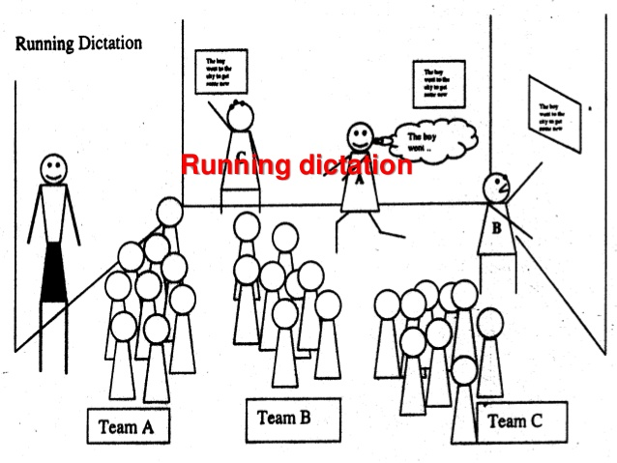
Game: Running dictation
Work in groups.
Find the sentence strips on the walls.
Memorize as much as they can.
Run back to their teams and dictate what you remember to the secretary.
repeat running and dictating until the whole group has correctly dictated the sentences.

Slide 23
LESSON 2
LANGUAGE
Unit
Guessing the years of inventions.
WARM-UP
Pronunciation
Activity 1: Listen and repeat. Pay attention to the stressed syllable in each word.
Activity 2: Connect all the words with the stress pattern -.- to cross the river. Then listen and check your answers. Practise saying these words in pairs.
PRESENTATION
Vocabulary: Community development
Unscramble the underlined letters in these words. Use the pictures below and the glossary (page 127) to help you.
PRACTICE
Grammar:
Present perfect: Circle the correct answers.
Gerunds and to-infinitives: Complete the sentences using the gerund or the to-infinitive of the verbs in brackets. Sometimes both forms are possible.
PRODUCTION
CONSOLIDATION
Wrap-up
Homework

Slide 24
CONSOLIDATION
1
Wrap-up
Use the lexical items related to the topic Inventions;
Pronounce correctly stress in three-syllable nouns;
Understand the the present perfect, gerunds and to-infinitives.

Slide 25
CONSOLIDATION
2
Homework
1. Prepare for the next lesson: Unit 5_Reading
2. Do exercises in the workbook

Slide 26


