Slide 1


Slide 2
Unit
8
BECOMING INDEPENDENT
Unit
FAMILY LIFE
LESSON 4
SPEAKING
Learning basic life skills

Slide 3
LESSON 4
SPEAKING
WARM-UP
Watch a video
CONTROLLED PRACTICE
Task 1. Discuss these questions.
Task 2: Choose the correct answers.
LESS CONTROLLED PRACTICE
Task 3: Practice giving instructions
Task 4: Add more steps and give instructions.
FUTHER PRACTICE
CONSOLIDATION
Wrap-up
Homework

Slide 4
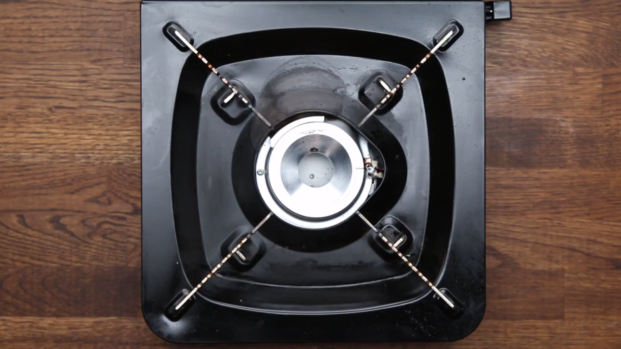
WARM-UP
WATCH A VIDEO
Notes:
https://www.youtube.com/watch?v=FTha4zARGN4

Slide 5
CONTROLLED PRACTICE
1
Work in pairs. Discuss these questions.
1. _____
2. _____
3. _____
4. _____
5. _____
B
D
E
C
A
A. Hang or fold, and store your own clothes
B. Sort the clothes by colour
C. Remove the wet clothes from the washing machine and dry them
D. Add the washing powder or liquid
E. Load the washing machine and turn it on

Slide 6
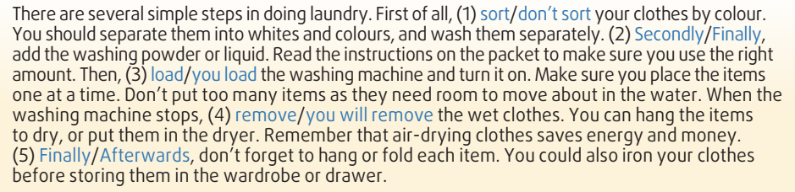
WHILE-SPEAKING
2
Read the following instructions on how to do laundry. Underline the correct answers.
1. sort 2. Secondly
3. load 4. remove 5. Finally

Slide 7
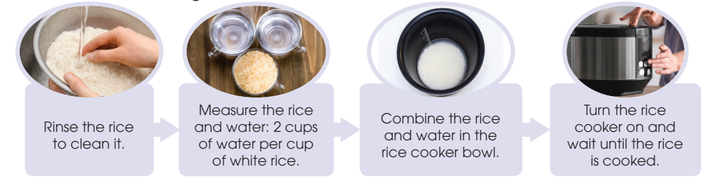
WHILE-SPEAKING
3
Work in pairs. Read the steps in cooking rice in a rice cooker. Use the model in 2 and the tips above to give instructions.

Slide 8
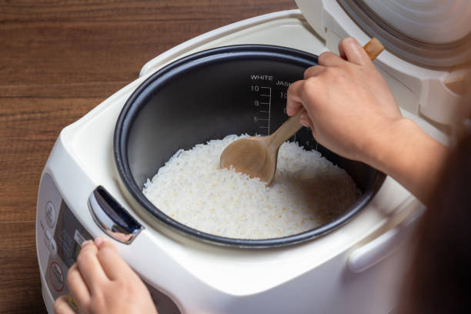
WHILE-SPEAKING
4
Work in groups. Add more steps or tips, and report to the whole class. Vote for the best recipe for cooking rice in a rice cooker.

Slide 9
CONSOLIDATION
1
Wrap-up
What have you learnt today?
How to give instructions on a basic life skill.

Slide 10
CONSOLIDATION
2
Homework
Do exercises in the workbook.
Prepare for Lesson 5 - Unit 8.

Slide 11

Website: hoclieu.vn
Fanpage: facebook.com/www.tienganhglobalsuccess.vn

