Slide 1

Unit 4: Holidays!
Lesson 4b: Grammar
Page 74

Slide 2
Lesson Outline
Warm-up
Grammar
Consolidation
Wrap-up

Slide 3
Objectives
By the end of this lesson, students will be able to…
use the Present Continuous for actions happening now.

Slide 4

WARM-UP

Slide 5
Miming
The teacher invites some students to the front of the class. The teacher gives a small piece of paper with an action (e.g. sleep, eat, run, cry, talk, walk, laugh, sing, etc.) to each student. The teacher asks those students to mime the actions.
The teacher asks the whole class: What’s he/she doing?
Students who can guess will volunteer and say: He/She is ……ing.
e.g. He/She is dancing.
Who can have more correct guesses will be the winner.

Slide 6

It’s time to learn …

Slide 7

The Present Continuous tense
Presentation

Slide 8
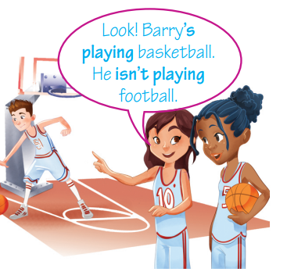
Look at the sentences and complete the rule for
The Present Continuous tense:
 | Affirmative | Negative
I | ……. sleeping | …………… sleeping
You | ……. sleeping | …………… sleeping
He / She / It | ……. sleeping | …………… sleeping
We / You / They | ……. sleeping | …………… sleeping
- I am doing homework.
- They are not watching TV. They are playing with toys.
- Be careful! You are walking on the wet floor.
am
am not
are
are not
is
is not
are
are not

Slide 9
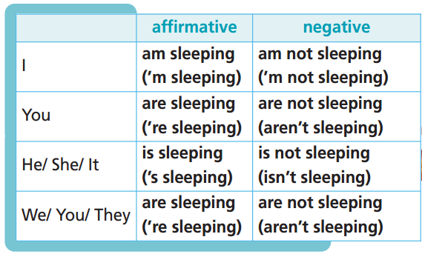
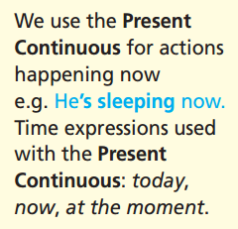
Remember:

Slide 10

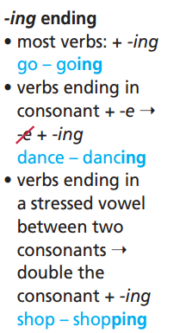
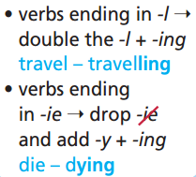

Slide 11

Practice

Slide 12
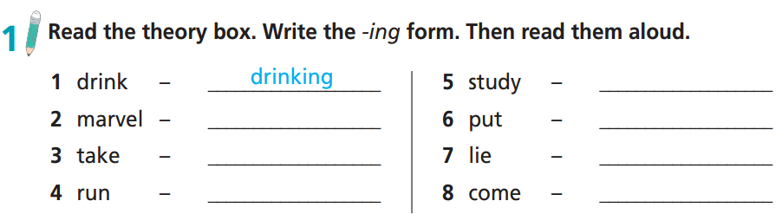
studying
marvelling
putting
taking
lying
running
coming

Slide 13
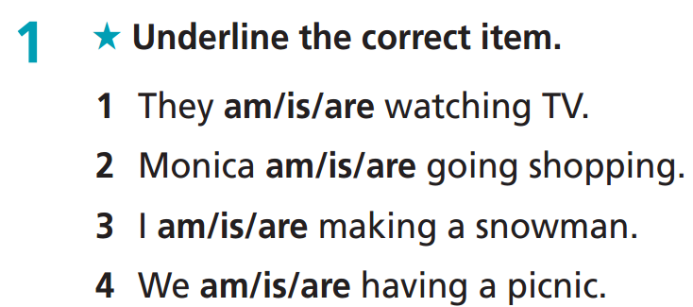
Extra Practice
WB page 39

Slide 14
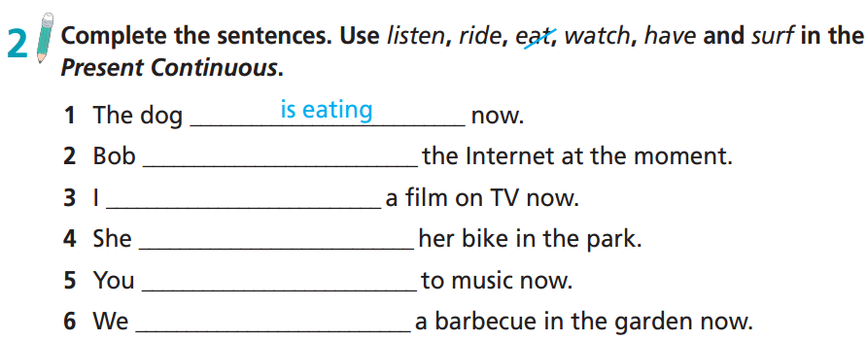
is surfing
am watching
is riding
are listening
are having

Slide 15
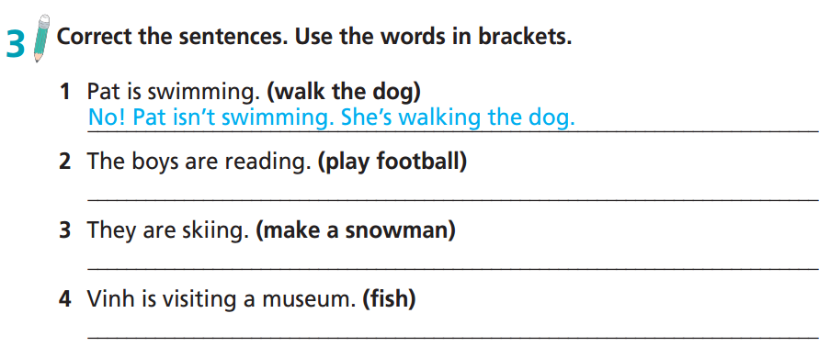
No! The boys aren't reading. They’re playing football.
No! They aren't skiing. They’re making a snowman.
No! Vinh isn't visiting a museum. He’s fishing.

Slide 16

Production

Slide 17

Work in pairs.
Tell your friend about what your family members are doing now.
My mom is working in the office.
My grandfather is taking care of the trees in the garden.
My little brother is sleeping.

Slide 18
Where am I?
The teacher asks each student to think about a place (e.g. at home, at the cinema, at a supermarket, etc.) and the activities they often do there (e.g. sleep, watch TV, sit, watch films, etc.). Each student makes at least 3 sentences using the Present Continuous tense to describe those activities (e.g. I am sleeping. I am watching TV. I am washing the dishes, etc. for “at home”). The teacher invites some students to read aloud their sentences one by one. Other students guess the place that the student is describing. Who can have more correct guesses will be the winner.

Slide 19

CONSOLIDATION

Slide 20
Write at least 4 sentences to describe what your family members or your friends are doing now.
E.g.
Now I am learning English at school.
My father is working in the factory.
My mother is selling vegetables in the market.
My grandparents are watching TV.

Slide 21

WRAP-UP

Slide 22
Today’s lesson
Grammar
use the Present Continuous for actions happening now

Slide 23
Homework
Practise vocabulary and grammar and make sentences using them.
Do the exercises in TA 6 Right on WB (p. 39).
Complete the grammar notes in TA 6 Right on Notebook (p. 40).
Prepare for the next lesson (p. 75 SB).

Slide 24
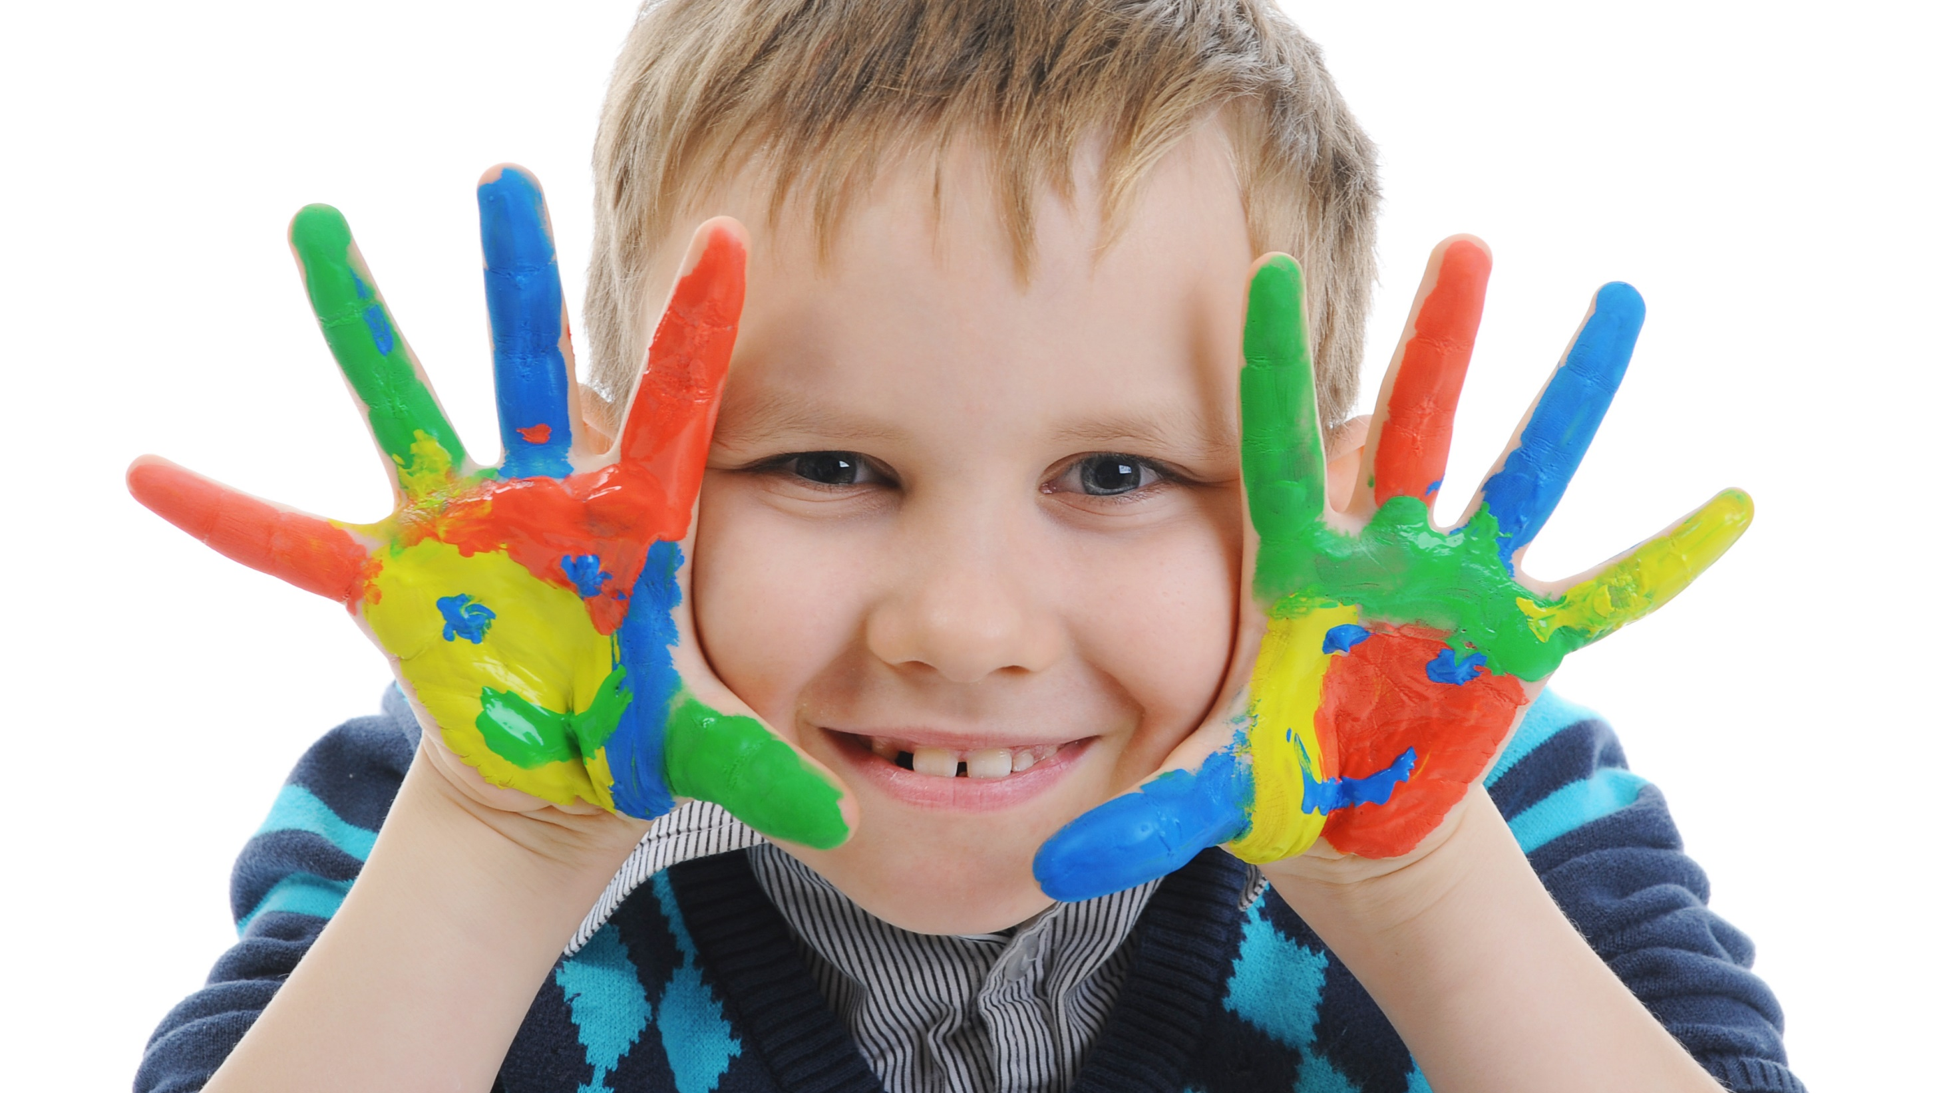
Enjoy your day!

