Slide 1

Unit 2: Fit for Life
Lesson: Overview
Pages 28 & 29

Slide 2
Lesson Outline
Warm-up
Vocabulary
Listening
Consolidation
Wrap-up

Slide 3
Objectives
By the end of this lesson, students will be able to…
- learn and use vocabulary for appearance.
- improve listening skills and pronunciation.
- recall the expressions for making suggestions.
- act out a dialogue to make suggestions.

Slide 4

WARM-UP

Slide 5

What is it?
It is now a popular form of exercise around the world.
It is an ancient practice.
It involves concentration and deep breathing.
Practising it regularly can improve strength, calmness, and well-being.
Yoga
Answer

Slide 6

It’s time to learn …

Slide 7

Presentation

Slide 8

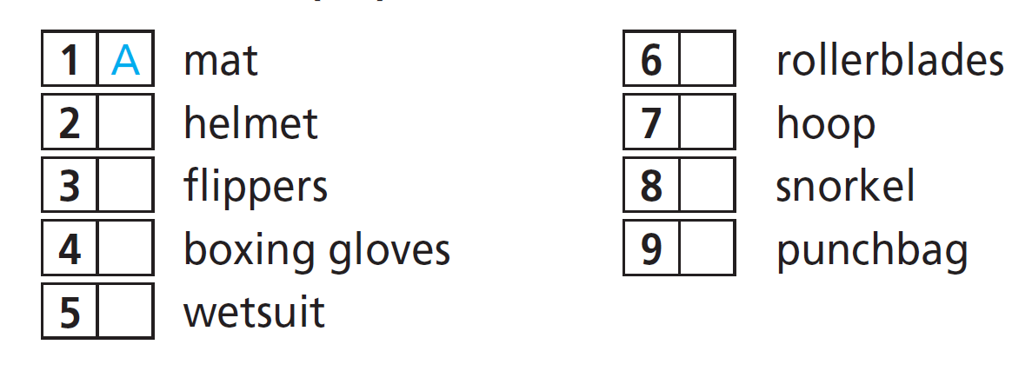
Vocabulary
Sports/Activities & Equipment
1. Match the words (1-9) to the letters (A-I). Listen and check.
F
E
G
D
B
I
H
C

Slide 9
Vocabulary
Listen and repeat.
- mat /mæt/ (n): cái thảm (chiếu)
- helmet /ˈhelmət/ (n): nón bảo hộ, mũ bảo hiểm
- flippers /ˈflɪpərz/ (pl.n): chân chèo
- boxing gloves /ˈbɒksɪŋ ɡlʌvz/ (n): găng tay đấm bốc
- wetsuit /ˈwetsuːt/ (n): bộ đồ lặn
- rollerblades /ˈrəʊləbleɪdz/ (n): đôi giày trượt patin
- hoop /huːp/ (n): cái vòng
- snorkel /ˈsnɔːkəl/ (n): ống thở
- punch bag /pʌntʃ bæɡ/ (n): bao đấm bốc

Slide 10
Vocabulary
Listen and repeat.
- mat /mæt/ (n): cái thảm (chiếu)
•
- helmet /ˈhelmət/ (n): nón bảo hộ, mũ bảo hiểm
•
- flippers /ˈflɪpərz/ (pl.n): chân chèo
•
- boxing gloves /ˈbɒksɪŋ ɡlʌvz/ (n): găng tay đấm bốc
•
- wetsuit /ˈwetsuːt/ (n): bộ đồ lặn
•
- rollerblades /ˈrəʊləbleɪdz/ (n): đôi giày trượt patin
- hoop /huːp/ (n): cái vòng
•
- snorkel /ˈsnɔːkəl/ (n): ống thở
- punch bag /pʌntʃ bæɡ/ (n): bao đấm bốc

Slide 11
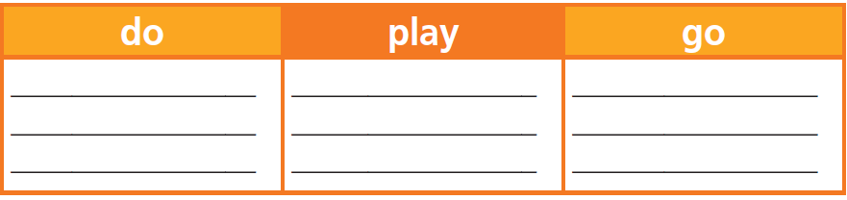
2. Write the sports/activities (1-5) under the correct heading.
1. yoga
2. snorkelling
3. rollerblading
4. basketball
5. kickboxing

Slide 12

Listening

Slide 13

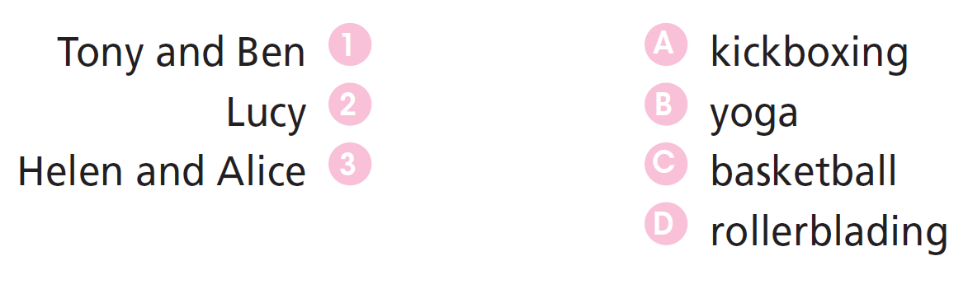
3. Listen and match the people (1-3) to the sports/activities (A-D) they are doing now. There is one extra word.

Slide 14

Practice

Slide 15
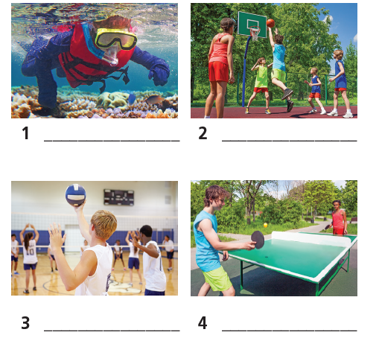
Extra Practice
WB, page 16
2. Label the pictures.
snorkelling
basketball
volleyball
table tennis

Slide 16
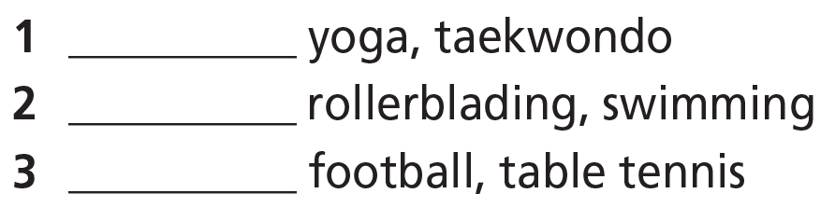
Extra Practice
WB, page 16
3 Fill in each gap with do, play or go.
do
go
play

Slide 17
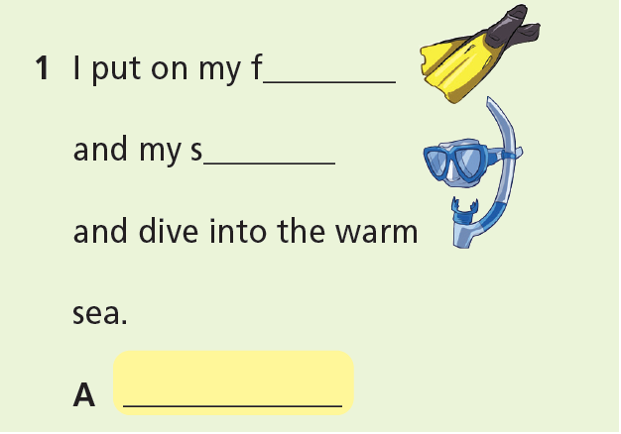
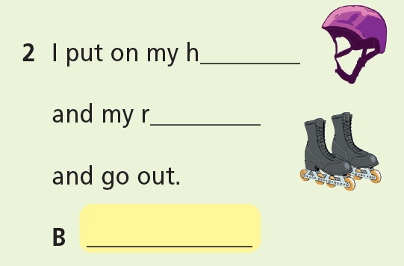
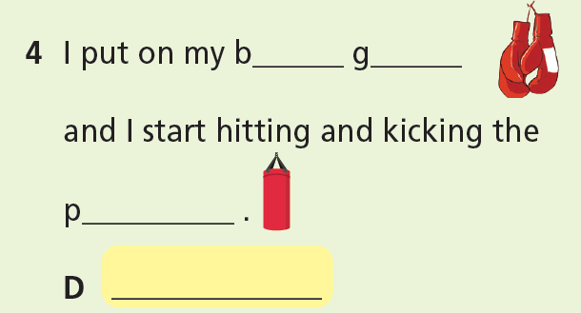
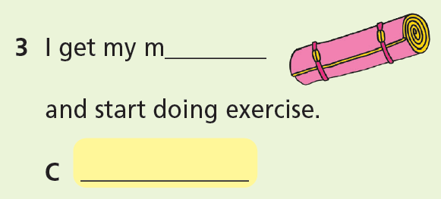
4 ★★★ Write the equipment. What sport are the people talking about?
Extra Practice
WB, page 16
flippers
helmet
snorkel
rollerblades
rollerblading
snorkelling
boxing gloves
mat
punchbag
yoga
kickboxing

Slide 18

Production

Slide 19

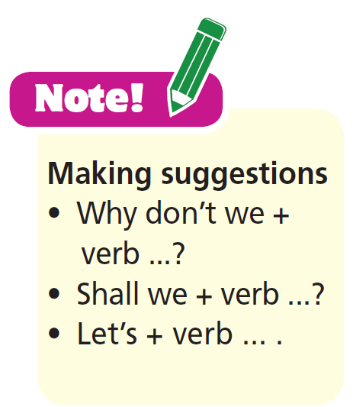
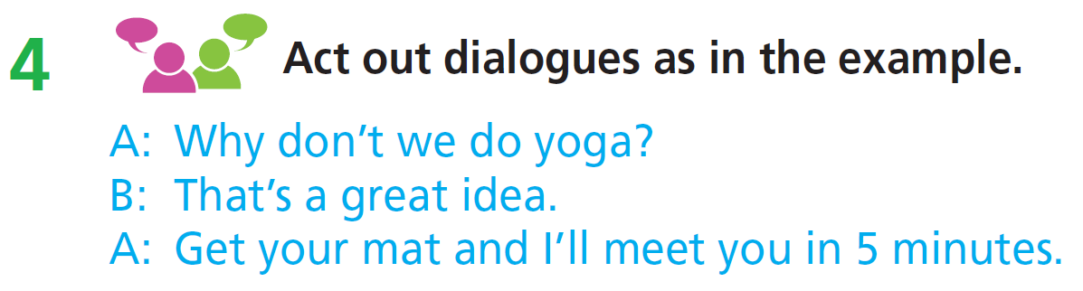
Speaking: Making suggestions

Slide 20

CONSOLIDATION

Slide 21
Work in pairs. Talk about the sport you like best.

Slide 22

WRAP-UP

Slide 23
Today’s lesson
Vocabularies
Sports and Equipment
Structures/ Sentence patterns
Making suggestions

Slide 24
Homework
- Do exercises in workbook on page 16.
- Practise the vocabulary in TA 7 Right On Notebook (pp. 10 & 11).
- Prepare the next lesson (page 30 SB).

Slide 25

Lesson 3
Stay positive and have a nice day!

