Slide 1


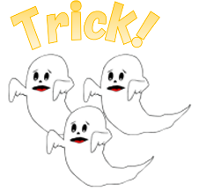
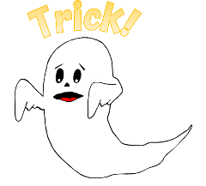

1
2
3
4
5
6
7
8
9
10
11
12
13
14
15
16
17
18
19
20
tekhnologic
Notes:
1 Ghost – 6, 9. 15, 16
3 Ghosts – 2, 13

Slide 2

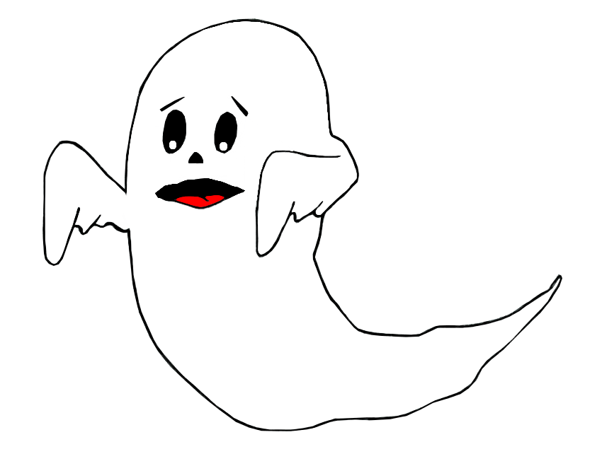

Trick!
Lose half your points!

Slide 3
Trick!
Lose all your points!

Slide 4

Challenge
Question

Slide 5
Challenge
Question

Slide 6
Challenge
Question

Slide 7
Challenge
Question

Slide 8
Challenge
Question

Slide 9
Challenge
Question

Slide 10
Challenge
Question

Slide 11
Challenge
Question

Slide 12
Challenge
Question

Slide 13
Challenge
Question

Slide 14
Challenge
Question

Slide 15
Challenge
Question

Slide 16
Challenge
Question

Slide 17
Challenge
Question

Slide 18

SƯU TẦM: ĐOÀN VĂN DOANH, NAM TRỰC, NAM ĐỊNH
LINK NHÓM DÀNH CHO GV BỘ MÔN VẬT LÝ TRAO ĐỔI TÀI LIỆU VÀ CHUYÊN MÔN CT 2018
https://www.facebook.com/groups/299257004355186

