Slide 1



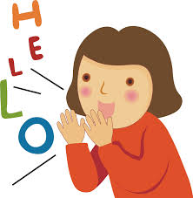
Welcome to English Class 8
Unit 6: FOLK TALES
Let’s learn English !
Nguyen Ba Loan Secondary School
Teacher: Vũ Đình Hùng

Slide 2
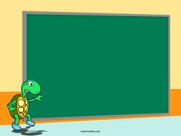
Unit 6:
FOLK TALES
LOOKING BACK +

Slide 3
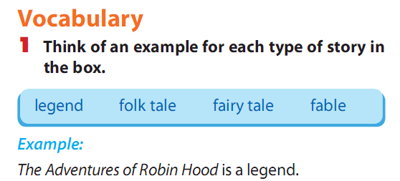
Unit 6: FOLK TALES - Looking back
- The Startfruit Tree and The Tortoise and the Hare are Fable
- Thanh Giong is Legend
- Chung Cakes ,Day Cakes is Fokl tale

Slide 4
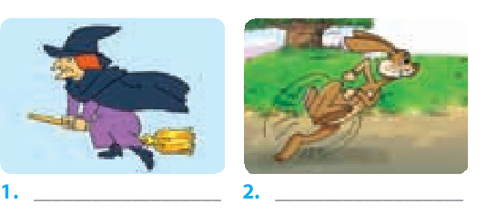
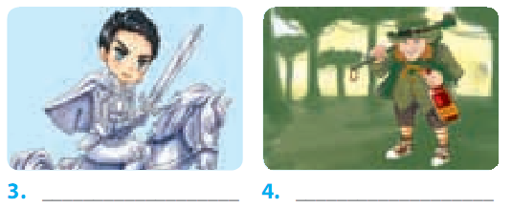
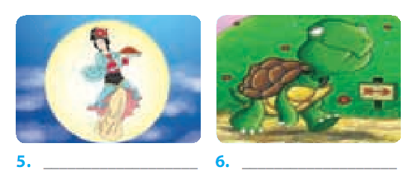
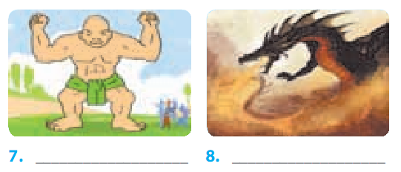
4
Unit 6: FOLK TALES - Looking back
2. Write the correct words under the pictures.
witch
hare
knight
ogre
fairy
tortoise
giaint
dragon

Slide 5
3. Put the words in the box into the correct column
Unit 6: FOLK TALES - Looking back
woodcutter fairy generous emperor brave eagle
knight witch giant cunning ogre mean
tortoise hare cheerful dragon evil cruel
greedy wicked kind fi erce Buddha
witch | kind
dragon | generous
fairy | mean
giant | wicked
hare | cheerful
emperor | fierce
ortoise | evil
knight | cunning
ogre | brave
eagle | greedy
Buddha
CHARACTERS
PERSONALITY

Slide 6
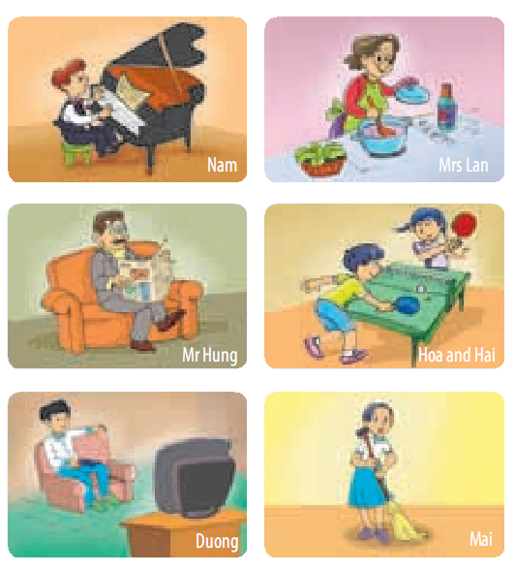
Grammar
Unit 6: FOLK TALES - Looking back
4. The following people were at home at 5 p.m.
yesterday.
What were they doing?
Work in pairs, ask and answer questions.
Example:
1. Nam/ play video games
A: Was Nam playing video games?
B: No, he wasn’t. He was playing the piano.

Slide 7
Unit 6: FOLK TALES - Looking back
ASK and ANSWER
2. Mrs Lan/
do the gardening
3. Mr Hung/
write a letter
4. Hoa and Hai/
play table tennis
5. Duong/
listen to music
6. Mai/
do homework
2. A: Was Mrs Lan doing the gardening?
B: No, she wasn’t. She was cooking.
3. A: Was Mr Hung writing a letter?
B: No, he wasn’t. He was reading a newspaper.
4. A: Were Hoa and Hai playing table tennis?
B: Yes, they were.
5. A: Was Duong listening to music?
B: No, he wasn’t. He was watching TV.
6. A: Was Mai doing her homework?
B: No, she wasn’t. She was sweeping the floor.

Slide 8
5.What were you doing at the following times? Work in pairs. Ask and answer questions, as in the example.
Unit 6: FOLK TALES - Looking back
1. At 10 p.m. yesterday evening
A: What were you doing at ten o’clock yesterday evening?
B: I was watching TV.
2. At 5 a.m. this morning
3. This time last week
4. At lunchtime yesterday
5. Two hours ago

Slide 9
6. Work in pairs. Make exclamatory sentences about your partner or other classmates.
Unit 6: FOLK TALES - Looking back
+ Example:
- What a lovely shirt you’re wearing!
-
-
-

Slide 10
7.Number the lines of the dialogue in the correct order.
Unit 6: FOLK TALES - Looking back
A. I tried to call you. What film did you see?
B. It’s about a green ogre named Shrek. He rescues a princess named Fiona.
C. Shrek.
D. What were you doing yesterday afternoon around 3 p.m.?
E. Not exactly. The characters are really funny and the story is surprising. You should see it.
F. I don’t know it.
G. It sounds like a typical fairy tale.
H. It’s a cartoon. It was really good.
I. Yesterday afternoon? I was watching a film. Why?
J. What’s it about?
=>Key: 1.D 2.I 3. A 4. C 5. F
6. H 7. J 8. B 9. G 10. E

Slide 11
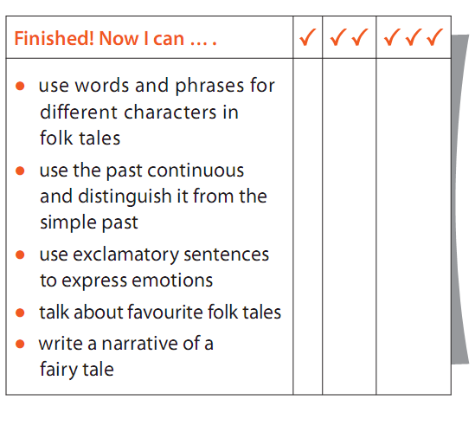
Complete yourselves
Unit 6: FOLK TALES - Looking back

Slide 12
Unit 6: FOLK TALES - Looking back
HOMEWORK
- Study the grammar. Make more examples.
- Do exercise in Workbook
- Prepare : REVIEW 2.

