Slide 1

UNIT 8: ECOLOGY AND THE ENVIRONMENT
Lesson 1.1 – Vocabulary & Listening
Page 64

Slide 2




Lesson 1.1
LESSSON OUTLINE
Consolidation

Slide 3
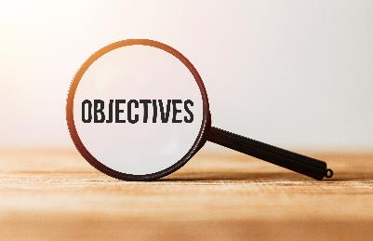
By the end of this lesson,
students will be able to:
- practice and learn vocab. for environment: ban, reduce, reuse, recycle, pollute, protect, damage.
- practice listening for specific information.
- practice functional English (Responding to ideas).
- improve listening skill.

Slide 4
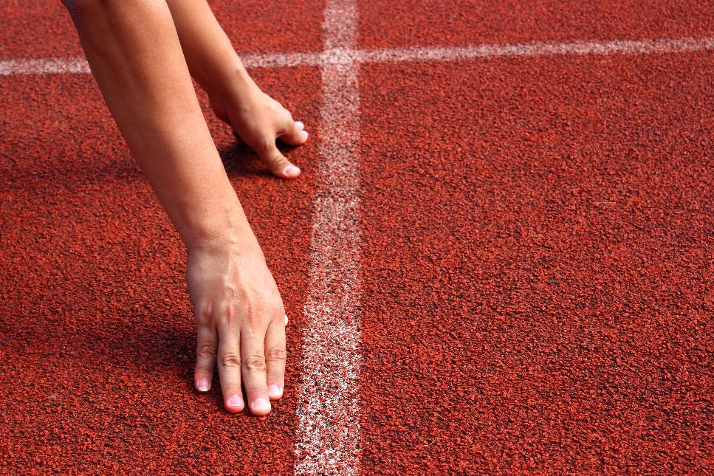


Slide 5

Work in pairs.
Why do you think it is important to look after the environment?

Slide 6
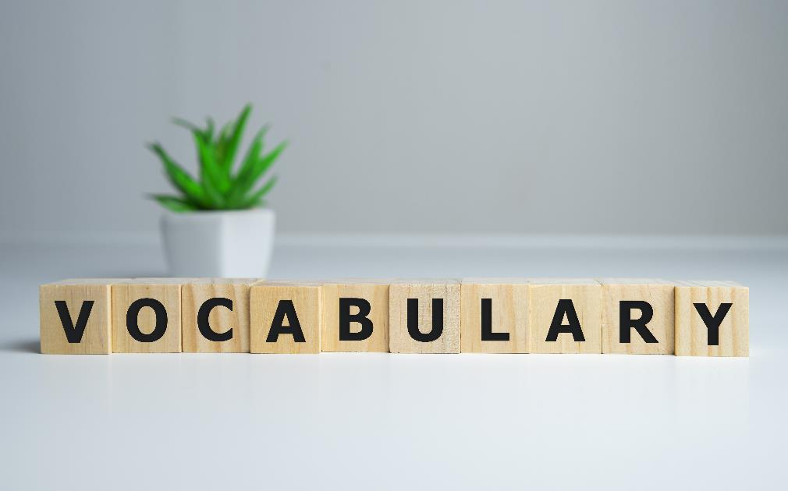


Slide 7


Match the words with the description. Listen and repeat
1. ban
2. reduce
3. reuse
4. recycle
5. pollute
6. protect
7. damage
a. keep someone or something safe or stop something dangerous happening
b. make the environment dirty
c. make trash (paper, glass, plastic, etc.) into a new product
d. make something less or smaller
e. officially stop people from doing something
f. hurt someone or something
g. use something again
Notes:
Please, click on each phrase to hear the sound

Slide 8
Listen and repeat.
1. ban (v) /bæn/ cấm
2. reduce (v) /rɪˈduːs/ giảm
3. reuse (v) /ˌriːˈjuːz/ tái sử dụng
4. recycle (v) /ˌriːˈsaɪkəl/ tái chế
5. pollute (v) /pəˈluːt/ làm ô nhiễm
6. protect ( v) /prəˈtekt/ bảo vệ
7. damage (v) /ˈdæmɪdʒ/ làm hại
Notes:
Please, click on each phrase to hear the sound

Slide 9
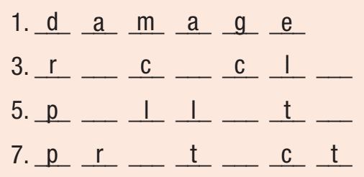
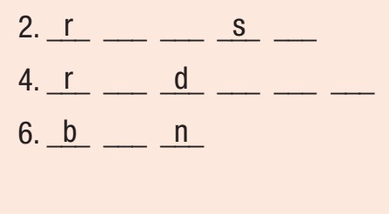
More Practice
WB, P. 44
e
u
e
e
y
e
e
u
c
e
o
u
e
a
o
e
Notes:
Taken from TA 10 i-Learn Smart World WB, page 44, New Words, activity a

Slide 10
More Practice
WB, P. 44
b. Fill in the blanks using the following words
damage, reuse, recycle, reduce, pollute, ban, protect
We really need to do more to ________ the environment
A lot of towns and cities ________plastic bags to help the environment. People don’t mind using their own bags when they go shopping
Schools can do a lot to ________ the amount of electricity they use
Coal power plants ________ the air more than many other kinds of power plant.
protect
ban
reduce
pollute
Notes:
Taken from TA 10 i-Learn Smart World WB, page 44, New Words, activity b

Slide 11
More Practice
WB, P. 44
b. Fill in the blanks using the following words
ban, reduce, reuse, recycle, pollute, protect, damage
5. I think we can ________ more at school if we have the right kinds of bins.
6. When there’s too much pollution, it can ________ people’s health.
7. I think it’s a good idea to ______ things like plastic bottles. I fill up mu bottle at home every morning
recycle
damage
reuse
Notes:
Taken from TA 10 i-Learn Smart World WB, page 44, New Words, activity b

Slide 12

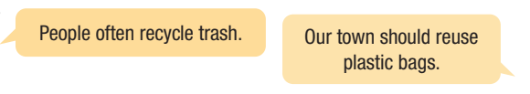
b. In pairs: How do people in your community help to look after the environment?
What else should they do?

Slide 13
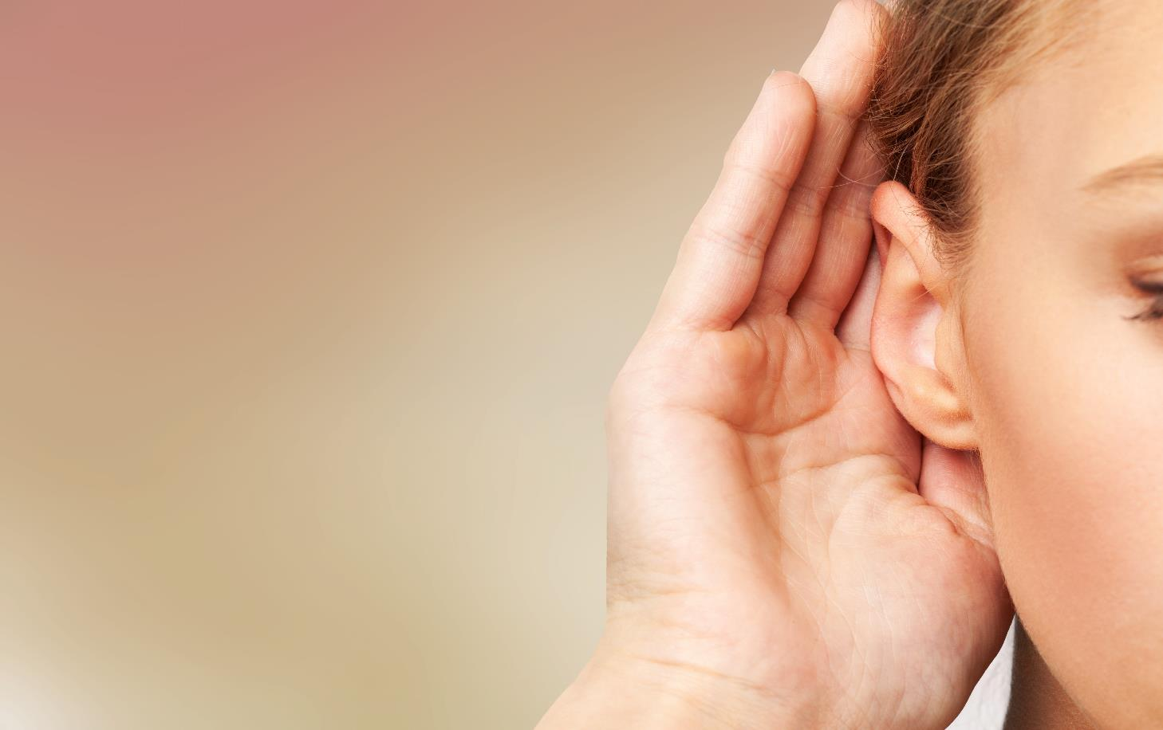


Slide 14
Pre - Listening
What are you going to listen?
→ Listen to Huy and Jane talking about what they can do to protect the environment
What are some key words in the question?
→ try their ideas at their school, in the town, or both?

Slide 15
While-Listening
Listen to Huy and Jane talking about what they can do to protect the environment. Do they want to try their ideas at their school, in the town, or both?
at their school
in the town
both

Slide 16
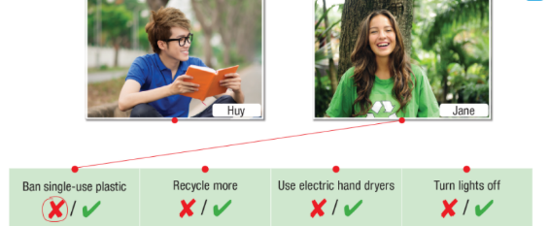
Pre-Listening
b. Now, listen and match Huy and Jane to their ideas. Circle the tick (✓) or cross (x) if the other person thinks it’s a good or bad idea.
What are you going to do?
→ Listen and match, circle
What are some key words in the question?
→ Huy’s ideas, Jane’s ideas, good (✓) , bad (x) idea

Slide 17

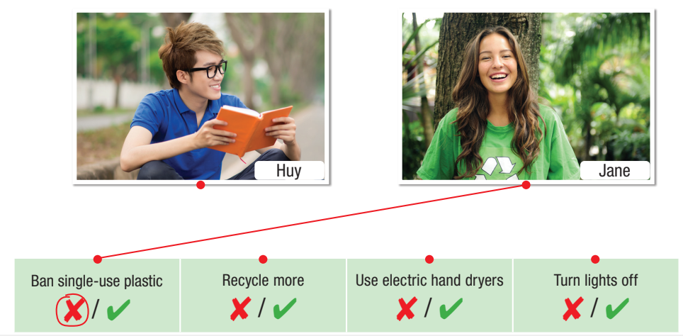
While-Listening
b. Now, listen and match Huy and Jane to their ideas. Circle the tick (✓) or cross (x) if the other person thinks it’s a good or bad idea.

Slide 18
Audio Scripts
Huy: Hi, Jane. Do you have any ideas for our presentation about protecting the environment?
Jane: Yeah. I think we should ban single-use plastic cups from the cafeteria. We'll reduce plastic pollution if students use their own bottles.
Huy: Hmm. I think that will be difficult to do.
Jane: Why?
Huy: Well, what if you forget your bottle and you're really thirsty? You can't get a cup of water? That's not fair.
Jane: Hmm... do you have any ideas?
Huy: We should recycle more. We already recycle paper, but we should recycle drink cans, too. If we recycle cans, we'll get money. We can use it for the school garden.
Jane: That's a great idea.
Huy: We could also stop using paper towels in the bathrooms.
Jane: Huh? Why?
Huy: It creates a lot of waste. We should use electric hand-dryers instead.
Jane: Hmm... that would reduce waste but use a lot of electricity. I'm not sure it's a good idea.
Huy: True. How can we reduce our electricity use?
Jane: I see students leaving the lights on in the classrooms all the time. If we turn them off, it'll reduce the amount of electricity that we use. This will save the school money, too.
Huy: Great idea! I think we're ready for our presentation.

Slide 19

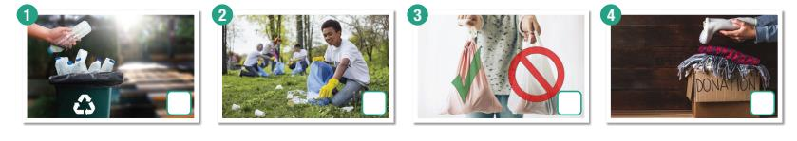
Pre-Listening
Bill is talking to Megan about his biology project. Listen and tick the pictures you hear.
More Practice
WB, P. 44
What are you going to listen?
→ Bill’s talking about his biology project
How many pictures are there?
→ Four
What are you going to do?
→ Listen and tick the picture
Notes:
Taken from TA 10 i-Learn Smart World WB, page 44

Slide 20
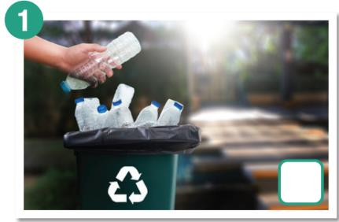
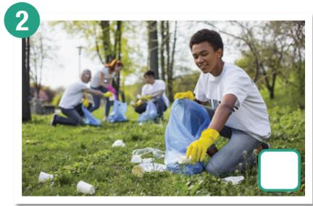
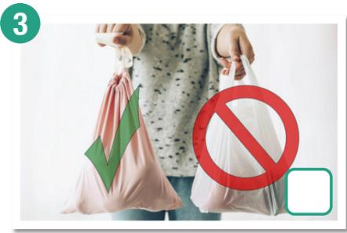
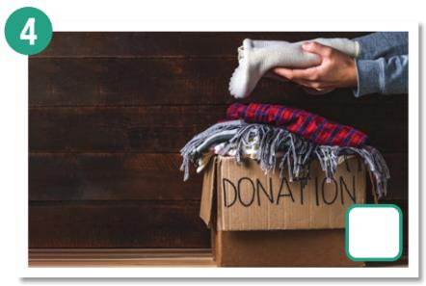
While-Listening
Bill is talking to Megan about his biology project. Listen and tick the pictures you hear.
✓
✓
✓
Notes:
Taken from TA 10 i-Learn Smart World WB, page 44

Slide 21
While-Listening
b. Now, listen and circle
Bill’s first idea is to …………..
a. ban plastic bags b. ban plastic bottles c. use paper bags
2. Bill’s says there will be less pollution in…………..
a. oceans b. parks c. rivers
3. Bill’s second idea is to …………..
a. recycle more b. reuse more c. reduce more
4. Bill’s says you can donate…………..
a. clothes and shoes b. books and shoes c. clothes and books
5. Bill’s says you can reuse…………..
a. bottles and cans b. bags and bottles c. cans and books
Notes:
Taken from TA 10 i-Learn Smart World WB, page 44

Slide 22
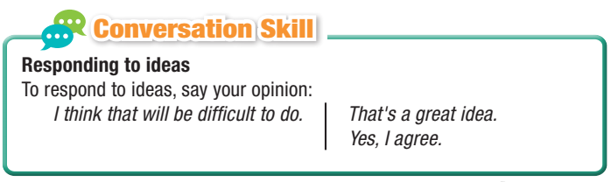
Post-Listening
c. Read the Conversation Skill box and listen to Task b. audio again. Circle the phrases in the Conversation Skill box that you hear.

Slide 23
Post-Listening
d. Listen and repeat.

Slide 24

Post-Listening
e. In pairs:
Which idea do you think is the best? Why?
I think the best idea is…………..because ……

Slide 25

Consolidation

Slide 26
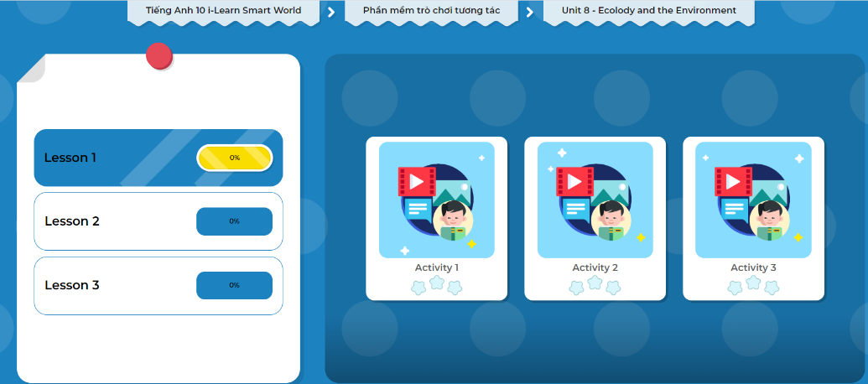
LET’S PLAY!
Click here to play the game!

Slide 27
Wrap-up
Today’s lesson
Vocabulary: for the environment.
Listening: for main ideas and specific information.
Speaking: responding to ideas.

Slide 28
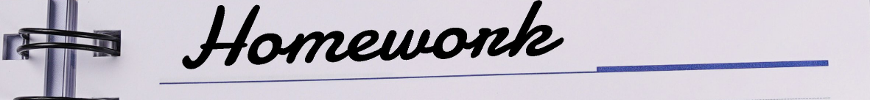
Write several suggestions about the ways to protect the environment that you and your friends used to do (present them to the class in the next period if possible)
Do the exercises in Tiếng Anh 10 i-Learn Smart World Notebook on page 44
Prepare the next lesson - Grammar on page 65 in SB.

