Slide 1
Unit 5: Science and technology
Lesson 1.1: Vocabulary & Reading
Pages 44 & 45

Slide 2
Lesson Outline
Warm-up
Vocabulary
Reading
Consolidation
Wrap-up

Slide 3
By the end of this lesson, students will be able to…
- use vocabulary related to technology
- practice reading and understanding general and specific information about features of electronic devices.

Slide 4
New words
tablet
screen
inch
weight
gigabyte
storage

Slide 5
WARM UP

Slide 6
Look at the picture
and answer the questions.
What can you see in the picture?
What are they?
Which devices do you often see?
Which devices do you often use?
Do they help make your life easier? How?

Slide 7
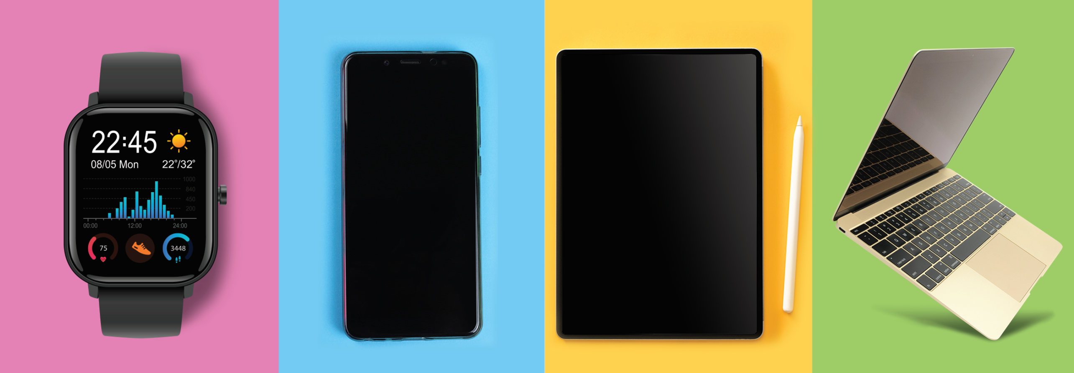
What can you see in the picture?
What are they?
Which devices do you often see?
4. Which devices do you often use?
5. Do they help make your life easier?
How?

Slide 8
Pre – Reading
Vocabulary

Slide 9
Listen and repeat. Click on each phrase to hear the sound.
tablet (n) / ˈtæblət/ máy tính bảng
screen (n) /skriːn/ màn hình
inch (n) /ɪntʃ/ inch (“) (đơn vị đo độ dài, bằng 2.54 cm)
weight (n) /weɪt/ trọng lượng, cân nặng
gigabyte (n) /ˈɡɪɡəbaɪt/ GB – đơn vị đo dữ liệu/ bộ nhớ máy tính
storage (n) /ˈstɔːrɪdʒ/ bộ nhớ, sự lưu trữ
Notes:
GV click vào từng cụm nghe âm thanh

Slide 10
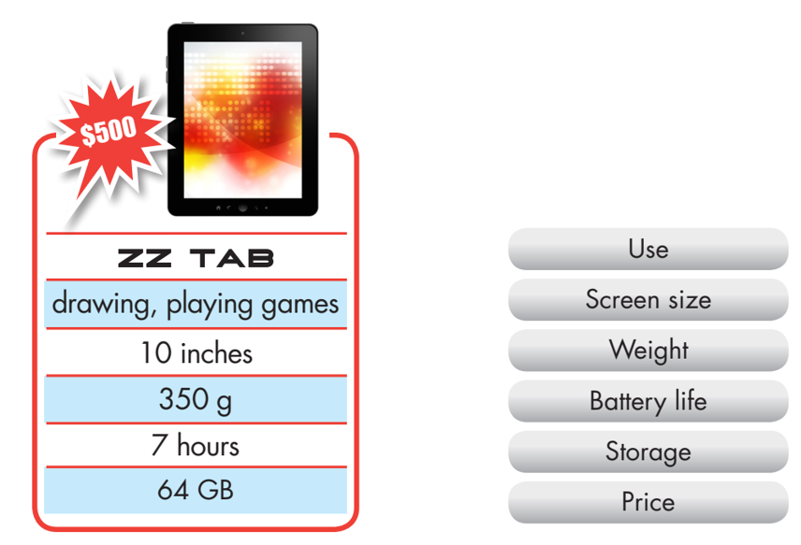
Work in pairs. Matching tablet descriptions with its features.

Slide 11
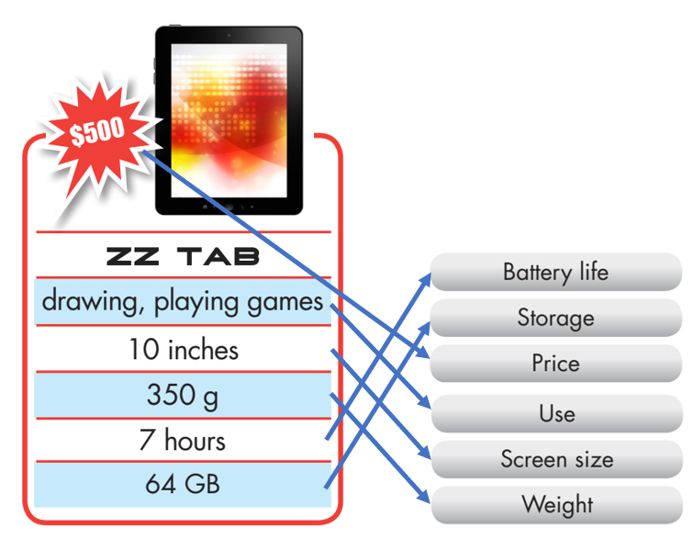
Work in pairs. Matching tablet descriptions with its features.

Slide 12
a. Fill in the blanks.
inch
screen
Storage
weight
gigabyte

Slide 13
Work in pairs
Talk about what you want a tablet and a laptop to have.

Slide 14
Reading

Slide 15
Pre - reading
Read the instruction quickly. Underline the key words. What are we going to do?
Read and choose the best title.

Slide 16
Task a
Read the magazine article. What is it about?
What's new in the Portal 7?
A review of the Portal 7: What we like and don't like
Pre-reading

Slide 17
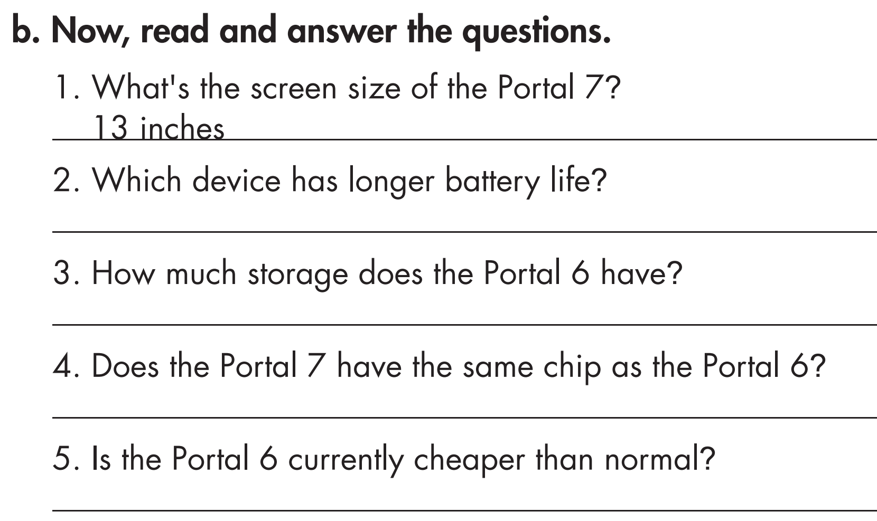
Task b
Read the questions and underline the key words.
What are we going to do?
Read and answer the questions.
Pre-reading

Slide 18
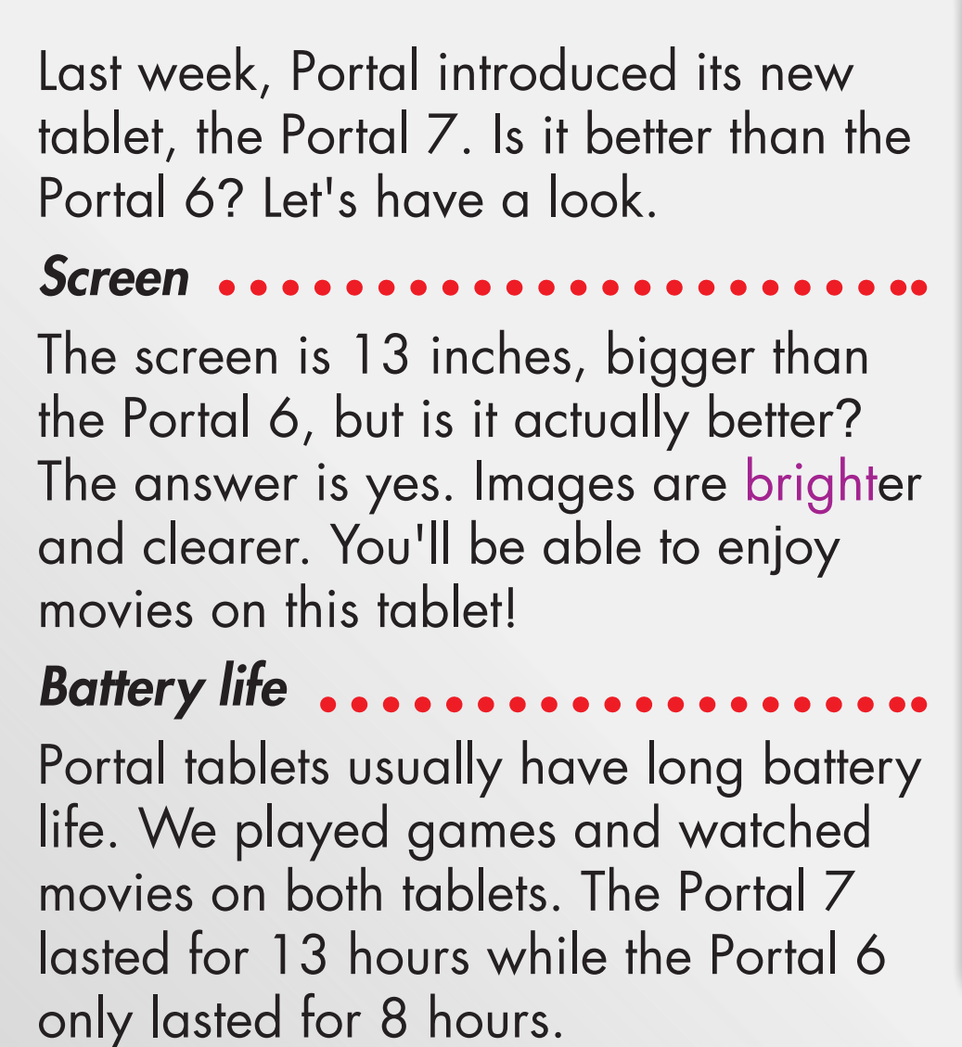
What's the screen size of the Portal 7?
2. Which device has longer battery life?
13 inches
the Portal 7

Slide 19
64 GB
3. How much storage does the Portal 6 have?
4. Does the Portal 7 have the same chip as the Portal 6?
5. Is the Portal 6 currently cheaper than normal?
No, it doesn’t.
Yes, it is.

Slide 20
Task c
Listen and read.
While-reading

Slide 21
Post-Reading

Slide 22
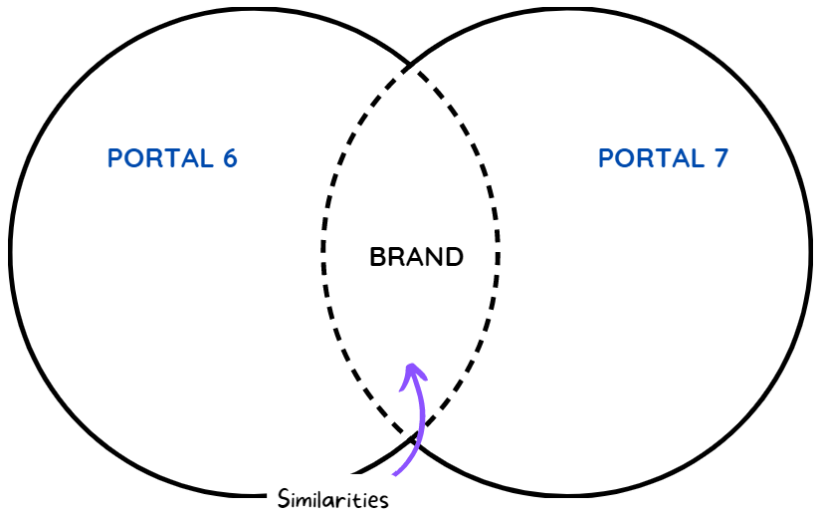
Post-reading
Work in pairs
Write down your ideas on a Venn diagram.

Slide 23
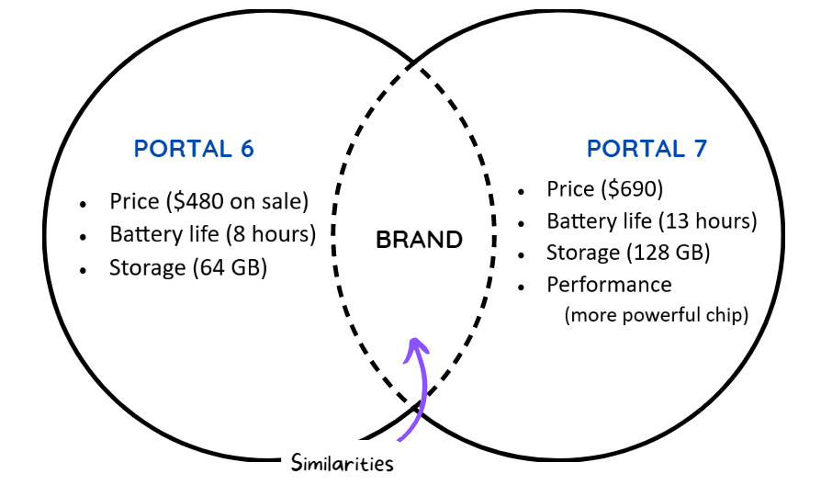

Slide 24
Task c
Work in pairs
Post-reading
Would you buy the Portal 6 or 7? Why?

Slide 25
CONSOLIDATION

Slide 26
Retell nouns/ noun phrases about technical features of an electronic device.

Slide 27
WRAP-UP

Slide 28
New words
tablet
screen
inch
weight
gigabyte
storage
Today’s lesson

Slide 29
Today’s lesson
Reading:
- Understanding instructions
Skimming and scanning for general and specific information
Speaking:
- Talking about what electronic devices you would like to have

Slide 30
Homework
- Learn the new words.
- Practice talking about words of electronic devices.
- Do the exercises in WB: Unit 5 - Lesson 1 - New words + Reading (pages 26 & 27).
- Do the exercises in Tiếng Anh 8 i-Learn Smart World Notebook (pages 38 & 39).
- Play the consolidation games in Tiếng Anh 8 i-Learn Smart World DHA App on www.eduhome.com.vn
- Prepare: Lesson 1.2 – Grammar (pages 45 & 46 – SB).

Slide 31
Lesson 3
Stay positive and have a nice day!

