Slide 1


Slide 2
PEER
PRESSURE
Unit
9
SOCIAL ISSUES
Unit
FAMILY LIFE
LESSON 3
READING

Slide 3

LESSON 3
READING
WARM-UP
Watch the video and answer the questions
PRE-READING
- Task 1: Discuss the question.
- Task 2: Read the article. Match the highlighted words and phrase with their meanings.
- Task 3: Read the article again. Which paragraph contains the following information?
- Task 4: Read the article again and choose the best answers
WHILE-READING
POST-READING
- Task 5: Work in pairs. Discuss the question.
CONSOLIDATION
Wrap-up
Homework

Slide 4
WARM-UP
Watch the video and decide if the statements below are true or false.
Teenagers are considered easily affected by peer pressure.
Positively, peer pressure can motivate us to try and become better.
Social media always bring stress to us when we see other peers having success and comfortable lives.
To define a clear life goal, respect yourself and others are effective ways to avoid peer pressure.

Slide 5
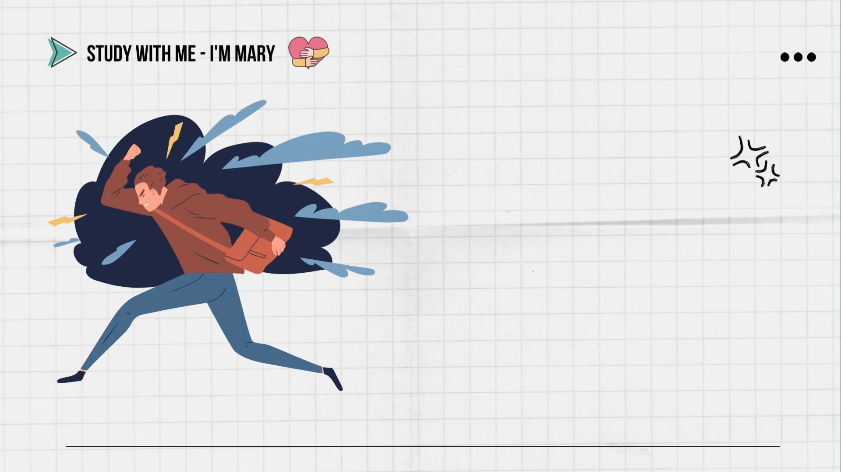
WARM-UP
Watch the video and decide if the statements below are true or false.
https://www.youtube.com/watch?v=6ZT0DAmOpWw

Slide 6

WARM-UP
1. Teenagers are considered uneasily affected by peer pressure.

Slide 7
WARM-UP
2. Positively, peer pressure can motivate us to try and become better.

Slide 8
WARM-UP
3. Social media always brings stress to us when we see other peers having success and comfortable lives.

Slide 9
WARM-UP
4. To define a clear life goal, respect yourself and others are effective ways to avoid peer pressure.

Slide 10
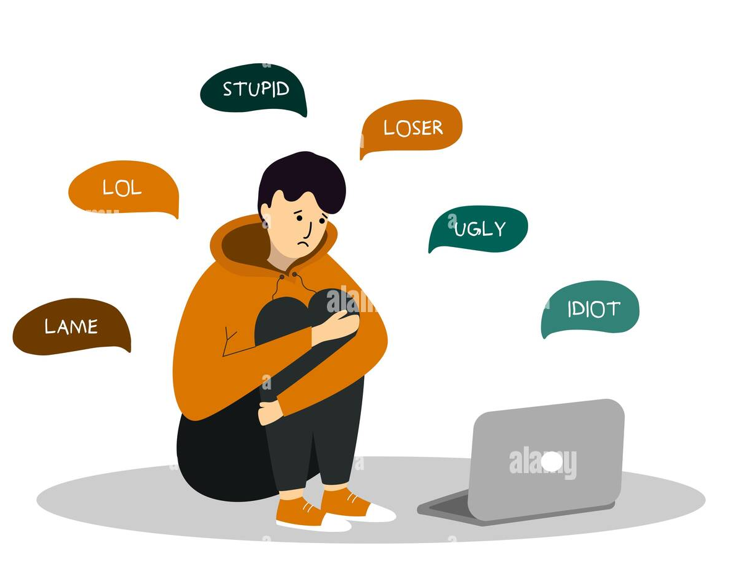

PRE-READING
1
Work in pairs. Discuss the question.
Have your friends ever made you do something you do not like? If yes, give an example.

Slide 11

PRE-READING
Depression (n)
/dɪˈpreʃ.ən/
the state of feeling very unhappy and without hope for the future

Slide 12

PRE-READING
self-confidence (n)
/ˌselfˈkɒn.fɪ.dəns/
the belief that you can do things well and that other people respect you

Slide 13

PRE-READING
Smoker (n)
/ˈsməʊ.kər/
someone who smokes tobacco regularly

Slide 14
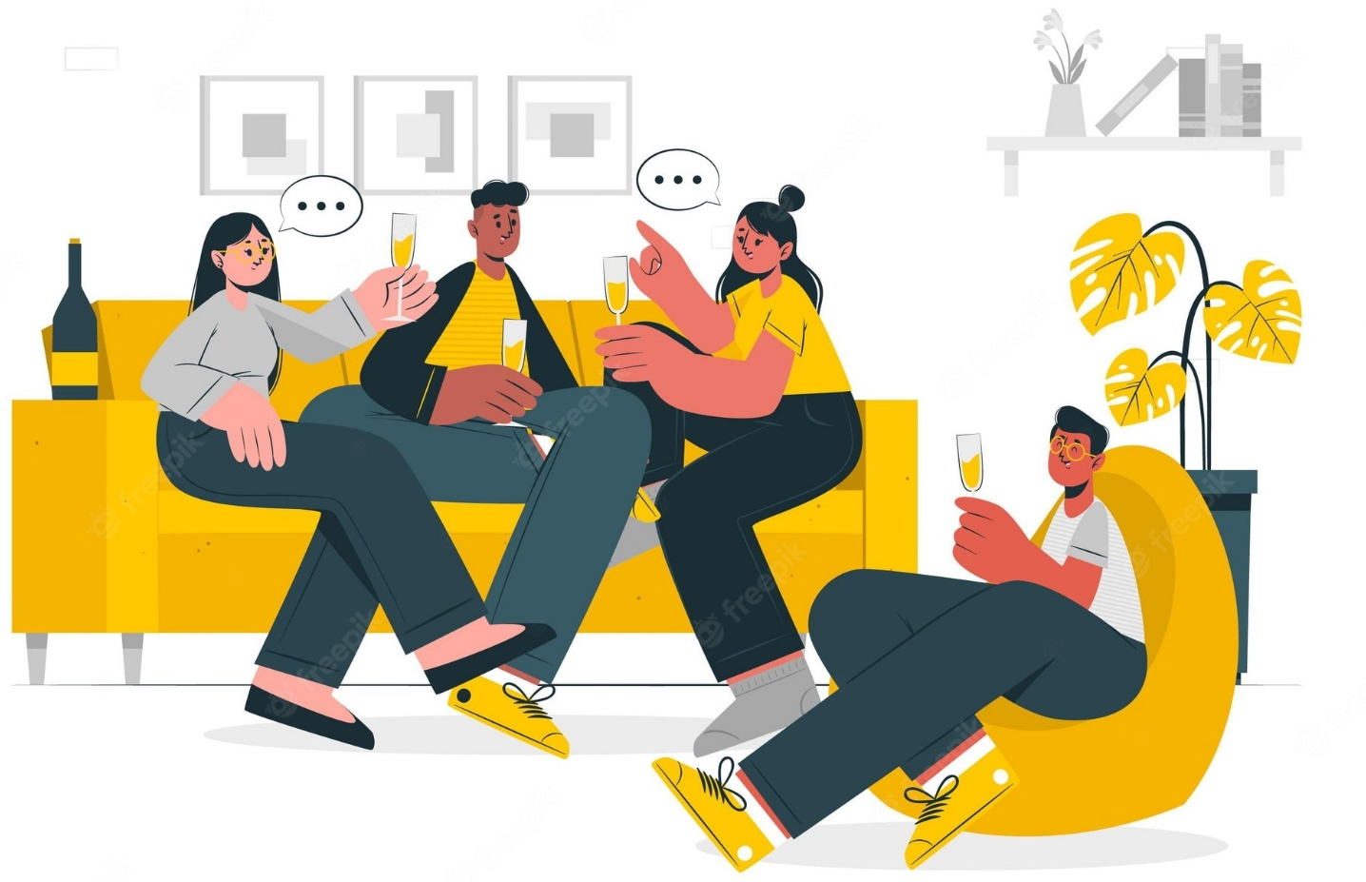
PRE-READING
hang out
/ˈhæŋ ˈaʊt/
to spend a lot of time in a place or with someone

Slide 15
PRE-READING
Form | Pronunciation | Meaning
1. Depression (n) | /dɪˈpreʃ.ən/ | the state of feeling very unhappy and without hope for the future
2. self-confidence (n) | /ˌselfˈkɒn.fɪ.dəns/ | the belief that you can do things well and that other people respect you
3. Smoker (n) | /ˈsməʊ.kər/ | someone who smokes tobacco regularly
4. hang out | /ˈhæŋ ˈaʊt/ | to spend a lot of time in a place or with someone

Slide 16



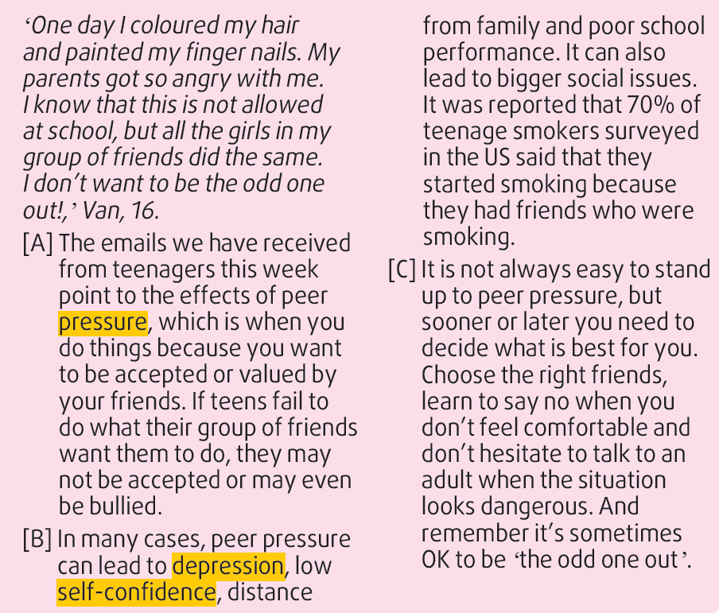

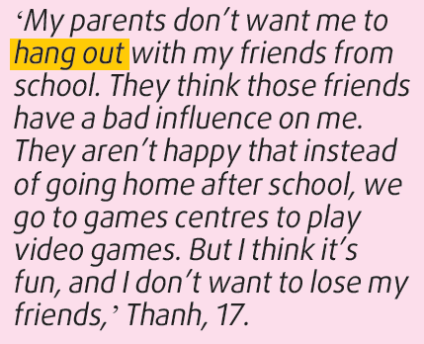
WHILE-READING
2

Slide 17
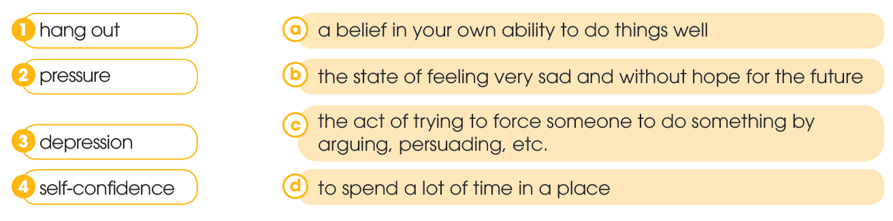
WHILE-READING
2
Read the article. Match the highlighted words and phrase with their meanings.

Slide 18
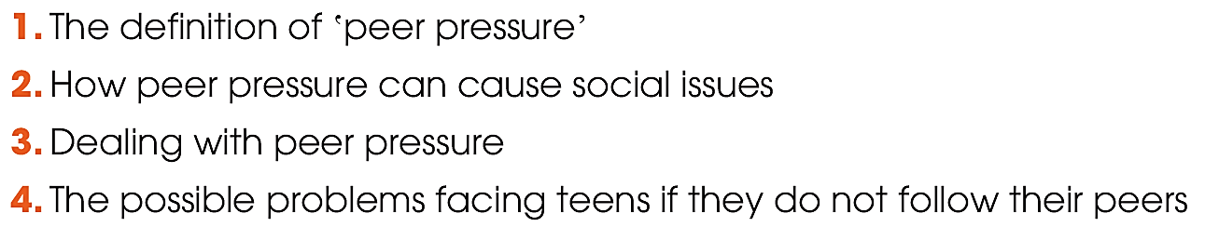

WHILE-READING
3
Read the article again. Which paragraph contains the following information? Write A, B, or C.
A
B
C
A

Slide 19
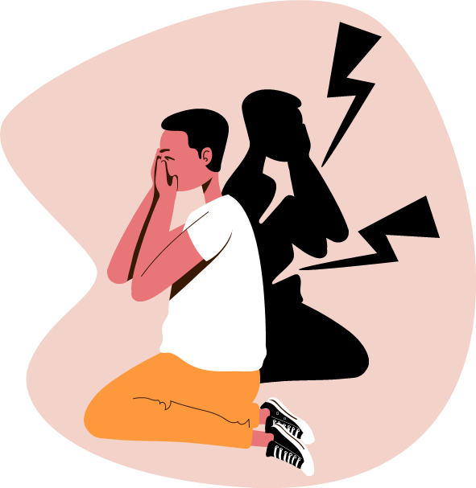
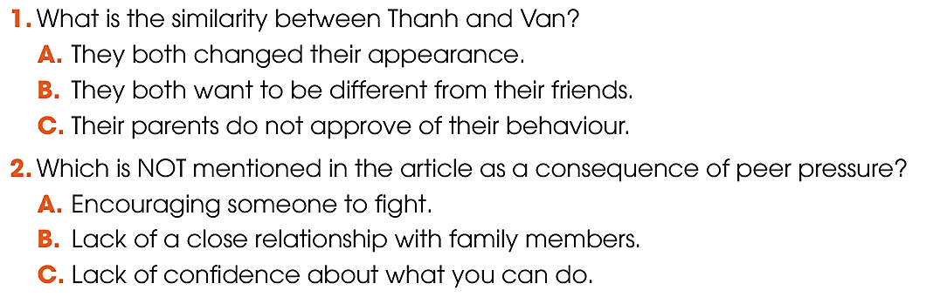
WHILE-READING
4
Read the article again and choose the best answers A, B, or C.

Slide 20
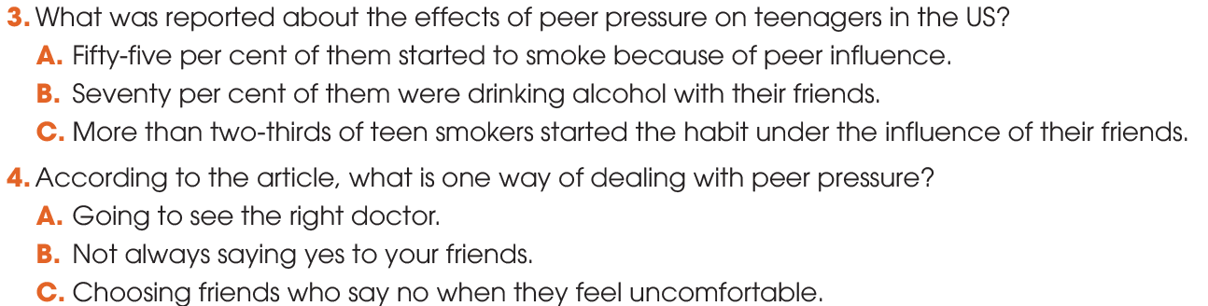

WHILE-READING
4
Read the article again and choose the best answers A, B, or C.

Slide 21
POST-READING
5
Work in pairs. Discuss the question.
Have you, or has someone you know, experienced any of the problems mentioned in this article?

Slide 22

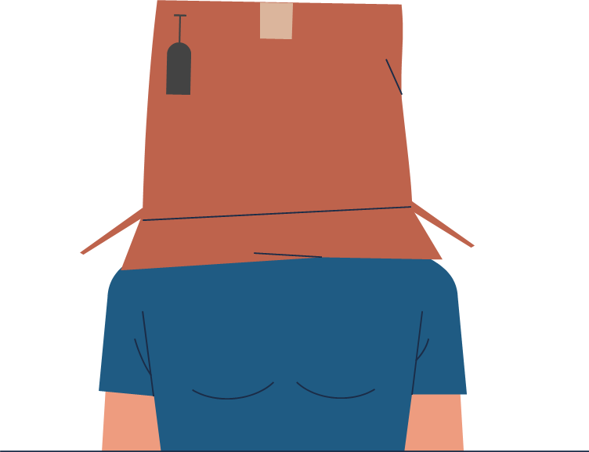
CONSOLIDATION
1
Wrap-up
What have you learnt today?
New vocabularies
Read for main ideas and specific information in an article about peer pressure.
Talk about experiences of peer pressure and respond to peer pressure situations.

Slide 23
CONSOLIDATION
2
Homework
Do exercises in the workbook.
Prepare for Lesson 4 - Unit 9.

Slide 24

Website: hoclieu.vn
Fanpage: facebook.com/sachmem.vn/

