Slide 1

Unit 2: Fit for life
Lesson 2a: Vocab Expansion
Page 31

Slide 2
Lesson Outline
Warm-up
Vocabulary
Speaking
Writing
Consolidation
Wrap-up

Slide 3
Objectives
By the end of this lesson, students will be able to…
- review some indoor and outdoor sports.
- learn and use some adjectives describing school sports/ activities.
- review agreeing and disagreeing expressions.
- write a blog comment.
- discuss your favourite school sports activities.

Slide 4

WARM-UP

Slide 5
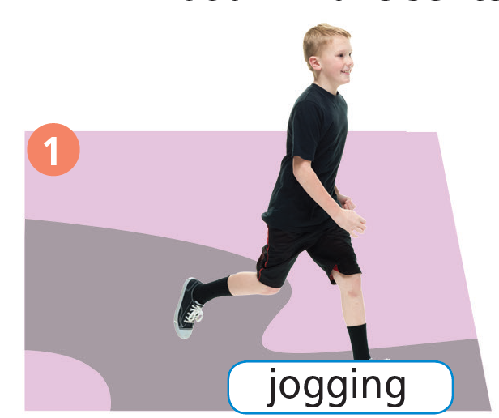
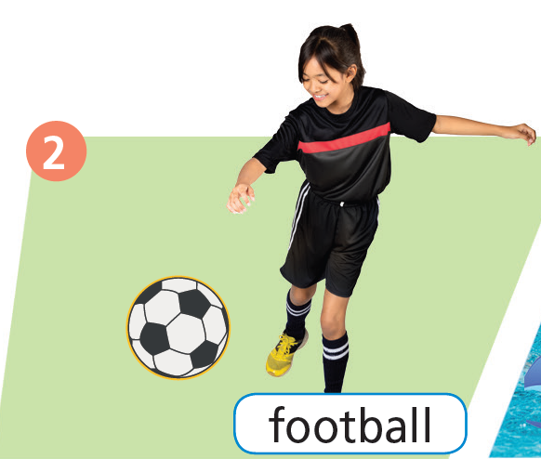
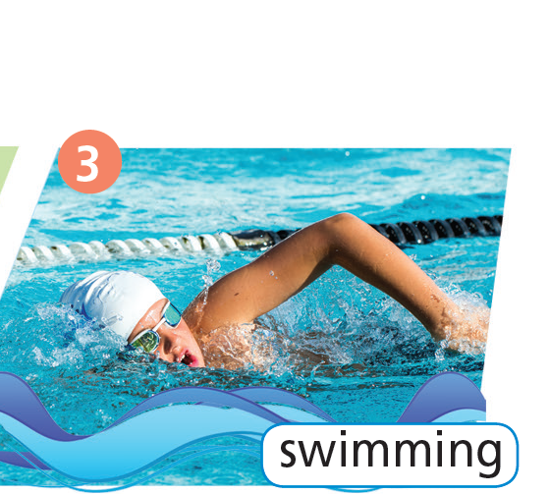
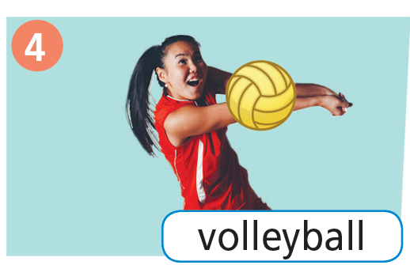
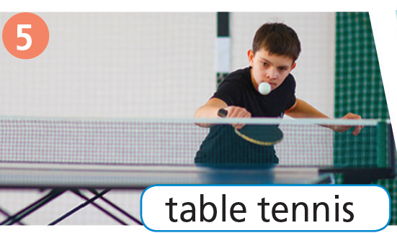
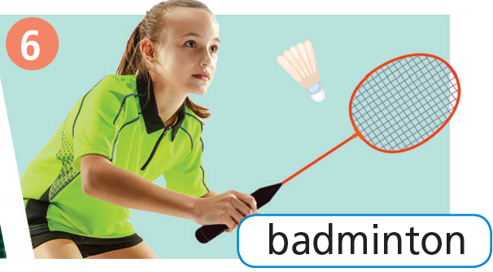
Name the sports in the pictures below.

Slide 6

It’s time to learn …

Slide 7

Vocabulary
Listen and repeat.
School sports/activities
- jogging /ˈdʒɒɡɪŋ/ (n): môn chạy bộ
- football /ˈfʊtbɔːl/ (n): môn bóng đá
- swimming /ˈswɪmɪŋ/ (n): môn bơi lội
- volleyball /ˈvɒlibɔːl/ (n): môn bóng chuyền
- table tennis /ˈteɪbl tenɪs/ (n): môn bóng bàn
- badminton /ˈbædmɪntən/ (n): môn cầu lông

Slide 8
Vocabulary
Listen and repeat.
School sports/activities
•
- jogging /ˈdʒɒɡɪŋ/ (n): môn chạy bộ
•
- football /ˈfʊtbɔːl/ (n): môn bóng đá
•
- swimming /ˈswɪmɪŋ/ (n): môn bơi lội
•
- volleyball /ˈvɒlibɔːl/ (n): môn bóng chuyền
•
- table tennis /ˈteɪbl tenɪs/ (n): môn bóng bàn
•
- badminton /ˈbædmɪntən/ (n): môn cầu lông

Slide 9

Presentation

Slide 10
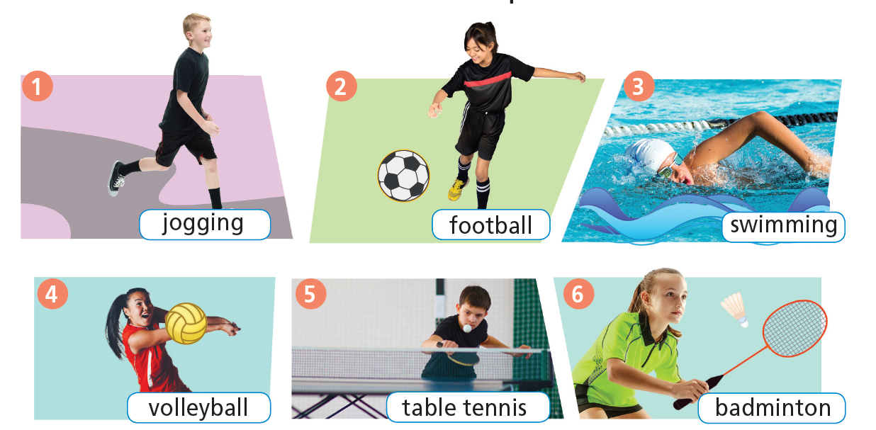
6 Listen and repeat. Which are outdoor sports? indoor sports? both? Make sentences as in the example.
outdoor
outdoor
indoor and outdoor
indoor and outdoor
indoor
indoor and outdoor

Slide 11

Practice

Slide 12

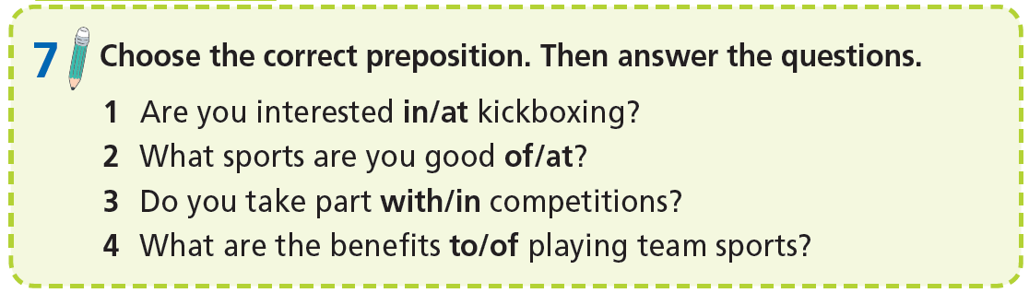

Slide 13

Speaking

Slide 14


Pre-speaking
Put these adjective into correct column.
amazing
thrilling
dull
relaxing
boring
tiring
exciting
stressful
fun
dangerous
It’s ...
It’s ...

Slide 15
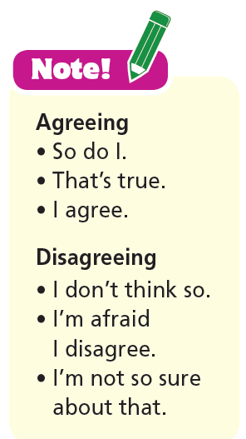

While-speaking
8. Discuss your favourite school sports activities as in the example.
A: I like playing table tennis.
B: So do I. It’s fun.
A: I don’t like taekwondo. It’s dangerous.
B: I don’t think so. It’s exciting. I like it.

Slide 16
Post-speaking
Write a paragraph (60-80 words) about your favourite sports.

Slide 17

Writing

Slide 18
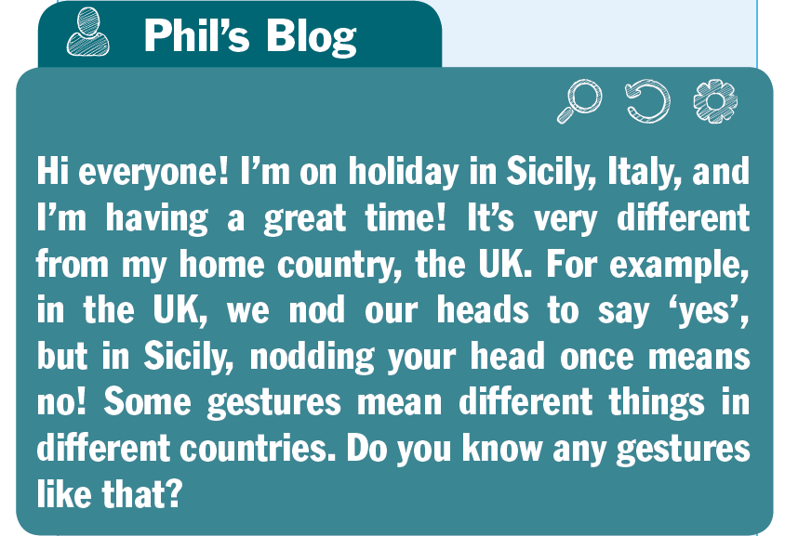
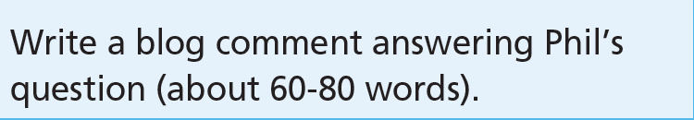
Pre-writing
1. Read the task. Underline the key words. For the statements (1-3), choose the correct option.
1 You are going to write a comment/letter on a blog entry.
2 You are going to write about a holiday/gesture.
3 You are going to write about 60-80/80-100 words.

Slide 19
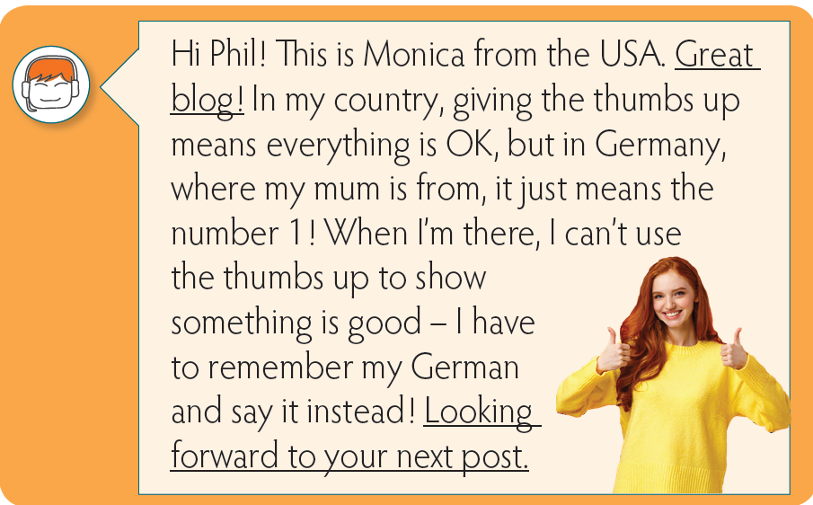
Model analysis
2 Read the model. How does the writer start/end the comment?
Start the comment
End the comment

Slide 20
3. Replace the underlined sentences with the sentences below in your notebook.
I really enjoy
reading your posts.
1 Can’t wait for your next blog entry.
2 I really enjoy reading your posts.
Can’t wait
for your next blog entry.

Slide 21
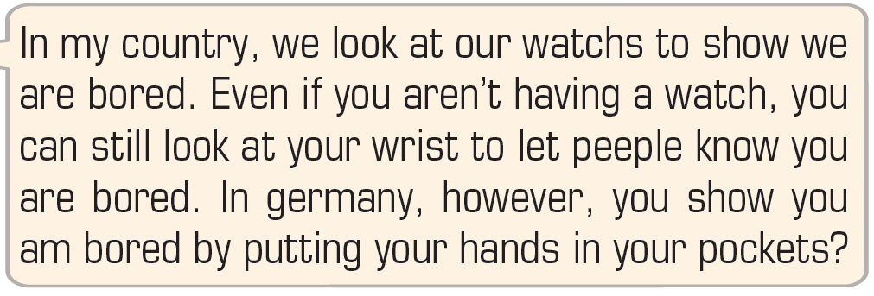
4. Read the extract from a blog entry and correct two grammar mistakes, one punctuation mistake, and three spelling mistakes.
grammar mistakes
have
are
spelling mistakes
punctuation mistake
watches
.
people
Germany

Slide 22
5. Fill in each gap with shake, thumbs up, wish, or curl.
1 In Asia, it’s rude to ____________ your index finger to ask somebody to come to you.
2 In Australia, the ____________ means everything is OK.
3 It’s polite to ____________ hands when you greet someone.
4 Don’t cross your fingers to __________ for luck in Vietnam. It’s very rude!
curl
thumbs up
shake
wish

Slide 23

While-writing
6. Brainstorming: Read the task in Exercise 1. Use ideas from Exercise 5 to make notes under the headings gesture, what it means in my country and what it means in another country.
7. Use your notes in Exercise 6 and the phrases/sentences from the Useful Language box to comment on Phil’s blog entry.

Slide 24

CONSOLIDATION

Slide 25
Write a paragraph about 60-80 words about your favourite sport (name of sport, place, number of players, equipment, aim, and how to play it).

Slide 26

WRAP-UP

Slide 27
Today’s lesson
Vocabularies
School sports/ activities
Skills
Speaking: agreeing/ disagreeing
Writing: a blog comment

Slide 28
Homework
- Do exercises in workbook on page 16.
- Practise the vocabulary in TA 7 Right On Notebook (page 12)
- Prepare the next lesson (page 32 SB).

Slide 29
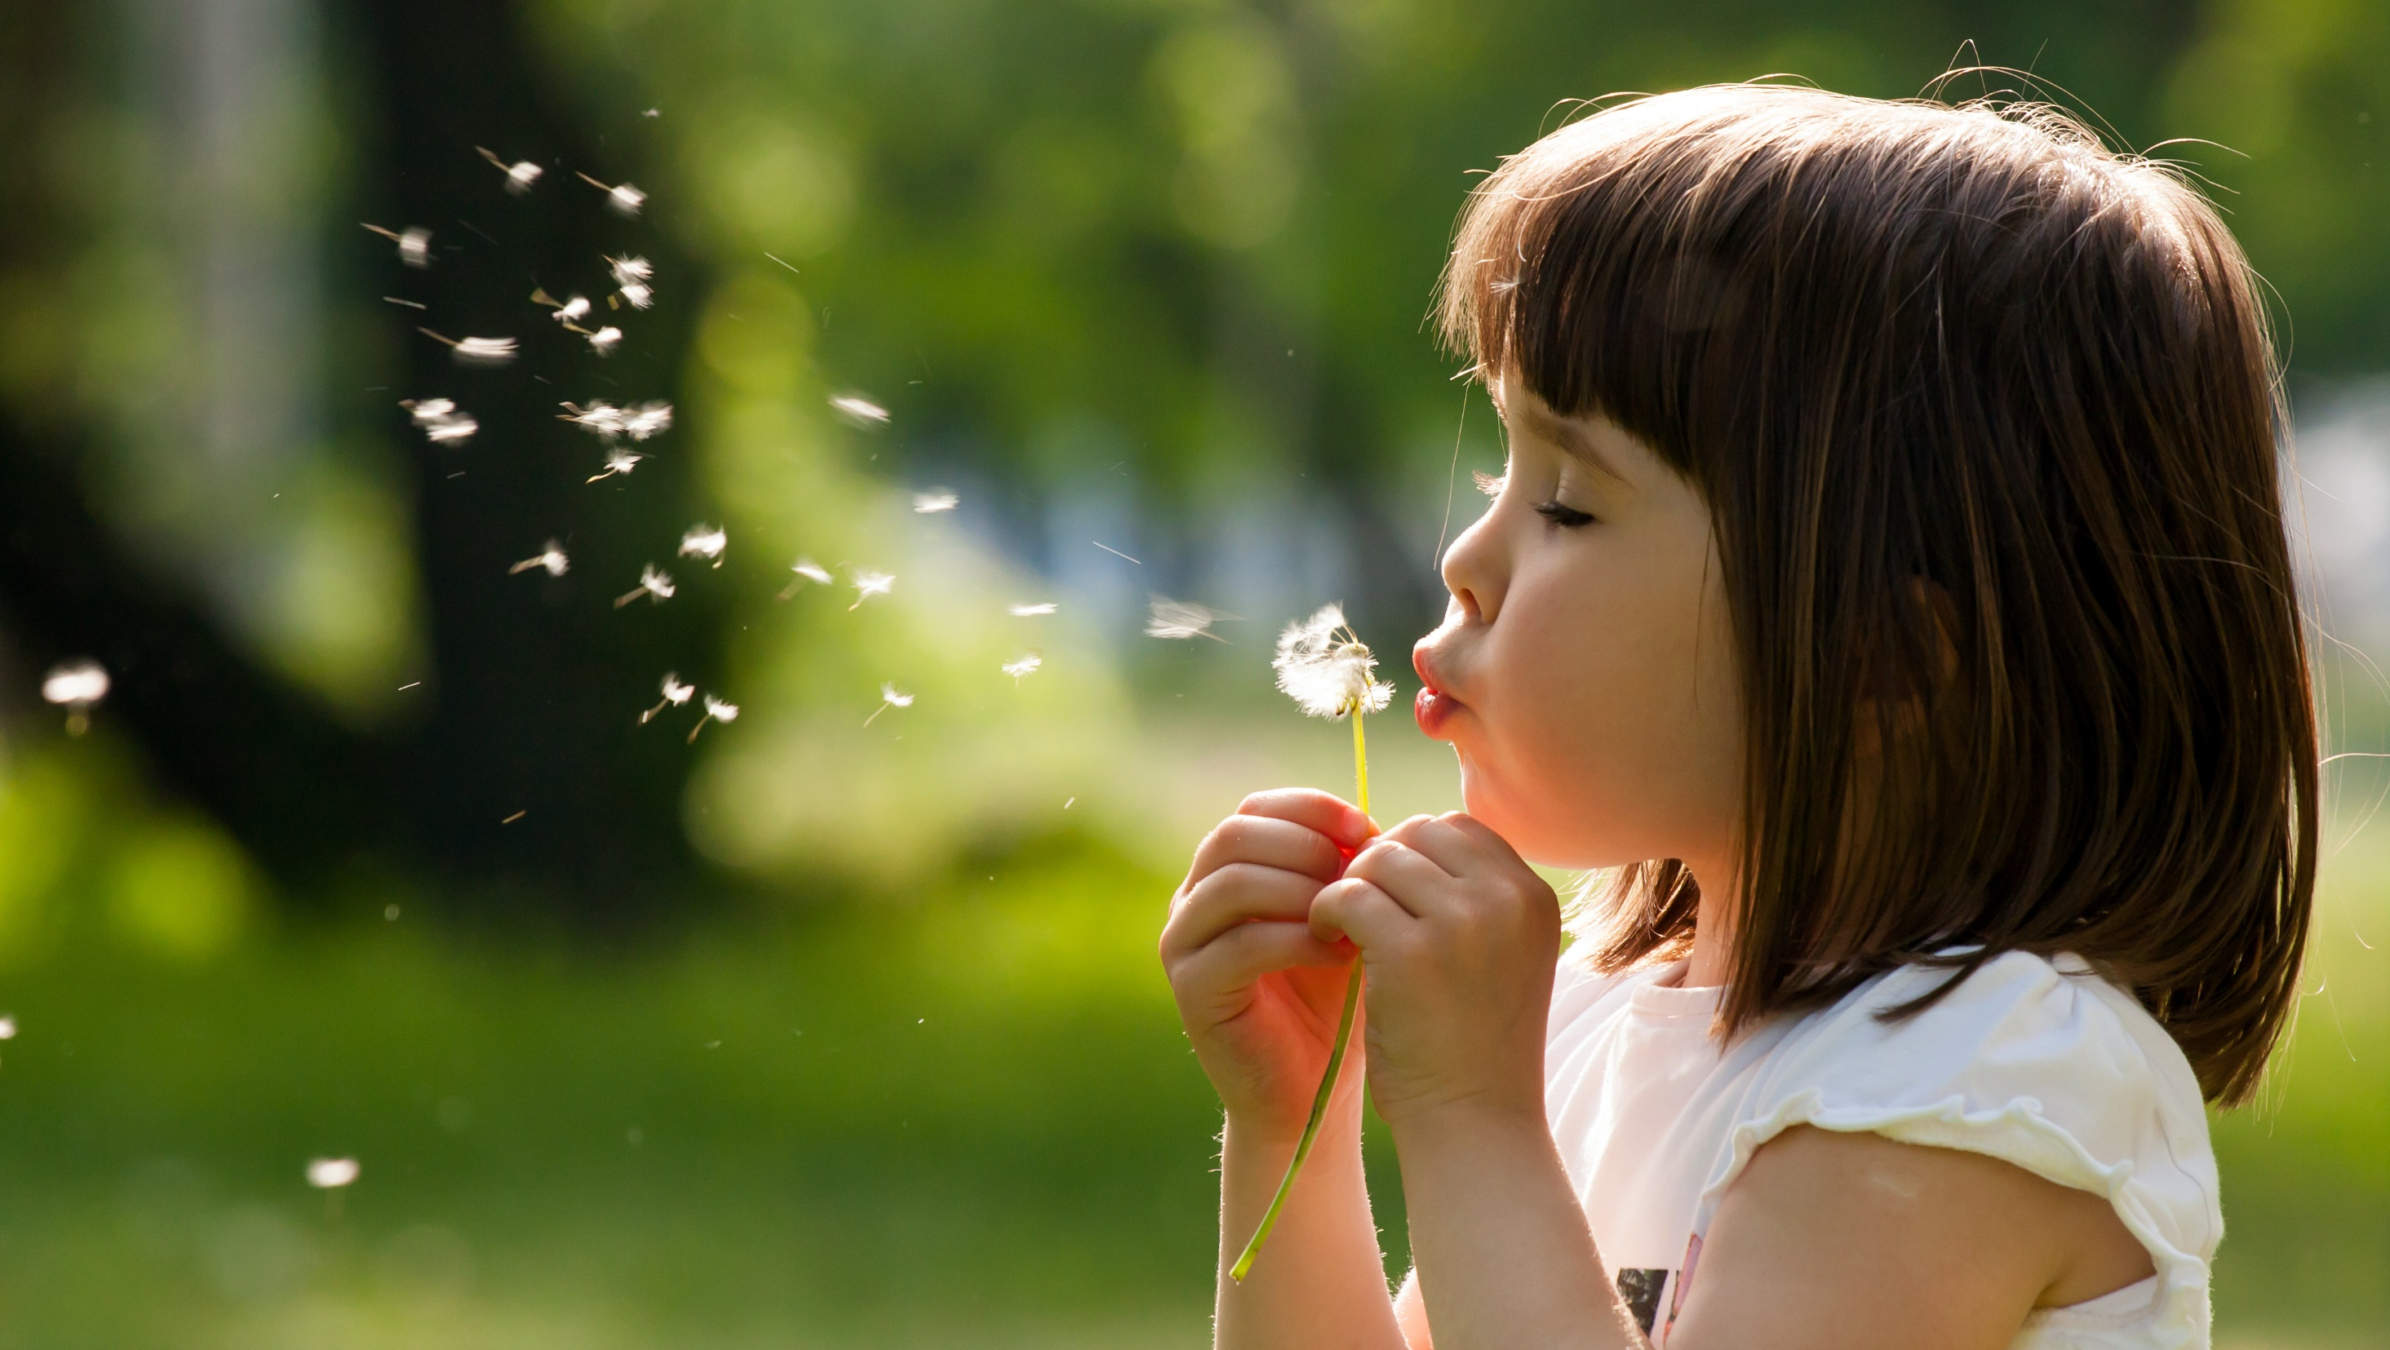
Enjoy your day!

