Slide 2



Unit
10
PLANET EARTH
LESSON 5: SKILLS 1

Slide 3

OBJECTIVES
By the end of the lesson, students will be able to:
Read for main idea and specific about role of plant and animals;
Talk about threats to flora and fauna and how to protect them.

Slide 4
LESSON 5: SKILLS 1
LESSON 1: GETTING STARTED
WARM-UP
Option 1: Brainstorm
Option 2: Predator-Prey Chain Challenge
Task 1: Tick (√) the things that show the roles of plants and animals.
Task 2: Read the passage and choose the correct answer A, B, C, or D.
Task 3: Read the passage again and fill in the diagram.
READING
SPEAKING
Task 4: Work in pairs. Discuss the threats to plants and animals and how we can protect them. You can use the ideas from the reading or your own ideas.
Task 5: Report the results of your discussion to the class.
CONSOLIDATION
Wrap-up
Homework

Slide 5

WARM-UP
OPTION 1
Brainstorming

Slide 6
WARM-UP
OPTION 1
- Work in groups to shouts out the name of a habitat.
Desert
- The other groups should say a sentence, telling about the feature of that habitat.
- A habitat name can be reused, but the features mentioned later must be different from the one(s) previously mentioned.
Limited water
- The group that can name a correct feature gets one point and the right to shout another habitat name or lose turn if this group cannot mention any feature.

Slide 7
WARM-UP
OPTION 1
Example:
Desert
Limited water

Slide 8
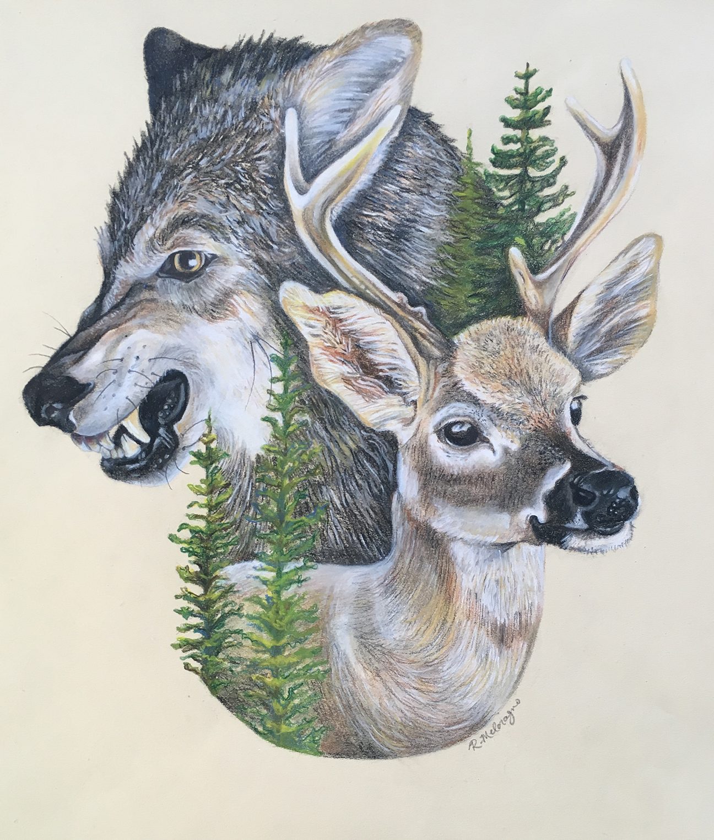
WARM-UP
OPTION 2
Predator-Prey Chain Challenge

Slide 9
WARM-UP
OPTION 2
Predator-Prey Chain Challenge
- Work in groups to represent different organisms in a food chain.
- Acts out their roles (standing, crouching, etc.).
Example:
grass -> grasshopper -> frog -> snake
- Discuss the roles each organism plays in the chain and how disruptions can affect the ecosystem.

Slide 10
WARM-UP
OPTION 2
Suggested answer:
Predator-Prey Chain Challenge.
Overall, each organism plays a vital role in maintaining the balance of the ecosystem. Any disruption can have cascading effects, impacting the populations of other organisms and potentially causing widespread damage. Understanding these interconnected relationships is crucial for conservation efforts and maintaining healthy ecosystems.

Slide 11
READING
1
Tick (√) the things that show the roles of plants and animals.
- Work in pairs to discuss which one(s) shows the role(s) of plants and animals.
- Give a simple explanation / example if possible.
1. providing sources of food
2. causing habitat loss
3. keeping the ecological balance
4. making Earth beautiful
√
√
√

Slide 12
READING
2
Read the passage and choose the correct answer A, B, C, or D.
Plants and animals are an essential part of Earth’s ecology. When we speak about a specific habitat and time, we refer to them as flora and fauna.
Flora refers to plants and fauna refers to animals. They are fascinating to study due to their beauty and significance to human life.
- What are the next paragraphs about?
First, the flora and fauna on Earth create an ecological balance, making life possible for humans. Flora releases oxygen for humans. The carbon dioxide we breathe out is vital to plants. Humans also rely on the plants and animals for food, medicine, and water.
Second, plants and animals combine to create a food chain. In the food chain, the animals play an important part. They feed on plants and, in turn, are the prey of other animals. Their droppings become fertilizers for plants.
Finally, plants and animals add a lot of beauty to our earth. People love and appreciate the natural beauty, the relaxed feeling in green spaces and water areas.
However, plants and animals are facing habitat loss, pollution, and climate change. To protect them, we should raise people’s awareness of their significance, stop hunting, plant more trees, and build nature reserves for our wildlife.

Slide 13
READING
2
Read the passage and choose the correct answer A, B, C, or D.
Plants and animals are an essential part of Earth’s ecology. When we speak about a specific habitat and time, we refer to them as flora and fauna. Flora refers to plants and fauna refers to animals. They are fascinating to study due to their beauty and significance to human life.
First, the flora and fauna on Earth create an ecological balance, making life possible for humans. Flora releases oxygen for humans. The carbon dioxide we breathe out is vital to plants. Humans also rely on the plants and animals for food, medicine, and water.
Second, plants and animals combine to create a food chain. In the food chain, the animals play an important part. They feed on plants and, in turn, are the prey of other animals. Their droppings become fertilizers for plants.
Finally, plants and animals add a lot of beauty to our earth. People love and appreciate the natural beauty, the relaxed feeling in green spaces and water areas. However, plants and animals are facing habitat loss, pollution, and climate change. To protect them, we should raise people’s awareness of their significance, stop hunting, plant more trees, and build nature reserves for our wildlife.
The Dolomites – Paradise at Your Feet
If you haven’t decided on where to travel this holiday, consider the Dolomites!
The Dolomites are a mountain range in Italy. It was recognised as a UNESCO World Heritage Site in 2009. The Dolomites are part of the Alps, stretching from the Adige River to the Piave River valley. This mountain range has a total area of about 141,900 hectares. It has 18 peaks over 3,000 metres high. It is easy to get access to most parts of the Dolomites.
The Dolomites are a majestic site. They are widely regarded as being among the most attractive mountain landscapes in the world. There are steep rocky cliffs, sharp peaks, narrow and deep valleys, and white snow on the mountain top. Their natural scenery attracts tourists from many parts of the world.

Slide 14
READING
A. The beauty of plants and animals.
B. How plants and animals protect
the environment.
C. The wonder of plants and animals.
D. The natural food chain.
Questions:
1. What is the passage mainly about?
A. The beauty of plants and animals.
B. How plants and animals protect the environment.
C. The wonder of plants and animals.
D. The natural food chain.
2. The author mentions ______ significant roles
plants and animals play.
A. two B. three C. four D. five
1. What is the word ‘significance’ in paragraph 1 closest in meaning to?
A. consequence B. threats C. importance
2. What is the word ‘fascinating’ in paragraph 1 closest in meaning to?
A. charming B. interesting C. ideal
3. What is the word ‘release’ in paragraph 2 closest in meaning to?
A. let out B. set free C. throw
4. What does the word “their” in paragraph 3 refer to?
A. of the flora and fauna B. of plants C. of animals
5. What do you think the paragraph after the last one would be about?
A. Problems wildlife face
B. Measures to protect wildlife
C. Importance of wildlife

Slide 15
READING
3. Which of the following do plants provide humans?
A. Oxygen. B. Aquatic environment.
C. Carbon dioxide. D. Habitat loss.
4. Which action does NOT preserve plants and animals?
A. Planting more trees. B. Raising awareness.
C. Building nature reserves. D. Hunting animals
5. The word “appreciate” means ______.
A. protect the qualities of B. recognise the wonder of
C. learn more about D. be aware of
1. What is the word ‘significance’ in paragraph 1 closest in meaning to?
A. consequence B. threats C. importance
2. What is the word ‘fascinating’ in paragraph 1 closest in meaning to?
A. charming B. interesting C. ideal
3. What is the word ‘release’ in paragraph 2 closest in meaning to?
A. let out B. set free C. throw
4. What does the word “their” in paragraph 3 refer to?
A. of the flora and fauna B. of plants C. of animals
5. What do you think the paragraph after the last one would be about?
A. Problems wildlife face
B. Measures to protect wildlife
C. Importance of wildlife

Slide 16
EXTRA ACTIVITY:
A. The beauty of plants and animals.
B. How plants and animals protect
the environment.
C. The wonder of plants and animals.
D. The natural food chain.
1. What is the word ‘fascinating’ in paragraph 1 closest in meaning to?
A. charming B. interesting C. ideal
2. What is the word ‘significance’ in paragraph 1 closest in meaning to?
A. consequence B. threats C. importance
3. What is the word ‘release’ in paragraph 2 closest in meaning to?
A. let out B. set free C. throw
4. What does the word “their” in paragraph 3 refer to?
A. of the flora and fauna B. of plants C. of animals
5. What do you think the paragraph after the last one would be about?
A. Problems wildlife face B. Measures to protect wildlife
C. Importance of wildlife

Slide 17
READING
3
Read the passage again and fill in the diagram.
- Work in pairs to read the diagram first.
- Follow the diagram by starting to look at (1) in the
diagram Food chain to work out what will come next.
Re-read the passage, search for needed information and underline the keywords / the evidence for the answers.

Slide 18
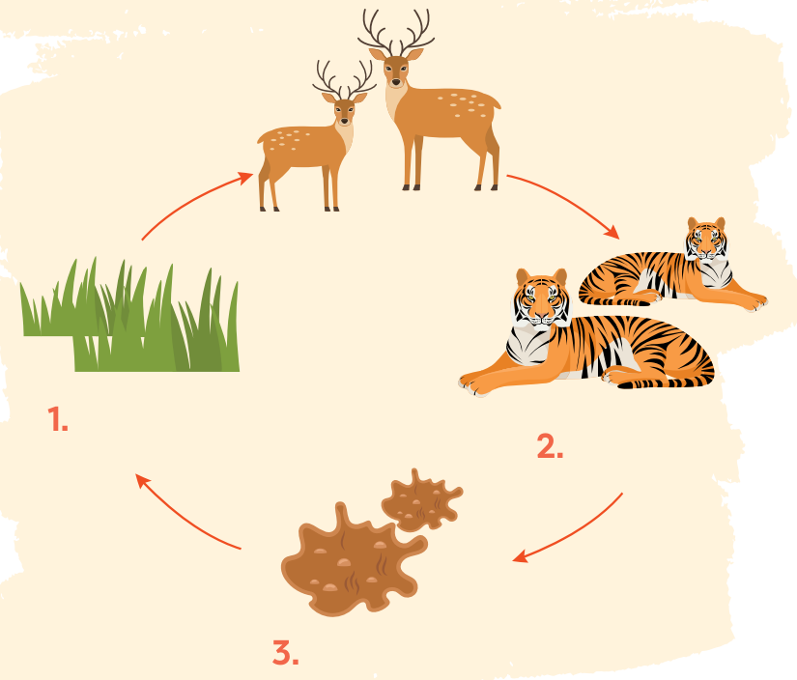
READING
3
Read the passage again and fill in the diagram.
animals (prey)
plants
animals (predator)
droppings

Slide 19
TRANSITION FROM READING TO SPEAKING
- The habitats are under threats and thus we have to take actions soon.
- Read the passage in 2 again and find two threats to plants and animals, and two actions
- In Activity 4 in SPEAKING, we will discuss the threats to plants and animals and what people should do to protect them.

Slide 20
LESSON 5: SKILLS 1
LESSON 1: GETTING STARTED
WARM-UP
Option 1: Brainstorm
Option 2: Predator-Prey Chain Challenge.
Task 1: Tick (√) the things that show the roles of plants and animals.
Task 2: Read the passage and choose the correct answer A, B, C, or D.
Task 3: Read the passage again and fill in the diagram.
READING
SPEAKING
Task 4: Work in pairs. Discuss the threats to plants and animals and how we can protect them. You can use the ideas from the reading or your own ideas.
Task 5: Report the results of your discussion to the class.

Slide 21
SPEAKING
4
Work in pairs. Discuss the threats to plants and animals and how we can protect them. You can use the ideas from the reading or your own ideas.
- What do you think is the first / second / third most significant threat to the environment?
- I think the / second / threat is ...
- What do you think humans should do to deal with the situation?
- The first thing humans can / should do is ...
Threats | Actions
habitat loss | buiding nature reserves

Slide 22
SPEAKING
Threats | Actions
- habitat loss | - buiding nature reserves
- deforestation
- stop hunting
- pollution
- stop cutting down forests
- climate change
- plant more trees
- global warming
- raise people’s awareness

Slide 23
SPEAKING
5
Report the result of your discussion to the class.
- Work to practice reporting.
- Use the sample in their books to
report the threats and actions.
- You can use the notes you made in 4.

Slide 24
SPEAKING
Example:
There are many threats to the flora and fauna. First, they face habitat loss. For example, when a river is polluted, the water habitat cannot be suitable for water species. Many other animals and plants suffer from deforestation because people cut down trees and clear the forests. Global warming is another threat to a large number of animals because when the temperature is too extreme, many animals may die out.
We can do several things to preserve their habitats. We should build natural reserves to preserve endangered animals and plants. People should also stop hunting and cutting down forests. If possible, people should start planting more trees. Above all, governments should have policies to raise people’s awareness of the protection of natural habitats.

Slide 25
LESSON 5: SKILLS 1
LESSON 1: GETTING STARTED
WARM-UP
Option 1: Brainstorm
Option 2: Predator-Prey Chain Challenge.
Task 1: Tick (√) the things that show the roles of plants and animals.
Task 2: Read the passage and choose the correct answer A, B, C, or D.
Task 3: Read the passage again and fill in the diagram.
READING
SPEAKING
Task 4: Work in pairs. Discuss the threats to plants and animals and how we can protect them. You can use the ideas from the reading or your own ideas.
Task 5: Report the results of your discussion to the class.
CONSOLIDATION
Wrap-up
Homework

Slide 26

CONSOLIDATION
1
Wrap-up
What have we learnt in this lesson?
Read for main idea and specific about role of plant and animals.
Talk about threats to flora and fauna and how to protect them.

Slide 27

CONSOLIDATION
2
Homework
- Do exercises in the workbook.

Slide 28
Website: hoclieu.vn
Fanpage: facebook.com/www.tienganhglobalsuccess.vn/

