Slide 1


Slide 2

Unit
8
1
FAMILY LIFE
Unit
NEW WAYS TO LEARN
LESSON 4
SPEAKING
Online learning

Slide 3

1
OBJECTIVES
FAMILY LIFE
Unit
1. Knowledge
- Gain an overview about the topic Online learning
- Memorize vocabulary to talk about online learning
2. Core competence
- Gain some language expressions about online learning
- Talk about the advantages and disadvantages of online learning and give reasons for their ideas
3. Personal qualities
- Familiarize with online learning and ready to adapt this new way of learning
- Develop self-study skills

Slide 4
LESSON 4
SPEAKING
GETTING STARTED
WARM-UP
Game: Jigsaw puzzle
CONTROLLED PRACTICE
Brainstorming
Task 1: Fill in the chart.
LESS CONTROLLED PRACTICE
Task 2: Discussion
FREE PRACTICE
Task 3: Role-play: Discuss your opinion about online learning
CONSOLIDATION
Wrap-up
Homework

Slide 5
LESSON 4
SPEAKING
GETTING STARTED
WARM-UP
Game: Jigsaw puzzle

Slide 6
LESSON 4
SPEAKING
Unit
GETTING STARTED
Jigsaw puzzle
- 1 correct answer = 10 points
- KEY picture = 50 points
1
2
5
3
4

Slide 7





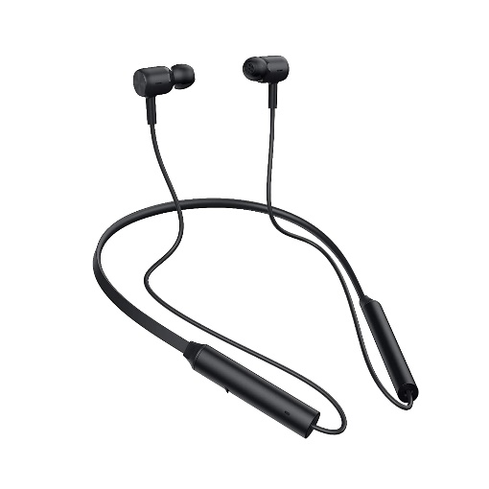

1
1
2
2
a laptop
5
5
3
3
4
4
a headset
Zoom
What is it?
What are these?
What is the name of this app?
What is it?
What is it?
earphones
a wifi router

Slide 8

ONLINE LEARNING

Slide 9
LESSON 4
SPEAKING
GETTING STARTED
WARM-UP
Game: Jigsaw puzzle
CONTROLLED PRACTICE
Brainstorm
Task 1: Fill in the chart.

Slide 10
CONTROLLED PRACTICE
List the advantages and disadvantages of
online learning (from the previous lesson)
ONLINE LEARNING | FALSE
ADVANTAGES | DISADVANTAGES
- can't discuss and communicate with friends
- can't ask for answers or help from teachers immediately
- don't have to go to school
- talk and exchange comments & ideas through emails and online discussion board
- lots of distractions
- need a fast Internet connection

Slide 11
CONTROLLED PRACTICE
1
Fill in the chart
ONLINE LEARNING
Advantages
Disadvantages
a. We can learn at our own pace.
b. We may have technical problems.
c. We sit in front of a computer for a long time.
d. We can learn anytime and anywhere with an Internet connection.
e. We can organise our own study schedule.
f. We can’t discuss and talk to each other face to face.
a
b
d
c
e
f

Slide 12
LESSON 4
SPEAKING
GETTING STARTED
WARM-UP
Game: Jigsaw puzzle
CONTROLLED PRACTICE
Brainstorm
Task 1: Fill in the chart.
LESS CONTROLLED PRACTICE
Task 2: Discussion

Slide 13


LESS CONTROLLED PRACTICE
2
Discussion
Evidence/Examples
FOR Group 1, 2 | a - can learn at our own pace
 | d - can learn anytime and anywhere
 | e - can organise our own study schedule
AGAINST Group 3, 4 | b - technical problems
 | c - sit in front of a computer for a long time
 | f - can't discuss and talk face-to-face
can record the lesson to listen again
don't have to go to school, save time
can take evening classes, have more time during the day
bad connection, broken mic, ...
cause eyes problems, body aches
can't ask questions, can't understand the lesson fully

Slide 14
LESSON 4
SPEAKING
GETTING STARTED
WARM-UP
Game: Jigsaw puzzle
CONTROLLED PRACTICE
Brainstorm
Task 1: Fill in the chart.
LESS CONTROLLED PRACTICE
Task 2: Discussion
FREE PRACTICE
Task 3: Role-play: Discuss your opinion about online learning

Slide 15

FREE PRACTICE
3
Role-play
1 member from Group 1, 2
works with
1 member from Group 3, 4
Choose any role:
Zoom CEO
A teacher
A student
A parent
FOR AGAINST

Slide 16
FREE PRACTICE
3
Role-play
Useful expressions
FOR - A positive aspect of … is that ... - A benefit of … - A good point about … - An argument in favor of ... | AGAINST - A disadvantage of ... is that ... - A negative aspect of ... - An argument against … - A drawback of ...

Slide 17
LESSON 4
SPEAKING
GETTING STARTED
WARM-UP
Game: Jigsaw puzzle
CONTROLLED PRACTICE
Brainstorm
Task 1: Fill in the chart.
LESS CONTROLLED PRACTICE
Task 2: Discussion
FREE PRACTICE
Task 3: Role-play: Discuss your opinion about online learning
CONSOLIDATION
Wrap-up
Homework

Slide 18
CONSOLIDATION
1
Wrap-up
Language items:
Vocabulary on the topic 'Online learning'
Useful expressions to talk about advantages and disadvantages of online learning and give reasons for their ideas

Slide 19

CONSOLIDATION
2
Homework
- Record yourself in 2 minutes, talking about the advantages OR disadvantages of online learning and reasons for your choice.
- Do the exercises: Unit 8 - Lesson 4, Workbook

Slide 20

Website: hoclieu.vn
Fanpage: facebook.com/tienganhglobalsuccess.vn/

