Slide 1

Unit 8: Festivals around the World
Lesson 2.1: Vocabulary & Listening
Page 63

Slide 2

LESSSON OUTLINE
Vocabulary
Listening
Practice
Consolidation
Wrap-up

Slide 3

By the end of this lesson, students will be able to…
- use some vocabularies about holidays, festivals and traditions.
- talk about New Year traditions in Spain and Scotland.

Slide 4

WARM UP

Slide 5
Work in pairs.
Talk to your partner the best festival in the world.
THE BEST FESTIVAL
1. What do you think is the best festival in the world?
2. Where is it? When does it take place?
3. What can you see and do there?
4. Why do you think it is the best festival?

Slide 6
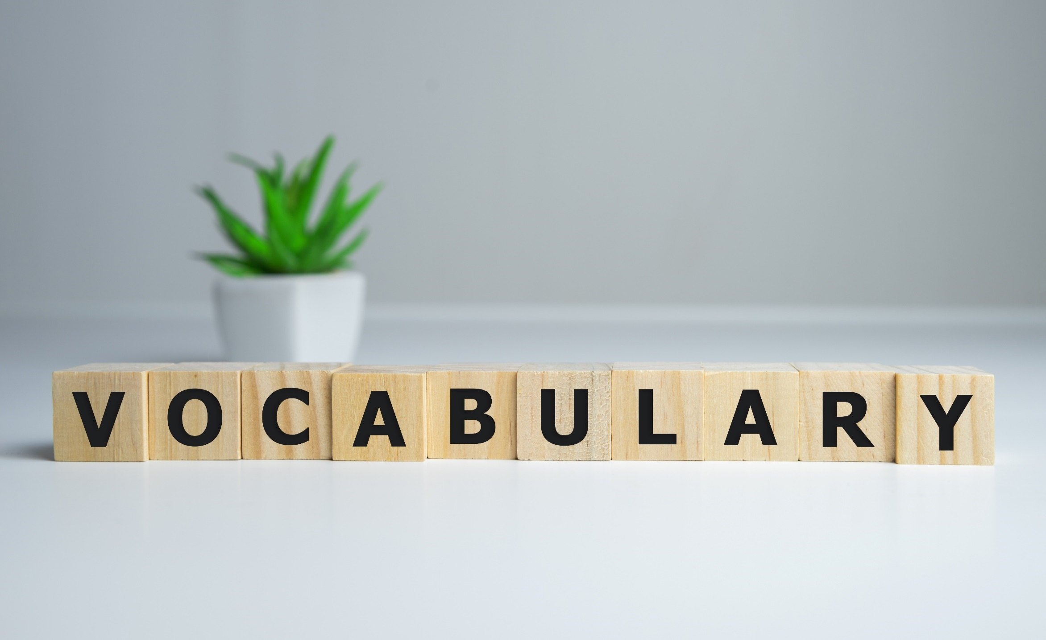


Slide 7

What can you see?
fireworks

Slide 8

What can you see?
board game

Slide 9
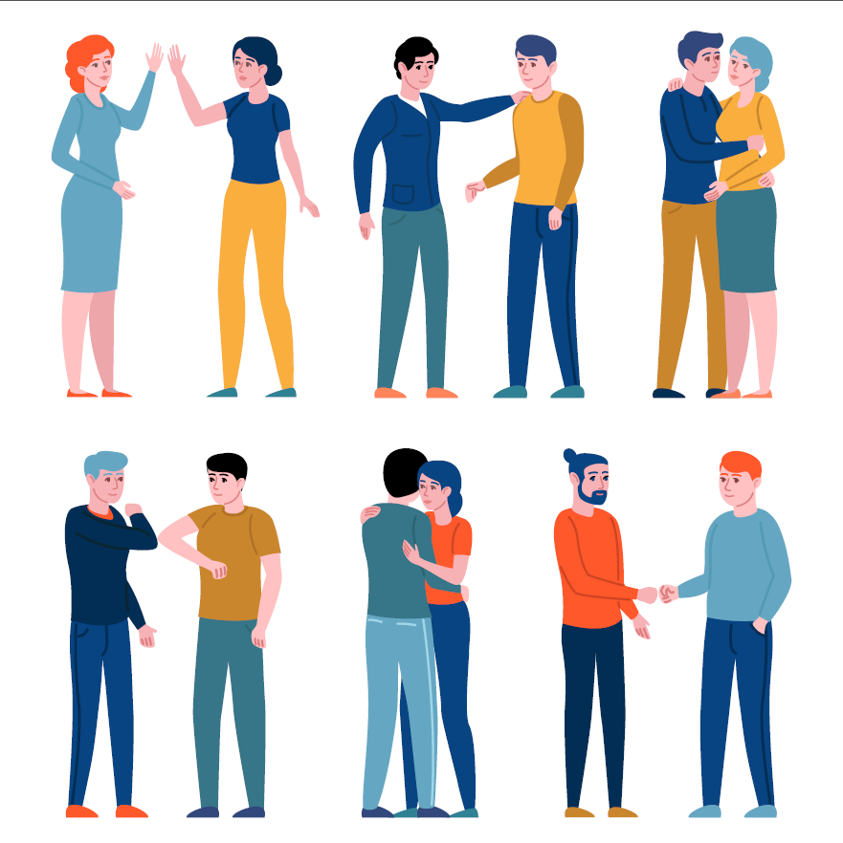
What are the people doing?
greeting
They are _____________ each other.

Slide 10
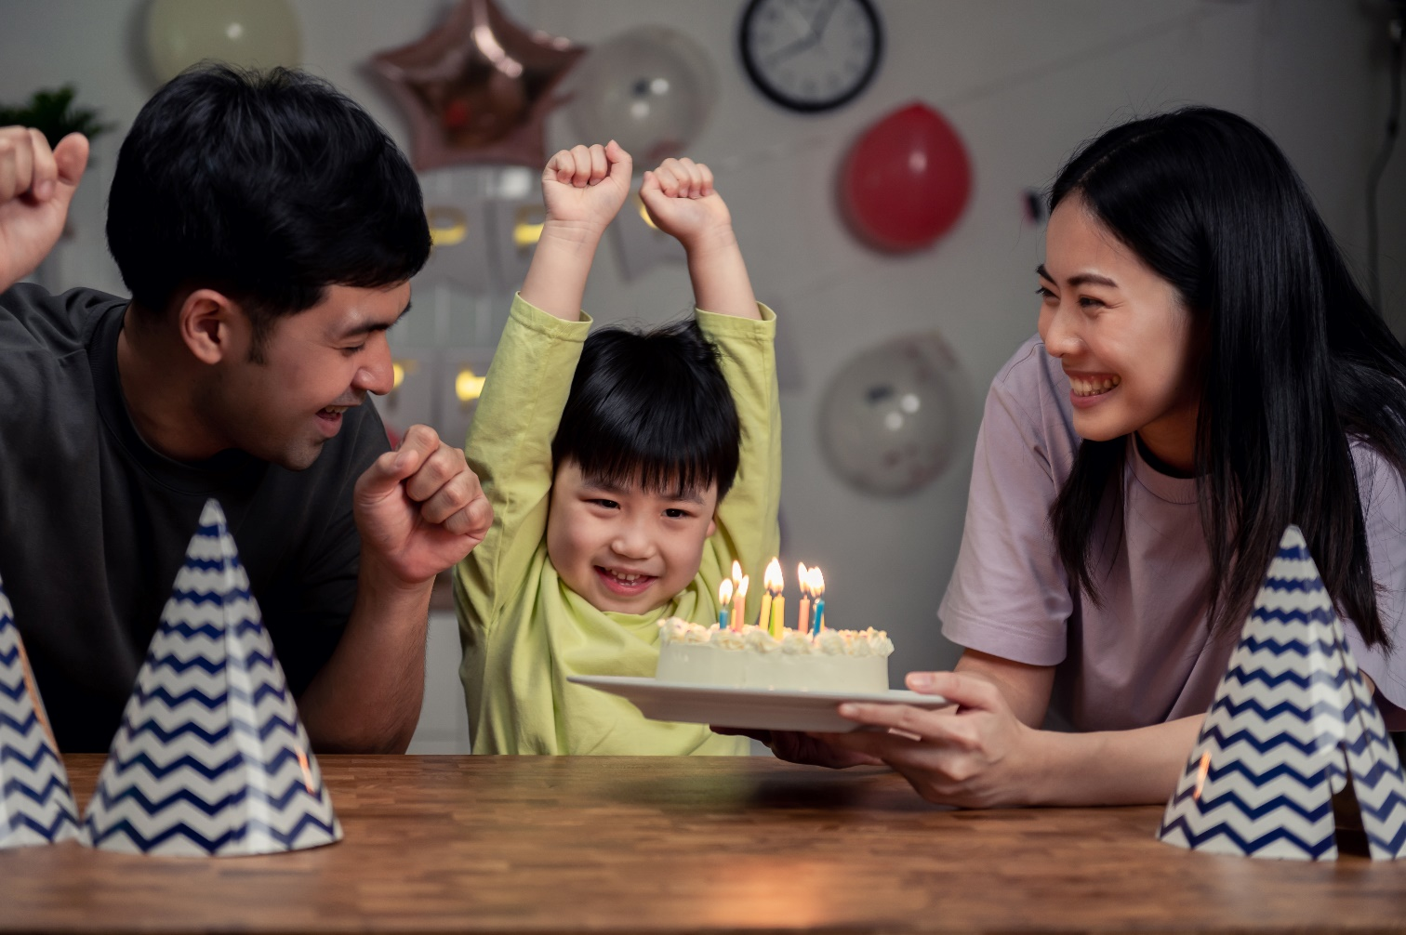
What are the people doing?
celebrating
They are _____________ a birthday.

Slide 11
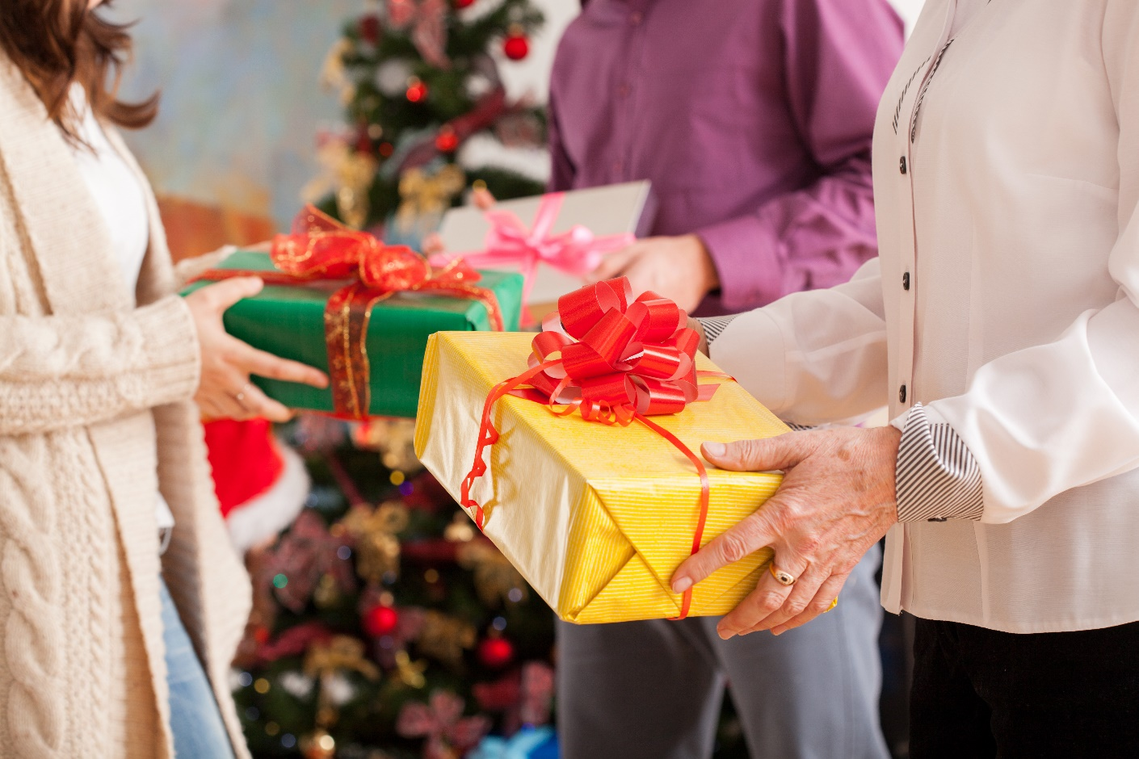
What are they doing?
exchanging
They are _____________ gifts.

Slide 12

What time is it?
It’s 12 o’clock at night (12 am).
It’s ___________.
midnight

Slide 13

tradition
It’s our family’s ___________ to have a party on New Year’s Eve.

Slide 14

celebrate
Some Asian countries, such as Vietnam and South Korea, ___________ Lunar New Year.
The boy wanted to stay up until ___________ to see the fireworks, but he fell asleep at 11:30 p.m.
I'm going to send him a card and ___________ him a happy birthday.
Many European countries share the ___________ of having a big family meal on Christmas Day.
He welcomed me with a warm ________ and introduced me to his friends.
We share the same birthday, so we often ___________ gifts with each other. Last year, I gave him a book and he gave me a board game.
midnight
wish
tradition
greeting
exchange

Slide 15
Listen and repeat.
exchange (v) / ɪksˈtʃeɪndʒ / trao đổi

tradition (n) / trəˈdɪʃən / truyền thống

midnight (n) / ˈmɪdnaɪt / nửa đêm

wish (v) / wɪʃ / chúc, mong ước

greeting (n) / ˈgriːtɪŋ / lời chào hỏi

celebrate (v) / ˈseləbreɪt / ăn mừng, làm lễ kỷ niệm

Notes:
GV click vào từng cụm nghe âm thanh

Slide 16
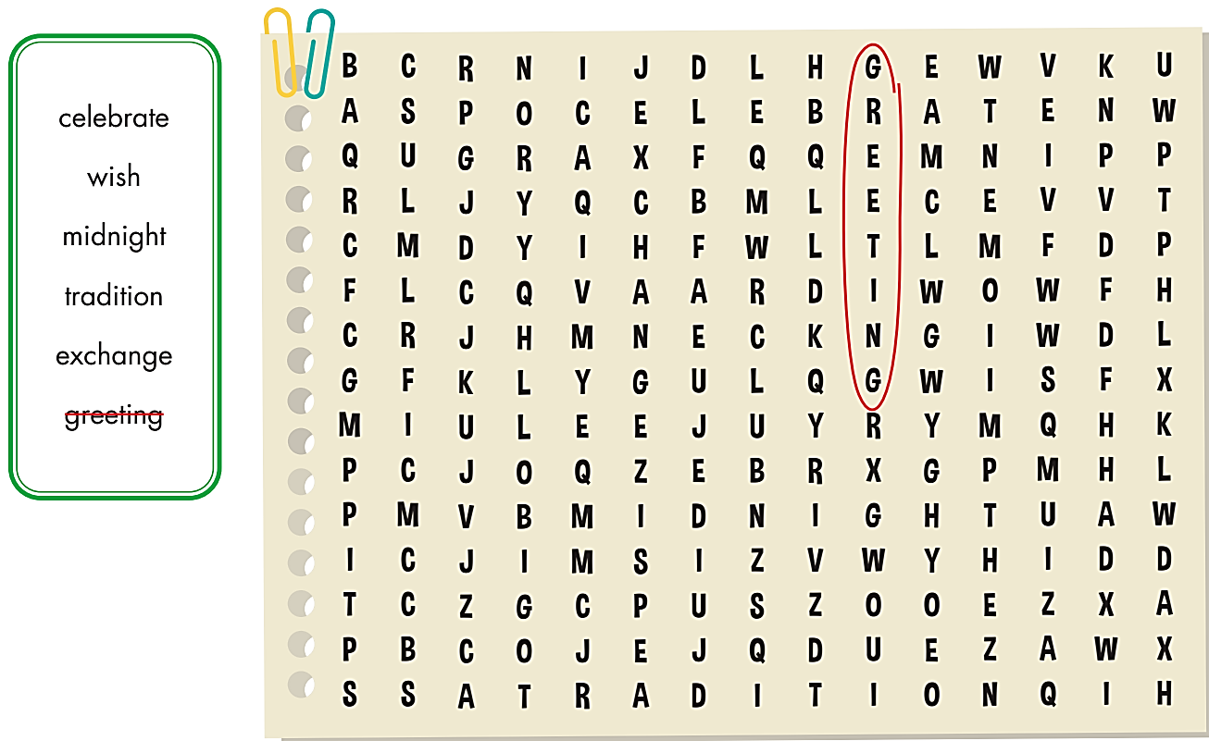

Extra Practice
WB, page 46

Slide 17
Extra Practice
WB, page 46
Fill in the blanks with the words from the box:
"Hello, how are you?" is a __________ we use every day.
When the clock shows __________, the new year will begin.
You should make a __________ before you blow out the candles.
I will __________ my birthday by having a party.
We always __________ lucky money with our family on
New Year's Eve.
Wearing áo dài is an important Vietnamese __________ .
greeting
midnight
wish
celebrate
exchange
tradition

Slide 18

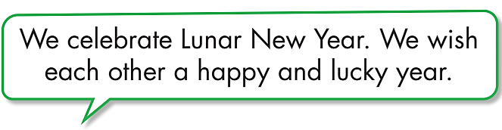

Slide 19
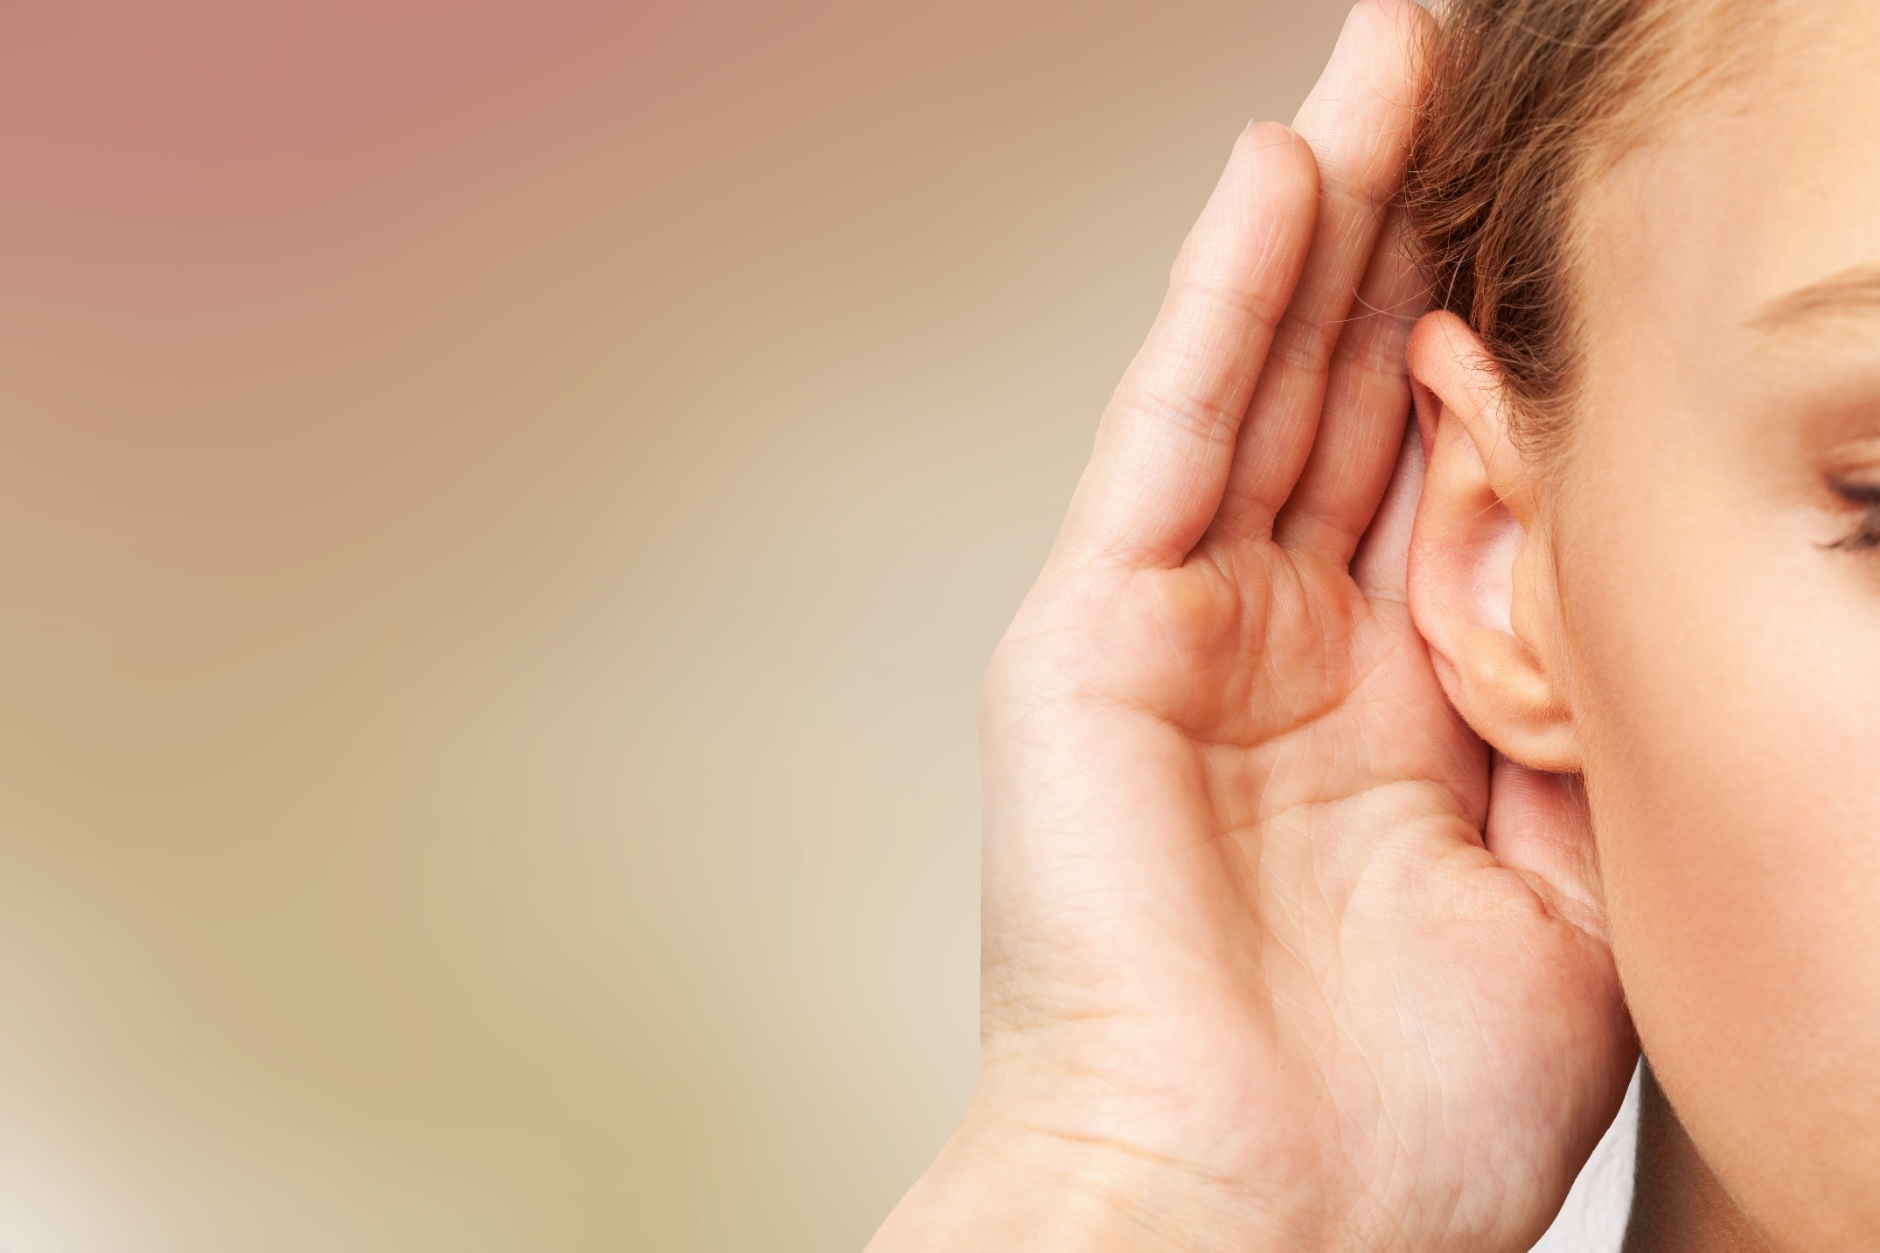
LISTENING

Slide 20
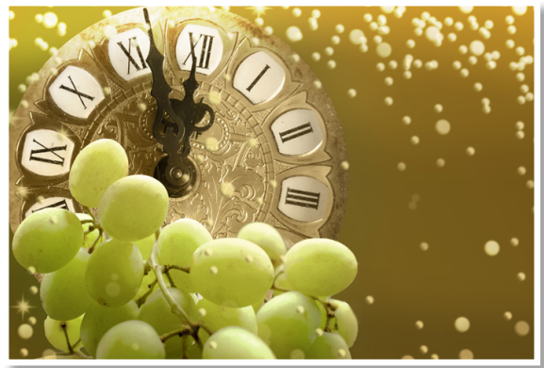
Pre-listening
What fruit can you see in the picture?
grapes

Slide 21
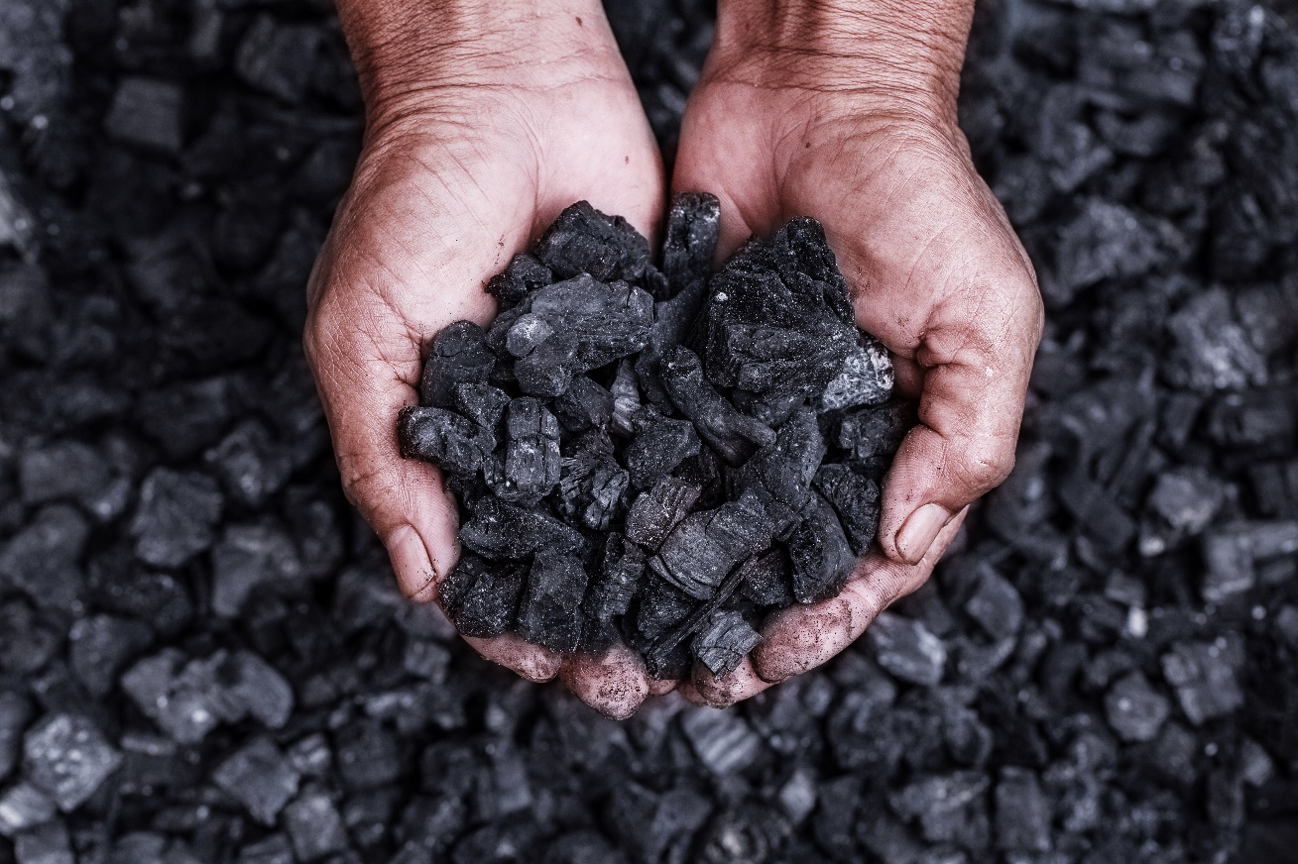
What can you see in the picture?
coal

Slide 22
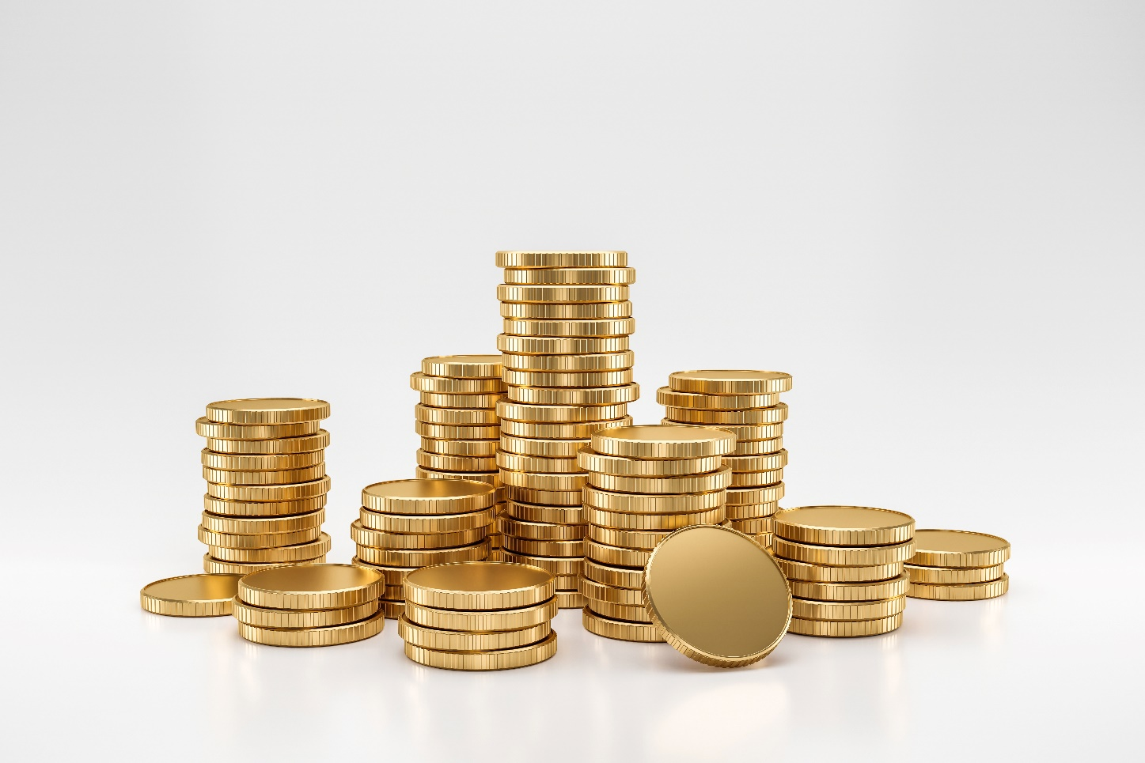
What can you see in the picture?
coins

Slide 23
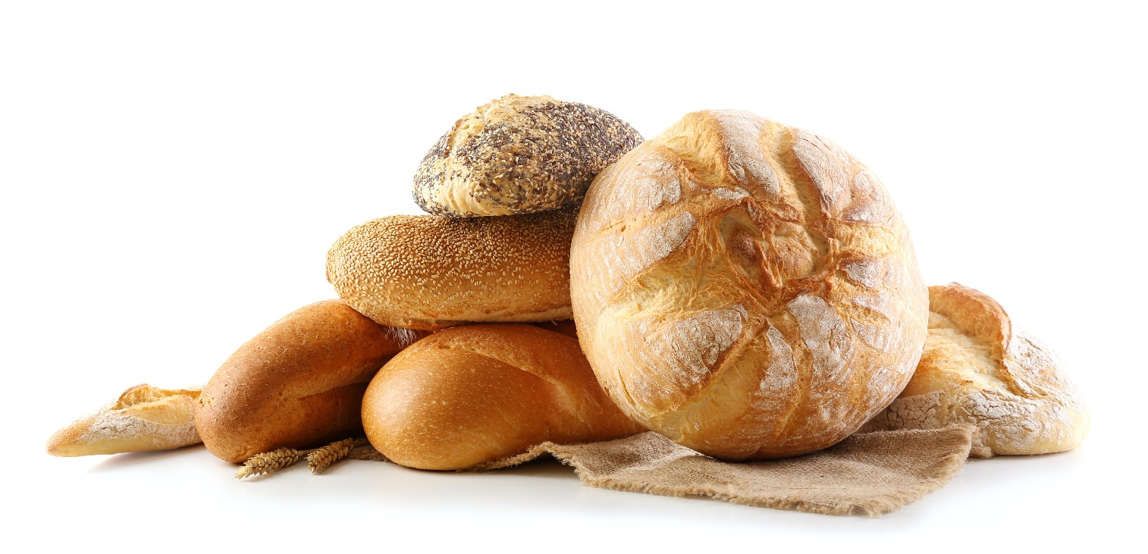
What can you see in the picture?
bread

Slide 24


While-listening


Slide 25
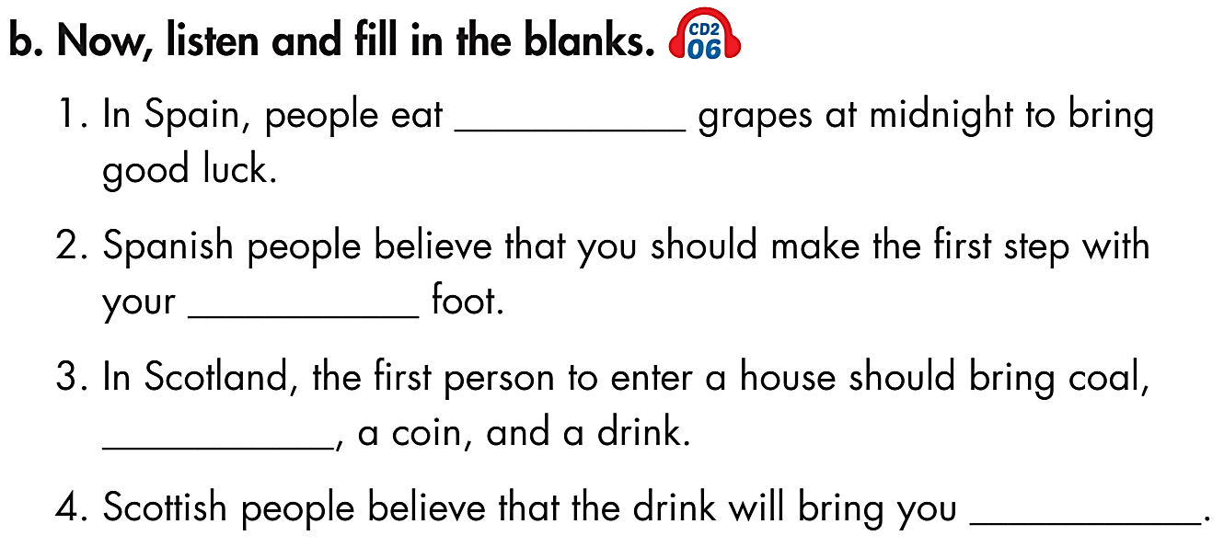

12
right
bread
happiness

Slide 26
Post-listening
12
right
bread
happiness

Slide 27
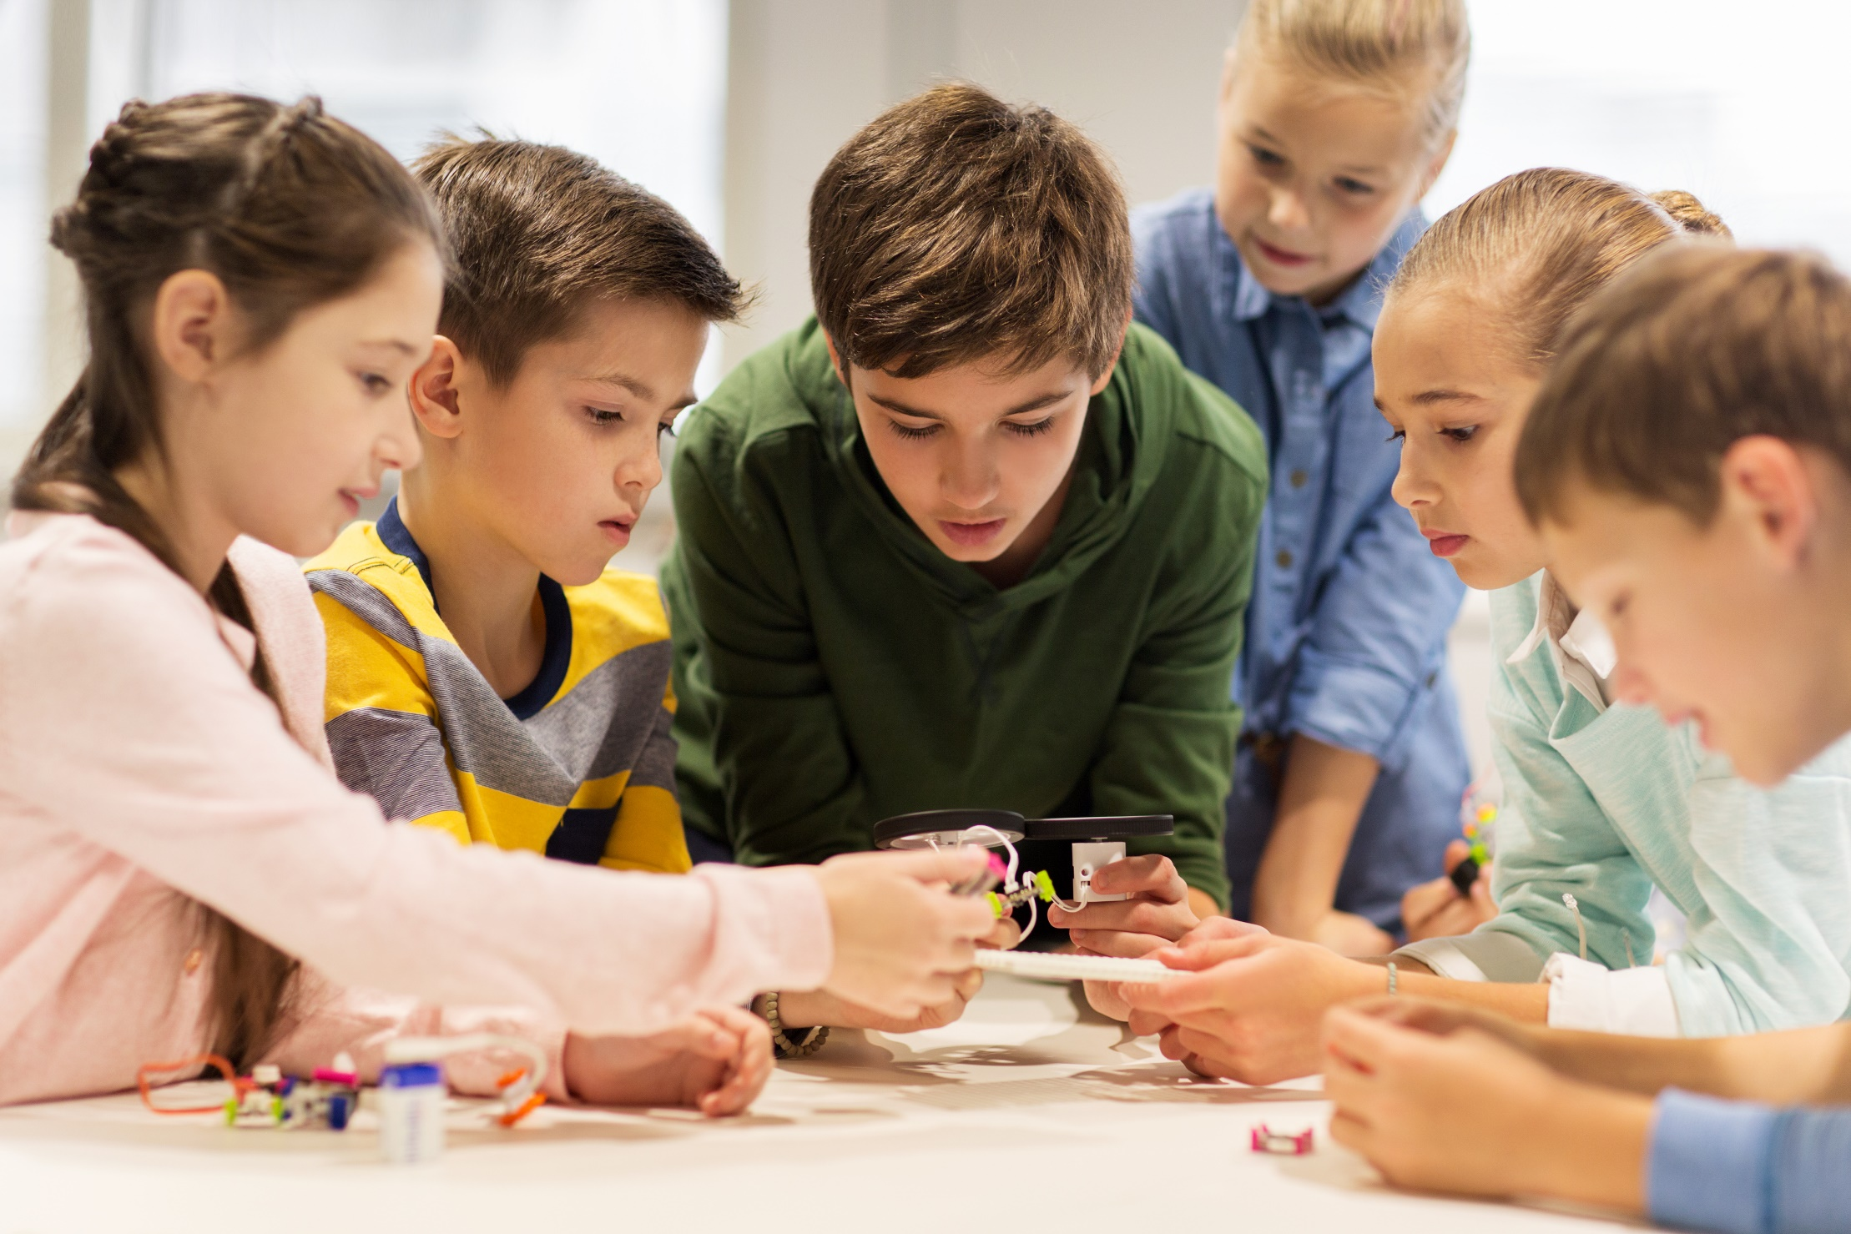
PRACTICE

Slide 28
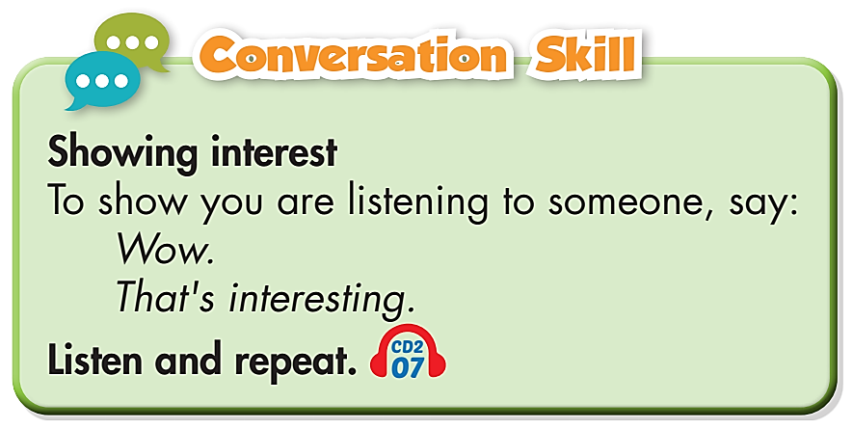


Slide 29

Look and listen, then practice the conversation with a partner:
Emily : OK. Right foot. That's a bit like
our "First Footing!“
Andy : What's "First Footing"?
Emily : The first person to enter your house
should bring a piece of coal, bread,
a coin, and a drink for good luck.
Andy : Why? Do they mean something?
Emily : Yes. The coal brings you warmth.
Bread brings food. The coin brings
money and the drink brings happiness.
Andy : That's interesting. Oh look! It’s
time! Are you ready?
Emily : Yes!
Emily: Thanks for inviting me tonight!
Andy: You're welcome. Do you like our
Spanish way of celebrating?
Emily : I love it! It's different from how
we celebrate in Scotland.
Andy : Now, here are your grapes.
Emily : Grapes?
Andy : Yes, it's a tradition here. You have
to eat twelve grapes at midnight.
You eat one grape every second.
Emily : Wow.
Andy : Then, you should make the first
step of the new year with your
right foot.

Slide 30

CONSOLIDATION

Slide 31
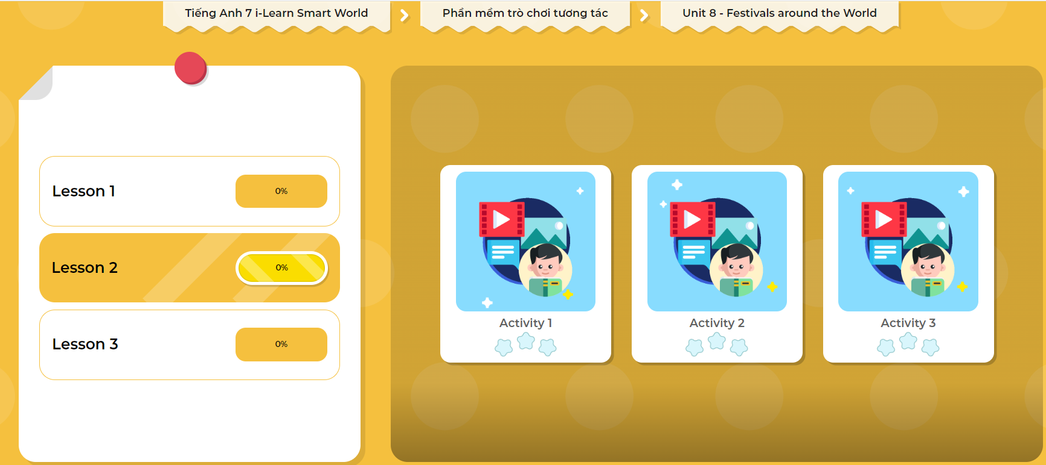
LET’S PLAY!
Click here to play the games!

Slide 32
Work in pairs.
Talk about New Year traditions in your country.

Slide 33

WRAP-UP

Slide 34
Today’s lesson
Vocabularies
celebrate
exchange
greeting
midnight
tradition
wish

Slide 35
Today’s lesson
Vocabulary about holidays, festivals and traditions.
Listening about New Year traditions in Spain and Scotland.
Conversation skill to show interest when you are listening to someone.

Slide 36
Homework
Learn vocabularies and practice using them.
Finish the listening exercise on page 46 in the WB.
Do the exercises in Tiếng Anh 7 i-Learn Smart World Notebook on page 50
Prepare the next lesson (page 64, SB).
Play the consolidation games in Tiếng Anh 7 i-Learn Smart World DHA App on www.eduhome.com.vn

Slide 37

Lesson 3
Stay positive and have a nice day!

