Slide 1


Slide 2



Unit
7
TRAFFIC
LESSON 7: LOOKING BACK & PROJECT
VOCABULARY REVIEW
IT -> DISTANCE
GRAMMAR REVIEW
PRODUCTION
PROJECT: TRAFFIC/ROAD SIGNS
TRAFFIC PROBLEMS AND MEANS OF TRANSPORT
Unit

Slide 3

OBJECTIVES
By the end of the lesson, students will be able to:
review the vocabulary and grammar of Unit 7
apply what they have learnt (vocabulary and grammar) into practice through a project

Slide 4
LESSON 7: LOOKING BACK & PROJECT
WARM-UP
QUICK REVISION CHECK
VOCABULARY REVIEW
Task 1: Label each sign. Work in pairs. What does each sign tell us to do?
Task 2: Fill in each gap with one word to complete the sentences.
Task 3: Write complete sentences, using these cues.
Task 4: Choose A, B, or C to complete the sentences.
GRAMMAR REVIEW
Traffic signs
Task 5: Show the prepared signs. Make your own sign.
Task 6: Traffic signs exhibition
PROJECT
CONSOLIDATION
Wrap-up
Home work

Slide 5
LESSON 7: LOOKING BACK & PROJECT
WARM-UP
QUICK REVISION CHECK
Aims of the stage:
To help students revise the vocabulary items they have learnt in the unit.To enhance students’ skills of cooperating with team mates.
Notes:
Wordwall link to spin the wheel in real time: https://wordwall.net/resource/27022823

Slide 6

LESSON 7: LOOKING BACK & PROJECT
WARM-UP
QUICK REVISION CHECK
VOCABULARY REVIEW
Task 1: Label each sign. Work in pairs. What does each sign tell us to do?
Task 2: Fill in each gap with one word to complete the sentences.

Slide 7
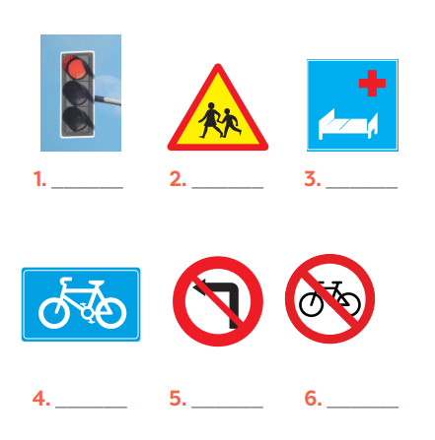
VOCABULARY REVIEW
1
Label each sign. Work in pairs. What does each sign tell us to do?
KEYS
1. traffic light
2. school ahead
3. hospital ahead
4. cycle lane
5. No left turn
6. Do not cycle

Slide 8
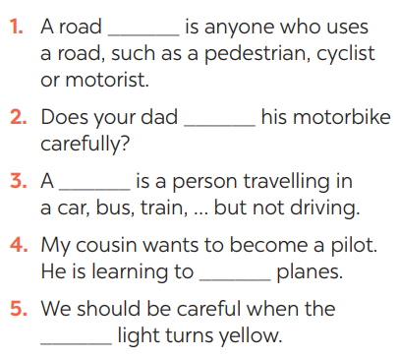
VOCABULARY REVIEW
2
Fill in each gap with one word to complete the sentences.
KEYS:
1. user
2. ride
3. passenger
4. drive
5. see/notice

Slide 9
LESSON 7: LOOKING BACK & PROJECT
WARM-UP
QUICK REVISION CHECK
VOCABULARY REVIEW
Task 1: Label each sign. Work in pairs. What does each sign tell us to do?
Task 2: Fill in each gap with one word to complete the sentences.
Task 3: Write complete sentences, using these cues.
Task 4: Choose A, B, or C to complete the sentences.
GRAMMAR REVIEW

Slide 10
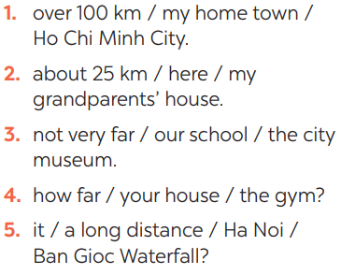
GRAMMAR REVIEW
Aim of the task:
To help Ss revise grammar points.
3
Write complete sentences, using these cues.
ANSWER KEYS
1- It’s over 100km from my hometown to Ho Chi Minh city.
2- It’s about 25 km from here to my grandparents’ house.
3- It’s not very far from our school to the city museum.
4- How far is it from your house to the gym?
5- Is it a long distance from Ha Noi to Ban Gioc Waterfall?

Slide 11
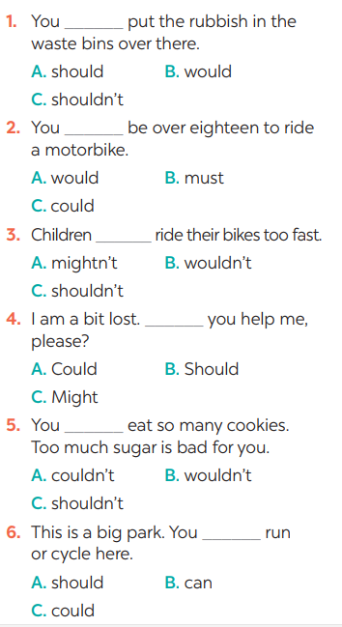
GRAMMAR REVIEW
4
Choose A, B, or C to complete the sentences.

Slide 12
LESSON 7: LOOKING BACK & PROJECT
WARM-UP
QUICK REVISION CHECK
VOCABULARY REVIEW
Task 1: Label each sign. Work in pairs. What does each sign tell us to do?
Task 2: Fill in each gap with one word to complete the sentences.
Task 3: Write complete sentences, using these cues.
Task 4: Choose A, B, or C to complete the sentences.
GRAMMAR REVIEW
Traffic signs
Task 5: Show the prepared signs. Make your own sign.
Task 6: Traffic signs exhibition
PROJECT

Slide 13

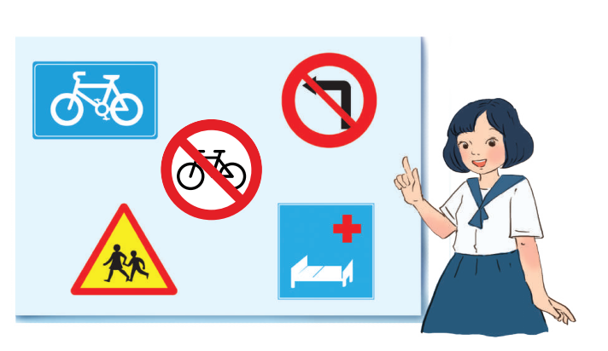
PROJECT
5
5
Show the prepared signs. Make your own sign.

Slide 14

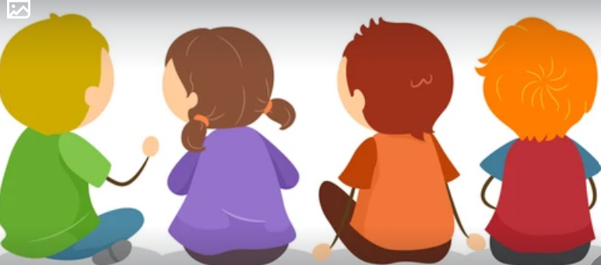
PROJECT
6
5
Traffic signs exhibition

Slide 15
LESSON 7: LOOKING BACK & PROJECT
WARM-UP
QUICK REVISION CHECK
VOCABULARY REVIEW
Task 1: Label each sign. Work in pairs. What does each sign tell us to do?
Task 2: Fill in each gap with one word to complete the sentences.
Task 3: Write complete sentences, using these cues.
Task 4: Choose A, B, or C to complete the sentences.
GRAMMAR REVIEW
Traffic signs
Task 5: Show the prepared signs. Make your own sign.
Task 6: Traffic signs exhibition
PROJECT
CONSOLIDATION
Wrap-up
Home work

Slide 16
Unit
7
TRAFFIC
LESSON 7: LOOKING BACK & PROJECT
VOCABULARY REVIEW
IT -> DISTANCE
GRAMMAR REVIEW
PRODUCTION
PROJECT: TRAFFIC/ROAD SIGNS
TRAFFIC PROBLEMS AND MEANS OF TRANSPORT
Unit

Slide 17
CONSOLIDATION
2
HOMEWORK
Prepare for the next lesson: Unit 8 – Getting started

Slide 18


