Slide 1

Unit 5: London was Great!
Progress Check
Page 100

Slide 2
Lesson Outline
Warm-up
Vocabulary
Grammar
Consolidation
Wrap-up

Slide 3
Objectives
By the end of this lesson, students will be able to…
- review vocabulary and grammar in Unit 5.

Slide 4

WARM-UP

Slide 5
Choose the word whose underlined part is pronounced differently from that of the other words.
1. A. boat B. road C. board D. goal
/bəʊt/ /rəʊd/ /bɔːd/ /ɡəʊl/
2. A. bun B. fun C. sun D. put
/bʌn/ /fʌn/ /sʌn/ /pʊt/
3. A. oven B. hot C. cod D. fog
/ˈʌvn/ /hɒt/ /kɒd/ /fɒɡ/
4. A. care B. name C. rare D. share
/keə/ /neɪm/ /reə/ /ʃeə/
5. A. pear B. wear C. near D. bear
/peə/ /weə/ /nɪə/ /beə/

Slide 6

It’s time to learn …

Slide 7
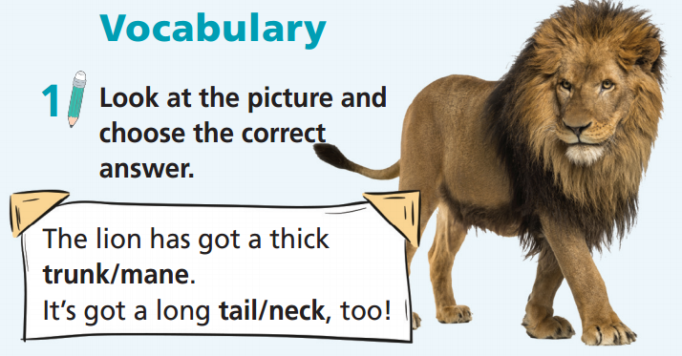

Slide 8
Choose the correct answer.
The elephant has got a long trunk/mane.
It’s got a big beak/body, too!

Slide 9
Choose the correct answer.
The parrot has got a long neck/long wings.
It’s got a sharp beak/body, too!

Slide 10
Choose the correct answer.
The giraffe has got a long neck/mane.

Slide 11
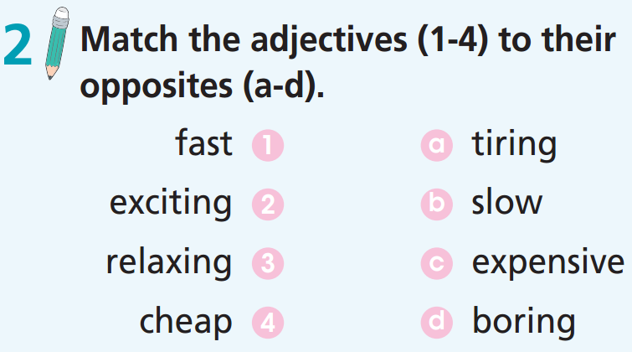

Slide 12
Complete the opposites.
1. Learning history isn’t boring. It’s ____________ because we can learn about life in the past.
2. Travelling by plane isn’t ____________. It’s really relaxing helps to save time.
3. The snail is ___________ but the rabbit is fast.
4. Tickets to the museum are not expensive. They are __________.
exciting
tiring
slow
cheap

Slide 13
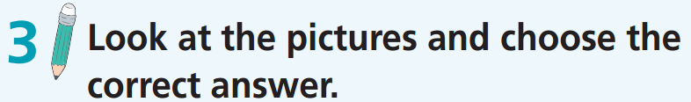
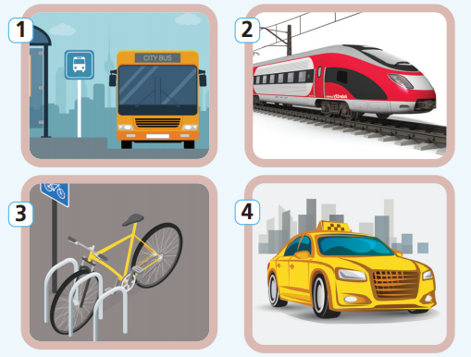
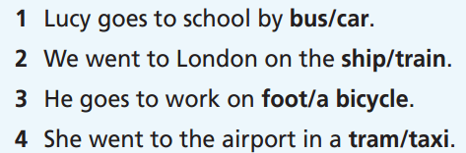

Slide 14
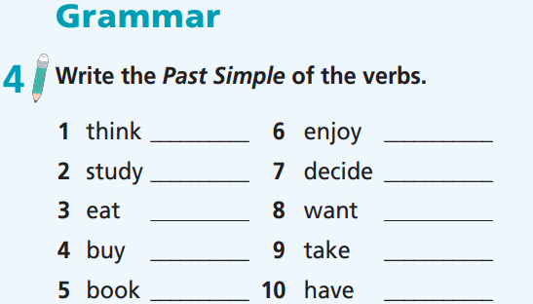
thought
enjoyed
studied
decided
ate
wanted
bought
took
booked
had

Slide 15
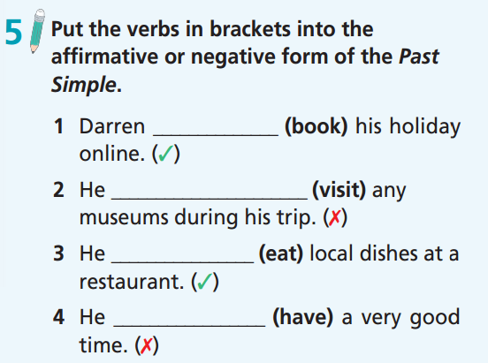
booked
didn’t visit
ate
didn’t have

Slide 16
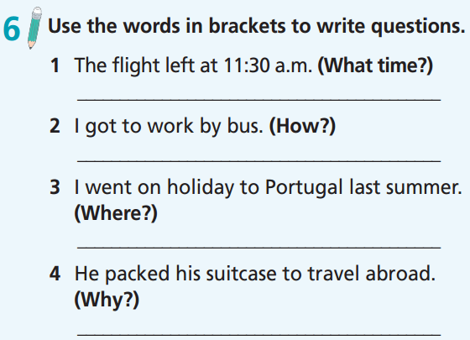
What time did the flight leave?
How did you get to work?
Where did you go on holiday last summer?
Why did he pack his suitcase?

Slide 17
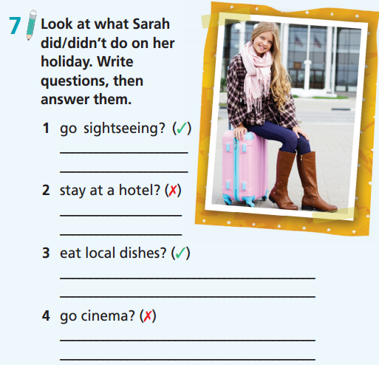
Did she go sightseeing?
Yes, she did.
2. Did she stay at a hotel?
No, she didn’t.
3. Did she eat local dishes?
Yes, she did.
4. Did she go to the cinema?
No, she didn’t.

Slide 18
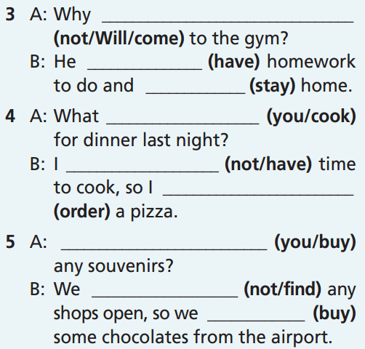
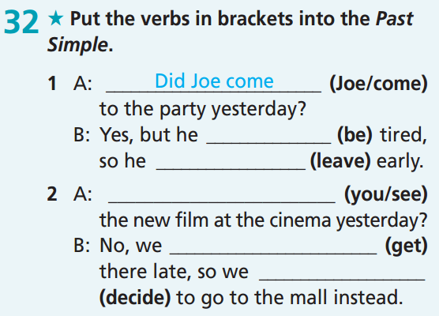
Extra-practice
GB-p. 71
didn’t Will come
had
stayed
did you cook
didn’t have
was
ordered
left
Did you see
Did you buy
got
didn’t find
decided
bought

Slide 19
Put the verbs into the correct column.
want cook plan need stop decide order stay pack watch wash study enjoy book
/id/ | /d/ | /t/
plan
order
stay
study
enjoy
cook
stop
pack
watch
wash
book
want
need
decide

Slide 20

Work in pairs.
Take turns to ask and answer about what your friend did/didn’t do last week.
No, I didn’t.
Did you go to the cinema last week?

Slide 21

CONSOLIDATION

Slide 22
Give a presentation about your last holiday. Try to answer the following questions:
Where did you go?
Who did you go with?
How did you go there?
What did you do?
What did you buy and bring home?
Introduce some interesting information about that place.
How did you feel?

Slide 23

WRAP-UP

Slide 24
Today’s lesson
- Review the language learned in Unit 5.
- Practise test-taking skills.

Slide 25
Homework
Practise the vocabularies and grammar and make sentences using them.
Do Unit 5 Test 2 in Bài Tập Bổ Trợ TA 6 Right on (pp. 46-47).
Prepare the next lesson (p. 101 SB).

Slide 26
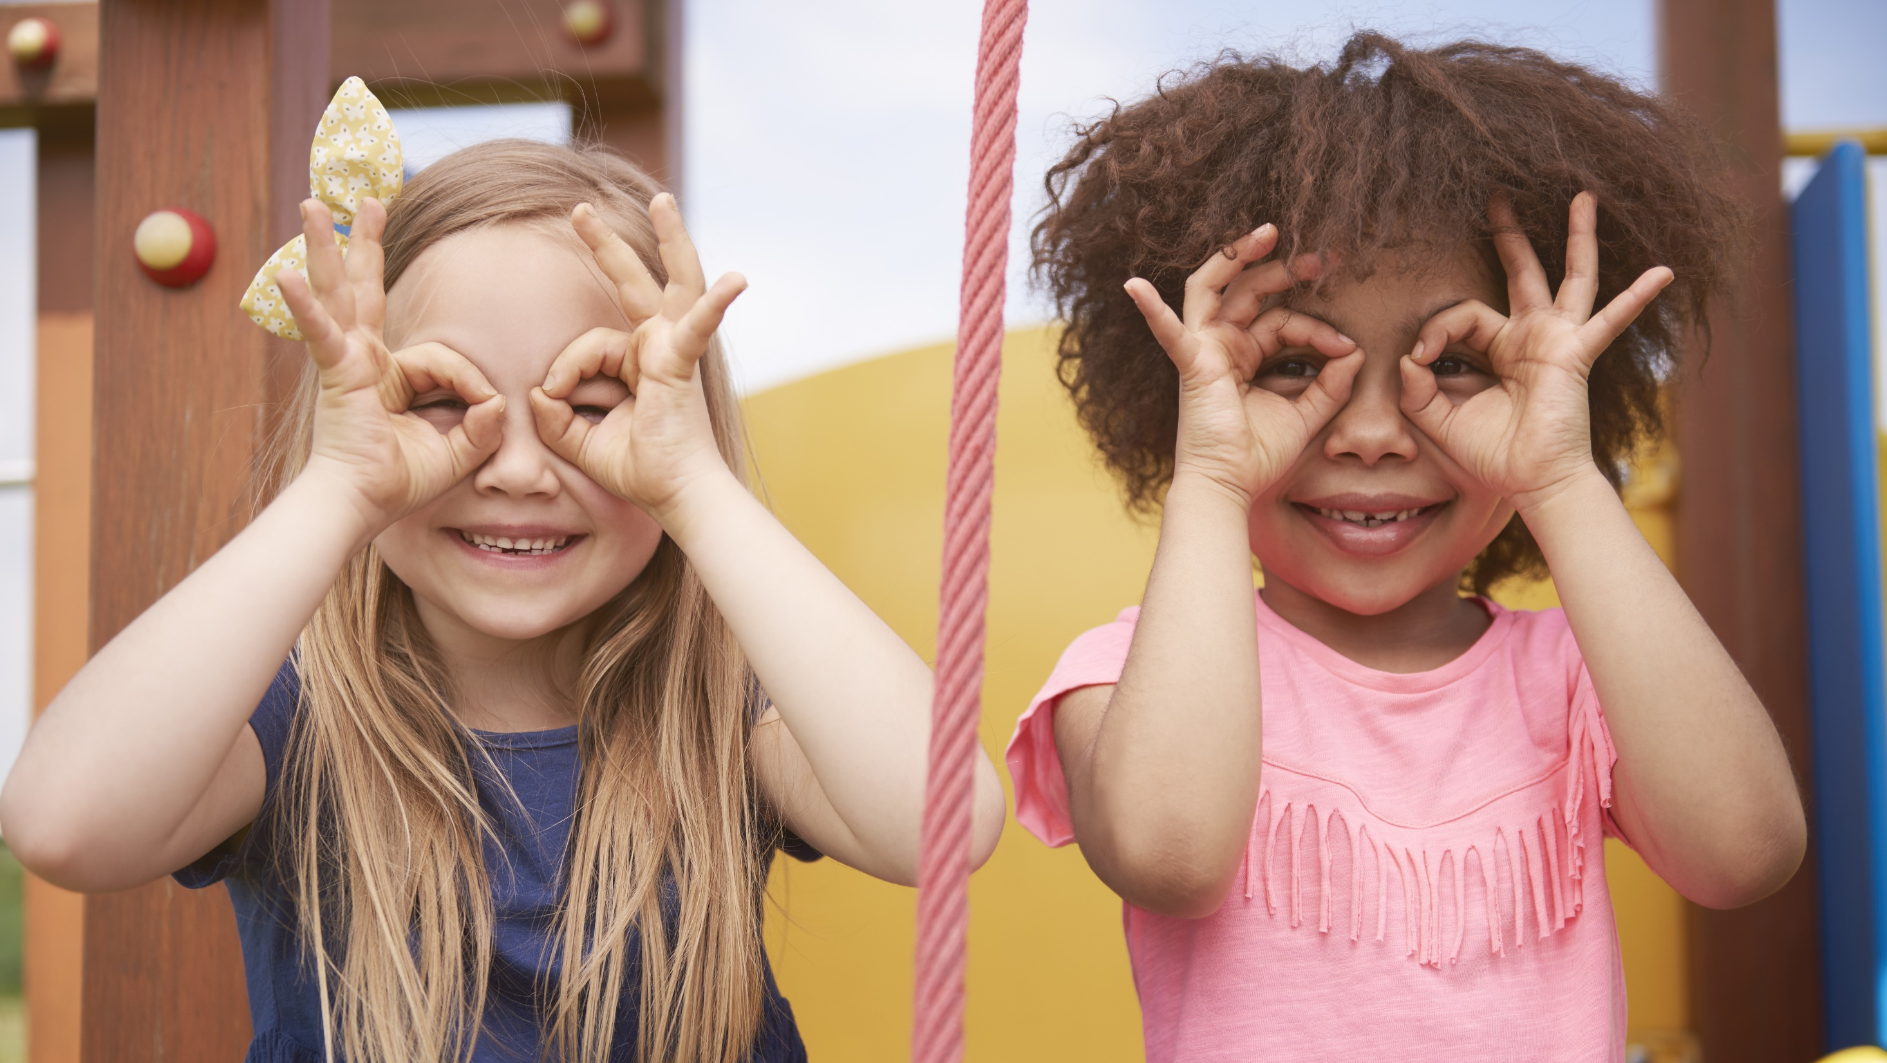
Enjoy your day!

