Slide 1

Unit 9: English in the World
Lesson 3.2: Writing
Page 75

Slide 2


LESSON OUTLINE
Consolidation

Slide 3

By the end of this lesson, students will be able to…
- write a postcard to a friend.
talk about the ways you used English on your vacation.

Slide 4

WARM-UP

Slide 5

Work in groups.
What did you use English for?

Slide 6
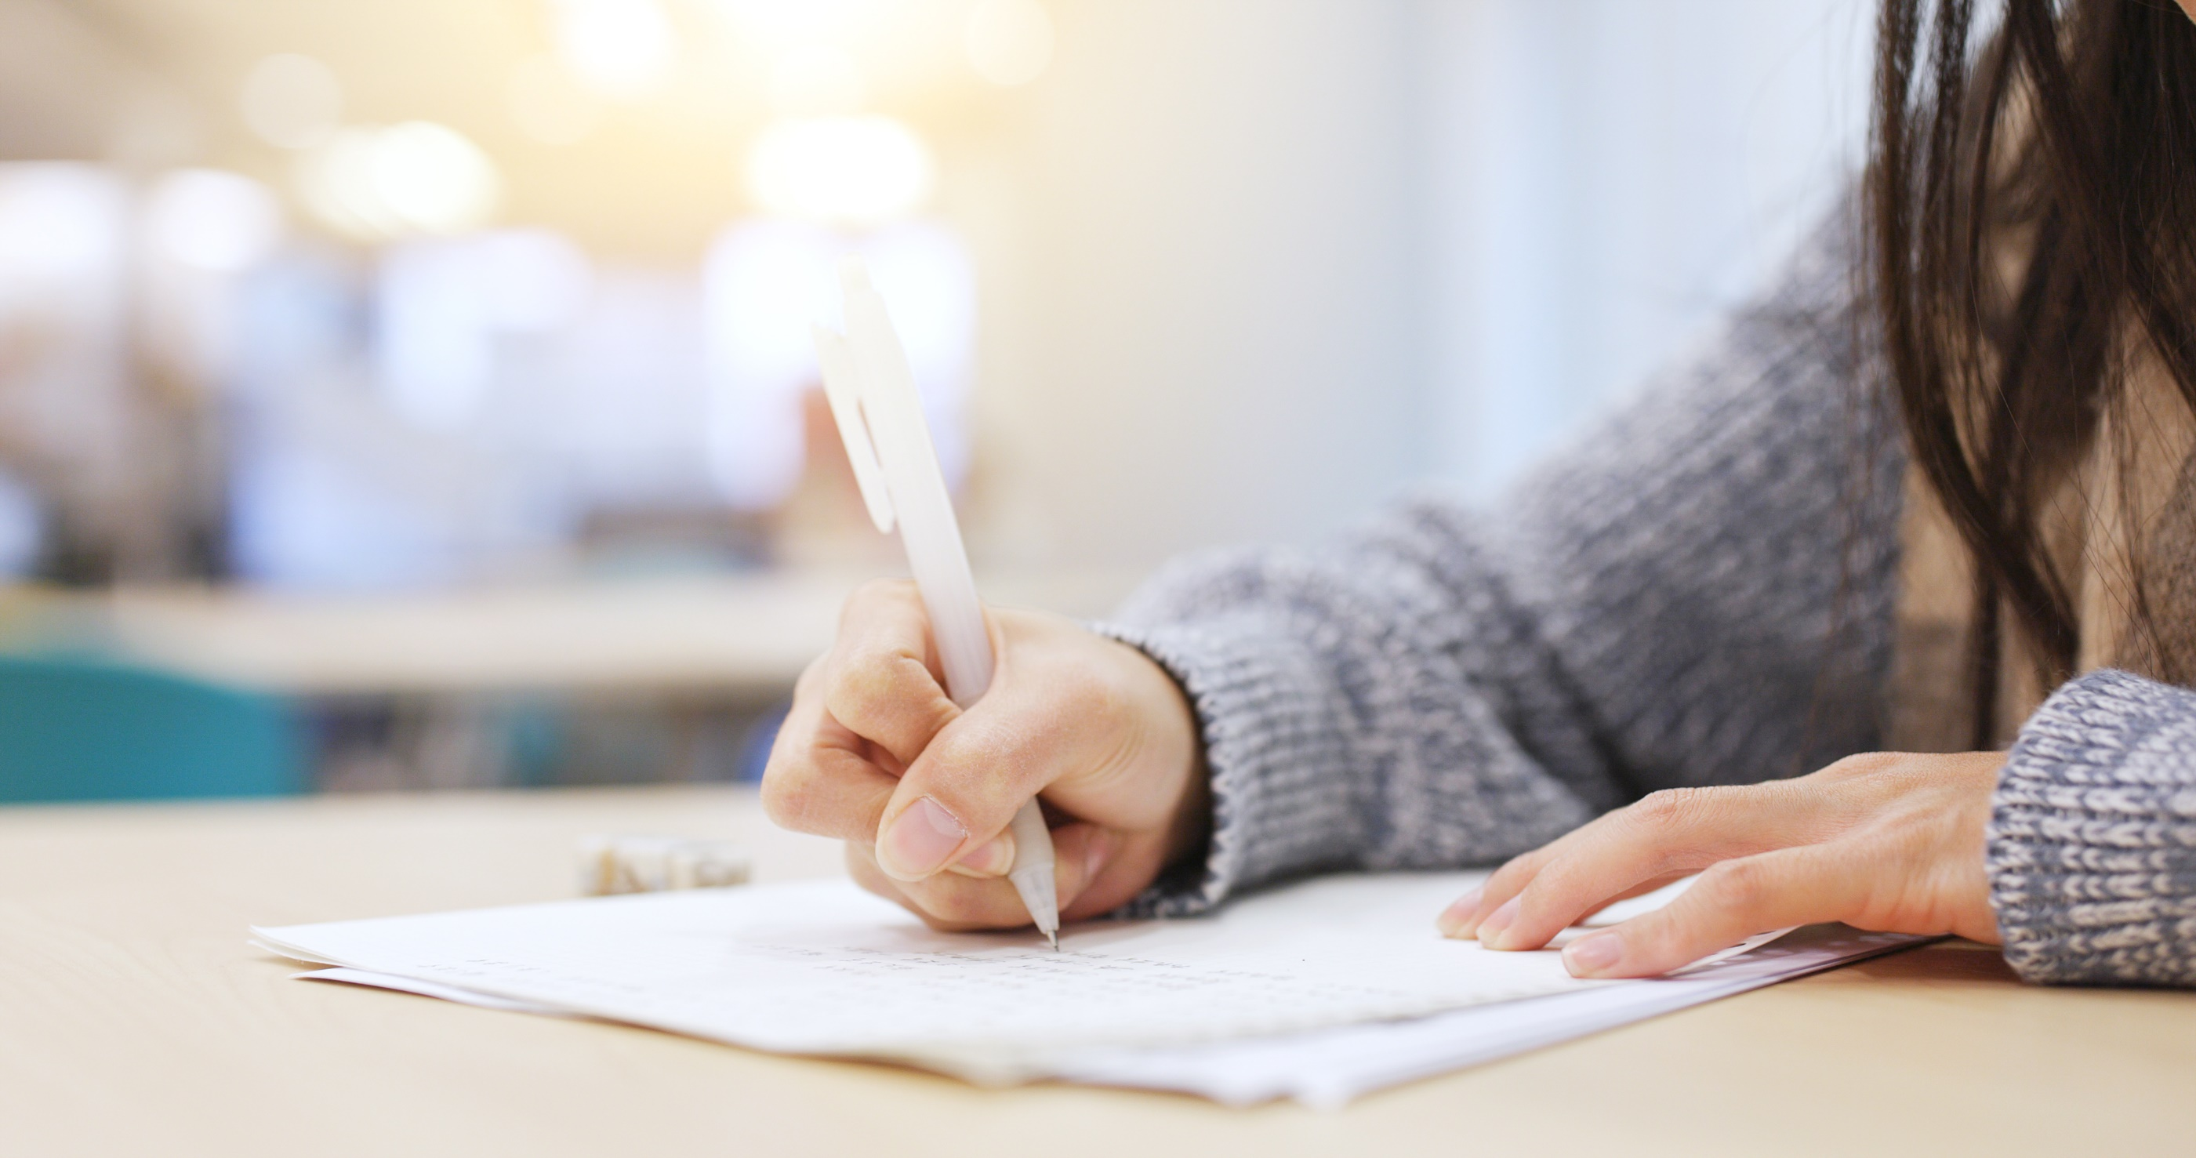

It’s writing time….

Slide 7
a. Read about writing postcards. Then, read An's postcard again and circle the examples she uses for each point in the Writing Skill box.
Pre - writing
Writing postcards
To write postcards to your friends, you should:
1. Start with an informal greeting:
"Hi Bảo...", "Hey Uyên..."
2. Say where you are using the Present Continuous:
"I'm writing to you from London...", "I'm having a great time in Sydney..."
3. Describe what you did using the Past Simple. Talk about activities:
"I went to the National Museum.", "I met a Canadian guy."
4. Talk about your plans for the rest of the vacation using the Present Continuous (future use) or the Future Simple: "Tomorrow, we're going to Melbourne.", "We'll be in Chicago on Monday..."
5. Finish with an informal goodbye:
"See you next week.", "Wish you were here."

Slide 8
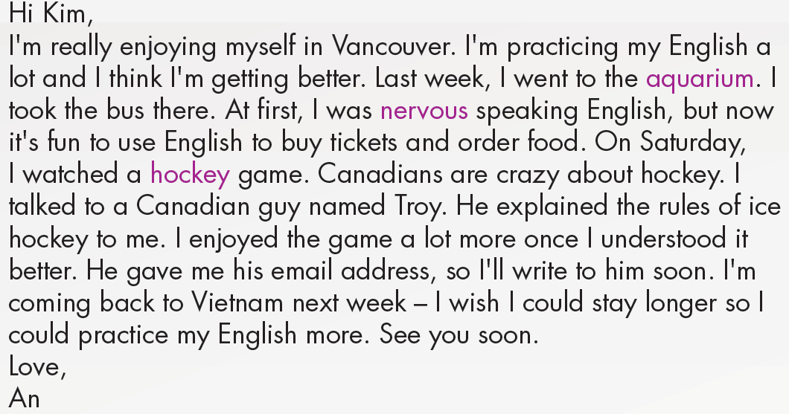
1. Start with an informal greeting
3. Describe what you did using the Past Simple. Talk about activities.
4. Talk about your plans for the rest of the vacation using the Present Continuous (future use) or the Future Simple
2. Say where you are using the Present Continuous
5. Finish with an informal goodbye

Slide 9

Click on the icon to check answers
b. Underline and correct the mistakes.
1. Wish you are here!
2. Last Thursday, I go shopping in SoHo and ordered lunch at a café. I met an interesting guy from Peru. We spoke English together.
3. Tomorrow, I walk around Central Park with him.
4. I have a great time in New York. I'm practicing English every day.
5. Dear Quý,
1. were
2. went
3. am walking
4. had
5. Hi

Slide 10
While - writing
Rewrite the postcard in the correct order in your notebook. Use the Skill box to help you.

Slide 11
Post- writing
Check the structure of the postcard.
Hi Quý,
I had a great time in New York. I'm practicing English every day. Last Thursday, I went shopping in SoHo and ordered lunch at a café. I met an interesting guy from Peru. We spoke English together. Tomorrow, I’m walking around Central Park with him. Wish you were here!
1. Start with an informal greeting
2. Say where you are using the Present Continuous
3. Describe what you did using the Past Simple. Talk about activities
4. Talk about your plans for the rest of the vacation using the Present Continuous (future use) or the Future Simple
5. Finish with an informal goodbye

Slide 12

In pairs
a. Imagine you went to an English-speaking country on vacation. Answer the questions.
Where did you go?
Why?
What did you do there?

Slide 13
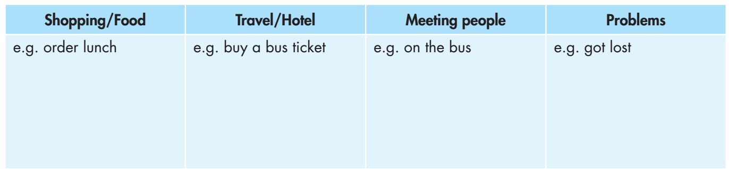
b. Make a list of ways you used English on your vacation. Use the table below and the examples to help you. Then, share with your friend.

Slide 14

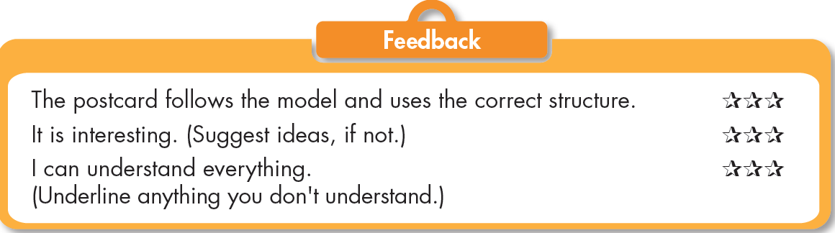
Now, write a postcard to your friend using two or three ideas from your notes in Speaking b. or your own ideas. Use the Feedback form to help you. Write 60 to 80 words.

Slide 15
Sample postcard
Hey Nam,
I'm writing to you from Melbourne. I'm staying with an Australian family. I think my English is getting better. Yesterday, I visited Queen Victoria Market. I bought some fruit and talked to the trader. It was fun! I met a girl from Korea on the bus. She was very friendly, and we spoke English together. We're walking around the Royal Botanic Gardens tomorrow. See you in two weeks!
Love,
Linh

Slide 16

CONSOLIDATION

Slide 17
Use your own ideas to write a postcard to your friend about your holiday. (About 60-80 words)

Slide 18
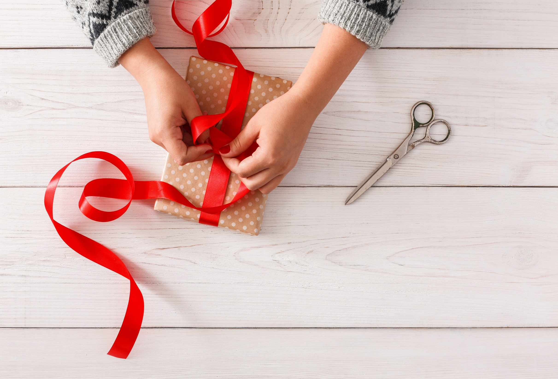
WRAP-UP

Slide 19
Today’s lesson
Writing:
- Practice writing a postcard to a friend.
Speaking:
- Talk about the ways you used English on your vacation.

Slide 20
Homework
Do the Writing exercise in Tiếng Anh 7 i-Learn Smart World Workbook on page 55.
Complete the writing notes in Tiếng Anh 7 i-Learn Smart World Notebook on page 59.
Prepare Review Unit 9 (pages 108 & 109 SB).
Play the consolidation games in Tiếng Anh 7 i-Learn Smart World DHA App on www.eduhome.com.vn

Slide 21
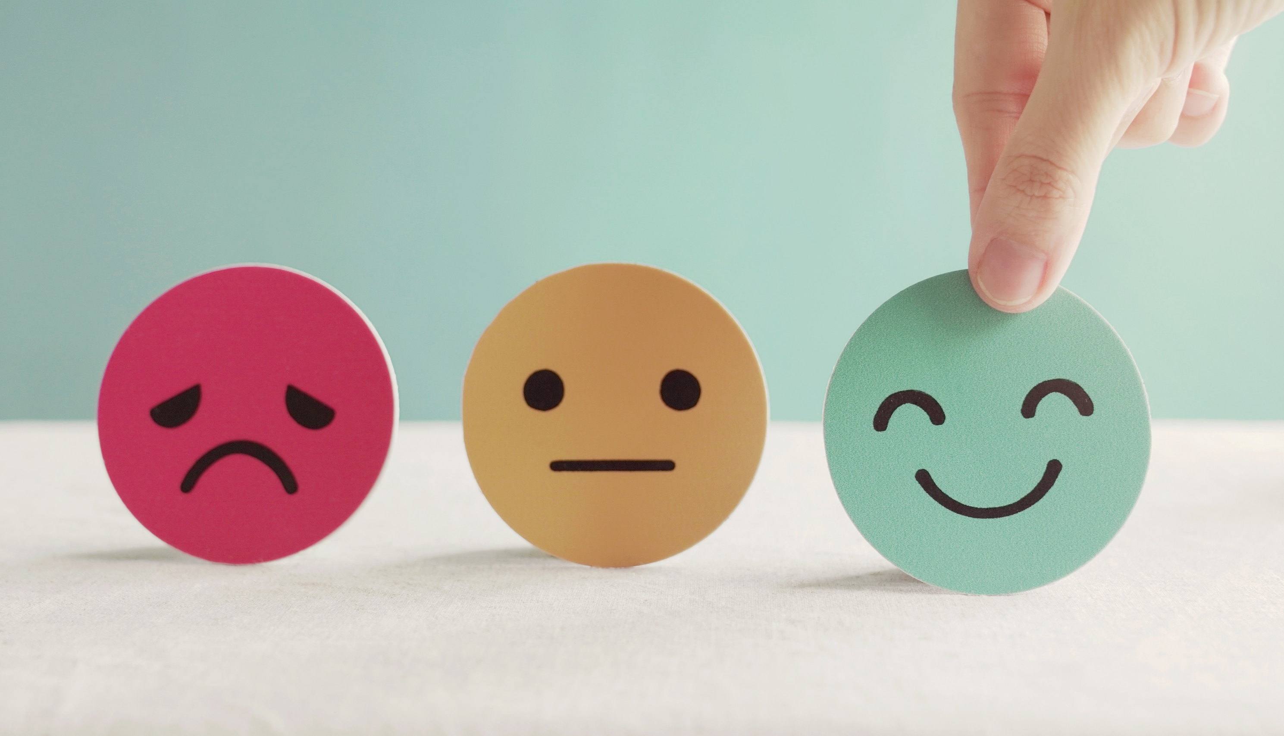
Lesson 3
Stay positive and have a nice day!

