Slide 1

Unit 1: My World
Lesson: CLIL
Page 24

Slide 2
Lesson Outline
Warm-up
Reading
Consolidation
Wrap-up

Slide 3
Objectives
By the end of this lesson, students will be able to…
practise listening and reading for gist, reading for specific information.
talk about similarities and differences in people (optional).

Slide 4

WARM-UP

Slide 5
Answer the questions
Who is your best friend?
Why are you best friends? Do you have any similarities or differences?

Slide 6
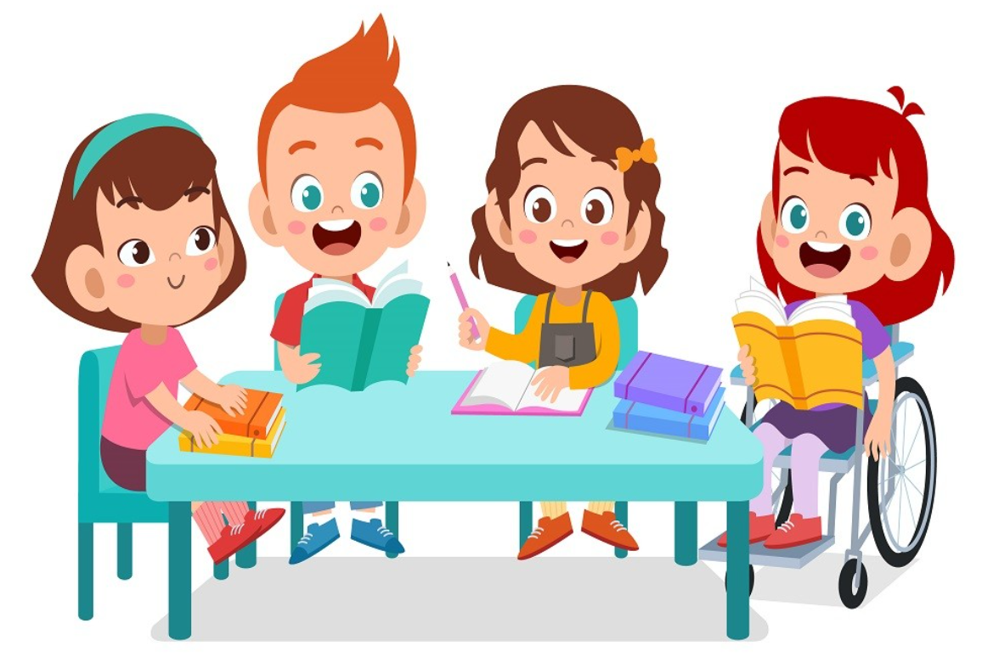
It’s time to learn …

Slide 7

Reading

Slide 8

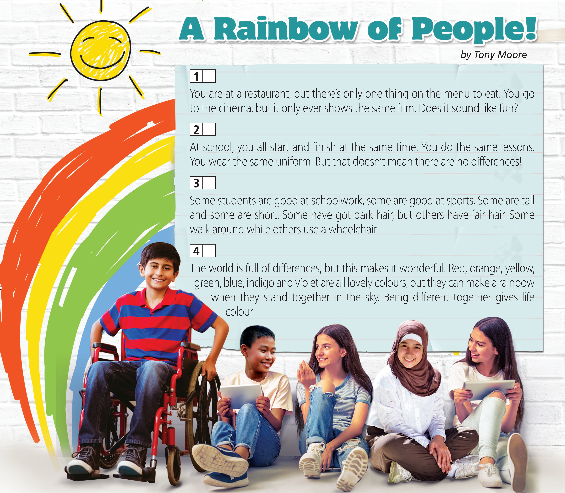
Pre-reading
A Better together
B Contrasts
C The same but different
D A boring world
=> I expect to read about how people are all different and why this is a good thing.

Slide 9
While-reading
2 Read again and match the headings to the paragraphs. Look for key words to help you do the task.
1
You are at a restaurant, but there’s only one thing on the menu to eat. You go to the cinema, but it only ever shows the same film. Does it sound like fun?
2
At school, you all start and finish at the same time. You do the same lessons. You wear the same uniform. But that doesn’t mean there are no differences!
3
Some students are good at schoolwork, some are good at sports. Some are tall and some are short. Some have got dark hair, but others have fair hair. Some walk around while others use a wheelchair.
4
The world is full of differences, but this makes it wonderful. Red, orange, yellow, green, blue, indigo and violet are all lovely colours, but they can make a rainbow when they stand together in the sky. Being different together gives life colour.
A Better together
B Contrasts
C The same but different
D A boring world

Slide 10
First, underline the key words.
1
You are at a restaurant, but there’s only one thing on the menu to eat. You go to the cinema, but it only ever shows the same film. Does it sound like fun?
2
At school, you all start and finish at the same time. You do the same lessons. You wear the same uniform. But that doesn’t mean there are no differences!
3
Some students are good at schoolwork, some are good at sports. Some are tall and some are short. Some have got dark hair, but others have fair hair. Some walk around while others use a wheelchair.
4
The world is full of differences, but this makes it wonderful. Red, orange, yellow, green, blue, indigo and violet are all lovely colours, but they can make a rainbow when they stand together in the sky. Being different together gives life colour.

Slide 11
A Better together
B Contrasts
C The same but different
D A boring world
1
You are at a restaurant, but there’s only one thing on the menu to eat. You go to the cinema, but it only ever shows the same film. Does it sound like fun?
2
At school, you all start and finish at the same time. You do the same lessons. You wear the same uniform. But that doesn’t mean there are no differences!
3
Some students are good at schoolwork, some are good at sports. Some are tall and some are short. Some have got dark hair, but others have fair hair. Some walk around while others use a wheelchair.
4
The world is full of differences, but this makes it wonderful. Red, orange, yellow, green, blue, indigo and violet are all lovely colours, but they can make a rainbow when they stand together in the sky. Being different together gives life colour.

Slide 12

Suggested Answer Key
The author’s purpose is to inform. The information in the text is very useful. It tells us that we are all special, but when we are all together, we become something even more beautiful, just like a rainbow.

Slide 13

Post-reading
Suggested Answer Key
My best friend is Myra. We are the same age. We like the same sport - football. We are both good at Maths. However, Myra has got black hair, but I’ve got brown hair. Myra is talkative, but I’m quite shy. Myra is good at geography, but I’m not.

Slide 14

CONSOLIDATION

Slide 15
Write a paragraph (60-80) about the similarities and differences between you and your father/ mother/ brother/ sister/ best friend.

Slide 16

WRAP-UP

Slide 17
Today’s lesson
Vocabularies about
Similarities
Differences
Structures/ Sentence patterns
Sentences to talk about similarities and differences

Slide 18
Homework
Practise the vocabularies and structure and make sentences using them.
Prepare the next lesson (page 25 SB)

Slide 19

Lesson 3
Stay positive and have a nice day!

