Slide 1

Unit 3: All About Food
Lesson 3h: Right on Page 65

Slide 2
Lesson Outline
Warm-up
Presentation
Practice
Production
Consolidation
Wrap-up

Slide 3
Objectives
By the end of this lesson, students will be able to…
create a poster about Healthy Eating.

Slide 4

WARM-UP

Slide 5
PAIRWORK
Tell your friend how important these foods are for your body.
fruits and vegetables
beans, fish, meat & eggs
bread, rice, potatoes, pasta & cereal
drinks (water, fruit juice, tea)
milk, yoghurt, butter & cheese

Slide 6
Fruit & vegetables
give us lots of vitamins
to stay fit and healthy.
Beans, fish, meat
& eggs give us the protein we need to grow big and strong.
Bread, rice, potatoes, pasta & cereal give us the energy to work and study all day.
Drinks (water, fruit
juice, and tea) help us stay healthy.
Milk, yoghurt, butter & cheese give us lots of calcium to grow strong bones and teeth.

Slide 7

It’s time to learn …

Slide 8

Presentation

Slide 9
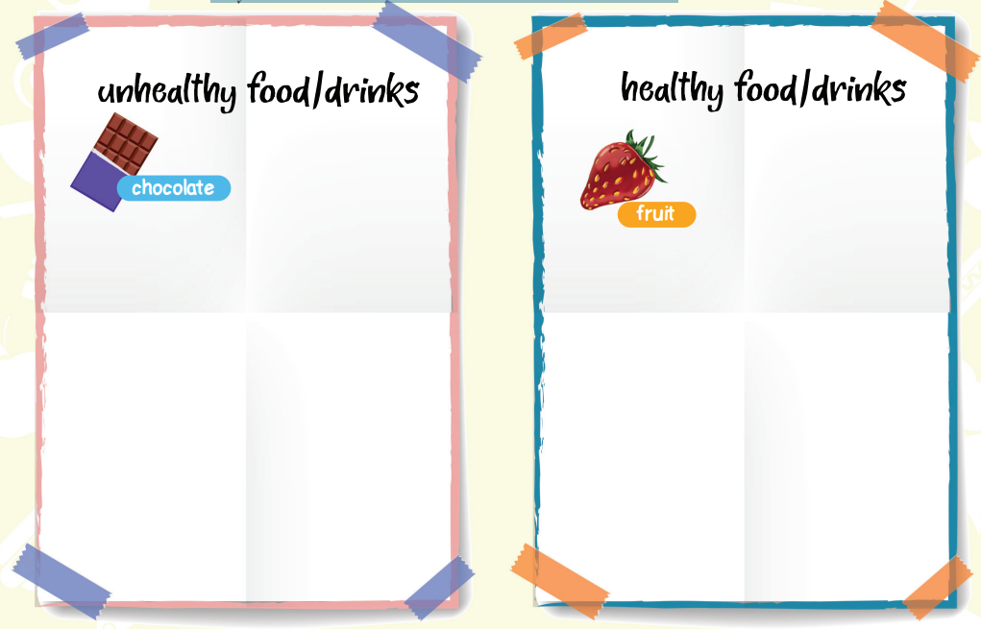
Discussion
1. Create a poster about Healthy Eating.
sweets, cake, sugar, cola,
ice cream, crisps, biscuits
vegetables, meat, fish, rice, pasta, eggs, cereal, olive oil, milk

Slide 10
Say why they are healthy.
vegetables:
meat, fish, eggs:
rice, pasta, cereal:
milk:
have lots of vitamins
help us grow strong
give us energy
good for our bones and teeth

Slide 11
2. Use your poster in Exercise 1 and the information from the Eatwell Guide to give a presentation about healthy/unhealthy eating habits to the class.
Sample
Fill in the gaps with the words in the box.
healthy, important, unhealthy
Our eating habits are ………………………….. We can help our body to be healthy by eating …………………………… food and not eating ……………………………… food.
important
healthy
unhealthy

Slide 12
five, energy, vitamins, bones, strong
Bread, rice, potatoes, pasta and cereal are healthy and give us …………………... Beans, fish, meat and eggs help us grow ……………… and milk, yoghurt and cheese are good for our ………………… and teeth. Eat ………………… portions of fruit and vegetables every day to stay healthy and get lots of …………………….
energy
strong
bones
five
vitamins

Slide 13
sweets, easy, OK
Biscuits, crisps, cake, …………………. and chocolate are unhealthy. It’s ………………… to eat chocolate or sweets sometimes, but don’t eat them every day!
It’s ……………………. to have a good diet! Give it a try!
sweets
OK
easy

Slide 14

Production

Slide 15
Use your ideas in Exercise 1 to present to the class.
Our eating habits are important. We can help our body to be healthy by eating healthy food and not eating unhealthy food.
Bread, rice, potatoes, pasta and cereal are healthy and give us energy. Beans, fish, meat and eggs help us grow strong. Milk, yoghurt and cheese are good for our bones and teeth. Eat five portions of fruit and vegetables every day to stay healthy and get lots of vitamins.
Biscuits, crisps, cake, sweets and chocolate are unhealthy. It’s OK to eat chocolate or sweets sometimes, but don’t eat them every day!
It’s easy to have a good diet! Give it a try!

Slide 16

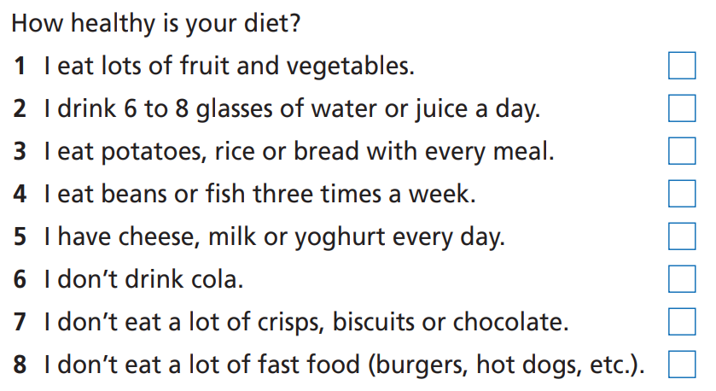
Healthy eating habits
3. Tick (✓) the sentences that are true about you.
✓
✓
✓
✓

Slide 17
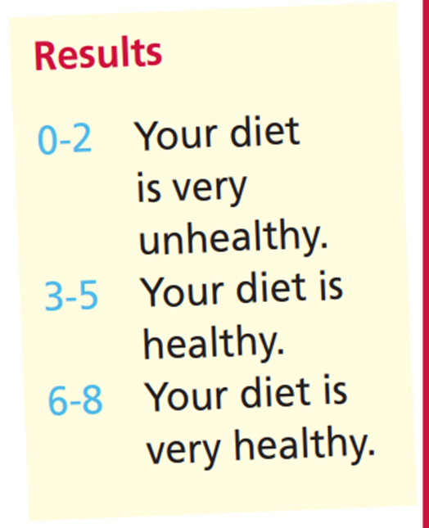
Add up your scores and see the results.
✓
✓
✓
Example:
Your score: 4
Your diet is healthy.
✓

Slide 18

CONSOLIDATION

Slide 19
Write a short paragraph (about 60 words) about healthy/unhealthy diets. Use the ideas you have presented to the class.

Slide 20

WRAP-UP

Slide 21
Today’s lesson
Speaking
Making a presentation about healthy eating

Slide 22
Homework
Practise the vocabulary and make sentences using them.
Do the exercises in TA 6 Right on Workbook (p. 35).
Prepare for the next lesson (p. 66 SB).

Slide 23

Enjoy your day!

