Slide 1


Slide 2

Unit
6
1
Unit
FAMILY LIFE
GENDER EQUALITY
LESSON 8
LOOKING BACK AND PROJECT

Slide 3

Unit
1
1
FAMILY LIFE
Family Life
Unit
OBJECTIVES
Knowledge
Review the vocabulary and grammar of Unit 6
Apply what Ss have learnt (vocabulary and grammar) into practice through a project
Core competence
Develop communication skills and creativity
Develop critical thinking skill
Be collaborative and supportive in pair work and team work
Develop presentation skills
Personal qualities
Understand more about students’ career choices
Develop self-study skills

Slide 4
LESSON 8
LOOKING BACK AND PROJECT
WARM-UP
Game: Last man standing
Task 1: Pronunciation: Listen and mark the stressed syllables in the words in bold.
Task 2: Vocabulary: Do the crossword. Use the words you have learnt in this unit.
Task 3: Grammar: Each of the following sentences has a mistake. Underline it and write the correct word(s) in the space given.
LOOKING BACK
PROJECT
Project: Students’ future jobs
CONSOLIDATION
Wrap-up
Homework

Slide 5
LESSON 8
LOOKING BACK AND PROJECT
WARM-UP
Game: Last man standing

Slide 6
WARM-UP
Game: Last man standing
Everyone takes turns saying one word/grammar point we have learned so far in Unit 6.
You will be eliminated from the game if you repeat what others said or cannot remember anything else.
The winner is the last person left in the game!

Slide 7
LESSON 8
LOOKING BACK AND PROJECT
WARM-UP
Game: Last man standing
Task 1: Pronunciation: Listen and mark the stressed syllables in the words in bold.
Task 2: Vocabulary: Do the crossword. Use the words you have learnt in this unit.
Task 3: Grammar: Each of the following sentences has a mistake. Underline it and write the correct word(s) in the space given.
LOOKING BACK

Slide 8

PRONUNCIATION
1
Listen and mark the stressed syllables in the words in bold.
1. The surgeon's job is quite difficult.
2. Soviet cosmonauts learnt how to parachute to safety.
3. I’m proud of my sister. She’s studying at a medical school.
4. We need to continue fighting for equal rights.

Slide 9
PRONUNCIATION
1
Listen and mark the stressed syllables in the words in bold.
1. The surgeon's job is quite ’difficult.
2. Soviet cosmonauts learnt how to ’parachute to safety.
3. I’m proud of my sister. She’s studying at a ’medical school.
4. We need to con’tinue fighting for equal rights.

Slide 10
VOCABULARY
Do the crossword. Use the words you have learnt in this unit.
1
1
K
I
N
D
E
R
G
A
R
T
E
N
2
1. A ___________ teacher works with small children to prepare them for school.
2. Job adverts should not mention their ideal candidate's ___________.
3. A very experienced ___________ was able to rebuild his nose after the accident.
4. Boys and girls should have ___________ opportunities in education.
5. Parents should not ___________ boys differently from girls.
G
E
N
D
E
R
3
S | U | R | G | E | O | N
4
E | Q | U | A | L
5
T | R | E | A | T

Slide 11
GRAMMAR
Each of the following sentences has a mistake. Underline it and write the correct
word(s) in the space given.
One paragraph about gender equality ought to write by each student. Action to stop domestic violence must take immediately. Should all people be provide with equal access to information? Young girls mustn’t force into marriage. Can men and women given equal opportunities in the workplace? | ________________ ________________ ________________ ________________ _________________
be written
be taken
provided
be forced
be given

Slide 12
LESSON 8
LOOKING BACK AND PROJECT
WARM-UP
Game: Last man standing
Task 1: Pronunciation: Listen and mark the stressed syllables in the words in bold.
Task 2: Vocabulary: Do the crossword. Use the words you have learnt in this unit.
Task 3: Grammar: Each of the following sentences has a mistake. Underline it and write the correct word(s) in the space given.
LOOKING BACK
PROJECT
Project: Students’ future jobs

Slide 13
PROJECT
Work in groups. Choose any class in your school and do a survey to find out:
• the number of boys and girls.
• how many of them would like to work as surgeons, airline pilots, nurses and shop assistants, or do other jobs in the future.
Class:
Number of students | Surgeons | Airline pilots | Nurses | Shop assistants | Others
_______ boys
_______ girls

Slide 14
PROJECT
Report your results to the class.
Which of the jobs is the least popular among the boys and which one the least popular among the girls? Give possible reasons.

Slide 15
LESSON 8
LOOKING BACK AND PROJECT
WARM-UP
Game: Last man standing
Task 1: Pronunciation: Listen and mark the stressed syllables in the words in bold.
Task 2: Vocabulary: Do the crossword. Use the words you have learnt in this unit.
Task 3: Grammar: Each of the following sentences has a mistake. Underline it and write the correct word(s) in the space given.
LOOKING BACK
PROJECT
Project: Students’ future jobs
CONSOLIDATION
Wrap-up
Homework

Slide 16
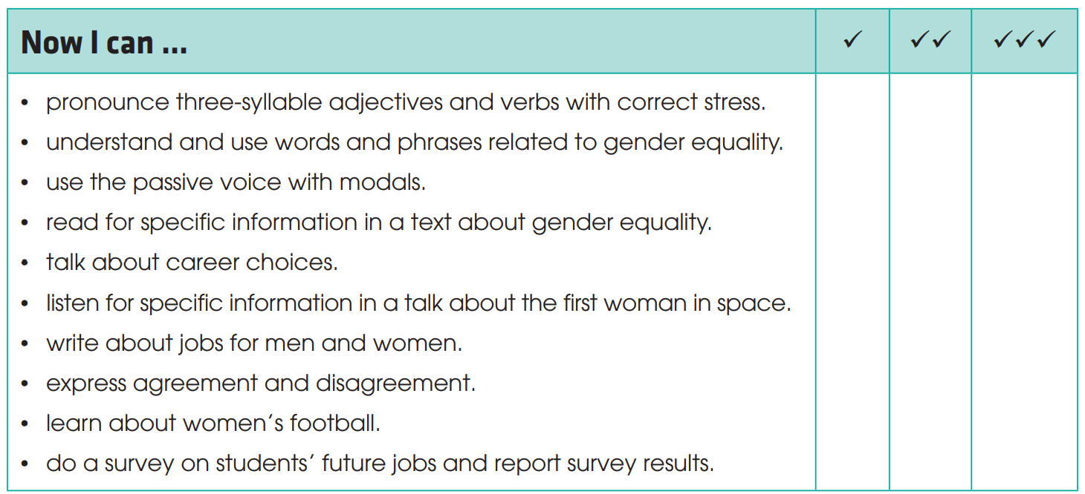
CONSOLIDATION
1
Wrap-up
Check what you have been able to do after this unit!

Slide 17
CONSOLIDATION
2
Homework
Do exercises in the workbook.
Prepare for the next lesson: Unit 7.

Slide 18


