Slide 1



Unit 3: On Screen
Lesson 3H: Writing

Slide 2


MOVIE
QUIZ

Slide 3
HOW TO
PLAY
COMPLETE THE SENTENCES WITH VOCABULARY FOR ASPECTS OF FILMS
YOU CAN USE THE LANGUAGE IN THE BOX BELOW TO HELP

Slide 4

COMPLETE THE SENTENCES WITH VOCABULARY
FOR ASPECTS OF FILMS
A. plots
B. characters
C. scripts
D. scenes

Slide 5
COMPLETE THE SENTENCES WITH VOCABULARY
FOR ASPECTS OF FILMS
A. plots
B. special effects
C. ending
D. scripts

Slide 6
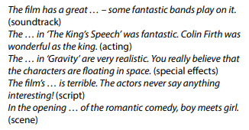
COMPLETE THE SENTENCES WITH VOCABULARY
FOR ASPECTS OF FILMS
A. ending
B. script
C. soundtrack
D. acting

Slide 7
COMPLETE THE SENTENCES WITH VOCABULARY
FOR ASPECTS OF FILMS
A. acting
B. character
C. ending
D. script

Slide 8
COMPLETE THE SENTENCES WITH VOCABULARY
FOR ASPECTS OF FILMS
A. characters
B. plots
C. soundtracks
D. special effects

Slide 9
COMPLETE THE SENTENCES WITH VOCABULARY
FOR ASPECTS OF FILMS
A. characters
B. scripts
C. acting
D. plots

Slide 10
COMPLETE THE SENTENCES WITH VOCABULARY
FOR ASPECTS OF FILMS
A. soundtrack
B. plot
C. scene
D. script

Slide 11



Do you know this film?
What genre is it?
The film is Iron Man 3.
Its genres are fantasy, action, science fiction, adventure.
Can you name the actor?
The actor is Robert Downey Jr.
Would you like to see it? Why / Why not?
www.phuongnam.edu.vn

Slide 12



www.phuongnam.edu.vn

Slide 13



VOCABULARY
twist (n) /twɪst/
a change in the way in which something happens
worth adjective (IMPORTANCE)
be worth having/doing sth
to be important or useful to have or do
a simple restaurant where Asian noodle dishes are served
noodle bar (n) /ˈnuː.dəl ˌbɑːr/
www.phuongnam.edu.vn

Slide 14
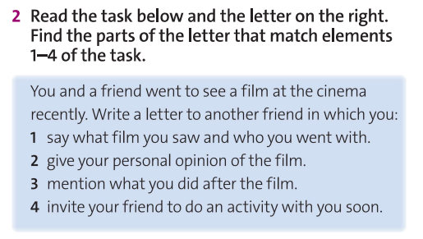
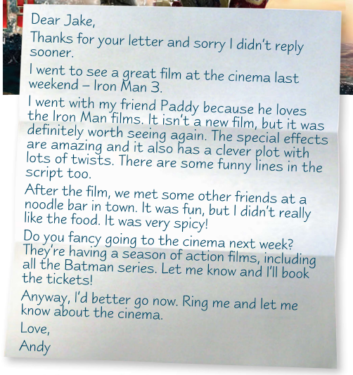
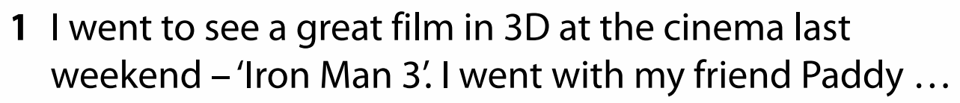
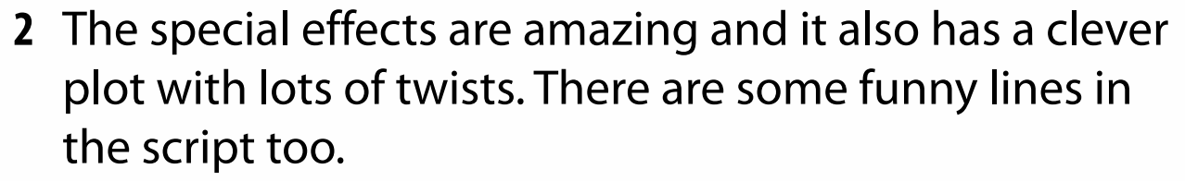
www.phuongnam.edu.vn

Slide 15
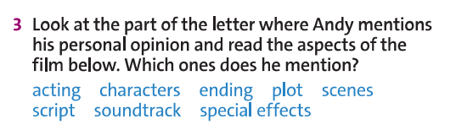



www.phuongnam.edu.vn

Slide 16
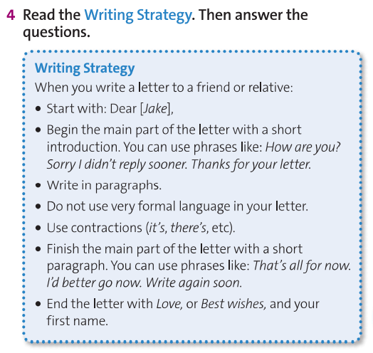
www.phuongnam.edu.vn

Slide 17
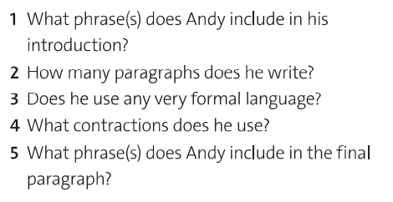
1. Thanks for your letter;
Sorry I didn’t reply sooner.
2. five
3. no
4. didn’t, isn’t, They’re
5. I’d better go now.
www.phuongnam.edu.vn

Slide 18

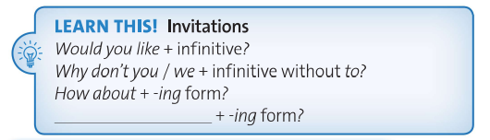
Do you fancy
www.phuongnam.edu.vn

Slide 19
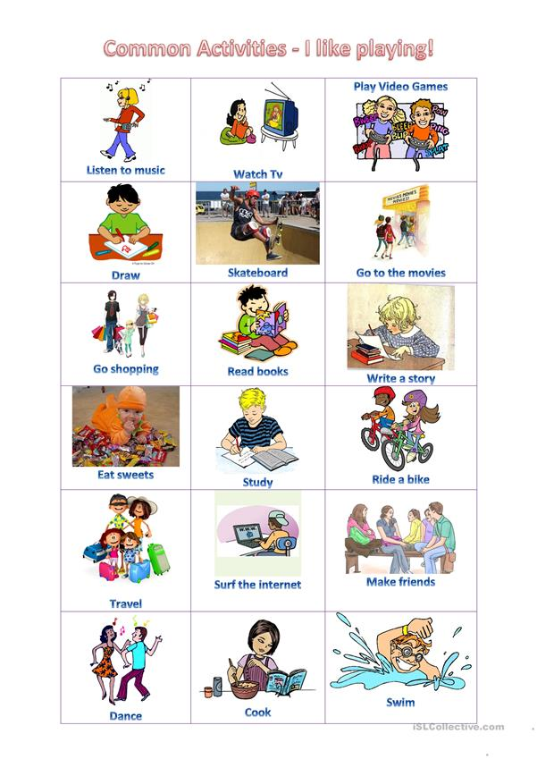
Practice making invitations in pairs using the phrases
Do you fancy
www.phuongnam.edu.vn

Slide 20
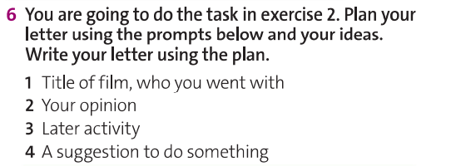
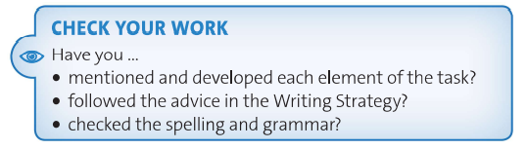
EX 6: Writing
Plan your letter using the prompts below and your own ideas.
www.phuongnam.edu.vn

Slide 21



EX 6: Writing
Plan your letter using the prompts below and your own ideas.
Choose 1 or 2 activities
Choose 1 film
eating fast food
Do you like it? What you think about the plot, scripts, special effects, etc.?
Practice making invitations using
“Do you fancy…?”
Example: Andy’s letter in Ex2
www.phuongnam.edu.vn

Slide 22



EX 6: Writing SAMPLE
Carl’s letter
Avengers: End Game
had dinner at KFC
eating fast food
Carl really liked the movie. He thinks the plot, scripts, special effects are significant.
Carl recommended his friend watching this movie.
www.phuongnam.edu.vn

Slide 23

Sample: Carl’s letter
EX 6: Writing
Dear Jack,
Hope you are doing well. I’m sorry for my big delay. During the past month I was too busy with schoolwork, and I had not any spare time even for myself.
I’m writing this letter to share my experience of watching an excellent movie last weekend when the final exam was over. I watched it in CGV Cinema with my classmates.
The title of the movie is “Avengers: End Game”. It’s a movie of Marvel, whose all movies have high ratings and gross sales. Furthermore, there are so many likes and shares on Facebook. The headquarters was massive with a lot of different aircraft and high-end cars. All costumes of the superheroes were in fine detail. One of the scenes, was in space, it looked real like solar systems, spaceships, and different spacecraft. This shows that the producer spent a hundred of million dollars to make the movie more reality. I don’t tell you the ending so it will be more exciting to watch it.
After the movie, we had dinner at a nearby KFC restaurant. The chicken was fantastic, but the French fries were too soggy.
I highly recommend this movie. I suggest that you watch this with your girlfriend. Remember to buy popcorn and soda as the movie is rather long.
That’s all for now. Write again soon.
Best wishes,
Carl
www.phuongnam.edu.vn

Slide 24
01
Homework
02
03
1. Finish writing your letter in Ex6
2. Prepare U3-I (P.44)
04
?
05
06

Slide 25

www.phuongnam.edu.vn

Slide 26



Thank you!
CTCP ĐẦU TƯ VÀ PHÁT TRIỂN GIÁO DỤC PHƯƠNG NAM

