Slide 1

Unit 3: All about food
CLIL - Food Technology
Page 64

Slide 2
Lesson Outline
Warm-up
Pre-reading
While-reading
Post-reading
Consolidation
Wrap-up

Slide 3
Objectives
By the end of this lesson, students will be able to…
read and understand an Eatwell guide.
share your diet.

Slide 4

WARM-UP

Slide 5
PAIRWORK
Put the foods and drinks below in two groups: healthy and unhealthy and say why.
carrots
apples
milk
coffee
hamburgers
coke
fish
sweets
yoghurt
chocolate
Healthy | Unhealthy
carrots
apples
milk
fish
yoghurt
coffee
coke
sweets
hamburgers
chocolate

Slide 6

It’s time to learn …

Slide 7

Pre-reading

Slide 8
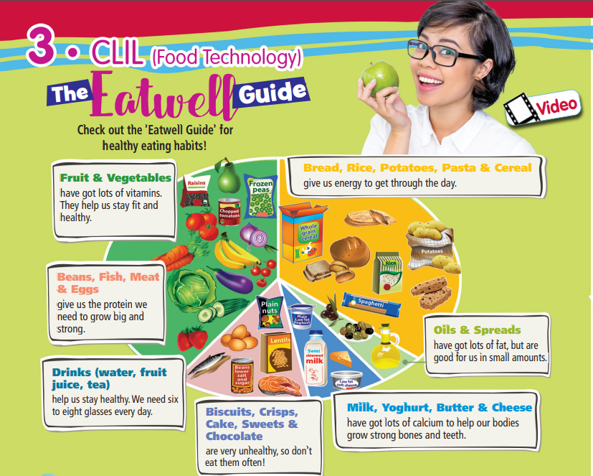

1. Which food do you think you should eat more, meat or potatoes?
Listen and read to find out.
We should eat more potatoes than meat because they give our body energy throughout the day.

Slide 9
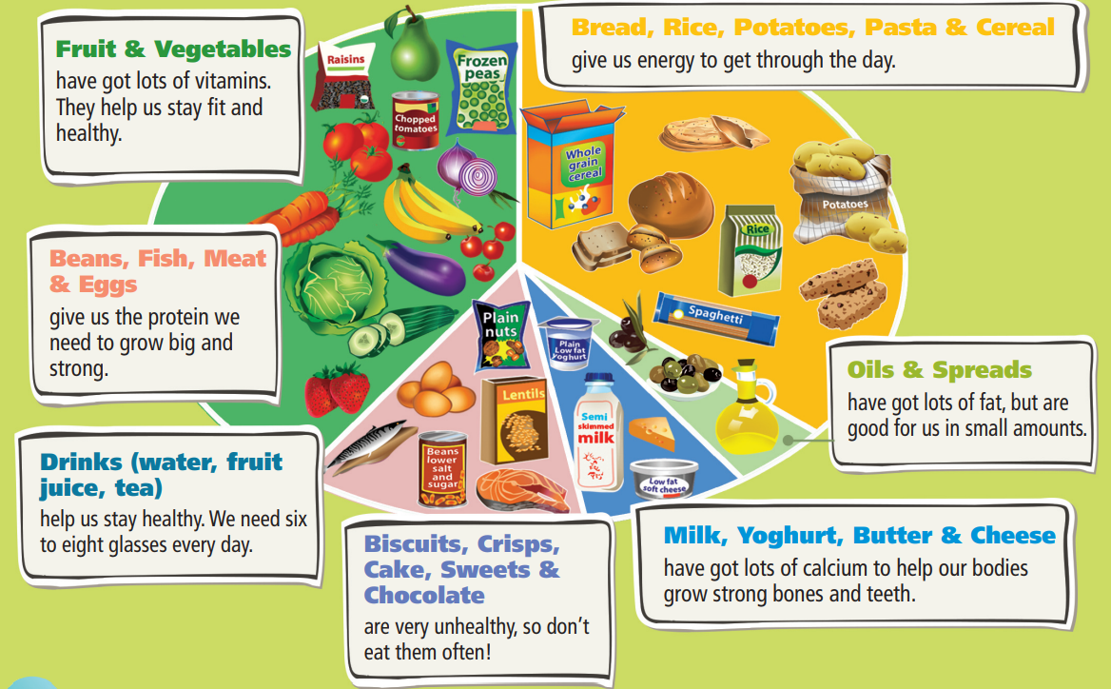
Find these words and underline them. Can you guess their meanings?
• vitamin • energy • protein • spread • fat • calcium

Slide 10
Vocabulary
Practise saying them. Focus on the word stress.
Listen and repeat. Click on each word to hear the sound.
• vitamin (n) /ˈvɪtəmɪn/: sinh tố, vitamin
• energy (n) /ˈenədʒi/: năng lượng
• protein (n) /ˈprəʊtiːn/: chất đạm
• spread (n) /spred/: món phết lên bánh
• fat (n) /fæt/: chất béo
• calcium (n) /ˈkælsiəm/: canxi

Slide 11
Make your own sentences, using the vocabulary you have learnt (vitamin, energy, protein, spread, fat, calcium).
I enjoy eating fruit because it is tasty and has lots of vitamin C.

Slide 12
Read and guess the missing information.
1 Fruit and vegetables have got lots of __________________.
2 Potatoes and rice give us ________________.
3 Meat and eggs help our body ___________________.
4 Oils are rich in _______________________.
5 We need to drink lots of water to _____________________.
noun
noun
verb
noun
verb

Slide 13

While reading

Slide 14
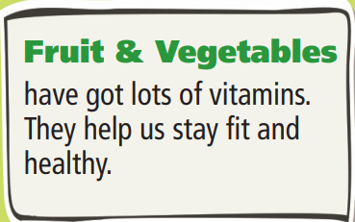
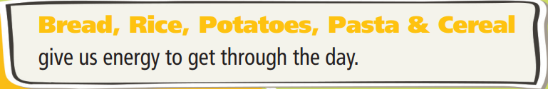
2 Read the text again. Complete the sentences.
1 Fruit and vegetables have got lots of __________________.
vitamins
2 Potatoes and rice give us ________________.
energy

Slide 15
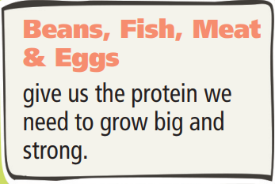
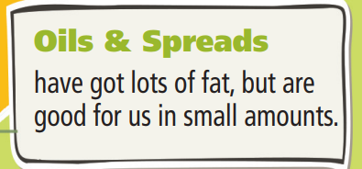
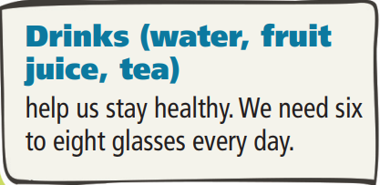
3 Meat and eggs help our body ___________________.
grow big and strong
4 Oils are rich in _______________________.
fat
5 We need to drink lots of water to _____________________.
stay healthy

Slide 16
Extra practise
Read the questions and underline key words.
What helps us stay fit and healthy?
How much water should we drink every day?
Are oils and spreads good for us?
What should we eat to have strong bones and teeth?
Why shouldn’t we eat chocolate very often?

Slide 17
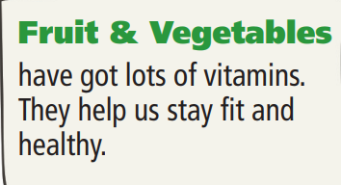
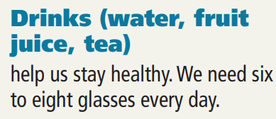
Read the text and answer the questions.
  What food helps us stay fit and healthy?
Fruit and vegetables help us stay fit and healthy.
2. How much water do we need to drink every day?
We need to drink six to eight glasses every day.

Slide 18
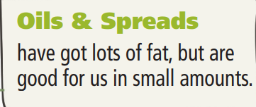
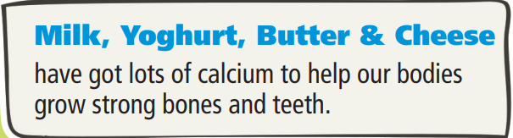
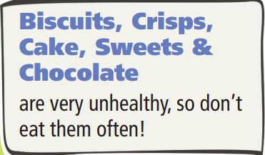
3. Are oils and spreads good for us?
Yes, but they are good for us in small amounts.
4. What should we eat to have strong bones and teeth?
We should eat milk, yoghurt, butter and cheese.
5. Why shouldn’t we eat chocolate very often?
Because it’s unhealthy.

Slide 19

Post-reading

Slide 20
Writing & Speaking
3 Which foods/drinks do/don’t you usually eat/drink from the Eatwell Guide? Tell the class.
I usually eat bread, rice and potatoes, fruit and vegetables and fish, and drink water or fruit juice. I don't usually eat crisps, cake or sweets or drink tea.

Slide 21
4. What is the purpose of the text: to inform? to entertain?
The purpose of the text is to inform us about eating more healthily.
Do you want to change anything in your diet because of the information in it?
I want to eat more fruit and vegetables, because the text says they help us stay fit and healthy.

Slide 22

CONSOLIDATION

Slide 23
Write five sentences about five foods or drinks you should have more and give reasons, using the information you have read.

Slide 24

WRAP-UP

Slide 25
Today’s lesson
Vocabularies
• vitamin
• energy
• protein
• spread
• fat
• calcium
Reading
Read an Eatwell guide
Speaking
Share your diets

Slide 26
Homework
Learn the vocabularies and make sentences using them.
Do the exercises in TA 6 Right on Workbook (p. 34)
Prepare the next lesson (p. 65 SB)

Slide 27
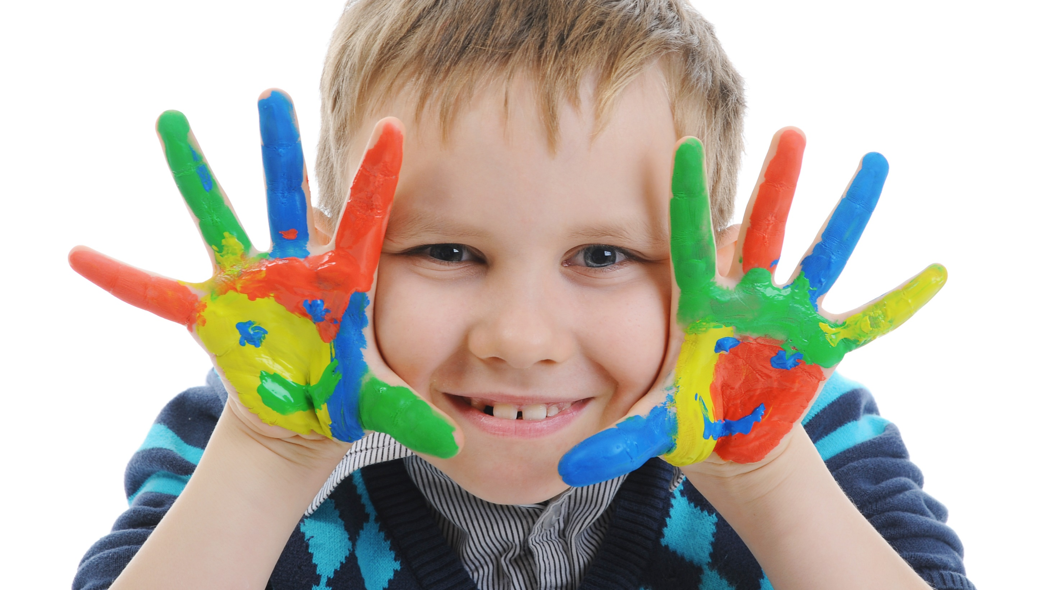
Enjoy your day!

