Slide 1
Unit 5: INVENTIONS Lesson 4: Speaking
Inventions and how they are used

Slide 2
Unit
1
1
FAMILY LIFE
Family Life
Unit
OBJECTIVES
Talk about inventions and how they are used.

Slide 3
Table of contents
01
02
03
Warm-up
Controlled Practice
Less Controlled Practice
04
Consolidation

Slide 4
Warm-up
01
Guessing game

Slide 5
GUESSING GAME
Pick a card containing the name of the invention.
Explain it to the class without showing the word.
The rest of the class guess its name.

Slide 6
Controlled Practice
02

Slide 8
Click on the correct option
invent
improve
next

Slide 9
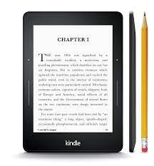
Click on the correct option
e-readers
app
next

Slide 10
Click on the correct option
invent
internet
next

Slide 11
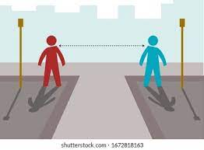
Click on the correct option
distance
robot
next

Slide 12
Click on the correct option
distance
communicate

Slide 13
CONTROLLED PRACTICE
Functions | Useful expressions
Uses of inventions | - … help(s)/ allow(s) us to do st Example: The Internet helps us to communicate over long distances. - We/ People (can) use st to do/ for st Example: People can use the Internet to communicate over long distances. - … is/ are used for st/ doing st Example: The Internet is used for communication/ communicating over long distances.

Slide 14
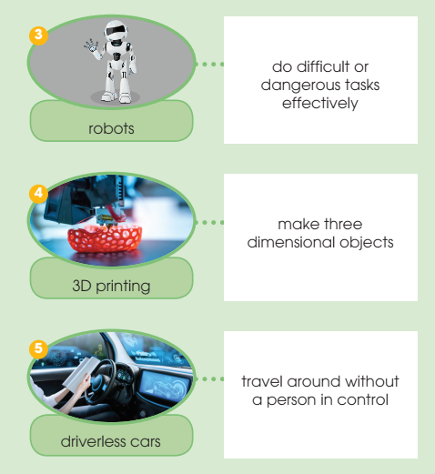
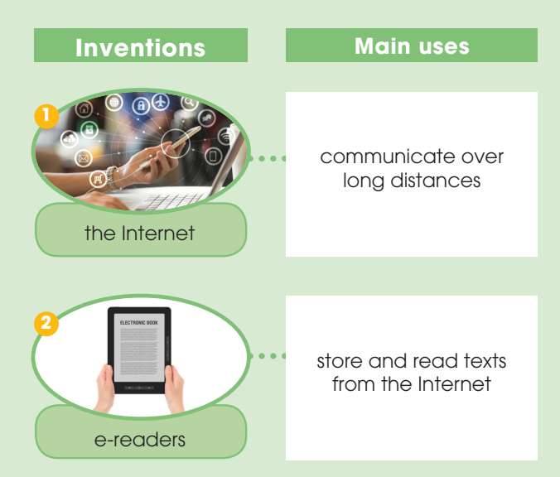
CONTROLLED PRACTICE
1
Work in pairs. Talk about the uses of these inventions. Use the expressions below to help you.

Slide 15
Less Controlled Practice
03

Slide 16
LESS CONTROLLED PRACTICE
2
Work in groups. Talk more about one of the inventions in activity 1. Use the outline below to help you prepare a group presentation.

Slide 17
LESS CONTROLLED PRACTICE
3
Present your ideas to the whole class. Then vote for the most interesting group presentation.
Present group’s ideas.
Give comments for friends’ groups and vote for the most interesting group presentation.

Slide 18
Consolidation
04

Slide 19
CONSOLIDATION
1
Wrap-up
Speaking about inventions and how they are used.

Slide 20
CONSOLIDATION
2
Homework
Prepare for the next lesson: Unit 5 – Listening
2. Do exercises in the workbook

Slide 21
SEE YOU NEXT TIME !!

