Slide 2


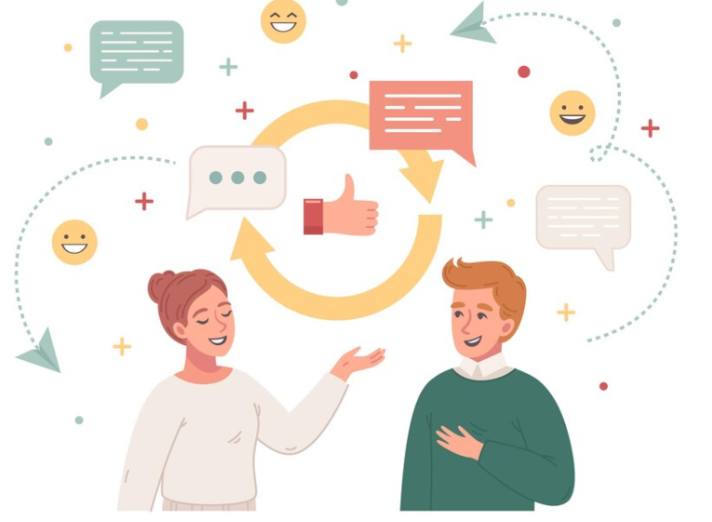
Unit
3
MY FRIENDS
LESSON 4: COMMUNICATION
1

Slide 3
LESSON 4: COMMUNICATION
LESSON 1: GETTING STARTED
WARM-UP
Game: Bingo
Task 1: Listen and read the dialogue between Linda and Mi. Pay attention to the highlighted.
Task 2: Work with a classmate. Ask him / her about his / her best friend. Remember to use the two questions highlighted in 1.
EVERYDAY ENGLISH
Task 3: Write the words and phrases from the box under the correct pictures. Then listen, check, and repeat.
Task 4: Work in pairs. Write the hobbies from Task 3 in the suitable columns.
Task 5: Read the descriptions in 4. Share your opinion with the class.
DATE OF BIRTH AND PERSONALITY
CONSOLIDATION
Wrap-up
Homework

Slide 4
WARM-UP
- Make a table of 3x3 into their notebooks and fill in with different personalities.
- Teacher reads out loud 9 personalities. The student has a line of 3 can shout: BINGO.
Bingo
Personalities vocabulary
Notes:
Teacher leads students into the lesson by telling about what they are going to learn: “How to ask and answer about people’s appearance and personalities”.

Slide 5
WARM-UP
Bingo
Personalities vocabulary
active | clever | kind
- Make a table of 3x3 into their notebooks and fill in with different personalities.
- Teacher reads out loud 9 personalities. The student has a line of 3 can shout: BINGO.

Slide 6

Everyday English
Asking about appearance and personality

Slide 7

EVERYDAY ENGLISH
1
Listen and read the dialogue between Linda and Mi. Pay attention to the highlighted.
…
Linda: What does your best friend look like?
Mi: She’s short with long black hair. She has bright brown eyes.
Linda: What’s she like?
Mi: She’s very kind and creative.
…
Ask about appearance:
What + do/does + S + look like?
Ask about personality:
What + be + S + like?

Slide 8
EVERYDAY ENGLISH
2
Work with a classmate. Ask him / her about his / her best friend. Remember to use the two questions highlighted in 1.
Suggested conversation:
A: What does he look like?
B: He is tall and slim. He has short black hair. He has glasses.
A: What’s he like?
B: He is hard-working and creative. He is kind, too.

Slide 9
Date of birth and personality

Slide 10
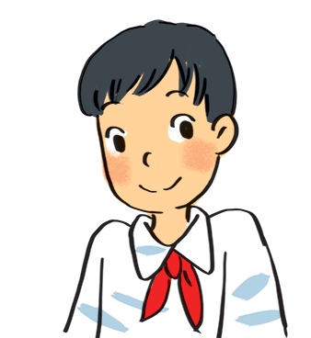
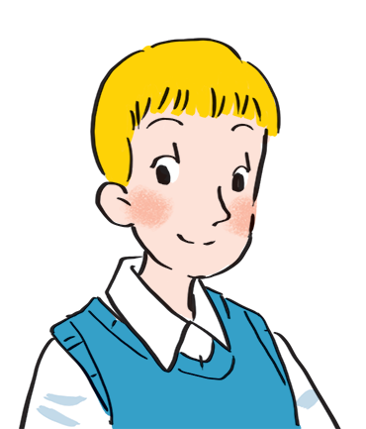
EVERYDAY ENGLISH
3
Read about these students in 4Teen magazine. Use one or two adjectives to describe them.
I live in Da Nang. At home, I can do my homework without my parents’ help. At school, I like speaking English. I’m going to an English club now.
clever
hard-working
I come from Cambridge. In my free time, I draw pictures and play the piano. I also help some old people near my house. I usually read to them at the weekend. Now I’m drawing in my garden.
creative
kind

Slide 11
DATE OF BIRTH AND PERSONALITY
4
We may have different personalities because we have different birthdays. Read the descriptions below. Do you think they match the friends in 3?
21/3 – 19/4 | confident, active
20/4 – 20/5 | loving, hard-working
21/5 – 21/6 | active, friendly
22/6 – 22/7 | caring, clever
23/7 – 22/8 | confident, creative
23/8 – 22/9 | careful, hard-working
23/9 – 23/10 | creative, friendly
24/10 – 21/11 | careful, funny
22/11 – 21/12 | clever, confident
22/12 – 19/1 | careful, hard-working
20/1 – 18/2 | friendly, clever
19/2 – 20/3 | kind, creative

Slide 12
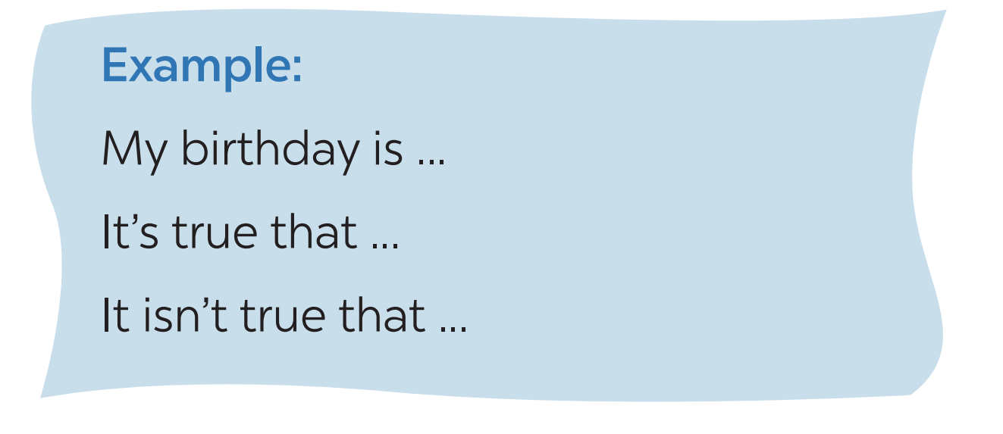
DATE OF BIRTH AND PERSONALITY
5
Read the descriptions in 4.
Share your opinion with the class.

Slide 13

CONSOLIDATION
1
Wrap-up
What have we learnt in this lesson?
Ask and answer about people’s appearance and personalities
Practice to talk about people’s appearance and personalities.

Slide 14

CONSOLIDATION
2
Homework
- Do exercises in the workbook.
- Prepare for the next lesson: Skills 1

Slide 15






Website: hoclieu.vn
Fanpage: facebook.com/www.tienganhglobalsuccess.vn/

