Slide 1

Unit 4: Holidays!
Lesson 4h: Right on!
Page 83

Slide 2
Lesson Outline
Warm-up
Project
Consolidation
Wrap-up

Slide 3
Objectives
By the end of this lesson, students will be able to…
create a poster of holiday destinations in Vietnam.
develop presentation skills by giving a presentation on holiday destinations in Vietnam.
talk about the value of travelling.

Slide 4

WARM-UP

Slide 5

Work in groups.
Look at the pictures and guess the places.

Slide 6


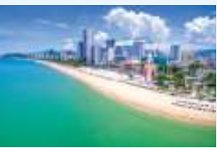
Hạ Long Bay
Phong Nha – Kẻ Bàng National Park
Nha Trang

Slide 7

Work in groups
Do you like travelling?
Where do you want to travel in Vietnam? Why?

Slide 8

It’s time to learn …

Slide 9
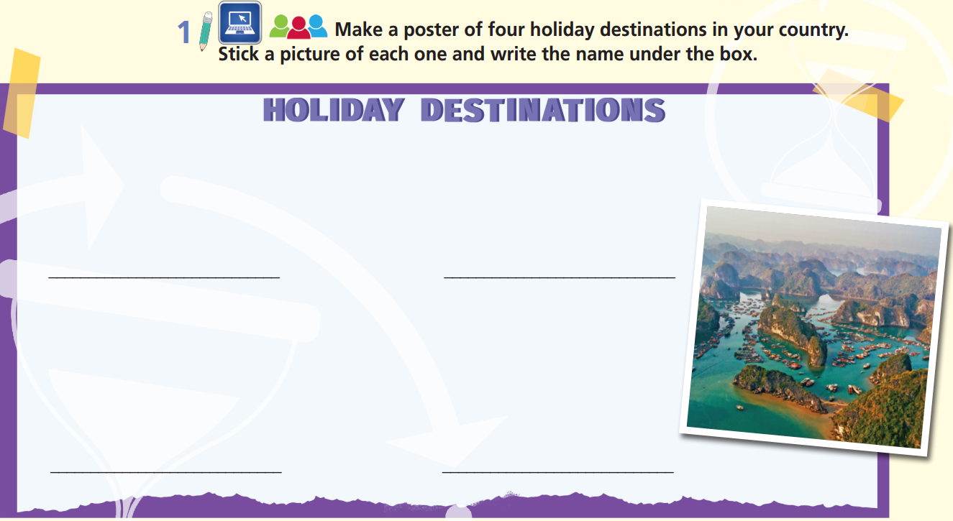

Slide 10
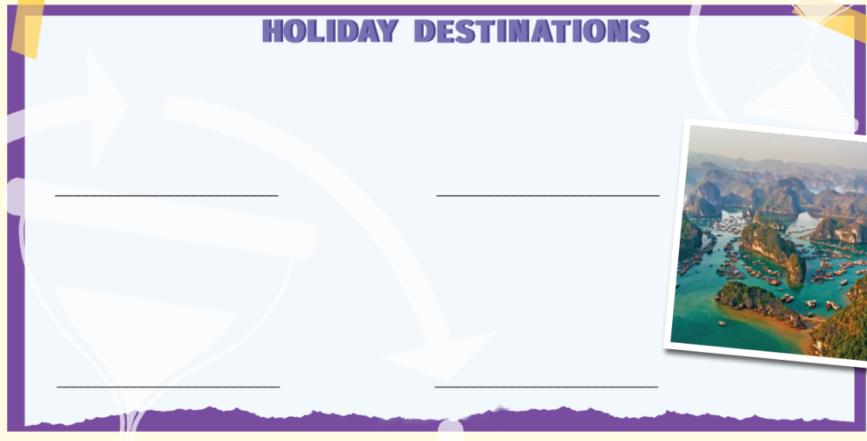
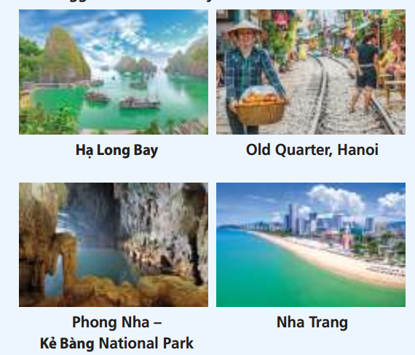

Slide 11
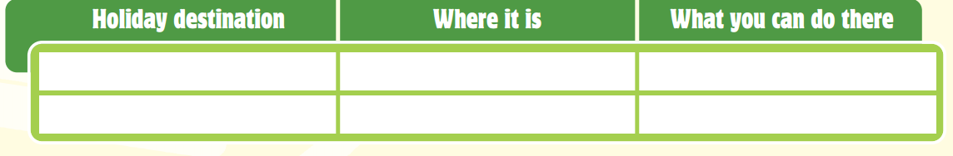
Work in small groups and collect information from the Internet about the holiday destinations in the poster.
Hạ Long Bay
north-east Vietnam
see beautiful islands
go shopping at markets, try street food
Old Quarter, Hanoi
northern Vietnam
Phong Nha – Kẻ Bàng National Park
central Vietnam
visit caves
go swimming, do water sports
Nha Trang
south-east Vietnam

Slide 12
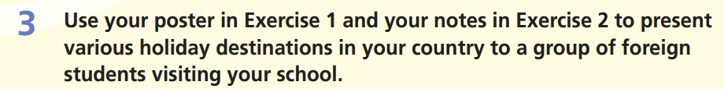
Hello and welcome to Vietnam. There are many places to visit in Vietnam. Here are four of them.
First of all, ………..
Another place you should see is ………….
One more place you might want to visit is ……………
The last holiday destination you should come is ………………..
Whatever you want for a perfect holiday, Vietnam can offer it to you! So, why not? Book your holiday now!

Slide 13

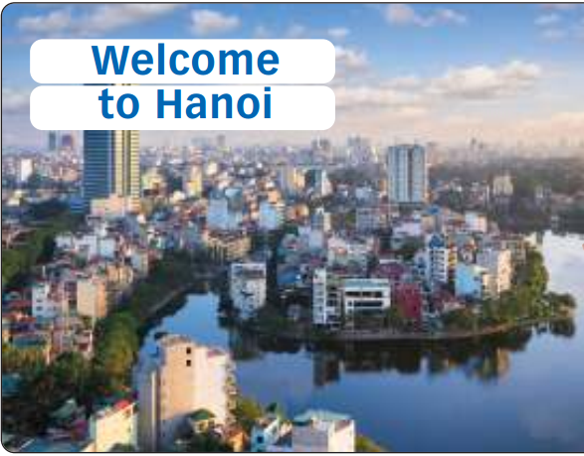
Remember
Photos and videos attract the audience. Photos need to support your words. Use keywords to find appropriate pictures.
Do not select a photo just because it looks nice. Make sure that the photos are clear and everyone in the room can see them.
Choose the visual that best attracts the audience:
A
B

Slide 14
Presentations tips
Keep eye contact with the class.
Look around the class.
Point at the poster (pictures, text…) when needed.
Use suitable movements.
Don’t turn your back to the class.
Be confident!
Speak loudly and clearly.

Slide 15
Evaluation form
While your friends are making a presentation, please leave your comments on the following form:
Criteria | Yes | No | Comments (if any)
Poster Nice pictures/drawings Clear and brief information Interesting content | ✓ | ✓
Presentation skills Confident Loud and clear voice Good eye-contact Suitable movement

Slide 16
Sample presentation
Hello and welcome to Vietnam. There are many places to visit in Vietnam. Here are four of them.
First of all, Hạ Long Bay is in north-east Vietnam. This is an area famous for its beautiful islands.
Another place you should see is The Old Quarter. This is part of the capital city, Hanoi. You can go shopping at markets or try street food there.
One more place you might want to visit is Phong Nha – Kẻ Bàng National Park in central Vietnam. If you are tired of city life, then this is an excellent destination for you. It has a lot of interesting caves to explore.
The last holiday destination you should come to is Nha Trang in south-east Vietnam. You can go swimming at the beautiful beach and do water sports there.
Whatever you want for a perfect holiday, Vietnam can offer it to you! So, why not? Book your holiday now!

Slide 17
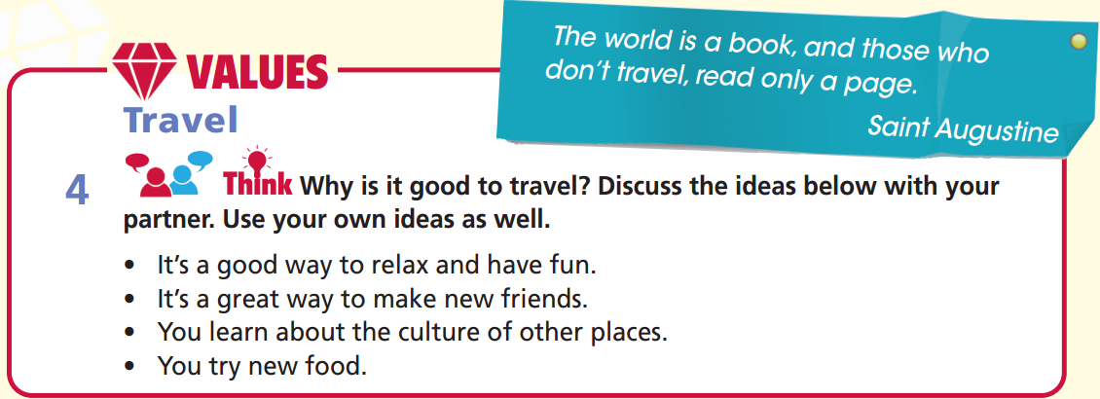

Work in pairs
I love to travel to new and interesting places. I think it’s a good way to relax.
That’s true. And it’s fun to see new places and try new things. You can meet some interesting people, too.
Yes, ….

Slide 18
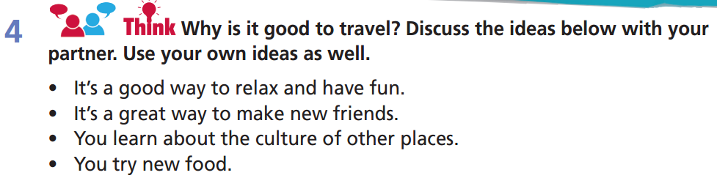
A: I love to travel to new and interesting places. I think it’s a good way to relax.
B: That’s true. And it’s fun to see new places and try new things. You can meet some interesting people, too.
A: Yes, you can, both on the journey and when you stay in a place. Also, of course, you can learn about the culture of another place.
B: That’s very important. People who don’t travel have a limited view of the world.
A: And don’t forget the new food you can try.
B: Yes, and all the new experiences you can have!

Slide 19

CONSOLIDATION

Slide 20
Imagine a foreign friend is going on holiday in Vietnam this summer. Write a letter of 50-60 words to introduce a destination in Vietnam. You can use the following information:
What’s the holiday destination? Where is it in Vietnam? What is it famous for? What can you do there?
Hi…,
I am happy to hear that you are going on holiday in Vietnam this summer. How about going to …….?
I hope to see you soon in Vietnam.
Cheers,

Slide 21
Imagine a foreign friend is going on holiday in Vietnam this summer. Write a letter of 50-60 words to introduce a destination in Vietnam.
Hi Anna,
I am happy to hear that you are going on holiday in Vietnam this summer. How about going to Hạ Long Bay? It’s in the north-east of Vietnam. It’s famous for many beautiful islands. You can go sightseeing and eat delicious seafood.
I hope to see you soon in Vietnam.
Cheers,

Slide 22

WRAP-UP

Slide 23
Today’s lesson
Create a poster of holiday destinations in Vietnam.
Develop presentation skill by giving a presentation on holiday destinations in Vietnam.
Talk about the value of travelling.

Slide 24
Homework
Practise vocabulary and make sentences using them.
Prepare for the next lesson (p. 84 SB).

Slide 25
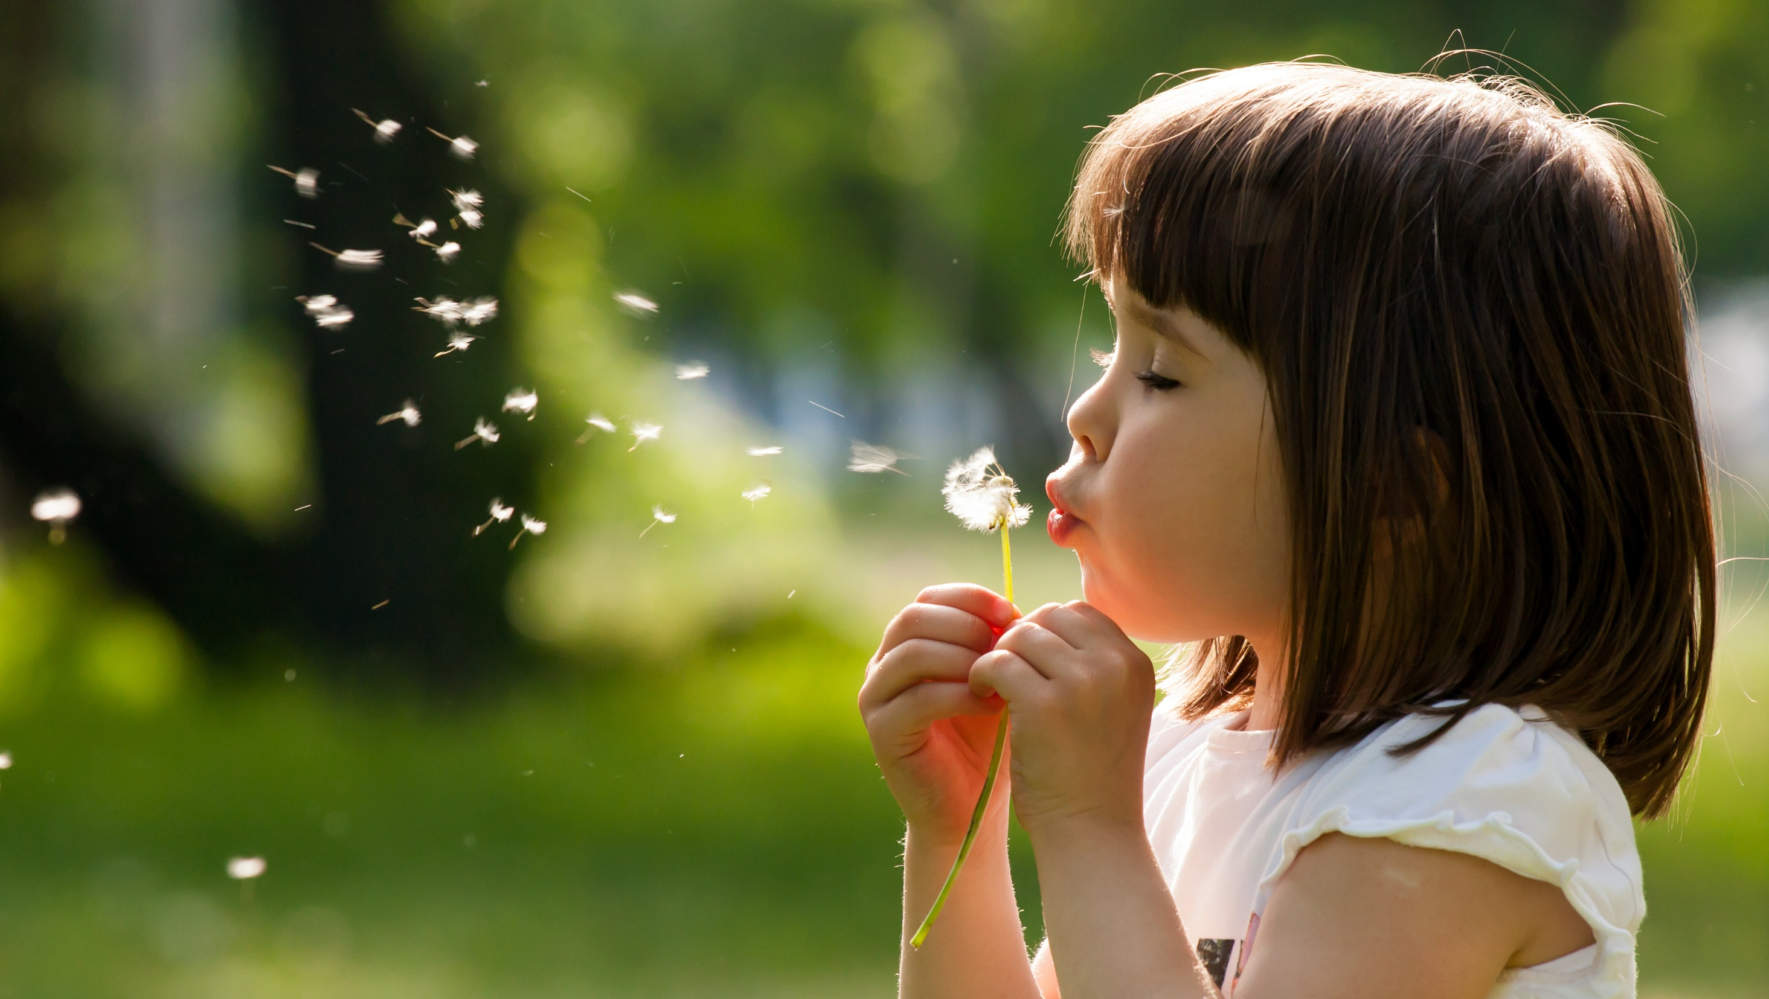
Enjoy your day!

