Slide 2

WARM-UP
GAME: CROSSWORD PUZZLES
-

Slide 3
1
1
F | R | I | D | G | E
2
2
C | O | M | P | U | T | E | R
3
3
C | O | O | K | E | R
4
4
B | E | D | R | O | O | M
5
5
K | I | T | C | H | E | N
6
6
E | N | E | R | G | Y
R | O | B | O | T
7
7
8
H | E | R
8
D | I | S | H | W | A | S
U | F | O
9
9
10
10
S | M | A | R | T
11
11
P | A | L | A | C | E
S | E | N | D
12
12
11. My dream house will be a big ________ in the mountain.
9. __________ stands for Unidentified Flying Object.
1. It’s the place where we keep food so that it can stay fresh.
10. He might have a__________ TV in his future house.
8. We often wash dishes and cups with this machine
12. A smart TV will help me to _____ and receive emails.
6. Our house will have solar________.
5. We often cook meals in this room.
7. The ________will help me to feed the dogs and cats.
3. An electric _________ can help us to cook rice.
4. We often sleep in this room.
2. He often plays ____________games all the day.

Slide 4



Unit
11
OUR GREENER WORLD
LESSON 1: GETTING STARTED
Let’s go green

Slide 5
LESSON 1: GETTING STARTED
Warm up: Crossword puzzles
Vocabulary
WARM-UP
Task 1: Listen and read.
Task 2: Read the conversation again. Complete the following sentence. Use no more than three words in each blank.
Task 3: Based on the ideas in the conversation, match the first half of the sentence in column A with the second half in column B.
Task 4: Match the picture with ways to help the environment.
PRESENTATION
PRACTICE
PRODUCTION
Task 5: Quiz: Find someone who…Work in groups. Ask and answer to find someone who does the things in 4.
CONSOLIDATION
Wrap-up
Homework

Slide 6


Vocabulary
PRESENTATION
go green
/ɡəʊ ɡriːn/
Sống xanh (thân thiện với môi trường)

Slide 7
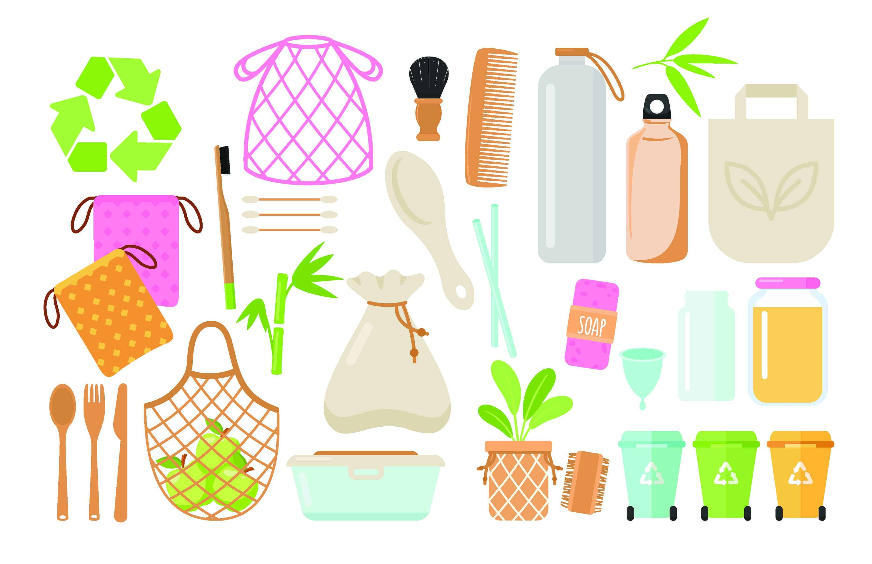
Vocabulary
PRESENTATION
reusable(adj)
/ˌriːˈjuːzəbl/
Có thể sử dụng lại

Slide 8

Vocabulary
PRESENTATION
environment
/ɪnˈvaɪrənmənt/
Môi trường

Slide 9
Vocabulary
PRESENTATION
New words | Pronunciation | Meaning
1. go green | /ɡəʊ ɡriːn/ | Sống xanh
2. reusable (adj) | /ˌriːˈjuːzəbl/ | Có thể sử dụng lại
3. environment (n) | /ɪnˈvaɪrənmənt/ | Cảnh đẹp

Slide 10

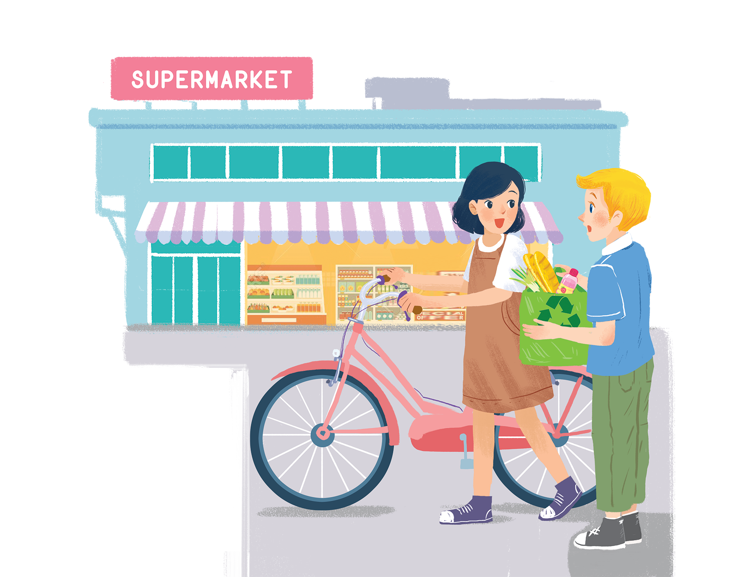
PRESENTATION
Listen and read.
Let’s go green!

Slide 11
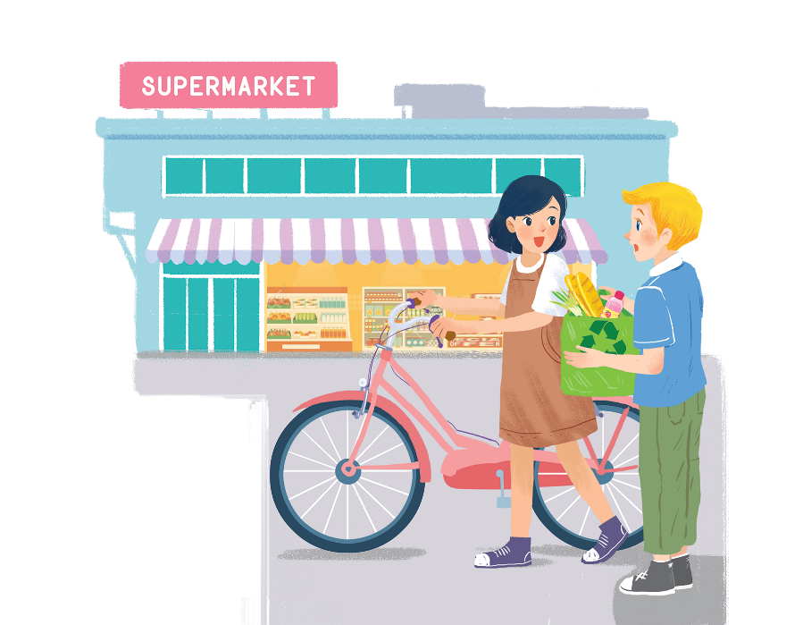
PRESENTATION
Listen and read.
Mi: Hi, Nick.
Nick: Hello, Mi.
Mi: You’ve bought a lot of things.
Nick: Yes. We’re going on a picnic tomorrow. What are you doing at the supermarket, Mi?
Mi: I’m buying some eggs. Hey, what’s this?
Nick: It’s a reusable shopping bag.
Mi: Do you always use it?
Nick: Yes. It’s better than a plastic one. If we all use this kind of bag, we will help the environment.
Mi: I see. I’ll buy one for my mum. Where can I buy one?
Nick: At the check-out. By the way, you’re also green. You’re cycling.
Mi: You’re right. If more people cycle, the air will be cleaner. Right?
Nick: Yes. Oh, it’s 5 o’clock already. I have to go now. See you later.
Mi: See you, Nick. Bye.
Let’s go green!

Slide 12

PRACTICE
Read the conversation again. Complete the following sentences. Use no more than three words in each blank.
1.
Nick is going on
a picnic tomorrow.
_______ tomorrow.
The green shopping bag is better than the
plastic one.
2.
_______.
3.
_______.
People can buy green bags at
the check-out.
4.
_______ bag for her mum.
Mi wants to buy
a reusable bag for her mum.
_______.
5.
Nick thinks that Mi is green because
she’s cycling.

Slide 13

PRACTICE
Based on the ideas in the conversation, match the first half of the sentence in column A with its second half in column B.
A
1. Green bags are better
2. The air will be cleaner
3. If people use reusable bags for shopping.
B
B
b. than plastic bags.
c. if more people cycle.
a. they will help the environment.
a. they will help the environment.
b. than plastic bags.
c. if more people cycle.

Slide 14

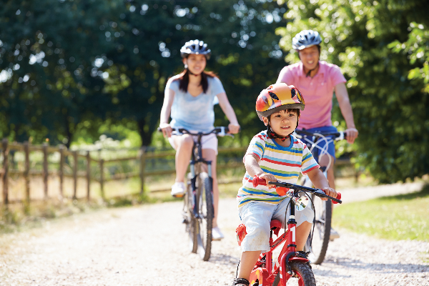
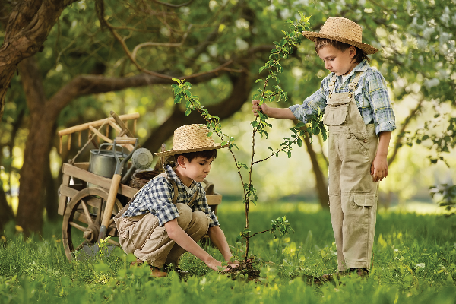
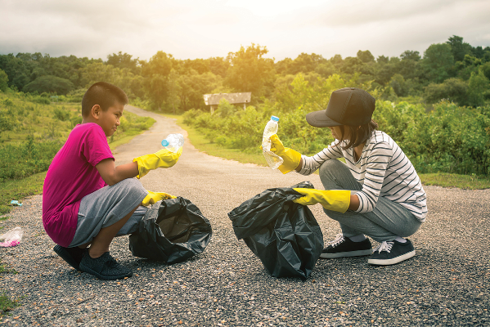
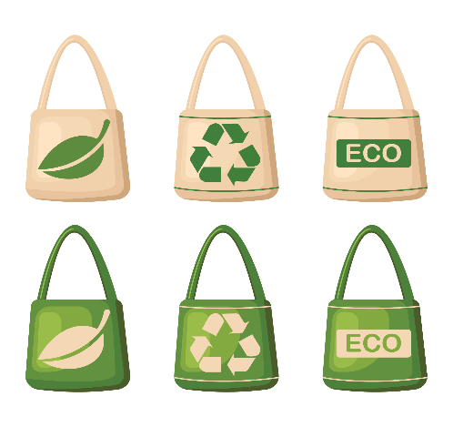
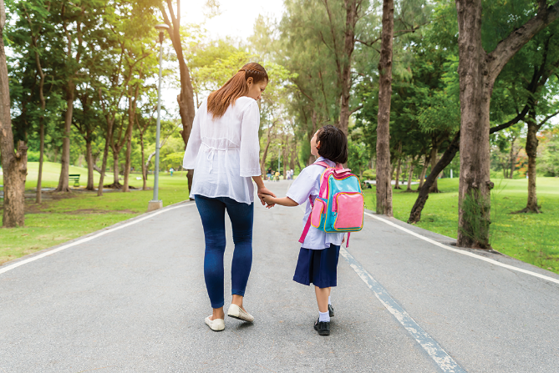
PRACTICE
Match the pictures with the ways to help the environment.
a.
planting trees and flowers
b.
picking up rubbish
d.
walking to school
e.
using reusable bags when shopping
c.
cycling
1
2
3
4
5

Slide 15
PRACTICE
Match the pictures with the ways to help the environment.
a.
planting trees and flowers
b.
picking up rubbish
d.
walking to school
e.
using reusable bags when shopping
c.
cycling
1
c.
cycling

Slide 16
PRACTICE
Match the pictures with the ways to help the environment.
a.
planting trees and flowers
b.
picking up rubbish
d.
walking to school
e.
using reusable bags when shopping
c.
cycling
2
planting trees and flowers
a.

Slide 17
PRACTICE
Match the pictures with the ways to help the environment.
a.
planting trees and flowers
b.
picking up rubbish
d.
walking to school
e.
using reusable bags when shopping
c.
cycling
3
picking up rubbish
b.

Slide 18
PRACTICE
Match the pictures with the ways to help the environment.
a.
planting trees and flowers
b.
picking up rubbish
d.
walking to school
e.
using reusable bags when shopping
c.
cycling
4
e.
using reusable bags when shopping

Slide 19
PRACTICE
Match the pictures with the ways to help the environment.
a.
planting trees and flowers
b.
picking up rubbish
d.
walking to school
e.
using reusable bags when shopping
c.
cycling
5
d.
walking to school

Slide 20


PRODUCTION
Find someone who ... Work in groups. Ask and answer to find someone who does the things in 4.
Ways to help the environment | Names
1. Planting trees and flowers
2. Pick up rubbish
3. Cycling
4. Walking to school
5. Using reusable bags when shopping
A: Do you plant trees?
B: No, I don’t.
A: Do you pick up rubbish?
B: Yes, I do.

Slide 21

CONSOLIDATION
1
Wrap-up
What have we learnt in this lesson?
Vocabulary: The lexical items related to Go Green
Some ways to help the environment

Slide 22

CONSOLIDATION
2
Homework
Learn by heart new words

Slide 23







