Slide 1


Slide 2

1
Unit
FAMILY LIFE
REVIEW 4
LESSON 3
SKILL 2_READING AND WRITING

Slide 3

Unit
1
1
FAMILY LIFE
Family Life
Unit
OBJECTIVES
Practice reading for general and specific information about how to protect the environment;
practice writing a short paragraph about things they should or shouldn’t do to reduce the negative impact of travelling on the environment.

Slide 4
LESSON 3
SKILL 2_ READING AND WRITING
Unit
GETTING STARTED
Talk about your plan for a day trip
WARM-UP
Task 1: Read the text. Match the highlighted words in the text with their meanings. (p. 123)
Task 2: Read the text again and choose the best answers. (p. 123)
READING
WRITING
Task 1: Write a paragraph (120 - 150 words) about things you should or shouldn’t do to reduce the negative impact of travelling on the environment. You may use the ideas in the reading to help you. (p. 123)
Wrap up
Homework
CONSOLIDATION

Slide 5
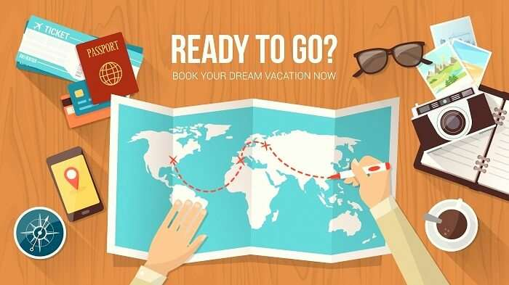
LESSON 3
SKILL 2_ READING AND WRITING
Unit
GETTING STARTED
WARM-UP
Talk about your plan for a day trip

Slide 6

LESSON 3
SKILL 2_ READING AND WRITING
Unit
GETTING STARTED
Talk about your plan for a day trip
WARM-UP
Task 1: Read the text. Match the highlighted words in the text with their meanings. (p. 123)
Task 2: Read the text again and choose the best answers. (p. 123)
READING

Slide 7
READING
1
Read the text. Match the highlighted words in the text with their meanings. (p. 123)
The more people travel, the bigger impact they may have on the environment. How can we reduce it while travelling? Here are some advice.
Reduce your carbon footprint while travelling. Since flying produces more carbon footprint than any other means of transport, you should only fly when the trip is long. During the trip, you should walk, cycle or use public transport as much as you can. This not only helps to keep the environment clean, but also allows you to enjoy the beauty of nature and interact with local people.
Choose eco-friendly activities that benefit animals and the ecosystem. Avoid activities that allow you to touch or ride animals because they disturb their natural patterns and attract many people. Instead, visit wildlife parks or organic farms. These will help you understand and respect the nature more and stop doing things that harm the environment.

Slide 8
READING
1
Read the text. Match the highlighted words in the text with their meanings. (p. 123)
Words | Meanings
1. interact | a. to be good for someone or something
2. benefit | b. to talk or do things with other people
3. disturb | c. to interrupt what people are doing and make them angry
1 - b
2 - a
3 - c

Slide 9
READING
2
Read the text again and choose the best answers. (p. 123)
1. What is the main idea of the text?
A. Reducing the environmental impact of tourism
B. Visiting wildlife parks
C. Choosing suitable tourist attractions
2. An easy way to reduce your carbon footprint is to ________.
A. fly when you travel
B. walk when you arrive at the place
C. ride animals
3. What can be inferred from the text?
A. T ourists are encouraged to watch the shows which are performed by animals.
B. Visits to organic farms or wildlife parks can be harmful to the environment.
C. T ourists should choose activities that are good for local people and the environment.

Slide 10
LESSON 3
SKILL 2_ READING AND WRITING
Unit
GETTING STARTED
Talk about your plan for a day trip
WARM-UP
Task 1: Read the text. Match the highlighted words in the text with their meanings. (p. 123)
Task 2: Read the text again and choose the best answers. (p. 123)
READING
WRITING
Task 1: Write a paragraph (120 - 150 words) about things you should or shouldn’t do to reduce the negative impact of travelling on the environment. You may use the ideas in the reading to help you. (p. 123)

Slide 11
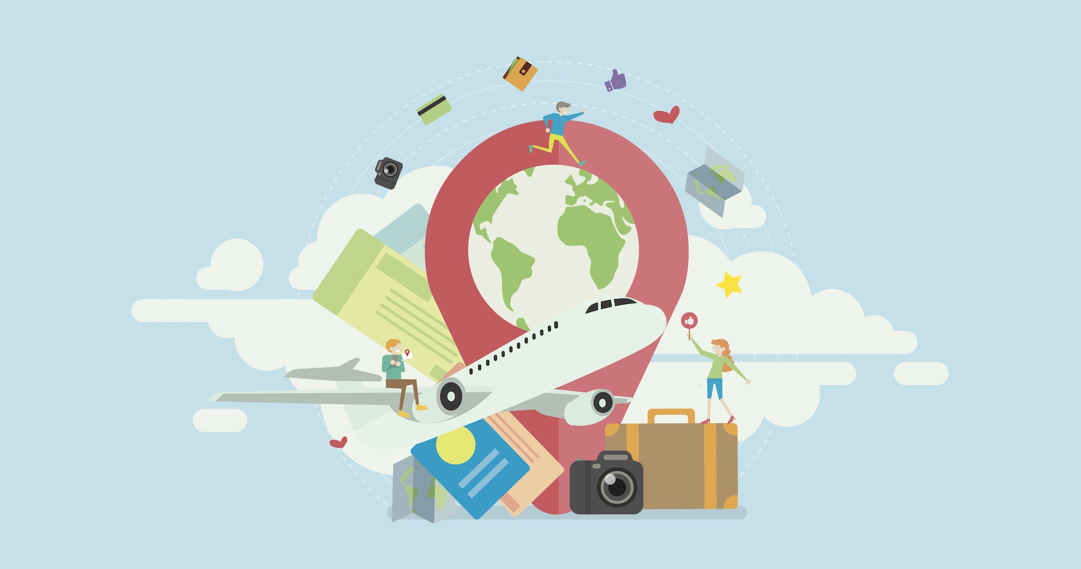
WRITING
1
Write a paragraph (120 - 150 words) about things you should or shouldn’t do to reduce the negative impact of travelling on the environment. You may use the ideas in the reading to help you. (p. 123)

Slide 12
WRITING
1
Write a paragraph (120 - 150 words) about things you should or shouldn’t do to reduce the negative impact of travelling on the environment. You may use the ideas in the reading to help you. (p. 123)
Sample answer:
There are several things that we should do to reduce the negative impact of travelling on the environment. Firstly, we should reduce our carbon footprint during the trip. We should only fly when the trip is long and choose environmentally-friendly means of transport such as cycling or public transport. Secondly, wherever we go, we should always protect our environment. By keeping it clean and safe, we can reduce the negative impact of travelling on the environment.

Slide 13
LESSON 3
SKILL 2_ READING AND WRITING
Unit
GETTING STARTED
Talk about your plan for a day trip
WARM-UP
Task 1: Read the text. Match the highlighted words in the text with their meanings. (p. 123)
Task 2: Read the text again and choose the best answers. (p. 123)
READING
WRITING
Task 1: Write a paragraph (120 - 150 words) about things you should or shouldn’t do to reduce the negative impact of travelling on the environment. You may use the ideas in the reading to help you. (p. 123)
Wrap up
Homework
CONSOLIDATION

Slide 14
CONSOLIDATION
1
Wrap-up
Practice reading for general and specific information about how to protect the environment;
practice writing a short paragraph about things they should or shouldn’t do to reduce the negative impact of travelling on the environment.

Slide 15
CONSOLIDATION
2
Homework
Write the final draft for the paragraph about things they should or shouldn’t do to reduce the negative impact of travelling on the environment.

Slide 16


