Slide 1





Slide 2


Time and daily routines
2
Lesson 3 - Period 6

Slide 3
Table of contents
Warm-up and review
04
01
02
03
Activity 3
Project.
Activity 1
Read and match.
05
Fun corner & wrap-up
Activity 2
Let’s write.

Slide 4
01
Warm-up & review

Slide 5

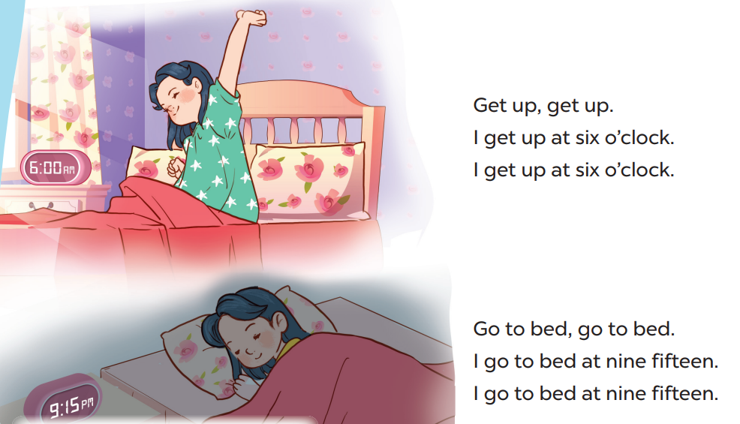

Slide 6
02
Activity 1
Read and match.

Slide 7
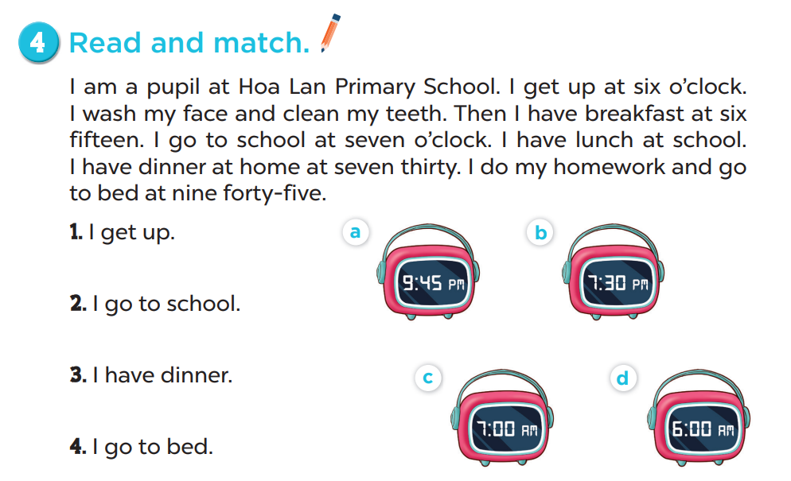

Slide 8
03
Activity 1
Let’s write.

Slide 9
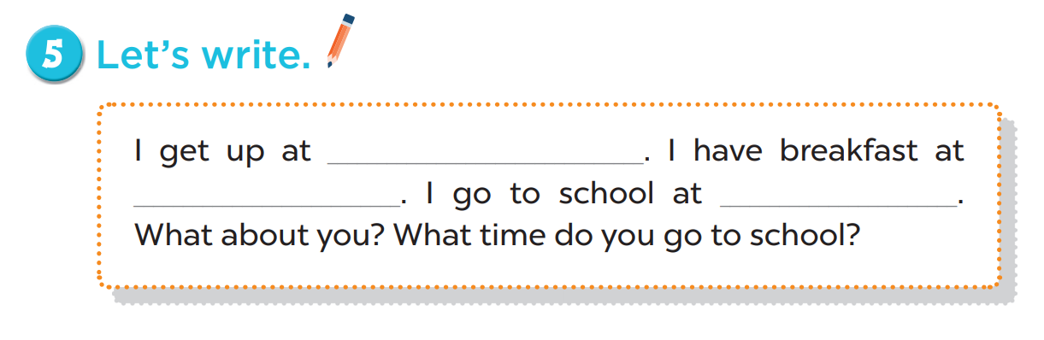
six o’clock
six thirty
seven o’clock

Slide 10
04
Activity 3
Project

Slide 11
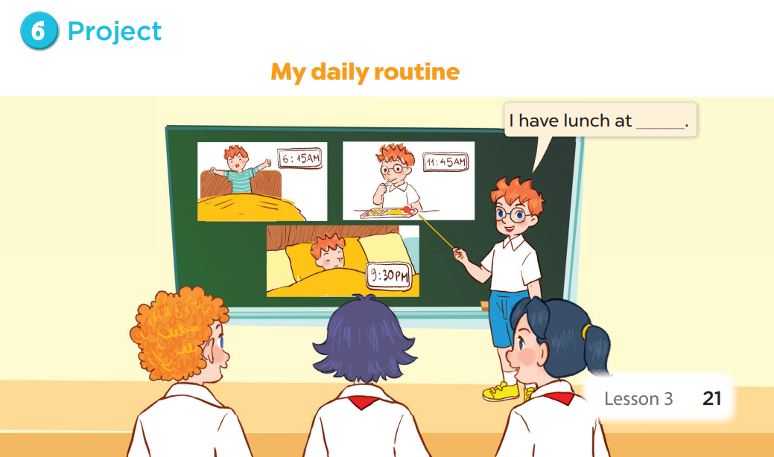

Slide 12
05
Fun corner & wrap-up

Slide 13






Slide 14

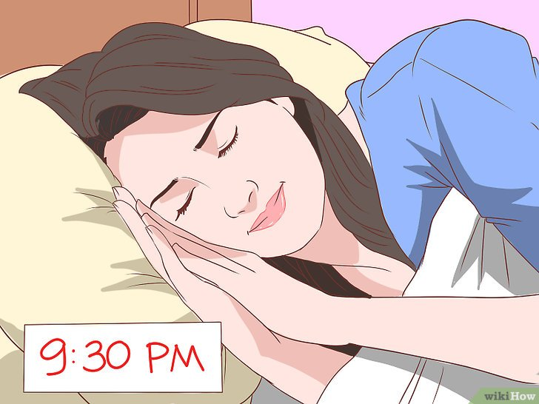



Câu hỏi 3
A. have breakfast
B. go to bed
+5
-1
-1
-1
C. go to school
D. get up

Slide 15
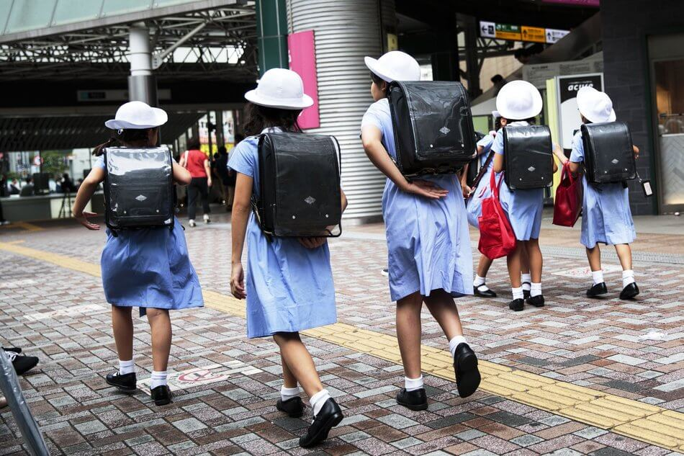

Câu hỏi 2
A. get up
B. have breakfast
+7
-1
-1
-1
C. go to school
D. go to bed

Slide 16
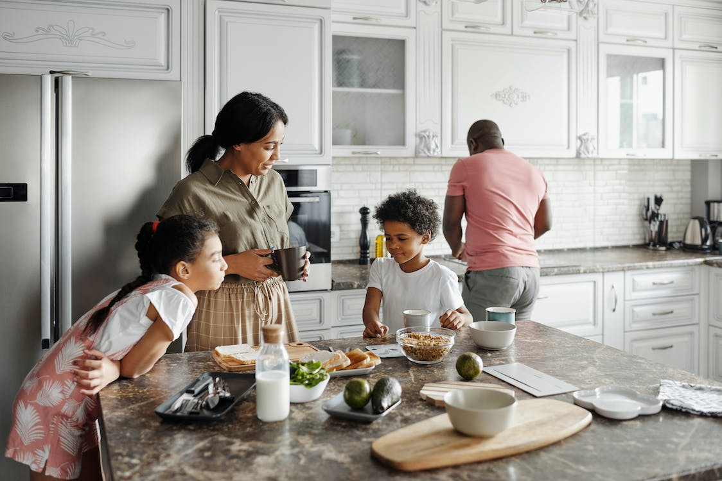
Câu hỏi 1
A. have breakfast
B. go to school
+5
-1
-1
-1
C. go to bed
D. get up

Slide 17
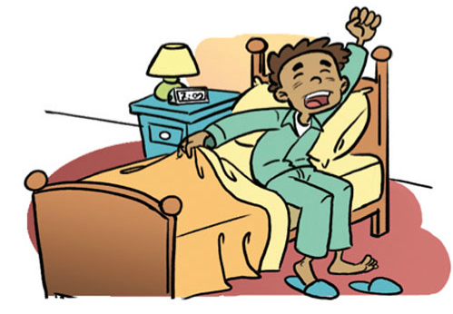
Câu hỏi 4
A. have breakfast
B. go to school
+6
-1
-1
-1
C. go to bed
D. get up

Slide 18

Câu hỏi 3
A. I go to school at seven fifteen.
B. I go to school at six
forty-five.
+8
-1
-1
-1
C. I go to school at seven forty-five.
D. I go to school at seven o’clock.

Slide 19
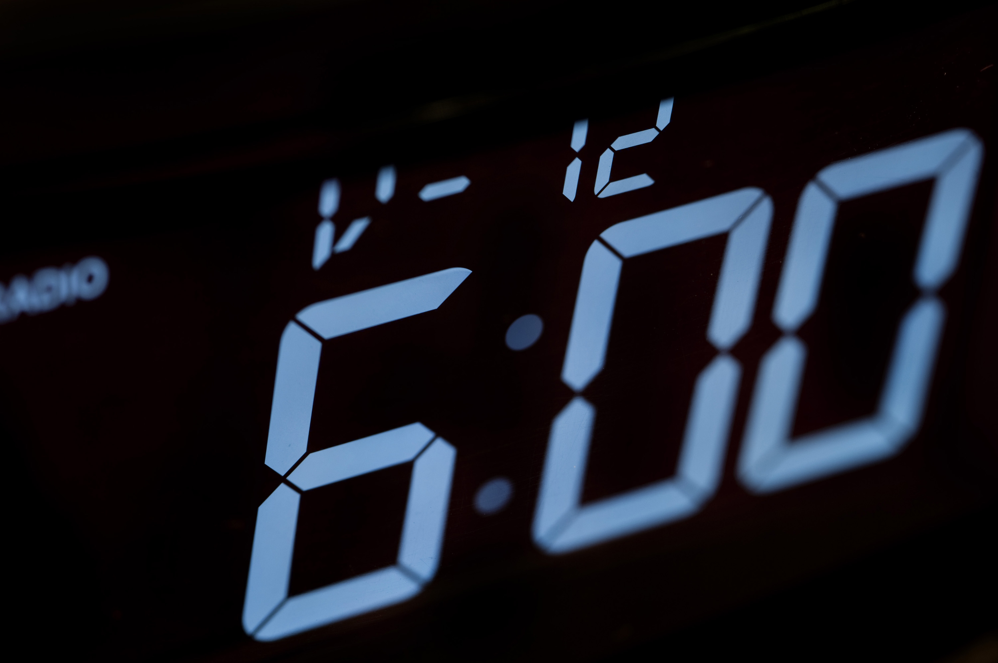
Câu hỏi 2
A. I get up at six fifteen.
B. I get up at six
forty-five.
+5
-1
-1
-1
C. I get up at six o’clock.
D. I get up at six thirty.

Slide 20


Great job!
Exit

Slide 21








THANK YOU
Website: hoclieu.vn
Fanpage: facebook.com/www.tienganhglobalsuccess.vn
Website: sachmem.vn; hoclieu.vn
Fanpage: www.facebook.com/sachmem.vn

