Slide 1

UNIT 9: TRAVEL AND TOURISM
Lesson 2.2 – Grammar
Page 78

Slide 2


Lesson 2.2
LESSSON OUTLINE
Presentation: Meaning and use, Form
Practice
Production
Consolidation

Slide 3

By the end of this lesson,
students will be able to:
- practice and use Past simple and Past continuous with When and While correctly.

Slide 4



Slide 5

Guessing game
Look at the picture and guess
what happened to the woman.
Notes:
Divide class into 2 teams
Ask each team to discuss and find down the answers ( as many as possible)
Remember: sts are not allowed to open the book
Compare the sts’ answer to the sentences in picture (in the book) to find the winner

Slide 6
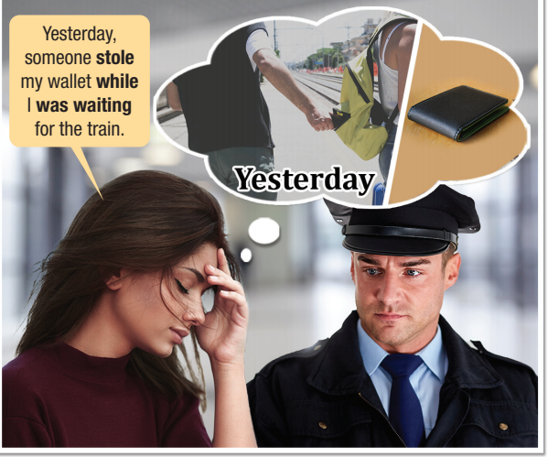

Guessing game
Answer
Listen and repeat.
Notes:
Divide class into 2 teams
Ask each team to discuss and find down the answers ( as many as possible)
Remember: sts are not allowed to open the book
Compare the sts’ answer to the sentences in picture (in the book) to find the winner

Slide 7

Presentation

Slide 8

Example:
(We went to the beach)
We were driving to the beach when our car broke down.
→ Meaning and Use:
We can use when to introduce an interruption to a past continuous action. We can use a sentence with when to start an interesting story.

Slide 9
Example:
She was talking on the phone when a monkey stole her bag.
Form:
Past continuous
When + Past Simple
V_{2/ed}
was/ were + V_{ing}

Slide 10

Example:
We went to the beach
While I was swimming, it started to rain.
→ Meaning and Use:
We can use while to continue a story where the time period is important. We don't begin a story with while.

Slide 11
Example:
They went for a walk.
While they were walking along the beach, they saw a dolphin
Form:
While + Past continuous
Past Simple
V_{2/ed}
was/ were + V_{ing}

Slide 12

Practice

Slide 13
Practice
b. Combine the sentences using when or while.
1. I was waiting for my taxi. My luggage was stolen.
2. (The family went to bed.) They were sleeping. The heater broke down.
3. We were watching TV. We got a message saying that our flight was canceled.
I was waiting for my taxi when my luggage was stolen.
The family went to bed. While they were sleeping, the heater broke down.
We were watching TV when we got a message saying that our flight was canceled.

Slide 14
Practice
b. Combine the sentences using when or while.
4. (The waiter gave us a menu.) We were ordering. People started running to the bathroom.
5. He was taking photos. A camel chased after him.
The waiter gave us a menu. While we were ordering, people started running to the bathroom.
He was taking photos when a camel chased after him.

Slide 15
Practice
c. Write sentences using the prompts and the correct form of the verbs.
1. I/swim/in the pool/when/the fire alarm/ring ______________________________________________
2. While/we/eat/my brother/start/feeling sick ______________________________________________
3. He/swim/in the sea/when/someone/steal/his clothes ______________________________________________
4. While/they/hike/it/start/raining/heavily ______________________________________________
5. We/buy/souvenirs/when/my favorite actor/walk/into the store
______________________________________________
I was swimming in the pool when the fire alarm rang.
While we were eating, my brother started feeling sick.
He was swimming in the sea when someone stole his clothes.
While they were hiking, it started raining heavily
We were buying souvenirs when my favorite actor walked into the store.

Slide 16
Extra Practice WB, p. 53
a. Combine the sentences using when or while.
I was taking pictures in the park. A monkey stole my camera.
____________________________________________________
(I went to take a bath.) I was standing in the bathroom. The fire alarm rang.
___________________________________________________
________________
3. Helen was writing an email to her boss. Her laptop crashed.
___________________________________________________
I was taking pictures in the park when a monkey stole my camera
I went to take a bath. While I was standing in the bathroom,
the fire alarm rang
Helen was writing an email to her boss when her laptop crashed.
Notes:
Taken from TA 10 i-Learn Smart World WB, page 53, activity a

Slide 17
Extra Practice WB, p. 53
a. Combine the sentences using when or while.
4. (Mr. Johnson went on a business trip.) He was in a meeting. He started feeling sick.
___________________________________________________
_________________
5. We were waiting at the airport. They announced that our plane was delayed.
______________________________________________________
_______________
Mr. Johnson went on a business trip. While he was in a meeting, he started feeling sick.
We were waiting at the airport when they announced that our plane was delayed.
Notes:
Taken from TA 10 i-Learn Smart World WB, page 53, activity a

Slide 18
Extra Practice WB, p. 53
b. Fill in the blanks with the correct form of the verbs.
1. The teacher _____________ (explain) a math problem when a bird ____ (fly) in.
2. Louisa and her son were at home. While Louisa ___________ (read) the magazine, her son ______ (start) to cry.
3. Everyone ___________ (watch) a gameshow when the TV ______ (turn) off.
4. I stopped at the station kiosk. While I ___________ (buy) magazines, someone _____ (steal) my bike.
5. They ____________ (sleep) when the fire alarm _____ (go) off.
was explaining
flew
was reading
started
was watching
turned
was buying
stole
were sleeping
went
Notes:
Taken from TA 10 i-Learn Smart World WB, page 53, activity b

Slide 19

Production

Slide 20
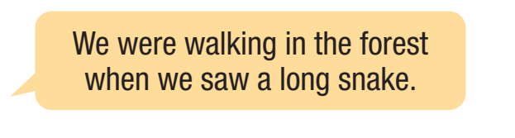
d. In pairs: Describe something that happened on your last vacation.
Example:

Slide 21

Consolidation

Slide 22
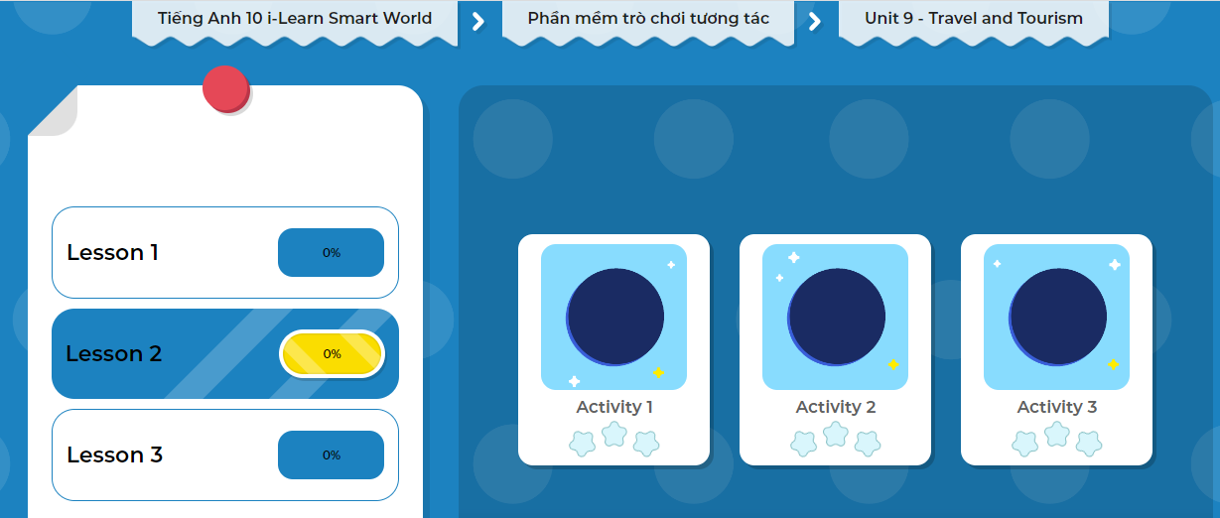
LET’S PLAY!
Click here to play the game!

Slide 23
Wrap-up
Today’s lesson
Past simple and Past continuous with When and While Form: When Past Simple, Past continuous
While Past Continuous, Past Simple
Meaning and use:
When: introduce an interruption to a past continuous action or start an interesting story.
While: continue a story where the time period is important (don’t begin a story with while)

Slide 24
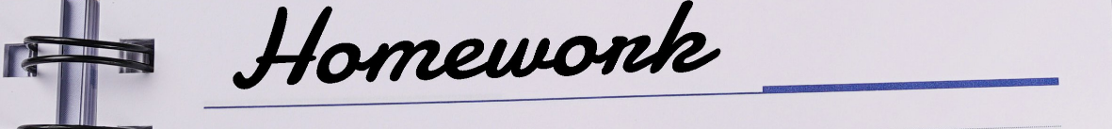
Complete the grammar notes in Tiếng Anh 10 i-Learn Smart World Notebook on page 53
Do the Writing exercises in workbook on page 53.
Prepare the next lesson - Lesson 2.3 – Pronunciation & Speaking (page 79).
Play the consolidation games in Tiếng Anh 10 i-Learn Smart World DHA App on www.eduhome.com.vn

