Slide 1
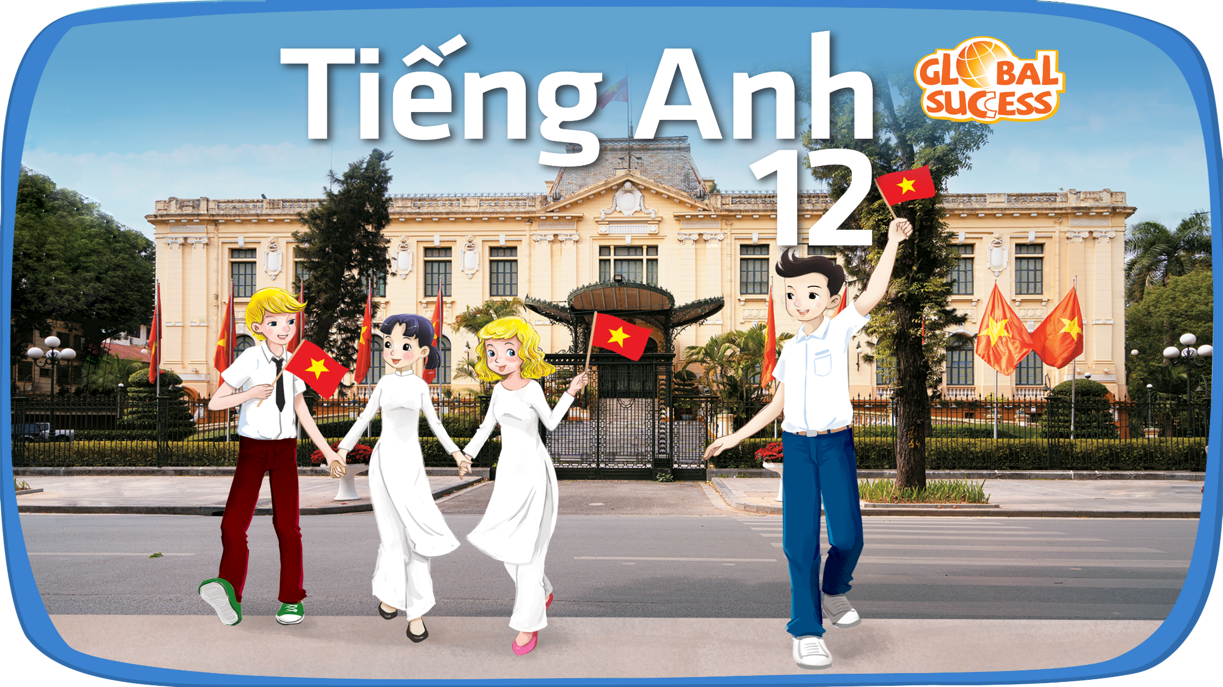

Slide 2
Unit 10
Lifelong learning
COMMUNICATION AND CULTURE / CLIL
LESSON VII
Thanking and accepting thanks

Slide 3
LESSON VII
COMMUNICATION AND CULTURE/CLIL
Watching a video
WARM-UP
Task 1: Listen and complete the conversations with the expressions in the box. Then practise them in pairs.
Task 2: Work in pairs. Use the models in 1 to make similar conversations for these situations. One of you is A, the other is B. Use the expressions below to help you.
EVERYDAY ENGLISH
CULTURE
Task 1: Read the text and complete the diagram with information from the text.
Task 2: Work in groups. Share stories of people you know who keep learning despite their old age.
EXTRA ACTIVITY
Discussion
CONSOLIDATION
Wrap-up
Homework

Slide 4
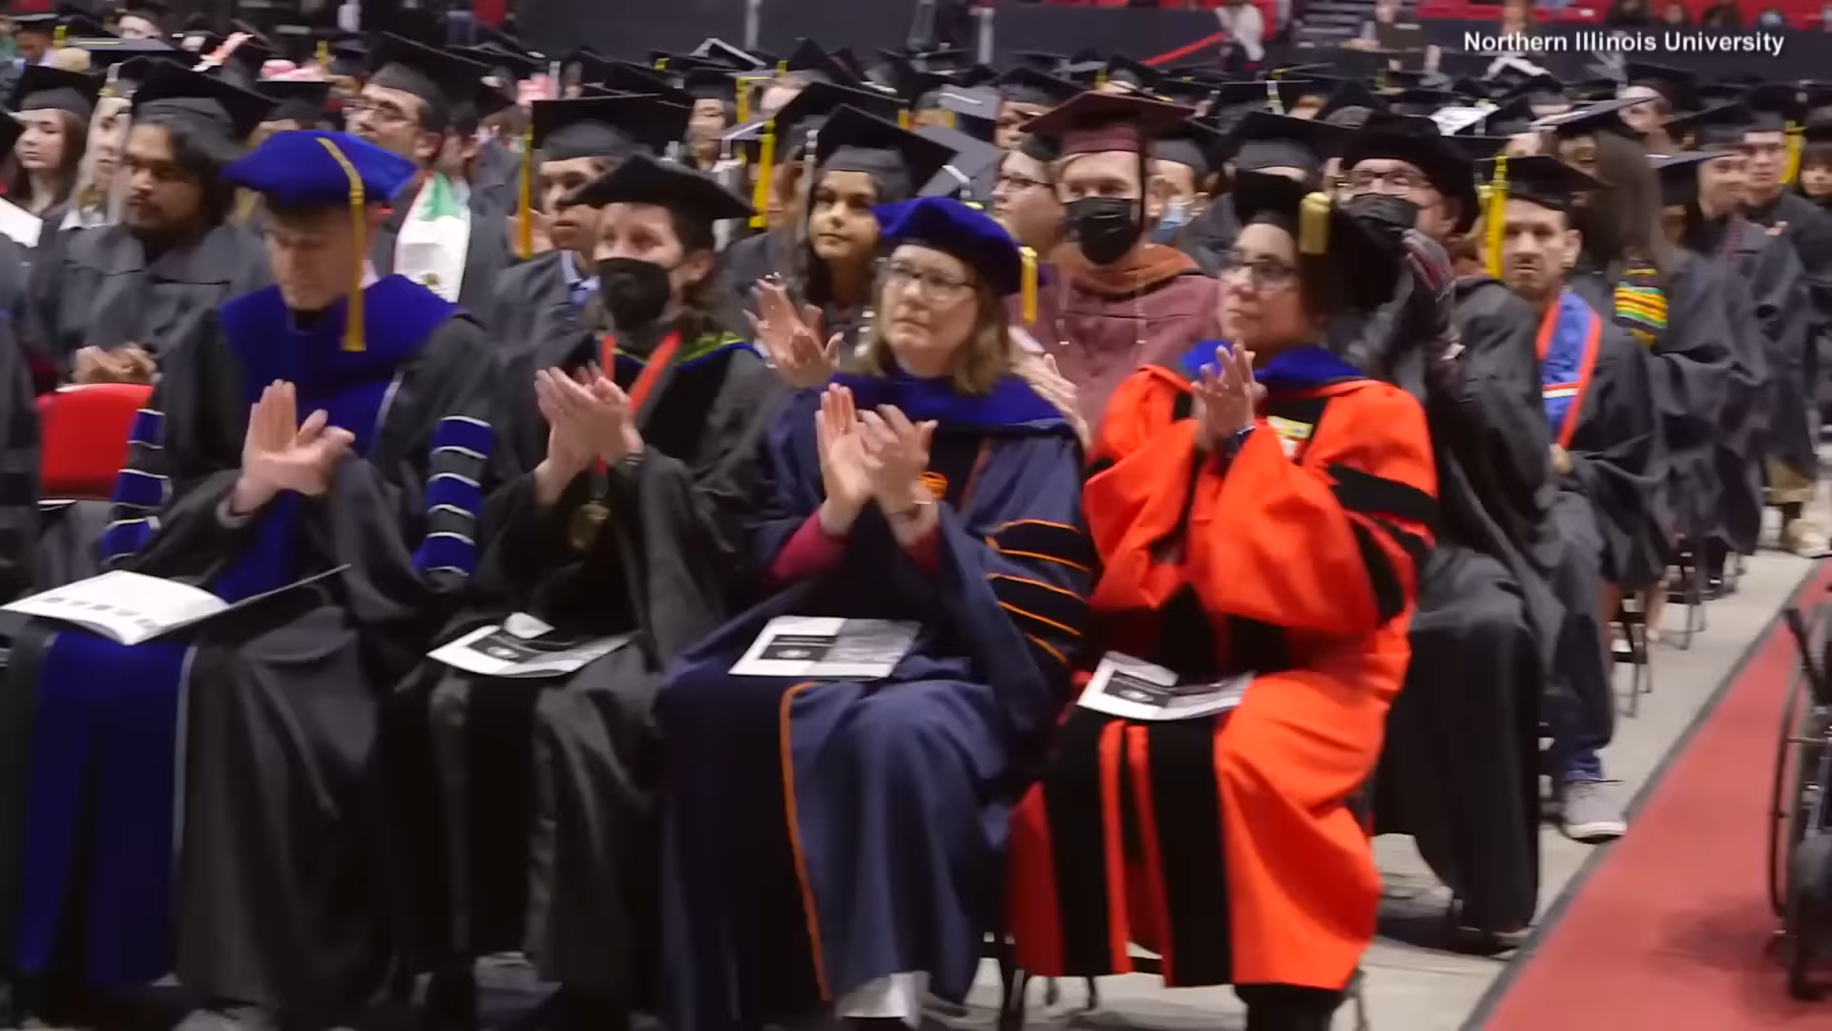
What do you know about this woman?
WARM-UP
Notes:
https://www.youtube.com/watch?v=ahxRv5Rzhe4

Slide 5

EVERYDAY ENGLISH
1
Listen and complete the conversations with the expressions in the box. Then practise them in pairs.
A. Don’t mention it B. I really appreciate it
C. It's my pleasure D. Thank you for inviting
Ms Lan: Mai, the information about the online courses is very useful. Thank you for presenting it. (1) ____________________.
Mai: (2) ____________________, Ms Lan. I’m glad you found it useful.
1
B. I really appreciate it
C. It’s my pleasure
Nam: Mark, I like the activities of the science club very much. (3) __________________________ me to join the club.
Mark: (4) ________________________. Glad to help.
2
D. Thank you for inviting
A. Don’t mention it

Slide 6
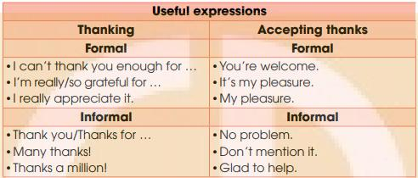
EVERYDAY ENGLISH
THANKING AND ACCEPTING THANKS

Slide 7
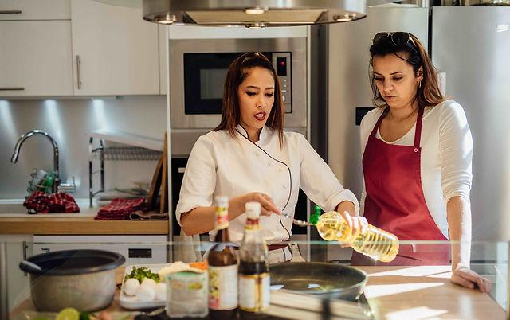
EVERYDAY ENGLISH
2
Work in pairs. Use the models in 1 to make similar conversations for these situations. One of you is A, the other is B. Use the expressions below to help you.
A attends a cooking class taught by B. A thanks B for teaching her/him to cook a traditional dish.
B replies by accepting thanks
Thank you very much for teaching me how to cook this fish soup. It’s so delicious.
Don’t mention it. I’ glad you like my cooking style.

Slide 8
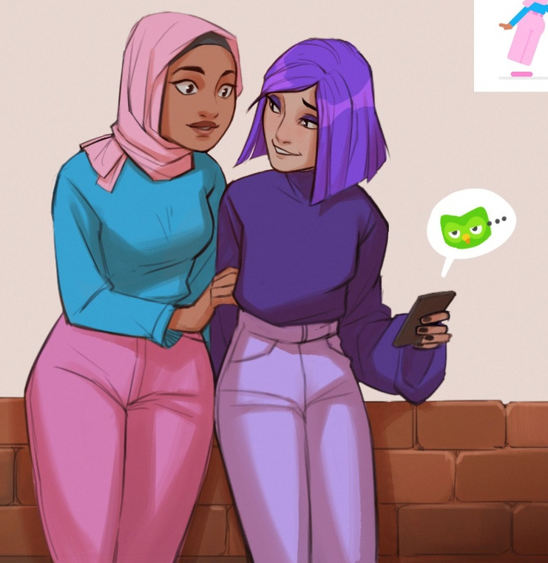
EVERYDAY ENGLISH
2
Work in pairs. Use the models in 1 to make similar conversations for these situations. One of you is A, the other is B. Use the expressions below to help you.
A and B are friends. B thanks A for sharing information about an app for learning English.
A replies by accepting thanks.
My pleasure.
Thank you for sharing about Duolingo app. I like it very much, and I try to learn French every day.

Slide 9
CULTURE
Answer these questions
Do you know any old-aged university students?
How old were they?
What did they study at university?

Slide 10
CULTURE
1
Read the text and complete the diagram with information from the text.
At 14
* left school
* didn’t finish secondary education
At 60
(1) ________
At 70
(2) ________
At 89
(3) _________
At 91
(4) _________

Slide 11
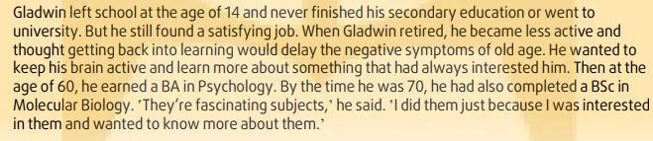
CULTURE
1
Read the text and complete the diagram with information from the text.
At 60
(1) ________
earned a BA in Psychology

Slide 12
CULTURE
1
Read the text and complete the diagram with information from the text.
At 70
(2) ________
completed a BSc in Molecular Biology

Slide 13
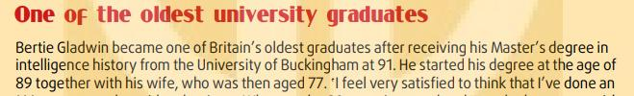
CULTURE
1
Read the text and complete the diagram with information from the text.
At 89
(3) ________
started his Master’s degree

Slide 14
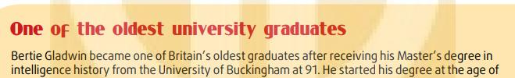
CULTURE
1
Read the text and complete the diagram with information from the text.
At 91
(4) ________
received his Master’s degree

Slide 15
CULTURE
1
Look at the diagram again.
At 14
* left school
* didn’t finish secondary education
At 60
earned a BA in Psychology
At 70
completed a BSc in Molecular Biology
At 89
started his Master’s degree
At 91
received his Master’s degree

Slide 16

CULTURE
2
Work in groups. Share stories of people you know who keep learning despite their old age.
How old was this person when he graduated?
Why did he study at university at such an old age?
How did he feel when he received his degree at such an old age?

Slide 17


CULTURE
2
Work in groups. Share stories of people you know who keep learning despite their old age.
In our group, we all admire Tam’s grandfather. He retired 10 years ago. After he retired, he had more free time to pursue his interests. He really likes French literature, especially novels, so he registers for a course to brush up on his French to help him translate French novels into Vietnamese. He also managed to publish some of them.

Slide 18
EXTRA ACTIVITY
Discuss the questions
1. Do you think lifelong learning is important?
2. Why do some people still choose to learn even when they are older?

Slide 19
CONSOLIDATION
1
Wrap-up
What have you learned today?
Thanking and accepting thanks
I can’t thank you enough for….
I’m really/ so grateful for…
I really appreciate it.
You’re welcome./ It’s my please. / My pleasure.
Thank you/ Thanks for/ Many thanks!/ Thanks a million!
No problem. Don’t mention it. Glad to help.
One of the oldest university graduates
=> Bertie Gladwin

Slide 20
CONSOLIDATION
2
Homework
Do exercises in the workbook.
Prepare for the next lesson.

Slide 21

Website: hoclieu.vn
Fanpage: facebook.com/www.tienganhglobalsuccess.vn

