Slide 1

Unit 9: English in the World
Lesson 1.2: Grammar
Page 69

Slide 2


LESSON OUTLINE
Consolidation

Slide 3

By the end of this lesson, students will be able to…
- use article “the” correctly.

Slide 4
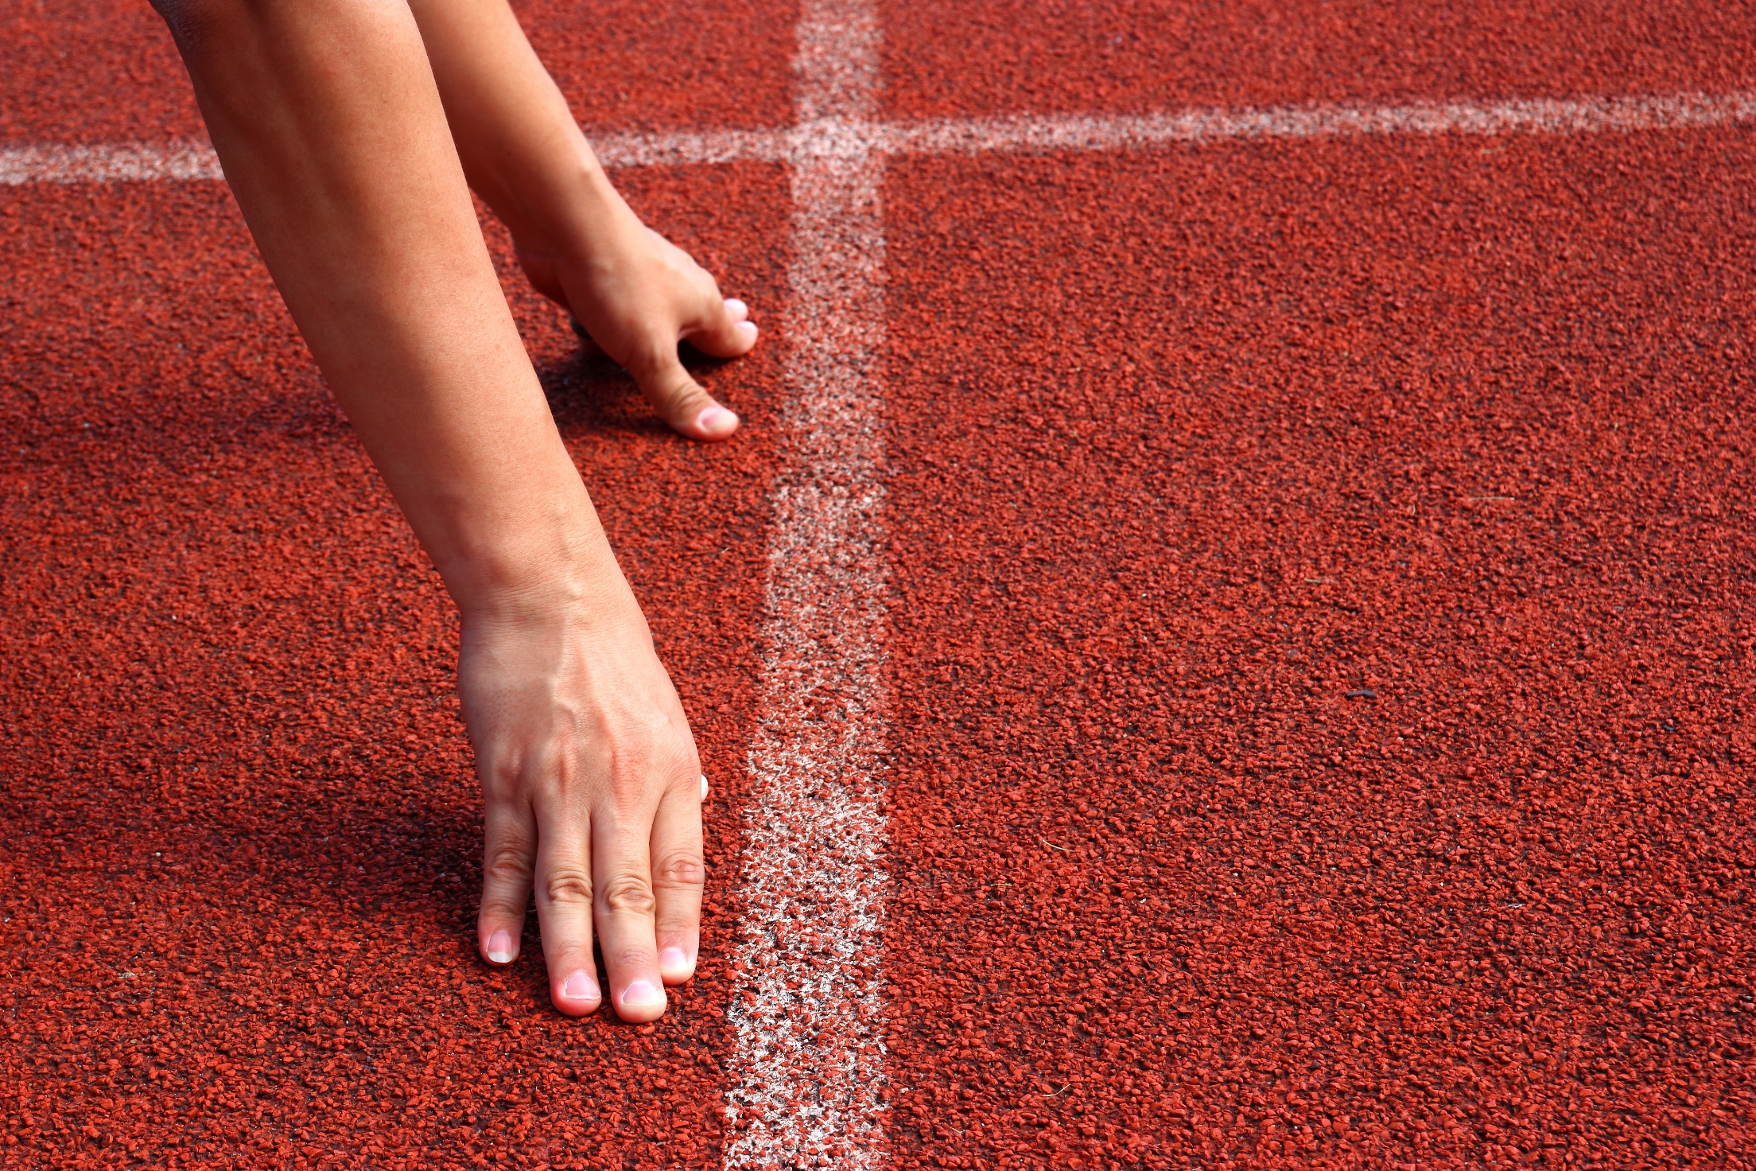
WARM-UP

Slide 5

Work in pairs
1. Where is Statue of Liberty?
2. Where is Ha Long Bay?
In The US
In Vietnam

Slide 6

PRESENTATION
article
(the)

Slide 7
Articles (zero article)
We use the zero article (Ø) with the names of streets, parks, lakes, rivers, beaches, towns, cities, islands, and most countries.
E.g. There are lots of department stores on Fifth Avenue.
They're visiting Hanoi, Huế, and Đà Nẵng in Vietnam.
He likes to jog in Hyde Park.

Slide 8
Articles “the”
☞ We use the with some countries.
E.g. the United States of America, the United Kingdom, the Netherlands, the Philippines, the United Arab Emirates, the Czech Republic
☞ We use the with famous buildings, museums, most hotels, and restaurants.
E.g. the Empire State Building, the Houses of Parliament, the Ritz Hotel, the White House, the Louvre Museum

Slide 9

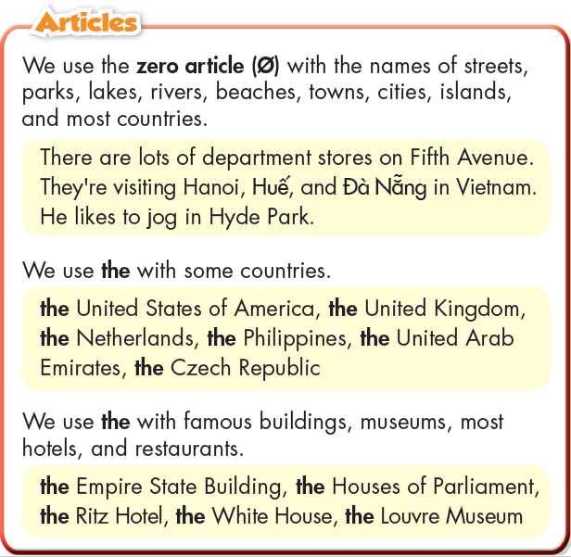
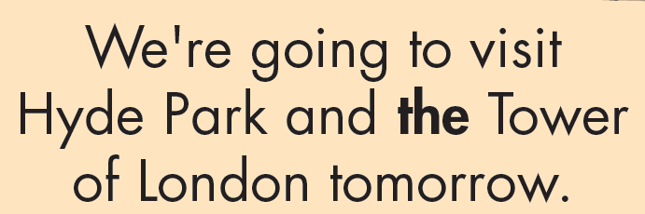
Click on the icon to hear the sound

Slide 10

PRACTICE

Slide 11
b. Write sentences using the prompts.
1. I/visiting/Sydney Opera House
I’m visiting the Sydney Opera House.
2. he/staying/next to/Hyde Park
He’s staying next to Hyde Park.
3. we/going to/United Kingdom
We’re going to the United Kingdom.

Slide 12
b. Write sentences using the prompts.
4. my parents/visiting/Louvre Museum
My parents are visiting the Louvre Museum.
5. Empire State Building/in/New York City
The Empire State Building is in New York City.
6. I/going to eat fish and chips/Bondi Beach
I’m going to eat fish and chips at Bondi Beach.

Slide 13
c. Fill in the blanks using the or Ø (zero article).
To: tobyel@frienzmail.com
Subject: Plan for our trip
Hi Toby,
This is our plan for our trip to London. We're arriving on Tuesday. We're staying at (1) ______ Hilton Hotel. We're going to go to (2) ______ Hyde Park on Wednesday. On Friday, we're going to visit (3) ______ Houses of Parliament. We're going to go to (4) _____ Regent's Park on Saturday and visit (5) ______ Imperial War Museum on Sunday. We're going to ride on (6) ______ London Eye and fly back to (7) ______ New York on Monday.
See you soon,
Luke
the
Ø
the
Ø
the
the
Ø

Slide 14
Extra Practice
WB, page 51
Fill in the blanks using the or Ø (zero article).
1. I'd love to go diving in _______ Philippines.
2. _______ Empire State Building is a very famous building in _______ United States.
3. _______ Mount Cook is the tallest mountain in New Zealand.
4. The tour guide will meet us at _______ Glasgow Airport.
5. _______ Metropolitan Museum of Art is one of the world's largest art museums.
6. _______ Galway is a city in the west of Ireland.
7. You can take a boat trip on _______ Crater Lake. It's very beautiful there.
the
The
the
Ø
Ø
The
Ø
Ø

Slide 15
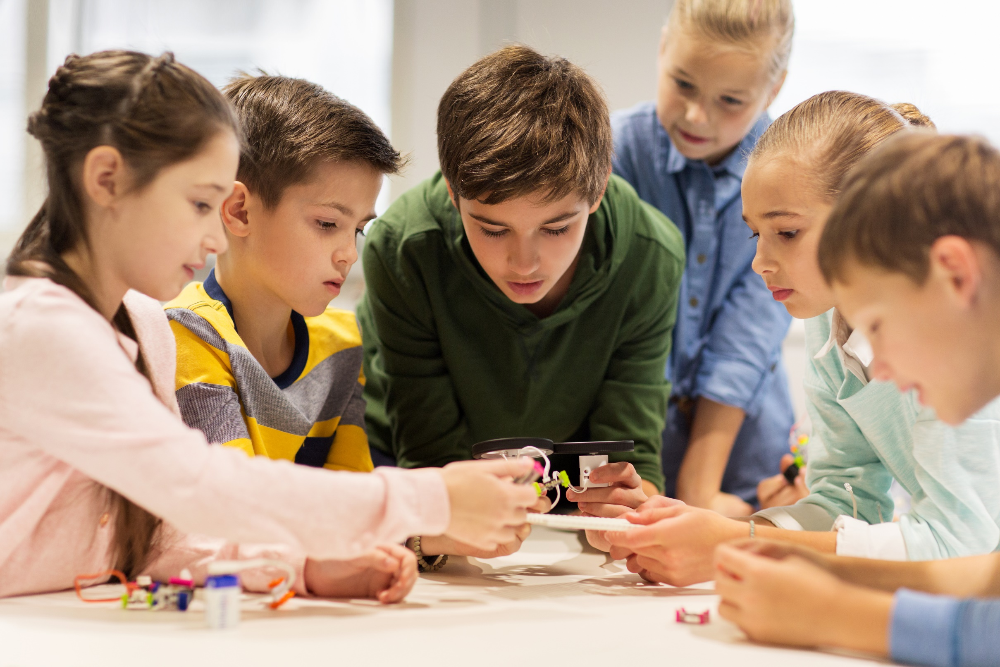
PRODUCTION

Slide 16
d. In pairs: Make sentences with your partner for a trip to London. Use the prompts.
Richmond Park Oxford Street Natural History Museum Ritz Hotel

Slide 17

CONSOLIDATION

Slide 18
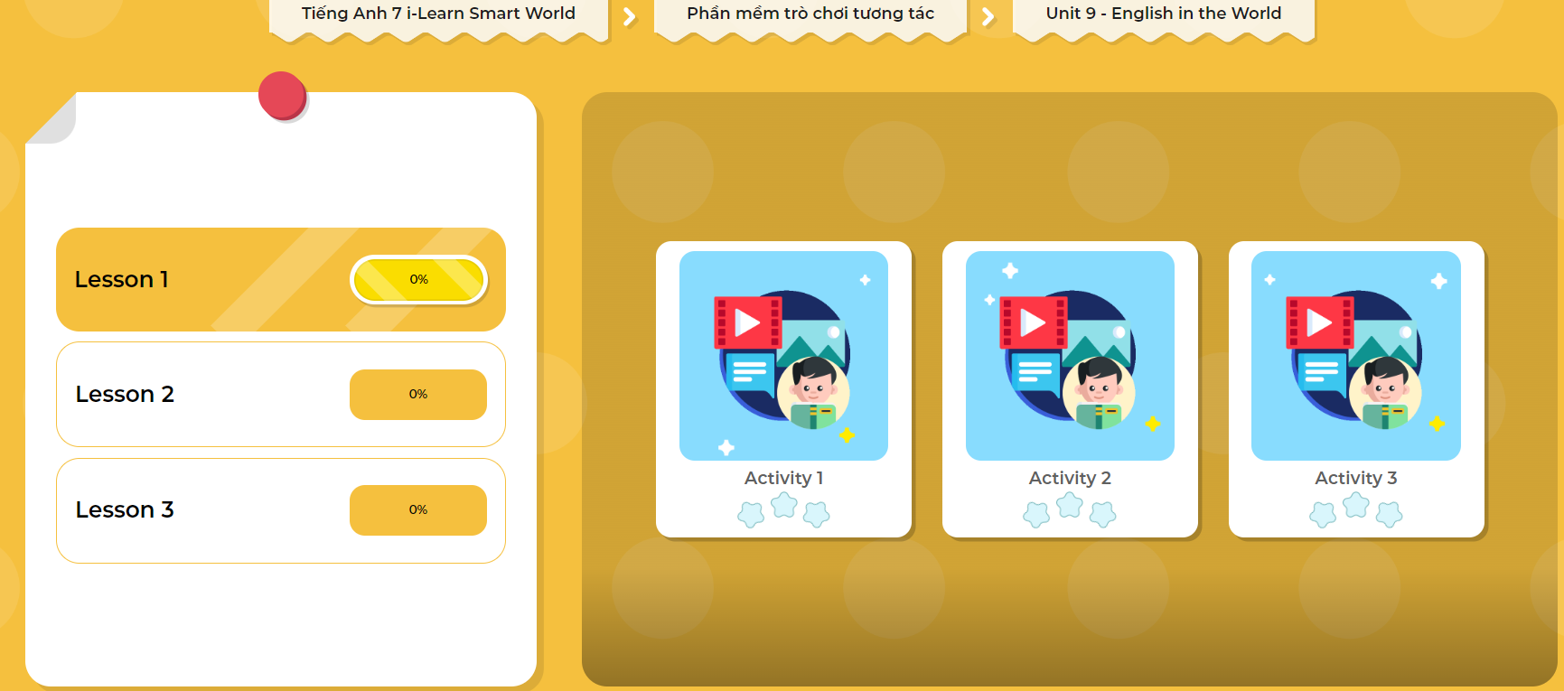
LET’S PLAY!
Click here to play the games!

Slide 19

Extra Practice
WB, page 51
Answer the questions.
1. Where do you want to go for your next vacation?
____________________________________________________________
2. How can you get there?
____________________________________________________________
3. Which historic places, famous buildings, or museums do you want to visit?
____________________________________________________________
4. What else do you want to do on your trip?
____________________________________________________________

Slide 20

WRAP-UP

Slide 21
Today’s lesson:
Grammar: Articles
☞ We use the zero article (Ø) with the names of streets, parks, lakes, rivers, beaches, towns, cities, islands, and most countries.
☞ We use the with some countries.
☞ We use the with famous buildings, museums, most hotels, and restaurants.

Slide 22
Today’s lesson
Grammar: Using article “the”.
Speaking & Writing: about some famous places.

Slide 23
Homework
Practice making sentences using article ‘the‘.
Do the grammar exercise in Tiếng Anh 7 i-Learn Smart World Workbook (page 51).
Complete the grammar notes in Tiếng Anh 7 i-Learn Smart World Notebook (page 55).
Prepare the next lesson (page 70 SB).
Play the consolidation games in Tiếng Anh 7 i-Learn Smart World DHA App on www.eduhome.com.vn

Slide 24
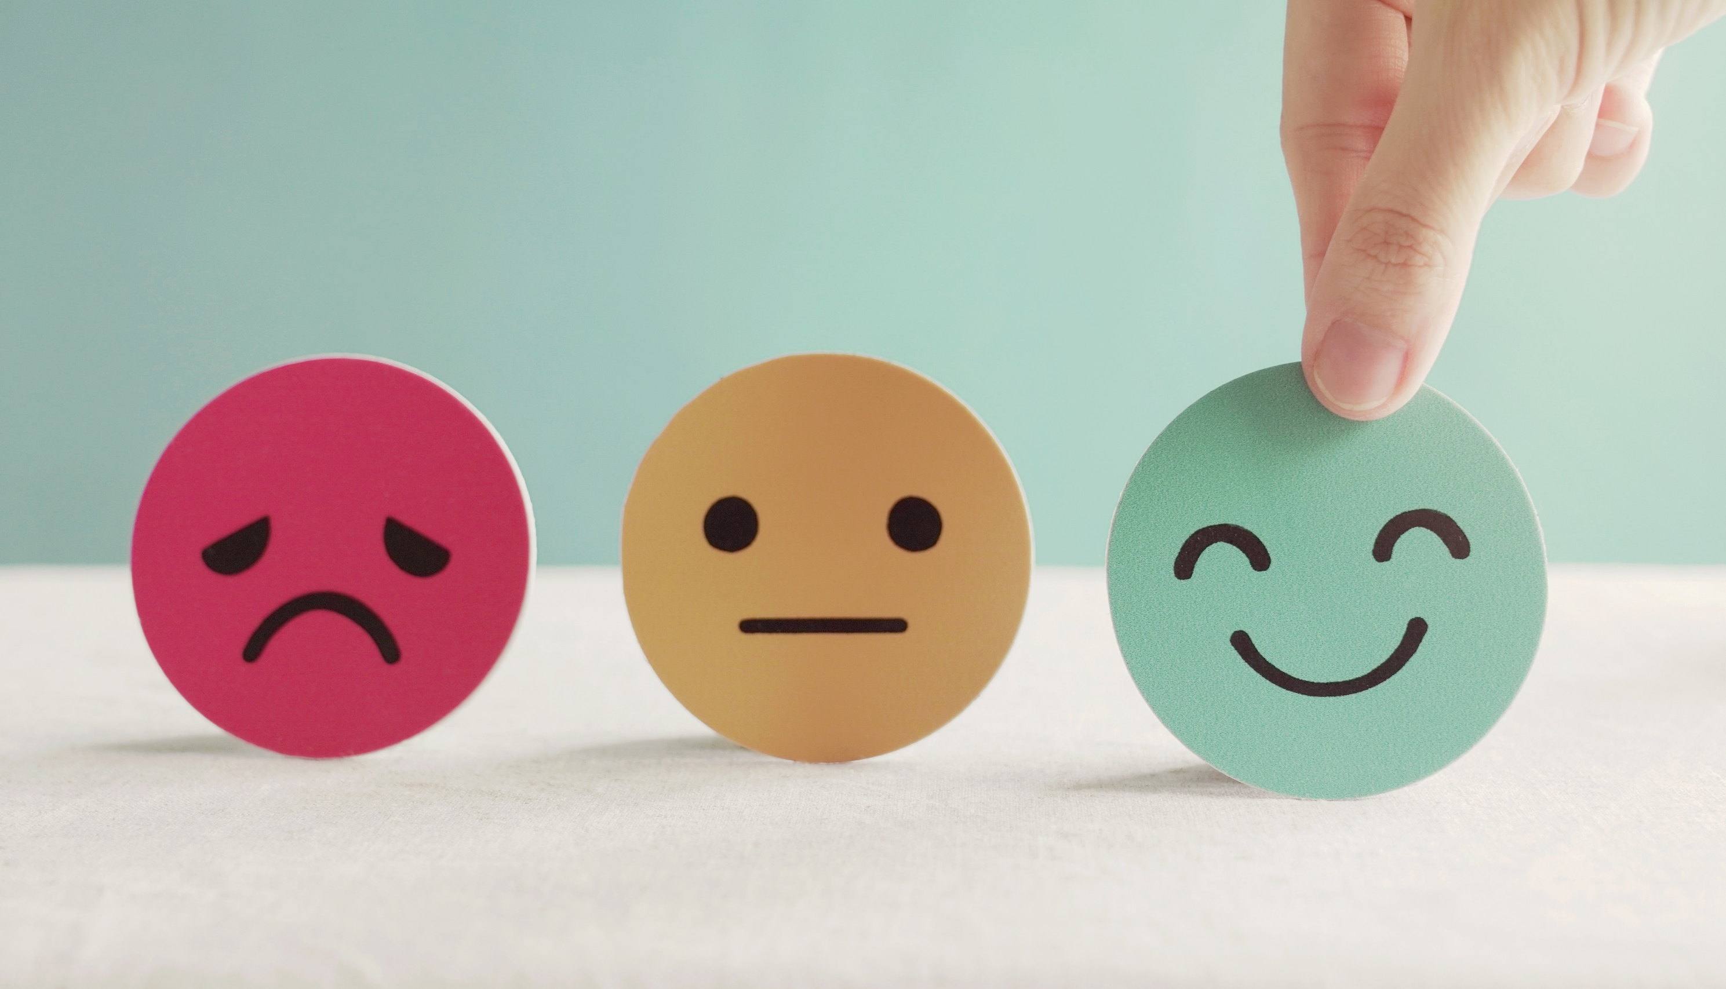
Lesson 3
Stay positive and have a nice day!

