Slide 1


Slide 2
Unit
4
Asean and Viet Nam
Unit
FAMILY LIFE
LESSON I
GETTING STARTED
At the ASEAN Youth Volunteer Programme (AYVP) office

Slide 3
LESSON I
GETTING STARTED
WARM-UP
Map Quiz
PRESENTATION
Vocabulary
Task 1: Listen and read.
Task 2: True or False.
Task 3: Match each word with its definition.
Task 4: Complete the sentences.
PRACTICE
PRODUCTION
Role play
CONSOLIDATION
Wrap-up
Homework

Slide 4
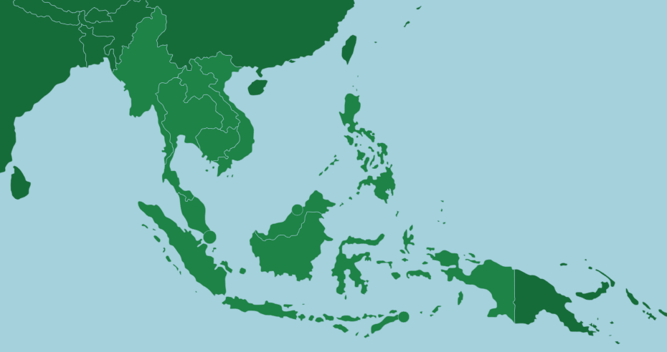
WARM-UP
Map Quiz
Work in 4 groups.
Guess the country by the shape on the map
The team have the most correct answer is the winner

Slide 5



WARM-UP
VIET NAM
What country is it?

Slide 6


WARM-UP
BRUNEI
What country is it?

Slide 7


WARM-UP
CAMBODIA
What country is it?

Slide 8


WARM-UP
THAILAND
What country is it?

Slide 9


WARM-UP
LAOS
What country is it?

Slide 10


WARM-UP
MALAYSIA
What country is it?

Slide 11


WARM-UP
PHILIPPINES
What country is it?

Slide 12


WARM-UP
SINGAPORE
What country is it?

Slide 13


WARM-UP
MYANMAR
What country is it?

Slide 14


WARM-UP
INDONESIA
What country is it?

Slide 15


PRESENTATION
apply (v)
/əˈplaɪ/
to officially ask for something such as a job, a place on a course, or a loan, usually by completing a special form or writing a letter

Slide 16

PRESENTATION
community (n)
/kəˈmjunɪt̬i/
all the people who live in a particular area, or a group of people who are considered as a unit because of their shared interests or background

Slide 17

PRESENTATION
contribution (n)
/ˌkɑntrəˈbjuʃən/
something that you contribute or do to help produce or achieve with other people, or to help make something successful

Slide 18

PRESENTATION
volunteer (v/ n)
/ˌvɒlənˈtɪər/
to do/ a person who does something that you do not have to do, often without having been asked to do it and/or without expecting payment

Slide 19
PRESENTATION
New words | Pronunciation | Meaning
Apply (v) | /əˈplaɪ/ | to officially ask for something such as a job, a place on a course, or a loan, usually by completing a special form or writing a letter
Community (n) | /kəˈmjunɪt̬i/ | all the people who live in a particular area, or a group of people who are considered as a unit because of their shared interests or background
Contribution (n) | /ˌkɑntrəˈbjuʃən/ | something that you contribute or do to help produce or achieve with other people, or to help make something successful
Volunteer (v/ n) | /ˌvɒlənˈtɪər/ | to do/ a person who does something that you do not have to do, often without having been asked to do it and/or without expecting payment

Slide 20



PRESENTATION
1
Listen and read.

Slide 21
PRACTICE
2
True or false.
Mai: Good afternoon. My name's Mai Nguyen.
Are you Ms Pang? You replied to my email and invited me to visit your office.
Ms Pang: Yes, I'm Ms Pang. It's nice to meet you, Mai. So how did you hear about us?
Mai: My cousin was an AYVP volunteer. He often said taking part in the programme was an experience he would never forget.
Ms Pang: Glad to hear that. The main goals of AYVP are promoting youth volunteering and helping the development of the ASEAN community.
 | T | F
1. Mai is a member of the ASEAN Youth Volunteer Programme.
2. One of the aims of AYVP is to help young people volunteer.
✓
It was her cousin, not Mai
✓

Slide 22
PRACTICE
2
True or false.
Mai: What can I do to prepare for the programme?
Ms Pang: Well, to become an AYVP volunteer, you must be qualified for the programme, and this depends on the themes for the year.
Mai: What are the areas covered by AYVP?
Ms Pang: There are eight themes. I suggest checking our website to find out this year's themes.
Mai: How are volunteers selected?
Ms Pang: To be selected, you should be over 18. Then you may need to propose a community project related to the theme. And we'll probably interview you to make sure you speak English well and are very keen on participating in the programme.
Mai: That doesn't sound too difficult. Thanks so much for meeting me.
Ms Pang: You're welcome.
 | T | F
3. Mai can only find last year’s themes on the AYVP's website.
4. Mai can apply to join the AYVP when she turns 18.
✓
Mai can also find out this year’s themes on the AYVP’s website.
✓
She should be over 18.

Slide 23
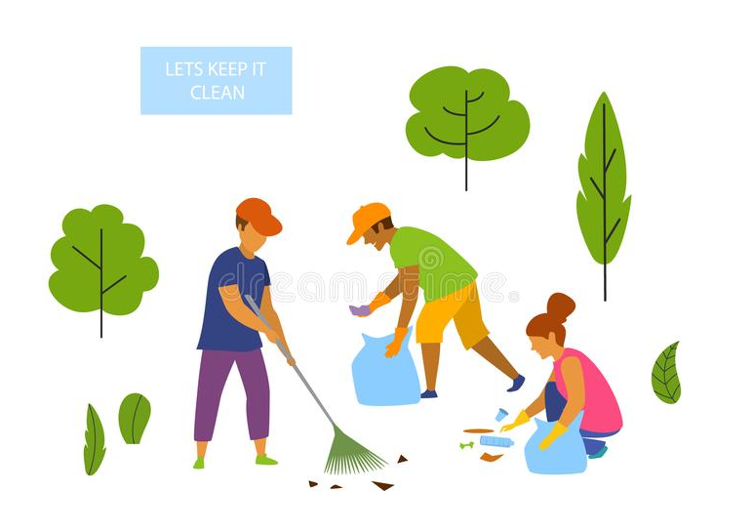
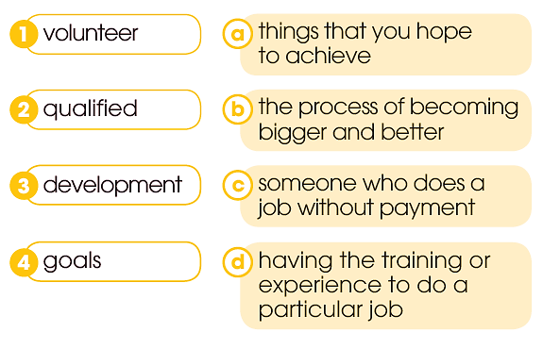



PRACTICE
3
Match each word with its definition.

Slide 24
PRACTICE
4
Complete the sentences using words and a phrase from 1.
Mai: My cousin was an AYVP volunteer. He often said taking part in the programme was an experience he would never forget.
Ms Pang: Glad to hear that. The main goals of AYVP are promoting youth volunteering and helping the development of the ASEAN community.
Taking part
1. ____________ in the programme was an unforgettable experience for Mai’s cousin.
2. The main goals of AYVP are ________ youth volunteering and ________ the development of the ASEAN community.
promoting
helping

Slide 25
PRACTICE
4
Complete the sentences using words and a phrase from 1.
Ms Pang: There are eight themes. I suggest checking our website to find out this year's themes.
Mai: How are volunteers selected?
Ms Pang: To be selected, you should be over 18. Then you may need to propose a community project related to the theme. And we'll probably interview you to make sure you speak English well and are very keen on participating in the programme.
Mai: That doesn't sound too difficult. Thanks so much for meeting me.
Ms Pang: You're welcome.
3. Ms. Pang suggested ________ their website.
checking
4. Mai thanked Ms. Pang for ________ her
meeting

Slide 26

PRODUCTION
Role-play
Work in groups.
In each group, 1 - 2 students play the role of the AYVP office’s staff. Others play the role of high school students asking for details information about the AYVP programme.
5 minutes to prepare for the role play.
3 minutes for each performance.

Slide 27
CONSOLIDATION
1
Wrap-up
What have you learnt today?
More knowledge about ASEAN
Reading for specific information
Gerunds

Slide 28

CONSOLIDATION
2
Homework
Learn by heart new vocabulary.
Do exercises in the workbook.
Prepare for Lesson 2 - Unit 4.
Prepare for the Project (Lesson 8).

Slide 29

Website: hoclieu.vn
Fanpage: facebook.com/www.tienganhglobalsuccess.vn

