Slide 1


Slide 2

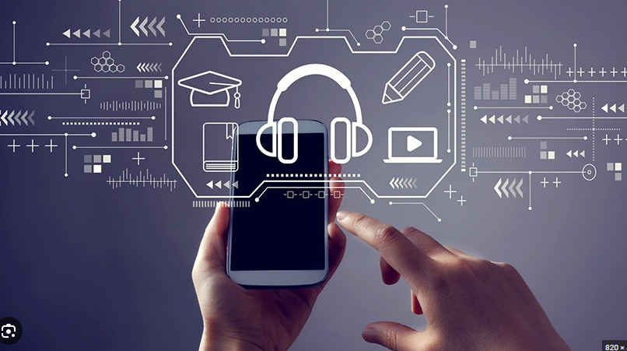
Unit
11
SCIENCE AND TECHNOLOGY
LESSON 5: SKILLS 1
1

Slide 3
LESSON 5: SKILLS 1
WARM-UP
Brainstorming
- Task 1: Name the technological applications in the pictures. - - Vocabulary teaching
- Task 2: Read the texts and tick B (Biometrics) or N (Nanolearning).
- Task 3: Read the texts again and choose the correct answer A, B, or C.
READING
SPEAKING
Task 4: Discuss and match the questions in A with the answers in B, and then make a conversation about an invention.
Task 5: Ask and answer questions about a technology or an invention. Then report your answers to the class.
CONSOLIDATION
Wrap-up
Homework

Slide 4

BRAINSTORMING
WARM-UP
Name the technological applications your school uses.

Slide 5
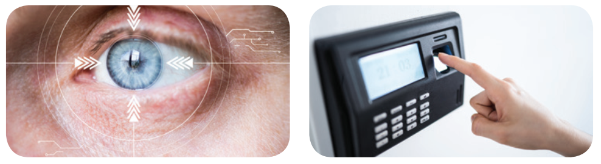
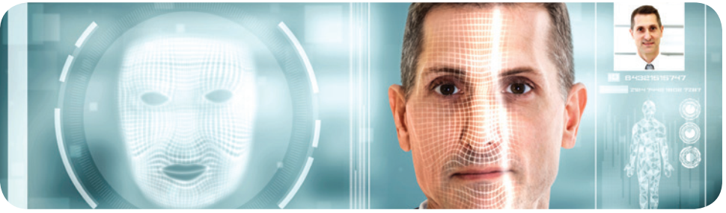
READING
1
Work in pairs. Name the technological applications in the pictures. Can they be used in schools?
eye-tracking
1. _______________
2. ________________
fingerprint scanner
3. _______________
face recognition

Slide 6
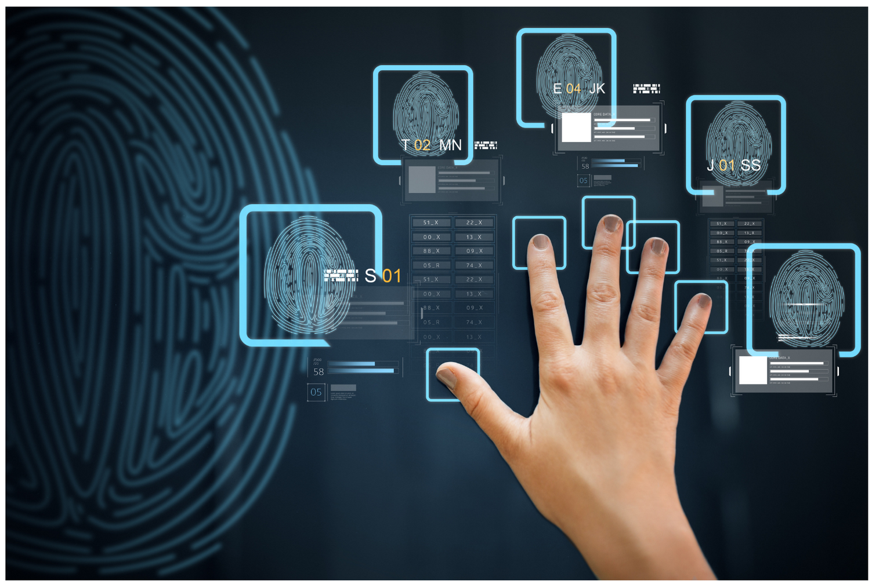

READING
biometrics (n)
/ˌbaɪəʊˈmetrɪks/
khoa học sinh trắc

Slide 7
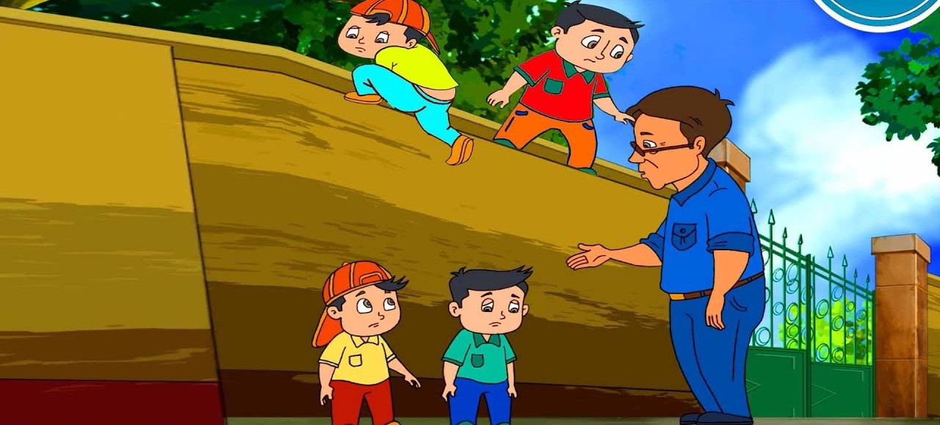
READING
truancy (v)
/ˈtruːənsi/
trốn học, nghỉ học không phép

Slide 8
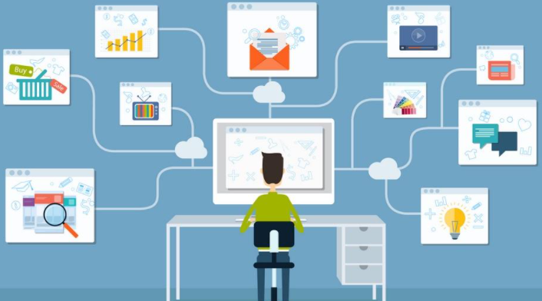
READING
nanolearning (n)
/’nænəʊlɜːnɪŋ/
học thông qua những nội dung ngắn gọn, cô đọng
(chương trình cho phép người tham gia học một chủ đề nhất định trong thời gian từ 2-10 phút thông qua việc sử dụng phương tiện điện tử và không tương tác với người hướng dẫn trong thời gian thực)

Slide 9

READING
effortless (adj)
/ˈefətləs/
không cần nhiều nỗ lực

Slide 10

READING
platform (n)
/ˈplætfɔːm/
nền tảng

Slide 11
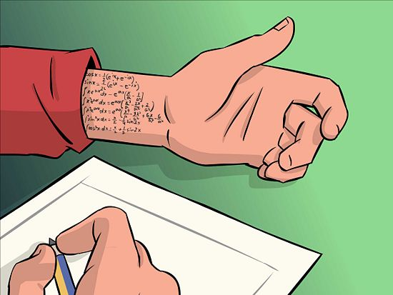
READING
cheating (n)
/tʃiːtɪŋ/
gian lận

Slide 12
READING
New words | Pronunciation | Meaning
1. biometrics (n) | /ˌbaɪəʊˈmetrɪks/ | khoa học sinh trắc
2. truancy (n) | /ˈtruːənsi/ | trốn học, nghỉ học không phép
3. nanolearning (n) | /’nænəʊlɜːnɪŋ/ | học thông qua những nội dung ngắn gọn, cô đọng
4. effortless(adj) | /ˈefətləs/ | không cần nhiều nỗ lực
5. platform(v) |  | nền tảng
6. cheating (n) | /tʃiːtɪŋ/ | gian lận

Slide 13

READING
2
Read the texts and tick B (Biometrics) or N (Nanolearning).
Benefits | B | N
1. It makes learning effortless.
2. It checks students’ understanding of the lessons.
3. Students use it when they borrow books and equipment.
4. It helps increase students’ learning attention.
5. It records students’ study activities and results.

Slide 14
READING
3
Read the texts again and choose the correct answer A, B, or C.
1. What does checking students’ attendance mean?
A. Checking their presence.
B. Scanning their faces.
C. Checking their fingerprints.
2. With Nanolearning students can ______.
A. access large amounts of information
B. improve their learning quality
C. concentrate longer

Slide 15
READING
3
Read the passage and choose the correct answer A, B, or C.
3. What DOESN’T Nanolearning do?
A. Provide platform.
B. Report students’ results.
C. Entertain students.
4. The texts are from______.
A. science books
B. advertisements
C. manuals

Slide 16
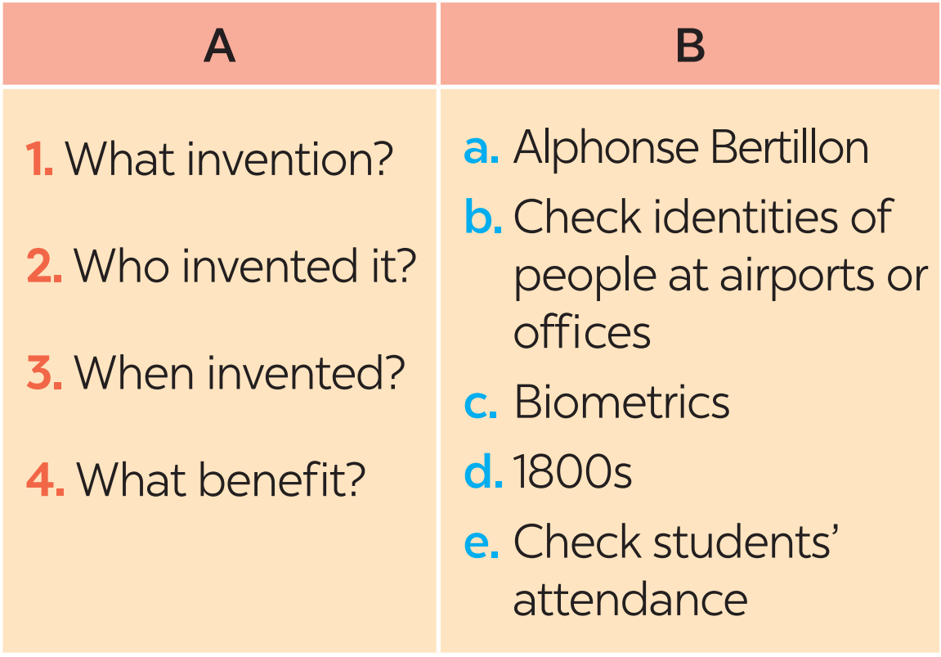
SPEAKING
4
Work in pairs. Discuss and match the questions in A with the answers in B, and then make a conversation about an invention.

Slide 17
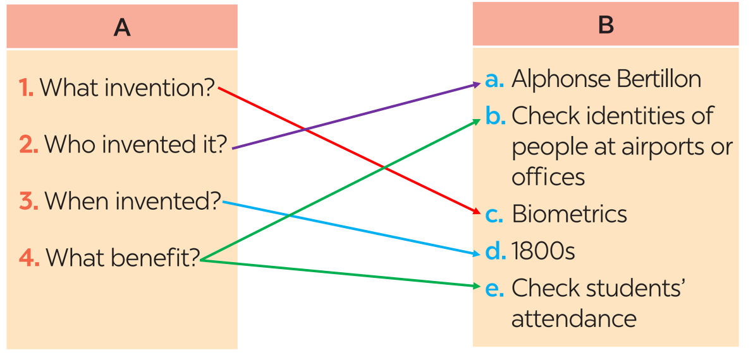
SPEAKING
4
Work in pairs. Discuss and match the questions in A with the answers in B, and then make a conversation about an invention.
A: What technology do you like?
B: I like ___________________.
A: Who invented it?
B: _______________________.
A: When did he invent it?
B: In _____________________.
A: How can it help us?
B: It can help us_____________.

Slide 18

SPEAKING
5
Work in groups. Ask and answer questions about a technology or an invention. Use the example in 4 as a cue. Then report your answers to the class.
Example:
Mi likes biometrics. Alphonse Bertillon invented it in 1800s. It is a very important technology. We use it to …

Slide 19

CONSOLIDATION
1
Wrap-up
What have we learnt in this lesson?
Some new technologies that are applied at schools
Information about some inventions, technologies

Slide 20

CONSOLIDATION
2
Homework
Learn the new words by heart.
Do the exercises in the workbook.

Slide 21

Website: hoclieu.vn
Fanpage: facebook.com/tienganhglobalsuccess.vn/

