Slide 1
7.You do not pass and the exam will be called…..
3.It replaces maths, geogrephy, history …………
8.You go to everyday to widen knowledge.
1.We learn my teacher’s ……… by heart.
6.To check your study
5.If you get 10 in studying, you will happy
9.What are the students in the examinations called?
2.Students scroring between 7.0 – 8.49 are called ……..
4.It is ranked and marked by behavior.
1
L
E
S
S
O
N
1
2
C
R
E
D
I
T
2
3
S
U
B
J
E
C
T
3
4
C
O
N
D
U
C
T
4
5
M
A
R
K
5
6
T
E
S
T
6
7
F
A
I
L
7
8
S
C
H
O
O
L
8
9
C
A
N
D
I
D
A
T
E
9

Slide 2
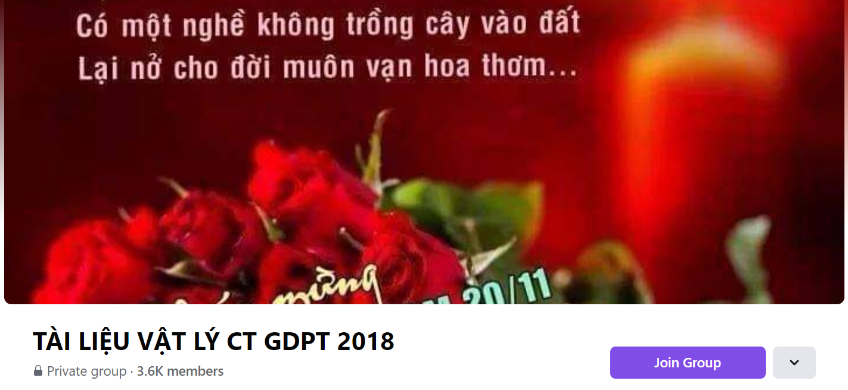
SƯU TẦM: ĐOÀN VĂN DOANH, NAM TRỰC, NAM ĐỊNH
LINK NHÓM DÀNH CHO GV BỘ MÔN VẬT LÝ TRAO ĐỔI TÀI LIỆU VÀ CHUYÊN MÔN CT 2018
https://www.facebook.com/groups/299257004355186

