Slide 1



Slide 2


Unit
4
REMEMBERING THE PAST
LESSON 7: LOOKING BACK & PROJECT

Slide 3

OBJECTIVES
By the end of the lesson, students will be able to:
Review the vocabulary and grammar of Unit 4;
Apply what they have learnt (vocabulary and grammar) into practice through a project.

Slide 4

LESSON 7: LOOKING BACK & PROJECT
LESSON 1: GETTING STARTED
WARM-UP
Brainstorming
Task 1: Choose the correct answer A, B, C, or D.
Task 2: Finish the sentence by completing each blank with a word. The first letter of each word is given.
VOCABULARY
Task 3: Put the verb in brackets in the past continuous to complete each sentence.
Task 4: Rewrite the following sentences, using wish.
GRAMMAR
Poster presentation
PROJECT
Wrap-up
Homework
CONSOLIDATION

Slide 5
WARM-UP
BRAINSTORMING
- Work in teams.
- Members of each team take turns and write as many vocabulary in Unit 4 as possible in ______ minutes.
- The group having more correct answers is the winner.

Slide 6
VOCABULARY
1
Choose the correct answer A, B, C, or D.
1. In keeping with ______, we cook five-colour sticky rice on the first day of a lunar month.
A. tradition
B. habit
C. ritual
D. practice
2. Sam is very interested in history, and he remembers a lot of historical ______and dates.
A. traditions
B. events
C. anniversaries
D. practices

Slide 7
VOCABULARY
1
Choose the correct answer A, B, C, or D.
3. The fire of London in 1666 destroyed thousands of old ______ and damaged a large part of London’s centre.
A. organisations
B. structures
C. associations
D. connections
4. This practice was more common in ______ times than it is now.
A. beginning
B. antique
C. historic
D. ancient

Slide 8
VOCABULARY
1
Choose the correct answer A, B, C, or D
5. This complex of buildings was ______ by foreign troops during the war.
A. received B. busy
C. occupied D. filled

Slide 9
VOCABULARY
2
Finish the sentence by completing each blank with a word. The first letter of each word is given.
1. The custom of w_________ ancestors is a beautiful and rich tradition in Vietnamese culture.
orshipping
2. The custom of sending a greeting card has become a d_______ tradition in many western countries.
eep-rooted
3. A country’s cultural h______ is a valuable resource
eritage
4. Festivals, which are handed down from one g_________ to the next, are an important way to promote tourism.
eneration
5. Besides the key i_________, another secret to achieving the perfect fish and chips is the temperature of the oil.
ngredients

Slide 10
LESSON 7: LOOKING BACK & PROJECT
LESSON 1: GETTING STARTED
WARM-UP
Brainstorming
Task 1: Choose the correct answer A, B, C, or D.
Task 2: Finish the sentence by completing each blank with a word. The first letter of each word is given.
VOCABULARY
Task 3: Put the verb in brackets in the past continuous to complete each sentence.
Task 4: Rewrite the following sentences, using wish.
GRAMMAR

Slide 11
GRAMMAR
3
Put the verb in brackets in the past continuous to complete each sentence.
was shining
1. Luckily, the sun (shine) ___________ brightly when we reached the campsite.
were building
2. They (build) ____________ Ho Chi Minh Mausoleum from 1973 to 1975.
4. When their mum came home, they (not study) ___________________________; they (chat) _____________ noisily.
were not / weren’t studying
were chatting

Slide 12
GRAMMAR
PAST CONTINUOUS
S + was/were + Ving
=> He was eating rice.
S + was/weren’t + Ving
=> They weren’t playing football
Was/Were + S + Ving?
=> Was she studying all night?

Slide 13
GRAMMAR
3
Put the verb in brackets in the past continuous to complete each sentence.
Were
waiting
4. ______ they still (wait) ________ when the tour guide arrived?
was thinking
5. I (think) ______________ of my grandmother for years after she died.

Slide 14
GRAMMAR
WISH + PAST SIMPLE
1. She doesn’t have an iPhone. She’d like to have one.
Subject + wish + subject + past simple
2. I’m sorry that I don’t have a three-month summer holiday as my grandma did.
I wish I had enough money to travel around the world.
I wish (that) my mother didn’t have to work so hard.

Slide 15
GRAMMAR
4
4
Rewrite the following sentences, using wish
3. I want my parents to let me make my own decisions, but they don’t.
1. She doesn’t have an iPhone. She’d like to have one.
She wishes (that) she had an IPhone.
2. I’m sorry that I don’t have a three-month summer holiday as my grandma did.
4. Mike wants to play musical instruments, but he can’t.
I wish I had a three-month summer holiday as my grandma did.
5. My dad is very busy. I want him to have more time with me.

Slide 16
GRAMMAR
4
4
Rewrite the following sentences, using wish
1. She doesn’t have an iPhone. She’d like to have one.
3. I want my parents to let me make my own decisions, but they don’t.
I wish (that) my parents let me make my own decisions.
2. I’m sorry that I don’t have a three-month summer holiday as my grandma did.
4. Mike wants to play musical instruments, but he can’t.
Mike wishes (that) he could play musical instruments.
5. My dad is very busy. I want him to have more time with me.
I wish (that) my dad was / were not very busy, and (that) he had more time with me.

Slide 17
LESSON 7: LOOKING BACK & PROJECT
LESSON 1: GETTING STARTED
WARM-UP
Brainstorming
Task 1: Choose the correct answer A, B, C, or D.
Task 2: Finish the sentence by completing each blank with a word. The first letter of each word is given.
VOCABULARY
Task 3: Put the verb in brackets in the past continuous to complete each sentence.
Task 4: Rewrite the following sentences, using wish.
GRAMMAR
Poster presentation
PROJECT

Slide 18

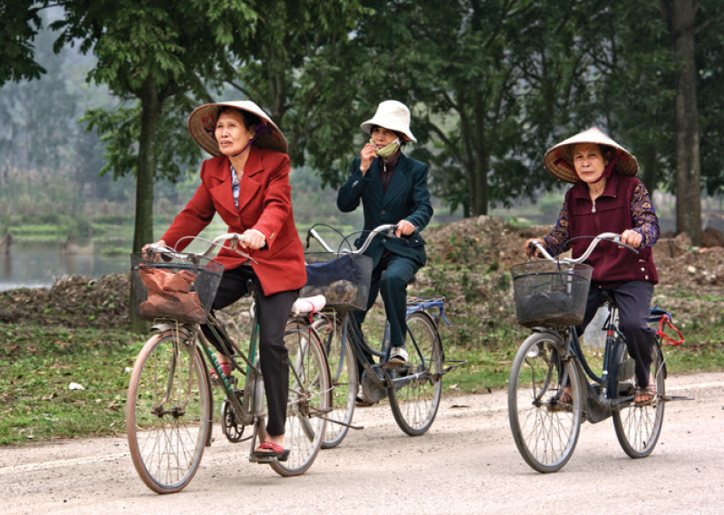
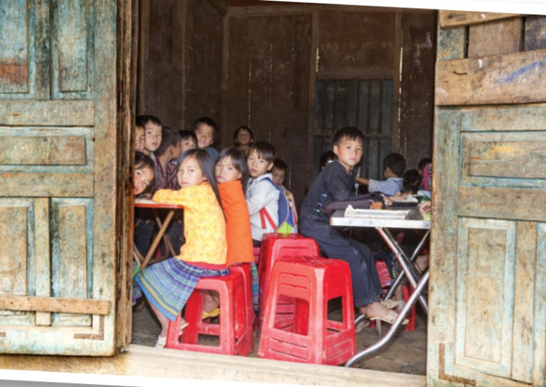
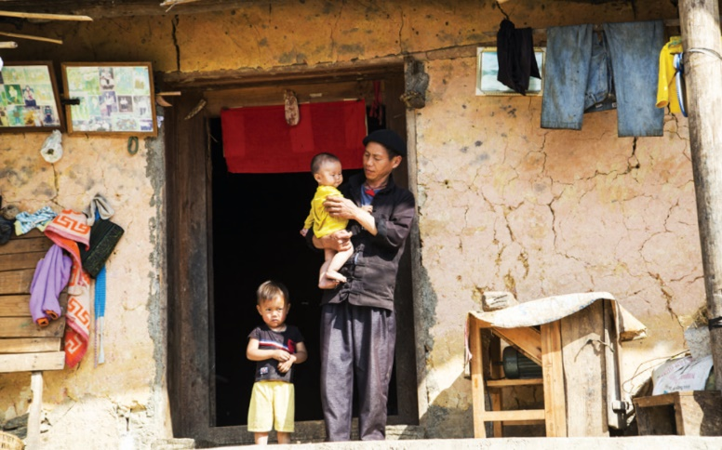
PROJECT
Life in your neighborhood
40 years ago

Slide 19
PROJECT
Task 1: Collect information and pictures about life in your area about 40 years ago.
- Ask your grandparents and / or old people, and / or read books or search the internet to find the information you want.
Information
+ Means of transport (on foot, on horseback, by bicycle, …)
+ Home life (electric devices, cooking, …)
+ Community services (electricity, running water, library, communal house, …)
+ way of cooking
…

Slide 20

PROJECT
Task 2: Make a poster. Write or print the information and stick the pictures on the poster.
- Work in groups to make a poster to introduce the information you have prepared.
PRESENTATION

Slide 21
PROJECT
PRESENTATION

Slide 22
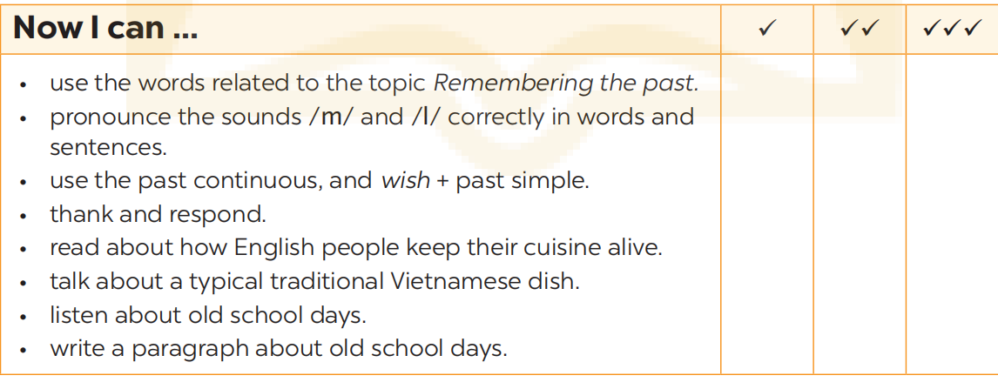
NOW I CAN...
Complete the self-assessment table.

Slide 23
LESSON 7: LOOKING BACK & PROJECT
LESSON 1: GETTING STARTED
WARM-UP
Brainstorming
Task 1: Choose the correct answer A, B, C, or D.
Task 2: Finish the sentence by completing each blank with a word. The first letter of each word is given.
VOCABULARY
Task 3: Put the verb in brackets in the past continuous to complete each sentence.
Task 4: Rewrite the following sentences, using wish.
GRAMMAR
Poster presentation
PROJECT
Wrap-up
Homework
CONSOLIDATION

Slide 24

CONSOLIDATION
1
Wrap-up
What have we learnt in this lesson?
Review the vocabulary and grammar of Unit 4;
Apply what they have learnt (vocabulary and grammar) into practice through a project.

Slide 25

CONSOLIDATION
2
Homework
- Prepare for the next lesson.

Slide 26
Website: hoclieu.vn
Fanpage: facebook.com/www.tienganhglobalsuccess.vn/

